Slide 1
Chapter 8 Advanced Counting Techniques 高级计数技术

Slide 2
Chapter Summary
Applications of Recurrence Relations
Solving Linear Recurrence Relations
Divide-and-Conquer Algorithms and Recurrence Relations
Generating Functions
Inclusion-Exclusion
Applications of Inclusion-Exclusion

Slide 3
Applications of Recurrence Relations
Section 8.1

Slide 4
Section Summary
Fibonacci Numbers
The Tower of Hanoi
Counting Problems

Slide 5
Recurrence Relations 递推关系
Definition: A recurrence relation for the sequence {a_{n}} is an equation that expresses a_{n} in terms of one or more of the previous terms of the sequence, namely, a₀, a₁, …, a_{n-1}, for all integers n with n ≥ n₀, where n₀ is a nonnegative integer.
A sequence is called a solution of a recurrence relation if its terms satisfy the recurrence relation.
The initial conditions for a sequence specify the terms that precede the first term where the recurrence relation takes effect.

Slide 6
Rabbits and the Fibonacci Numbers 兔子和斐波那契数
Example: A young pair of rabbits (one of each gender) is placed on an island. A pair of rabbits does not breed (繁殖) until they are 2 months old. After they are 2 months old, each pair of rabbits produces another pair each month. Find a recurrence relation for the number of pairs of rabbits on the island after n months, assuming that rabbits never die.
This is the original problem considered by Leonardo Pisano (Fibonacci) in the thirteenth century.

Slide 7
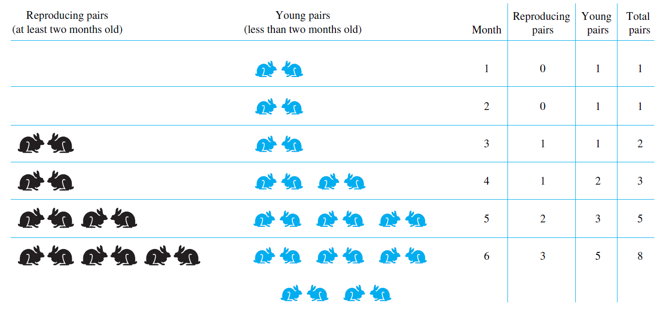
Rabbits and the Fibonacci Numbers 兔子和斐波那契数
Modeling the Population Growth of Rabbits on an Island

Slide 8
Rabbits and the Fibonacci Numbers 兔子和斐波那契数
Solution: Let f_{n} be the number of pairs of rabbits after n months.
There are is f₁ = 1 pairs of rabbits on the island at the end of the first month.
We also have f₂ = 1 because the pair does not breed during the first month.
To find the number of pairs on the island after n months, add the number on the island after the previous month, f_{n-1}, and the number of newborn pairs, which equals f_{n-2}, because each newborn pair comes from a pair at least two months old.
Consequently the sequence {f_{n} } satisfies the recurrence relation f_{n} = f_{n-1} + f_{n-2} for n ≥ 3 with the initial conditions f₁ = 1 and f₂ = 1.
The number of pairs of rabbits on the island after n months is given by the nth Fibonacci number.

Slide 9
Rabbits and the Fibonacci Numbers 递归定义
Solution: Let f_{n} be the number of pairs of rabbits after n months.
BASIS STEP: There are is f₁ = 1 , f₂ = 1 because the pair does not breed during the first two months.
RECURSIVE STEP: To find the number of pairs on the island after n months, satisfies the recurrence relation f_{n} = f_{n-1} + f_{n-2} for n ≥ 3.
The number of pairs of rabbits on the island after n months is given by the nth Fibonacci number.

Slide 10
Section Summary
Fibonacci Numbers
The Tower of Hanoi
Counting Problems

Slide 11
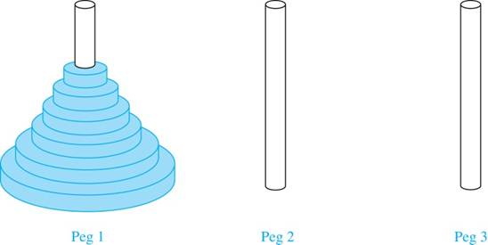
The Tower of Hanoi 汉诺塔
In the late nineteenth century, the French mathematician Édouard Lucas invented a puzzle consisting of three pegs on a board with disks of different sizes. Initially all of the disks are on the first peg in order of size, with the largest on the bottom.
The Initial Position in the Tower of Hanoi Puzzle

Slide 12
The Tower of Hanoi 汉诺塔
Rules: You are allowed to move the disks one at a time from one peg to another as long as a larger disk is never placed on a smaller.
Goal: Using allowable moves, end up with all the disks on the second peg in order of size with largest on the bottom.
The Initial Position in the Tower of Hanoi Puzzle

Slide 13
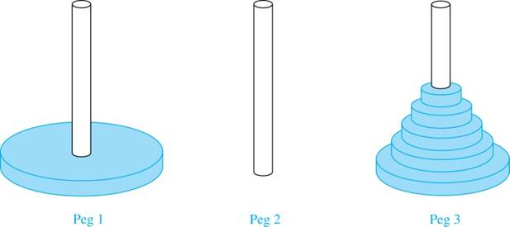
The Tower of Hanoi 汉诺塔
Solution: Let {H_{n}} denote the number of moves needed to solve the Tower of Hanoi Puzzle with n disks. Set up a recurrence relation for the sequence {H_{n}}. Begin with n disks on peg 1. We can transfer the top n −1 disks, following the rules of the puzzle, to peg 3 using H_{n−1} moves.
First, we use 1 move to transfer the largest disk to the second peg. Then we transfer the n −1 disks from peg 3 to peg 2 using H_{n−1} additional moves. This can not be done in fewer steps. Hence,
The initial condition is H₁= 1 since a single disk can be transferred from peg 1 to peg 2 in one move.

Slide 14
The Tower of Hanoi 汉诺塔
We can repeatedly expressing H_{n} in terms of the previous terms of the sequence.
There was a myth (传说) created with the puzzle. Monks in a tower in Hanoi are transferring 64 gold disks from one peg to another following the rules of the puzzle. They move one disk each day. When the puzzle is finished, the world will end.
Using this formula for the 64 gold disks of the myth, 2⁶⁴ −1 = 18,446, 744,073, 709,551,615 （Moves） days are needed to solve the puzzle, which is more than 500 billion years.【1天移动1个的话，需要5000亿年】

Slide 15
Section Summary
Fibonacci Numbers
The Tower of Hanoi
Counting Problems

Slide 16
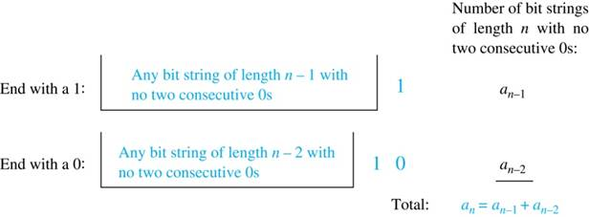
Counting Bit Strings
Example: Find a recurrence relation and give initial conditions for the number of bit strings of length n without two consecutive 0s. How many such bit strings are there of length five? 【没有连续2个0，长为5的字符串】
Solution: Let a_{n} denote the number
of bit strings of length n without
two consecutive 0s. Then, a_{n} equals
the number of bit strings ending with
a 0 plus the number of such bit strings
ending with a 1.
Now assume that n ≥ 3.
The bit strings of length n ending with 1 without two consecutive 0s are the bit strings of length n −1 with no two consecutive 0s. Hence, it has a_{n−1} such bit strings.
The bit strings of length n ending with 0 without two consecutive 0s are the bit strings of length n −2 with no two consecutive 0s with 10 at the end. Hence, there are a_{n−2} such bit strings.
We conclude that a_{n} = a_{n−1} + a_{n−2} for n ≥ 3.

Slide 17
Bit Strings 2
The initial conditions are:
a₁ = 2, since both the bit strings 0 and 1 do not have consecutive 0s.
a₂ = 3, since the bit strings 01, 10, and 11 do not have consecutive 0s, while 00 does.
To obtain a₅ , we use the recurrence relation three times to find that:
a₃ = a₂ + a₁ = 3 + 2 = 5
a₄ = a₃ + a₂ = 5+ 3 = 8
a₅ = a₄ + a₃ = 8+ 5 = 13
Note that {a_{n} } satisfies the same recurrence relation as the Fibonacci sequence. Since a₁ = f₃ and a₂ = f₄ , we conclude that a_{n} = f_{n+2} .

Slide 18
Counting the Ways to Parenthesize a Product
Example: Find a recurrence relation for C_{n} , the number of ways to parenthesize the product of n + 1 numbers, x₀ ∙ x₁ ∙ x₂ ∙ ⋯ ∙ x_{n}, to specify the order of multiplication. For example, C₃ = 5, since all the possible ways to parenthesize 4 numbers are
$$\left(\left(x_{0}⋅x_{1}\right)⋅x_{2}\right)⋅x_{3}, \left(x_{0}⋅\left(x_{1}⋅x_{2}\right)\right)⋅x_{3}, \left(x_{0}⋅x_{1}\right)⋅\left(x_{2}⋅x_{3}\right),$$
$${ x}_{0}⋅\left(\left(x_{1}⋅x_{2}\right)⋅x_{3}\right),{ x}_{0}⋅\left(x_{1}⋅\left(x_{2}⋅x_{3}\right)\right)$$
Solution: Note that however parentheses are inserted in x₀ ∙ x₁ ∙ x₂ ∙ ⋯ ∙ x_{n}, one “∙” operator remains outside all parentheses. This final operator appears between two of the n + 1 numbers, say x_{k} and x_{k+1}. Since there are C_{k} ways to insert parentheses in the product x₀ ∙ x₁ ∙ x₂ ∙ ⋯ ∙ x_{k} and C_{n−k−1} ways to insert parentheses in the product x_{k+1} ∙ x_{k+2} ∙ ⋯ ∙ x_{n}, we have
The initial conditions are C₀ = 1 and C₁ = 1.
The sequence {C_{n} } is the sequence of Catalan Numbers. This recurrence relation can be solved using the method of generating functions; see Exercise 41 in Section 8.4.

Slide 19
Solving Linear Recurrence Relations 求解线性递推关系
Section 8.2

Slide 20
Section Summary 2
Linear Homogeneous Recurrence Relations【线性齐次递推关系】
Solving Linear Homogeneous Recurrence Relations with Constant Coefficients.

Slide 21
Linear Homogeneous Recurrence Relations 线性齐次递推关系
Definition: A linear homogeneous recurrence relation of degree k with constant coefficients is a recurrence relation of the form a_{n} = c₁a_{n−1} + c₂a_{n−2} + ….. + c_{k} a_{n−k ,} where c₁, c₂, ….,c_{k} are real numbers, and c_{k} ≠ 0.
it is linear because the right-hand side is a sum of the multiplies of the previous terms of the sequence.
it is homogeneous because no terms occur that are not multiples of the a_{j}s. Each coefficient is a constant.【所出现的各项都是 a_{j} 的倍数】
the degree is k because a_{n} is expressed in terms of the previous k terms of the sequence.【表示成前k项】
By strong induction, a sequence satisfying such a recurrence relation is uniquely determined by the recurrence relation and the k initial conditions a₀ = C₁, a₀ = C₁ ,… , a_{k−1} = C_{k−1}.

Slide 22
Examples of Linear Homogeneous Recurrence Relations
linear homogeneous recurrence relation of degree one
linear homogeneous recurrence relation of degree two
not linear 不是线性的
not homogeneous 不是齐次的
coefficients are not constants 系数不是常数

Slide 23
Section Summary 2
Linear Homogeneous Recurrence Relations【线性齐次递推关系】
Solving Linear Homogeneous Recurrence Relations with Constant Coefficients.

Slide 24

Solving Linear Homogeneous Recurrence Relations
The basic approach is to look for solutions of the form a_{n} = r^{n}, where r is a constant.
Note that a_{n} = r^{n} is a solution to the recurrence relation
if and only if
$$r^{n}=c_{1}r^{n−1}+ c_{2}r^{n−2}+⋯+c_{k}r^{n−k}.$$
Algebraic manipulation yields the characteristic equation:
$$r^{k}−c_{1}r^{k−1}−c_{2}r^{k−2}−...−c_{k−1}r−c_{k}=0$$
The sequence {a_{n}} with a_{n} = r^{n} is a solution if and only if r is a solution to the characteristic equation 特征方程. The solutions to the characteristic equation are called the characteristic roots 特征根 of the recurrence relation.
A linear combination of two solutions of a linear homogeneous recurrence relation is also a solution!

Slide 25
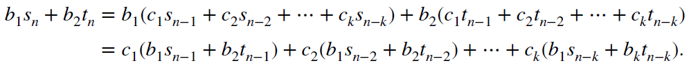

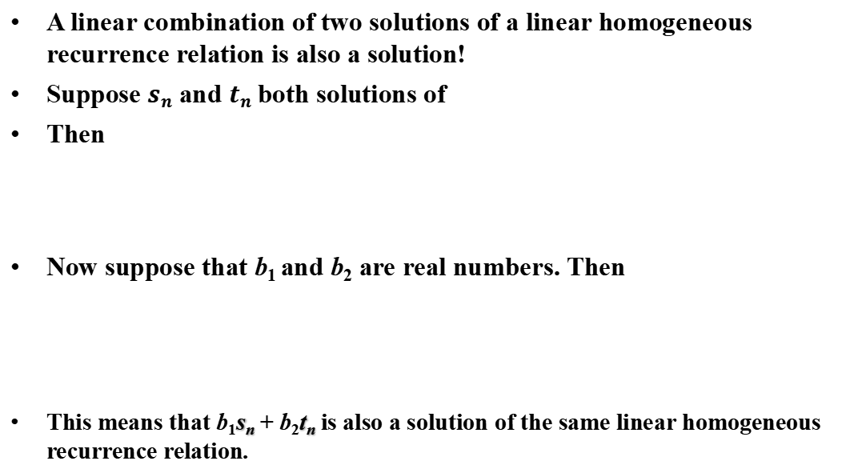
Solving Linear Homogeneous Recurrence Relations
A linear combination of two solutions of a linear homogeneous recurrence relation is also a solution!
Suppose $sn$ and $tn$ both solutions of
Then
Now suppose that b₁ and b₂ are real numbers. Then
This means that b₁s_{n} + b₂t_{n} is also a solution of the same linear homogeneous recurrence relation.
$$a_{n}= c_{1}a_{n−1}+ c_{2}a_{n−2}+⋯+c_{k}a_{n−k}$$

Slide 26


Solving Linear Homogeneous Recurrence Relations of Degree Two
Theorem 1: Let c₁ and c₂ be real numbers. Suppose that r² – c₁r – c₂ = 0 has two distinct roots r₁ and r₂. Then the sequence {a_{n}} is a solution to the recurrence relation
$$a_{n}=c_{1}a_{n−1}+ c_{2}a_{n−2}$$
if and only if
$$a_{n}=α_{1}r_{1}^{n}+α_{2}r_{2}^{n}$$
for n = 0,1,2,… , where α₁ and α₂ are constants.

Slide 27
Using Theorem 1
Example: What is the solution to the recurrence relation
a_{n} = a_{n−1} + 2a_{n−2} with a₀ = 2 and a₁ = 7?
Solution: The characteristic equation is r² − r − 2 = 0.
Its roots are r = 2 and r = −1 . Therefore, {a_{n}} is a solution to the recurrence relation if and only if a_{n} = α₁2^{n} + α₂(−1)^{n}, for some constants α₁ and α₂.
To find the constants α₁ and α₂, note that
a₀ = 2 = α₁ + α₂ and a₁ = 7 = α₁2 + α₂(−1).
Solving these equations, we find that α₁ = 3 and α₂ = −1.
Hence, the solution is the sequence {a_{n}} with a_{n} = 3∙2^{n} − (−1)^{n}.

Slide 28
An Explicit Formula for the Fibonacci Numbers 斐波那契数的显式公式
斐波那契数递推关系：The sequence of Fibonacci numbers satisfies the recurrence relation f_{n} = f_{n−1} + f_{n−2} with the initial conditions: f₀ = 0 and f₁ = 1.
Solution: The roots of the characteristic equation r² – r – 1 = 0 are

Slide 29
Fibonacci Numbers 2
Therefore by Theorem 1
for some constants α₁ and α₂.
Using the initial conditions f₀ = 0 and f₁ = 1 , we have
Solving, we obtain
Hence,

Slide 30

The Solution when there is a Repeated Root 有相同根的情况
Theorem 2: Let c₁ and c₂ be real numbers with c₂ ≠ 0. Suppose that r² – c₁r – c₂ = 0 has one repeated root r₀. Then the sequence {a_{n}} is a solution to the recurrence relation a_{n} = c₁a_{n−1} + c₂a_{n−2} if and only if
$$a_{n}=α_{1}r_{0}^{n}+α_{2}nr_{0}^{n}$$
for n = 0,1,2,… , where α₁ and α₂ are constants.

Slide 31
Using Theorem 2
Example: What is the solution to the recurrence relation a_{n} = 6a_{n−1} − 9a_{n−2} with a₀ = 1 and a₁ = 6?
Solution: The characteristic equation is r² − 6r + 9 = 0.
The only root is r = 3. Therefore, {a_{n}} is a solution to the recurrence relation if and only if
a_{n} = α₁3^{n} + α₂n(3)^{n}
where α₁ and α₂ are constants.
To find the constants α₁ and α₂, note that
a₀ = 1 = α₁ and a₁ = 6 = α₁ ∙ 3 + α₂ ∙3.
Solving, we find that α₁ = 1 and α₂ = 1 .
Hence,
a_{n} = 3^{n} + n3^{n} .

Slide 32

Solving Linear Homogeneous Recurrence Relations of Arbitrary Degree
This theorem can be used to solve linear homogeneous recurrence relations with constant coefficients of any degree when the characteristic equation has distinct roots.
Theorem 3: Let c₁, c₂ ,…, c_{k} be real numbers. Suppose that the characteristic equation r^{k} – c₁r^{k−1} –⋯ – c_{k} = 0 has k distinct roots (互不相同的根) r₁, r₂, …, r_{k}. Then a sequence {a_{n}} is a solution of the recurrence relation a_{n} = c₁a_{n−1} + c₂a_{n−2} + ….. + c_{k} a_{n−k}
if and only if
$$a_{n}=α_{1}r_{1}^{n}+α_{2}r_{2}^{n}+⋯+α_{k}r_{k}^{n}$$
for n = 0, 1, 2, …, where α₁, α₂,…, α_{k} are constants.

Slide 33
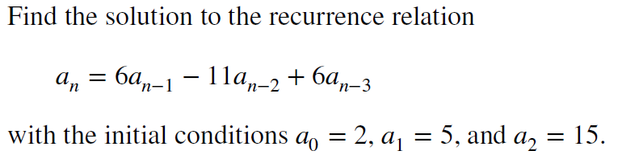
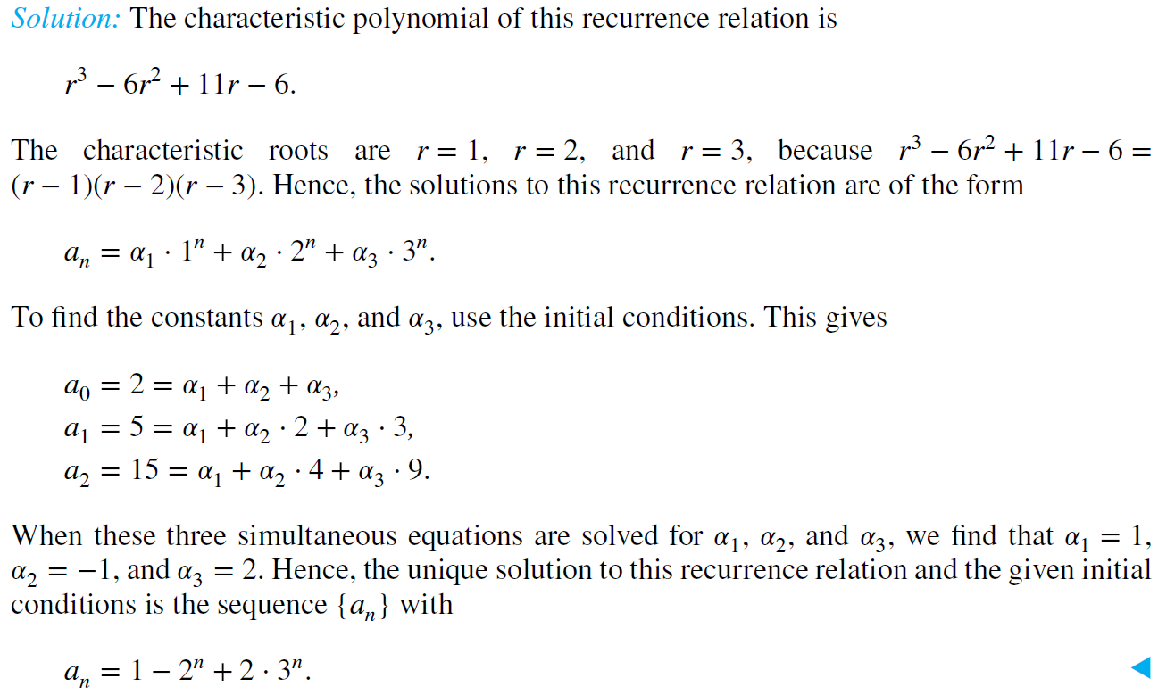
Solving Linear Homogeneous Recurrence Relations of Arbitrary Degree
Example:

Slide 34
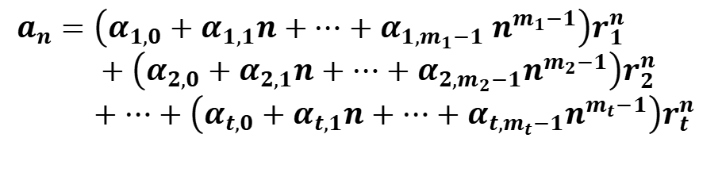

The General Case with Repeated Roots Allowed
Theorem 4: Let c₁, c₂ ,…, c_{k} be real numbers. Suppose that the characteristic equation
has t distinct roots r₁, r₂, …, r_{t} with multiplicities m₁, m₂, …, m_{t}, respectively so that m_{i} ≥ 1 for i = 0, 1, 2, …,t and m₁ + m₂ + … + m_{t} = k. Then a sequence {a_{n}} is a solution of the recurrence relation
$$a_{n}=c_{1}a_{n−1}+c_{2}a_{n−2}+…..+c_{k}a_{n−k}$$
if and only if
$$a_{n}=\left(α_{1,0}+α_{1,1}n+⋯+α_{1,m_{1}−1} n^{m_{1}−1}\right)r_{1}^{n} \\ +\left(α_{2,0}+α_{2,1}n+⋯+α_{2,m_{2}−1}n^{m_{2}−1}\right)r_{2}^{n} \\ +⋯+\left(α_{t,0}+α_{t,1}n+⋯+α_{t,m_{t}−1}n^{m_{t}−1}\right)r_{t}^{n}$$
for n = 0, 1, 2, …, where α_{i,j} are constants for 1≤ i ≤ t and 0≤ j ≤ m_{i−1}.

Slide 35
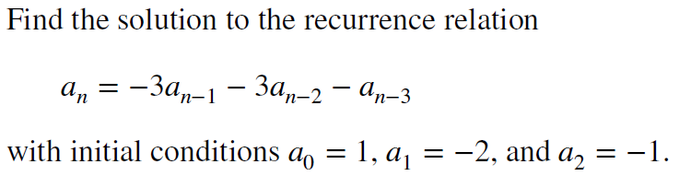
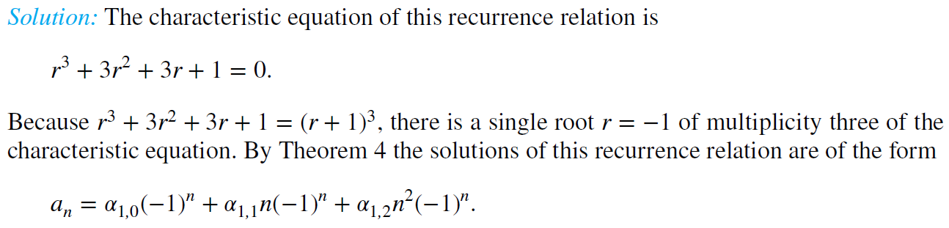
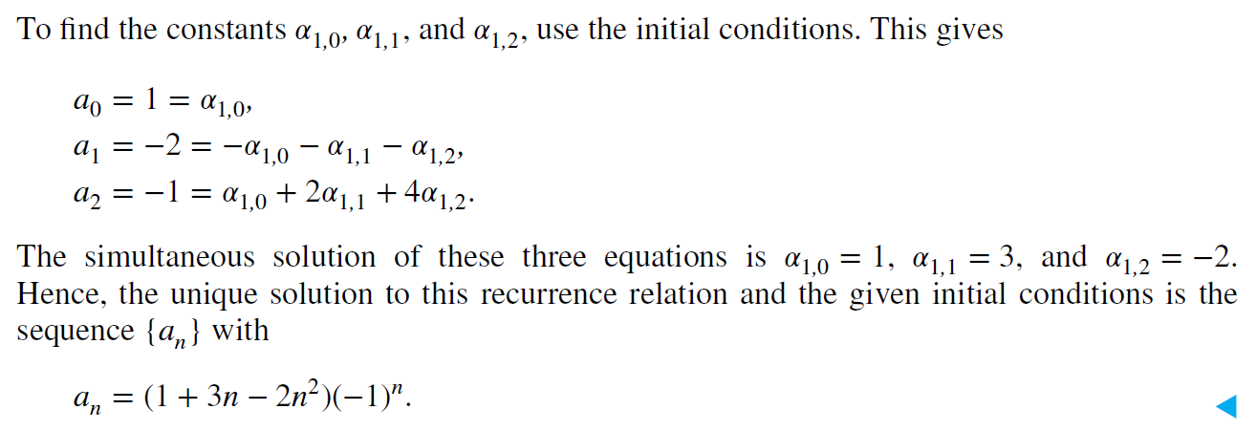
The General Case with Repeated Roots Allowed
Example:

Slide 36


Linear Nonhomogeneous Recurrence Relations with Constant Coefficients 1
Definition: A linear nonhomogeneous recurrence relation with constant coefficients is a recurrence relation of the form:
$$a_{n}=c_{1}a_{n−1}+c_{2}a_{n−2}+…..+c_{k}a_{n−k}+F\left(n\right),$$
where c₁, c₂, …., c_{k} are real numbers, and F(n) is a function not identically zero depending only on n.
The recurrence relation
$$a_{n}=c_{1}a_{n−1}+c_{2}a_{n−2}+…..+c_{k}{a_{n−k}}_{,}$$
is called the associated homogeneous recurrence relation.

Slide 37
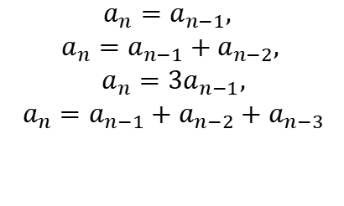
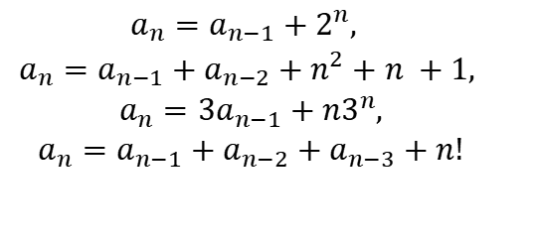
Linear Nonhomogeneous Recurrence Relations with Constant Coefficients 2
The following are linear nonhomogeneous recurrence relations with constant coefficients:
$$\begin{matrix}a_{n}=a_{n−1}+2^{n}, \\ a_{n}=a_{n−1}+a_{n−2}+n^{2}+n +1, \\ a_{n}=3a_{n−1}+n3^{n}, \\ a_{n}=a_{n−1}+a_{n−2}+a_{n−3}+n!\end{matrix}$$
where the following are the associated linear homogeneous recurrence relations, respectively:
$$\begin{matrix}a_{n}=a_{n−1}, \\ a_{n}=a_{n−1}+a_{n−2}, \\ a_{n}=3a_{n−1}, \\ a_{n}=a_{n−1}+a_{n−2}+a_{n−3}\end{matrix}$$

Slide 38

Solving Linear Nonhomogeneous Recurrence Relations with Constant Coefficients 1
Theorem 5: If {a_{n}^{(p)}} is a particular solution of the nonhomogeneous linear recurrence relation with constant coefficients
$$a_{n}=c_{1}a_{n−1}+c_{2}a_{n−2}+⋯+c_{k}a_{n−k}+F\left(n\right),$$
then every solution is of the form {a_{n}^{(p)} + a_{n}^{(h)}}, where {a_{n}^{(h)}} is a solution of the associated homogeneous recurrence relation
$$a_{n}=c_{1}a_{n−1}+c_{2}a_{n−2}+⋯+c_{k}{a_{n−k}}_{.}$$

Slide 39
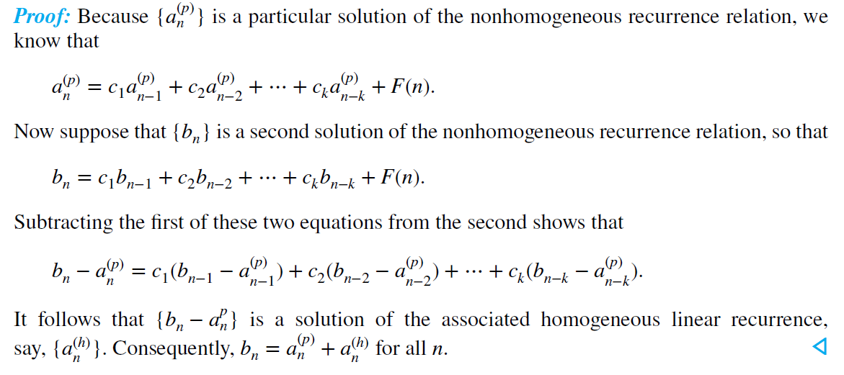
Solving Linear Nonhomogeneous Recurrence Relations with Constant Coefficients

Slide 40
Solving Linear Nonhomogeneous Recurrence Relations with Constant Coefficients
Example: Find all solutions of the recurrence relation a_{n} = 3a_{n−1} + 2n. What is the solution with a₁ = 3?
Solution: The associated linear homogeneous equation is a_{n} = 3a_{n−1}.
Its solutions are a_{n}^{(h)} = α3^{n}, where α is a constant.
Because F(n)= 2n is a polynomial in n of degree one, to find a particular solution we might try a linear function in n, say
p_{n} = cn + d, where c and d are constants.
Suppose that p_{n} = cn + d is such a solution. Then a_{n} = 3a_{n−1} + 2n is
cn + d = 3(c(n−1) + d)+ 2n.
Simplifying yields (2 + 2c)n + (2d − 3c) = 0. It follows that cn + d is a solution if and only if 2 + 2c = 0 and 2d − 3c = 0.
Therefore, cn + d is a solution if and only if c = − 1 and d = − 3/2.
Consequently, a_{n}^{(p)} = −n − 3/2 is a particular solution.

Slide 41
Solving Linear Nonhomogeneous Recurrence Relations with Constant Coefficients
Example: Find all solutions of the recurrence relation a_{n} = 3a_{n−1} + 2n. What is the solution with a₁ = 3?
Solution: By Theorem 5, all solutions are of the form
a_{n} = a_{n}^{(p)} + a_{n}^{(h)} = −n − 3/2 + α3^{n},
where α is a constant.
To find the solution with a₁ = 3, let n = 1 in the above formula for the general solution. Then
3 = −1 − 3/2 + 3 α, and α = 11/6.
Hence, the solution is
a_{n} = −n − 3/2 + (11/6)3^{n}.

Slide 42
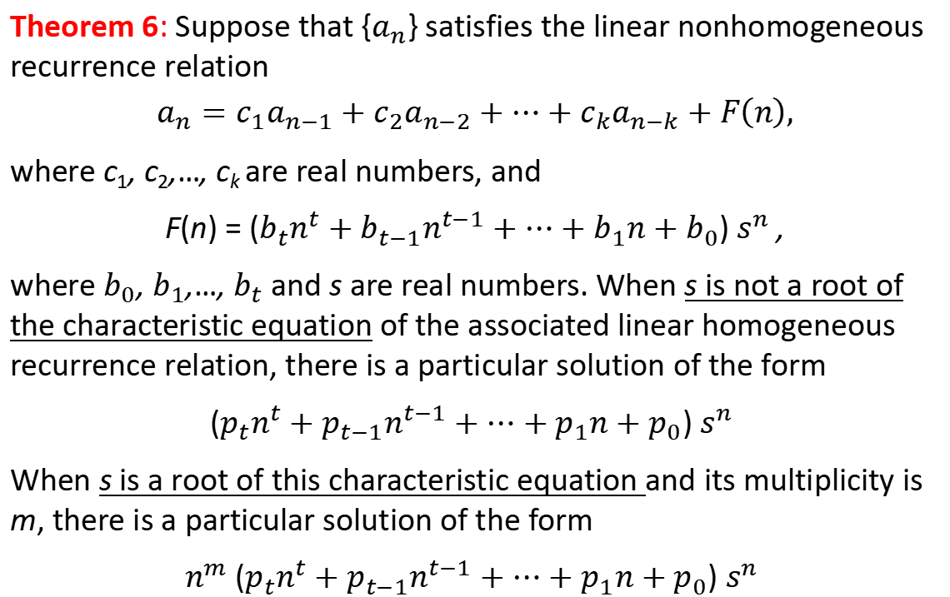
Solving Linear Nonhomogeneous Recurrence Relations with Constant Coefficients
Theorem 6: Suppose that {$a_{n}$} satisfies the linear nonhomogeneous recurrence relation
$$a_{n}=c_{1}a_{n−1}+c_{2}a_{n−2}+⋯+c_{k}a_{n−k}+F\left(n\right),$$
where c₁, c₂,…, c_{k} are real numbers, and
F(n) = ($b_{t}n^{t}+b_{t−1}n^{t−1}+⋯+b_{1}n+b_{0}$) $s^{n}$,
where $b_{0}$, $b_{1}$,…, $b_{t}$ and s are real numbers. When s is not a root of the characteristic equation of the associated linear homogeneous recurrence relation, there is a particular solution of the form
($p_{t}n^{t}+p_{t−1}n^{t−1}+⋯+p_{1}n+p_{0}$) $s^{n}$
When s is a root of this characteristic equation and its multiplicity is m, there is a particular solution of the form
$n^{m}$($p_{t}n^{t}+p_{t−1}n^{t−1}+⋯+p_{1}n+p_{0}$) $s^{n}$

Slide 43
Divide-and-Conquer Algorithms and Recurrence Relations 分治算法与递推关系
Section 8.3

Slide 44
Divide-and-Conquer Algorithmic Paradigm
Definition: A divide-and-conquer algorithm works by first dividing 【分解】a problem into one or more instances of the same problem of smaller size and then conquering 【攻克】the problem using the solutions of the smaller problems to find a solution of the original problem.

Slide 45
Divide-and-Conquer Recurrence Relations
Subproblems ：Suppose that a recursive algorithm divides a problem of size n into a subproblems.
n/b : Assume each subproblem is of size n/b.【子问题的规模】
g(n) ：Suppose g(n) extra operations are needed in the conquer step.【 g(n) 额外的工作】
a: 多少个子问题
Then f(n) represents the number of operations to solve a problem of size n satisfies the following recurrence relation:
This is called a divide-and-conquer recurrence relation.

Slide 46
Example: Binary Search
Binary search reduces the search for an element in a sequence of size n to the search in a sequence of size n/2. Two comparisons are needed to implement this reduction.
When n is even,
n/b= n/2 ： 【子问题规模n/2 】.
a=1: 【1个主问题分解成1个子问题】.
g(n)=2:【分解一次产生的额外操作有2次：1次是确定用到表的哪一半，1次判断余下是否存在元素】

Slide 47
Complexity of Binary Search
Binary Search Example: Give a big-O estimate for the number of comparisons used by a binary search.
Solution:
Since the number of comparisons used by binary search is f(n) = f(n/2) + 2 where n is even.
n=2^{k} , k=logn
n =1, f(1)=1
f(n) = f(n/2) + 2= f(n/4) + 4= f(n/16) +6=… =f(n/2 ^{k} )+2k= f(1 )+2logn =1+ 2logn
It follows that f(n) is O(log n)

Slide 48
Example: Merge Sort
The merge sort algorithm splits a list of n (assuming n is even) items to be sorted into two lists with n/2 items. It uses fewer than n comparisons to merge the two sorted lists.
Hence, the number of comparisons required to sort a sequence of size n, is no more than than M(n) where

Slide 49
Example: Fast Multiplication of Integers
An algorithm for the fast multiplication of two 2n-bit integers (assuming n is even) first splits each of the 2n-bit integers into two blocks, each of n bits.
Suppose that a and b are integers with binary expansions of length 2n. Let a = (a_{2n−1}a_{2n−2} … a₁a₀)₂ and b = (b_{2n−1}b_{2n−2} … b₁b₀)₂ .
Let a = 2^{n}A₁ + A₀, b = 2^{n}B₁ + B₀ , where
A₁ = (a_{2n−1} … a_{n+1}a_{n})₂ , A₀ = (a_{n−1} … a₁a₀)₂ ,
B₁ = (b_{2n−1} … b_{n+1}b_{n})₂ , B₀ = (b_{n−1} … b₁b₀)₂.
The algorithm is based on the fact that ab can be rewritten as:
ab = (2^{2n} + 2^{n})A₁B₁ +2^{n} (A₁−A₀)(B₀ − B₁) +(2^{n} + 1)A₀B₀.

Slide 50

Example: Fast Multiplication of Integers
The algorithm is based on the fact that ab can be rewritten as:
ab = (2^{2n} + 2^{n})A₁B₁ +2^{n} (A₁−A₀)(B₀ − B₁) +(2^{n} + 1)A₀B₀.
This identity shows that the multiplication of two 2n-bit integers can be carried out using three multiplications of n-bit integers, together with additions, subtractions, and shifts.
Hence, if f(n) is the total number of operations needed to multiply two n-bit integers, then
$$f\left(2n\right)=3f\left(n\right)+\text{C}\text{n}$$
Where 𝐶n represents the total number of bit operations; the additions, subtractions and shifts that are a constant multiple of n-bit operations.

Slide 51
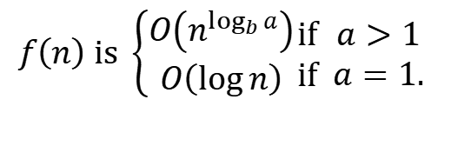

Estimating the Size of Divide-and-Conquer Functions 1
Theorem: Let f be an increasing function that satisfies the recurrence relation
$$f\left(n\right)=af\left(n/b\right)+c$$
whenever n is divisible by b, where a≥ 1, b is an integer greater than 1, and c is a positive real number. Then
$$f\left(n\right) \text{is} \left\{\begin{matrix}O\left(n^{\log_{b}{a}}\right) \\ O\left(\log{n}\right)\end{matrix}\right.\begin{matrix}\text{if} \\ \text{if}\end{matrix} \begin{matrix}a>1 \\ a=1.\end{matrix}$$
Furthermore, when n = b^{k} and a ≠1, where k is a positive integer,

Slide 52
Complexity of Binary Search
Binary Search Example: Give a big-O estimate for the number of comparisons used by a binary search.
Solution: Since the number of comparisons used by binary search is f(n) = f(n/2) + 2 where n is even, by Theorem 1, it follows that f(n) is O(log n).

Slide 53
Estimating the Size of Divide-and-conquer Functions 2
Theorem (Master Theorem): Let f be an increasing function that satisfies the recurrence relation
whenever n = b^{k}, where k is a positive integer greater than 1, and c and d are real numbers with c positive and d nonnegative. Then

Slide 54
Complexity of Merge Sort
Merge Sort Example: Give a big-O estimate for the number of comparisons used by merge sort.
Solution: Since the number of comparisons used by merge sort to sort a list of n elements is less than M(n) where M(n) = 2M(n/2) + n, and a = 2, b = 2, c = 1, d=1 (so that we have the case where a = b^{d}).
By the master theorem M(n) is O(n log n).

Slide 55
Complexity of Fast Integer Multiplication Algorithm
Integer Multiplication Example: Give a big-O estimate for the number of bit operations used needed to multiply two n-bit integers using the fast multiplication algorithm.
Solution: We have shown that f(n) = 3f(n/2) + Cn, when n is even, where f(n) is the number of bit operations needed to multiply two n-bit integers. Hence by the master theorem with a = 3, b = 2, c = C, and d = 1 (so that we have the case where a > b^{d}), it follows that f(n) is O(n^{log 3}).
Note that log 3 ≈ 1.6. Therefore the fast multiplication algorithm is a substantial improvement over the conventional algorithm that uses O(n²) bit operations.

Slide 56
Generating Functions 生成函数
Section 8.4

Slide 57
Generating Functions 生成函数
Definition: The generating function for the sequence a₀, a₁,…, a_{k}, … of real numbers is the infinite series
Examples:
The sequence {a_{k}} with a_{k} = 3 has the generating function
The sequence {a_{k}} with a_{k} = k + 1 has the generating function
The sequence {a_{k}} with a_{k} = 2^{k} has the generating function

Slide 58
Generating Functions for Finite Sequences 1
Generating functions for finite sequences of real numbers can be defined by extending a finite sequence a₀, a₁, … , a_{n} into an infinite sequence by setting a_{n+1} = 0, a_{n+2} = 0, and so on.
The generating function G(x) of this infinite sequence {a_{n}} is a polynomial of degree n because no terms of the form a_{j}x^{j} with j > n occur, that is,

Slide 59
Generating Functions for Finite Sequences 2
Example: What is the generating function for the sequence 1,1,1,1,1,1?
Solution: The generating function of 1,1,1,1,1,1 is
1 + x + x² + x³ + x⁴ + x⁵.
we have
(x⁶ − 1)/(x −1) = 1 + x + x² + x³ + x⁴ + x⁵
when x ≠ 1.
Consequently G(x) = (x⁶ − 1)/(x −1) is the generating function of the sequence.

Slide 60
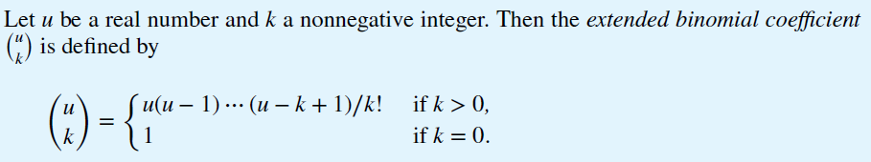

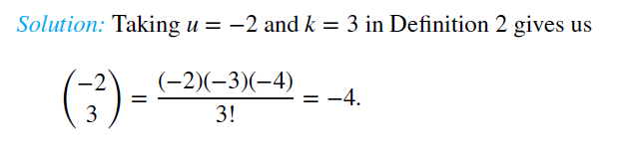
The Extended Binomial Coefficient
Definition:
Example:

Slide 61
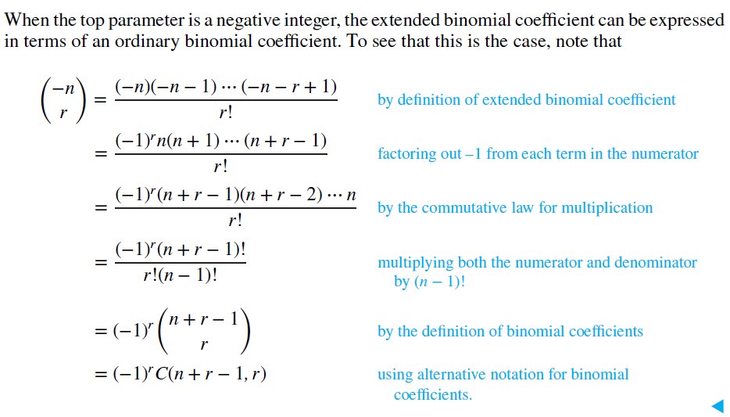
The Extended Binomial Coefficient
Example:

Slide 62
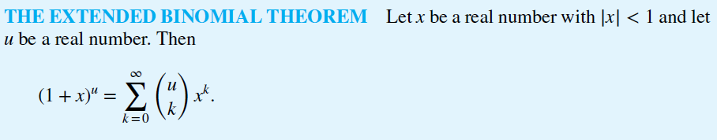
The Extended Binomial Theorem
Theorem:

Slide 63
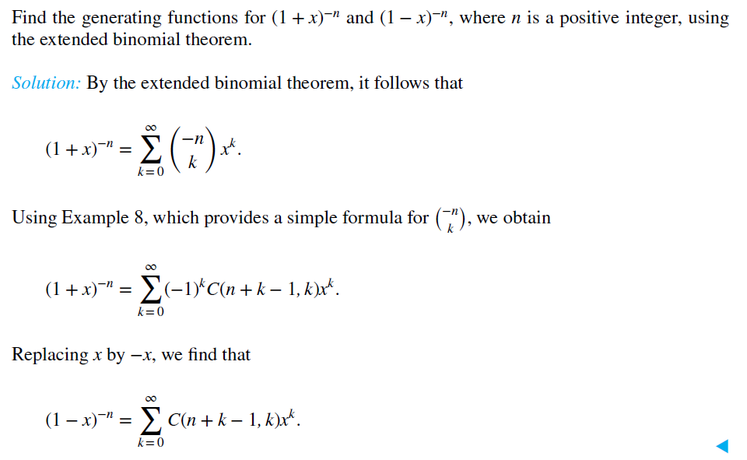
The Extended Binomial Theorem
Example:

Slide 64
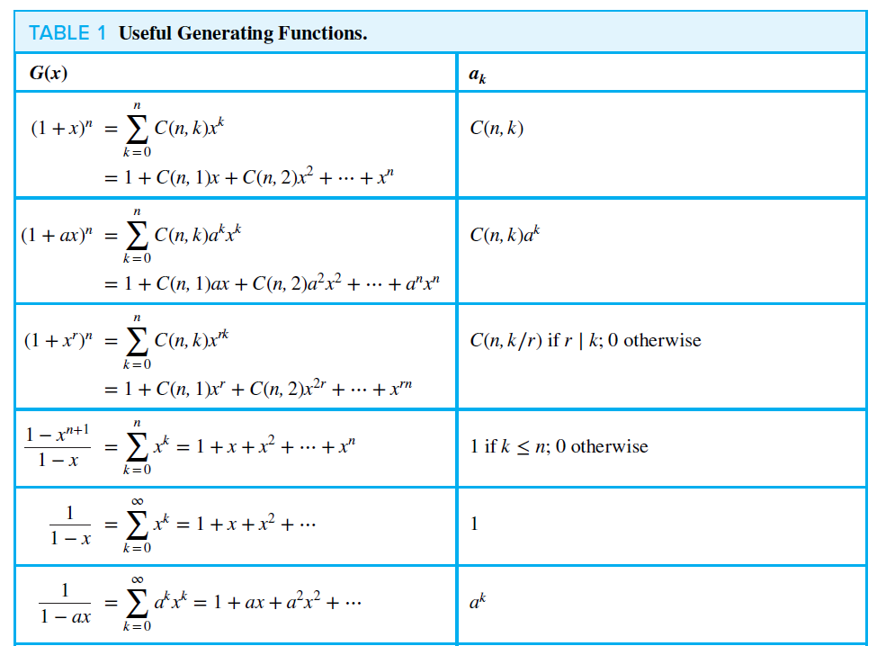
Useful Generating Functions

Slide 65
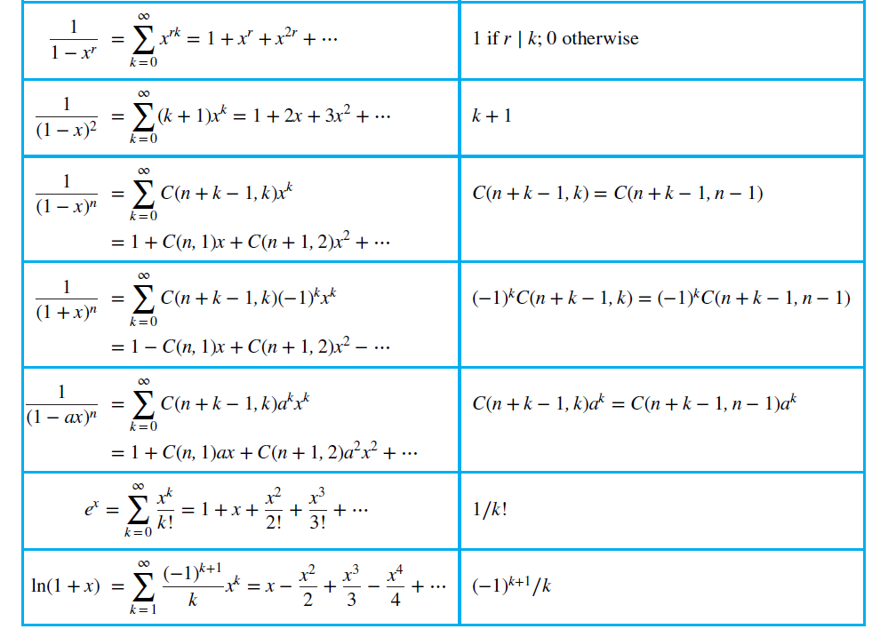
Useful Generating Functions

Slide 66
Counting Problems and Generating Functions 1
Example: Find the number of solutions of
e₁ + e₂ + e₃ = 17,
where e₁, e₂, and e₃ are nonnegative integers with 2 ≤ e₁≤ 5, 3 ≤ e₂ ≤ 6, and 4 ≤ e₃ ≤ 7.
Solution: The number of solutions is the coefficient of x¹⁷ in the expansion of
(x² + x³ + x⁴ + x⁵) (x³ + x⁴ + x⁵ + x⁶) (x⁴ + x⁵ + x⁶ + x⁷).
This follows because a term equal to is obtained in the product by picking a term in the first sum x^{e1}, a term in the second sum x^{e2}, and a term in the third sum x^{e3}, where e₁ + e₂ + e₃ = 17.
There are three solutions since the coefficient of x¹⁷ in the product is 3.

Slide 67
Counting Problems and Generating Functions 1
Example: In how many different ways can eight identical cookies be distributed among three distinct children if each child receives at least two cookies and no more than four cookies?
Solution: Because each child receives at least two but no more than four cookies, for each child there is a factor equal to
(x² + x³ + x⁴)
in the generating function for the sequence {c_{n}}, where c_{n} is the number of ways to distribute n cookies. Because there are three children, this generating function is
(x² + x³ + x⁴) ³
We need the coefficient of x⁸ in this product. The reason is that the x⁸ terms in the expansion correspond to the ways that three terms can be selected, with one from each factor, that have exponents adding up to 8. Computation shows that this coefficient equals 6. Hence, there are six ways to distribute the cookies so that each child receives at least two, but no more than four, cookies.

Slide 68

Counting Problems and Generating Functions
Example: Use generating functions to find the number of k-combinations of a set with n elements, i.e., C(n, k).
Solution: Each of the n elements in the set contributes the term (1 + x) to the generating function
$$f\left(x\right)=\sum_{k=0}^{n}{a_{k}x^{k}.}$$
Hence f(x) = (1 + x)^{n} where f(x) is the generating function for {a_{k}}, where a_{k} represents the number of k-combinations of a set with n elements.
By the binomial theorem, we have
where
Hence,

Slide 69
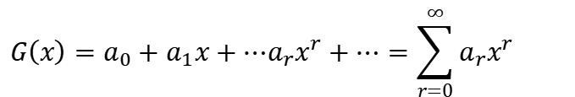
Counting Problems and Generating Functions
Example: Use generating functions to find the number of r-combinations from a set with n elements when repetition of elements is allowed.
Solution: Let G(x) be the generating function for the sequence {a_{r}}, where a_{r} equals the number of r-combinations of a set with n elements with repetitions allowed. That is,
$$G\left(x\right)=a_{0}+a_{1}x+⋯a_{r}x^{r}+⋯=\sum_{r=0}^{∞}{{a_{r}x}^{r}}$$
Because we can select any number of a particular member of the set with n elements when we form an r-combination with repetition allowed, each of the n elements contributes (1 + x + x² + x³ +⋯) to a product expansion for G(x). Because there are n elements in the set and each contributes this same factor to G(x), we have
G(x) = (1 + x + x² + x³ +⋯) ^{n}

Slide 70
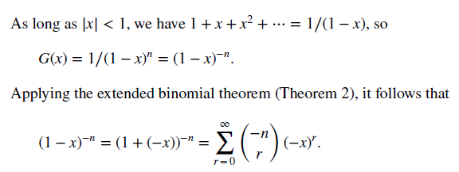
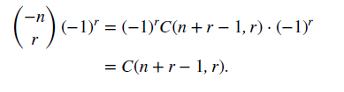
Counting Problems and Generating Functions
Solution:
The number of r-combinations of a set with n elements with repetitions allowed, when r is a positive integer, is the coefficient a_{r} of x^{r} in this sum. Consequently, using Example 8 we find that a_{r} equals

Slide 71
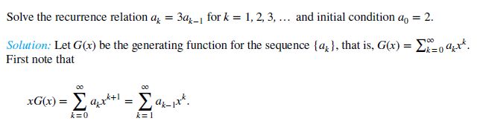
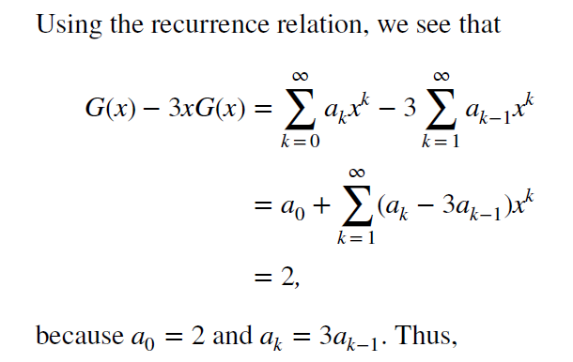

Linear Homogeneous Recurrence Relations and Generating Functions
Example:

Slide 72
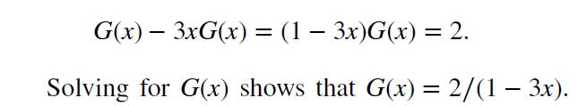

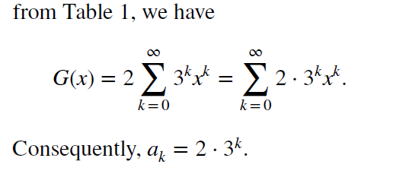
Linear Homogeneous Recurrence Relations and Generating Functions
Solution (continue):

Slide 73
Inclusion-Exclusion 包含排斥原理
Section 8.5

Slide 74
Principle of Inclusion-Exclusion
In Section 2.2, we developed the following formula for the number of elements in the union of two finite sets:
We will generalize this formula to finite sets of any size.

Slide 75
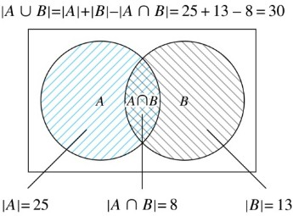
Two Finite Sets
Example: In a discrete mathematics class every student is a major in computer science or mathematics or both. The number of students having computer science as a major (possibly along with mathematics) is 25; the number of students having mathematics as a major (possibly along with computer science) is 13; and the number of students majoring in both computer science and mathematics is 8. How many students are in the class?
Solution:

Slide 76
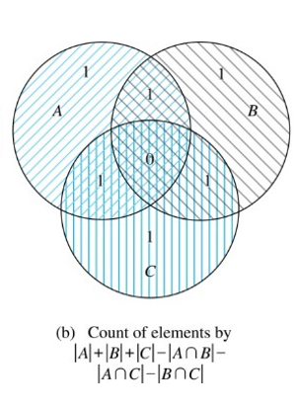
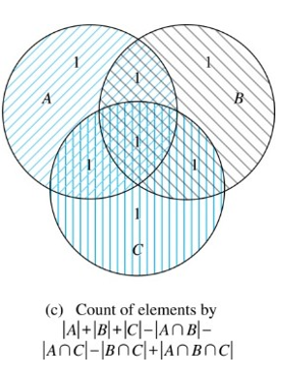
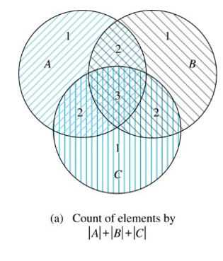
Three Finite Sets 1

Slide 77
Three Finite Sets 2
Example: A total of 1232 students have taken a course in Spanish, 879 have taken a course in French, and 114 have taken a course in Russian. Further, 103 have taken courses in both Spanish and French, 23 have taken courses in both Spanish and Russian, and 14 have taken courses in both French and Russian. If 2092 students have taken a course in at least one of Spanish French and Russian, how many students have taken a course in all 3 languages.
Solution: Let S be the set of students who have taken a course in Spanish, F the set of students who have taken a course in French, and R the set of students who have taken a course in Russian. Then, we have
|S| = 1232, |F| = 879, |R| = 114, |S∩F| = 103, |S∩R| = 23, |F∩R| = 14, and |S∪F∪R| = 2092.
Using the equation
|S∪F∪R| = |S|+ |F|+ |R| − |S∩F| − |S∩R| − |F∩R| + |S∩F∩R|,
we obtain 2092 = 1232 + 879 + 114 −103 −23 −14 + |S∩F∩R|.
Solving for |S∩F∩R| yields 7.

Slide 78
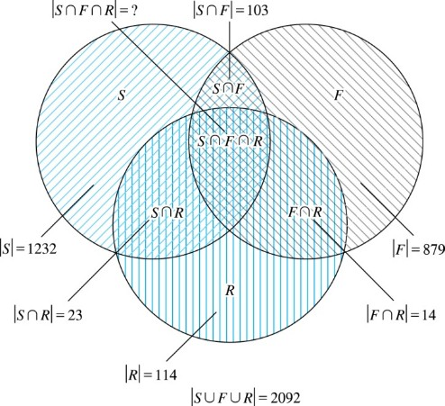
Illustration of Three Finite Set Example

Slide 79
The Principle of Inclusion-Exclusion 1
Theorem 1. The Principle of Inclusion-Exclusion: Let A₁, A₂, …, A_{n} be finite sets. Then:

Slide 80
The Principle of Inclusion-Exclusion 2
Proof: An element in the union is counted exactly once in the right-hand side of the equation. Consider an element a that is a member of r of the sets A₁,…., A_{n} where 1≤ r ≤ n.
It is counted C(r,1) times by
It is counted C(r,2) times by
In general, it is counted C(r,m) times by the summation of m of the sets A_{i}.

Slide 81
The Principle of Inclusion-Exclusion 3
Thus the element is counted exactly
$$C\left(r,1\right)−C\left(r,2\right)+C\left(r,3\right)−⋯+{\left(−1\right)}^{r+1}C\left(r,r\right)$$
times by the right hand side of the equation.
By Corollary 2 of Section 6.4, we have
$$C\left(r,0\right)−C\left(r,1\right)+C\left(r,2\right)−⋯+{\left(−1\right)}^{r}C\left(r,r\right)=0.$$
Hence,

Slide 82
Applications of Inclusion-Exclusion
Section 8.6

Slide 83
The Number of Onto Functions 映上函数的个数
Example: How many onto (surjection 满射) functions are there from a set with six elements to a set with three elements?
Solution: Suppose that the elements in the codomain are b₁, b₂, and b₃. Let P₁, P₂, and P₃ be the properties that b₁, b₂, and b₃ are not in the range of the function, respectively. The function is onto if none of the properties P₁, P₂, and P₃ hold
By the inclusion-exclusion principle the number of onto functions from a set with six elements to a set with three elements is
N − { (|P₁| + |P₂| + |P₃|) − [|P₁∩P₂|+ |P₁∩P₃| + |P₂∩P₃|] + |P₁∩P₂∩P₃| }
Here the total number of functions from a set with six elements to one with three elements is N = 3⁶.
The number of functions that do not have in the range is N(P₁) = 2⁶. Similarly, |P₂| = |P₃|= 2⁶ .
Note that |P₁ ∩P₂ | = |P₁ ∩P₃|= | P₂ ∩P₃ | = 1 and | P₁ ∩P₂∩P₃ | = 0.
Hence, the number of onto functions from a set with six elements to a set with three elements is:
3⁶ − 3∙ 2⁶ + 3 = 729 − 192 + 3 = 540

Slide 84
The Number of Onto Functions 映上函数的个数
Theorem 1: Let m and n be positive integers with m ≥ n. Then there are
onto functions from a set with m elements to a set with n elements.
Proof follows from the principle of inclusion-exclusion (see Exercise 27).

Slide 85
Derangements 错位排列
Definition: A derangement is a permutation of objects that leaves no object in the original position.
Example: The permutation of 21453 is a derangement of 12345 because no number is left in its original position. But 21543 is not a derangement of 12345, because 4 is in its original position.

Slide 86
Derangements 错位排列
Theorem 2: The number of derangements of a set with n elements is
Proof follows from the principle of inclusion-exclusion (see text).

Slide 87
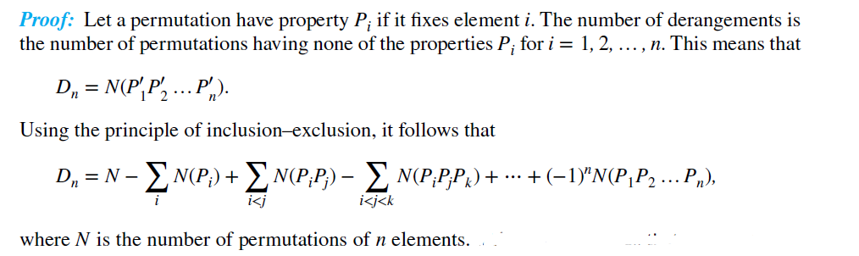



Derangements 错位排列
Note that
……

Slide 88
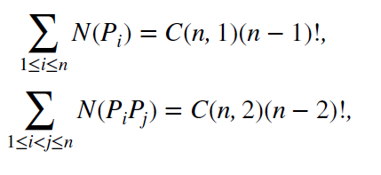
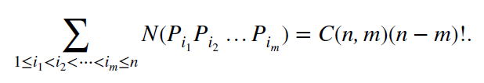
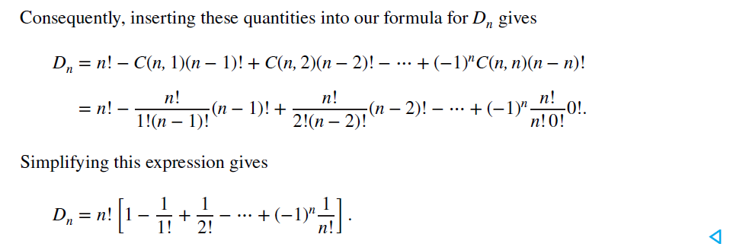
Derangements 错位排列

Slide 89
Derangements 错位排列
The Hatcheck Problem: A new employee checks the hats of n people at restaurant, forgetting to put claim check numbers on the hats. When customers return for their hats, the checker gives them back hats chosen at random from the remaining hats. What is the probability that no one receives the correct hat.
Solution: The answer is the number of ways the hats can be arranged so that there is no hat in its original position divided by n!, the number of permutations of n hats.
Remark: It can be shown that the probability of a derangement approaches 1/e as n grows without bound.
TABLE 1 The Probability of a Derangement.
n | 2 | 3 | 4 | 5 | 6 | 7
D_{n} / n! | 0.50000 | 0.33333 | 0.37500 | 0.36667 | 0.36806 | 0.36786

Slide 90
Homework
§8.1 10, 17 §8.2 4 a), 12 §8.3 18
§8.4 8 a)
§8.5 12
§8.6 8,13
Due date : 2024.5.7

