Slide 1
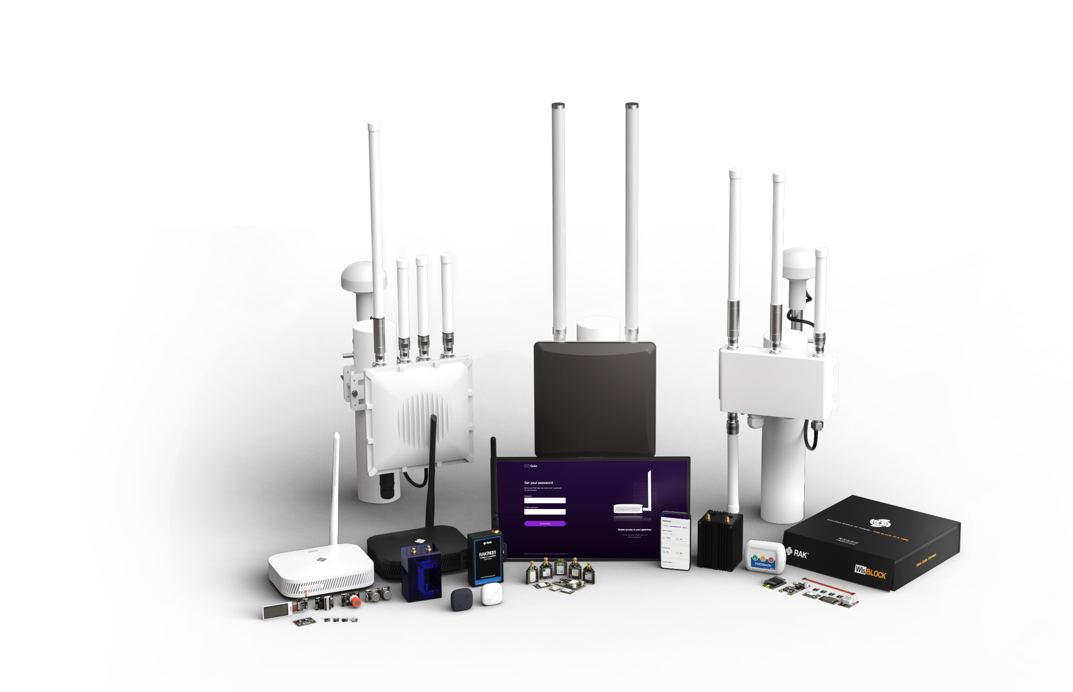
RAK
IoT Made Easy

Slide 2


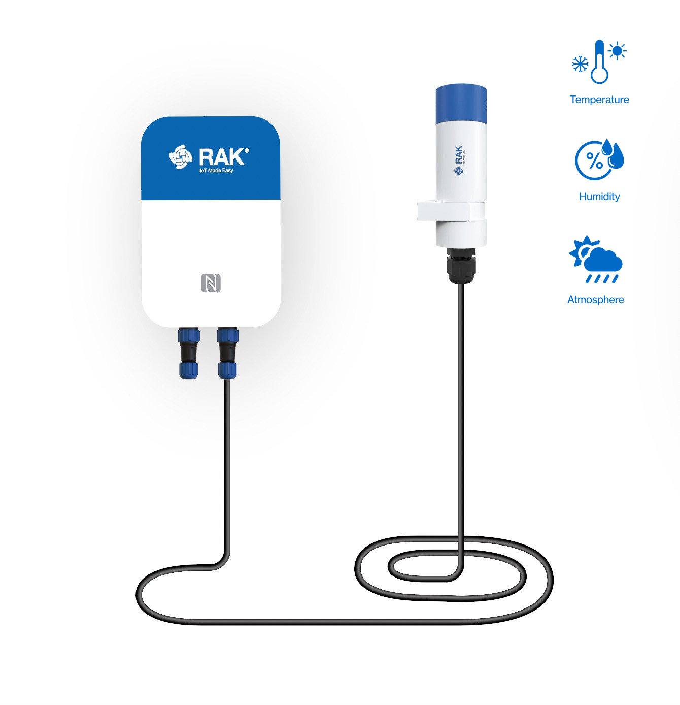
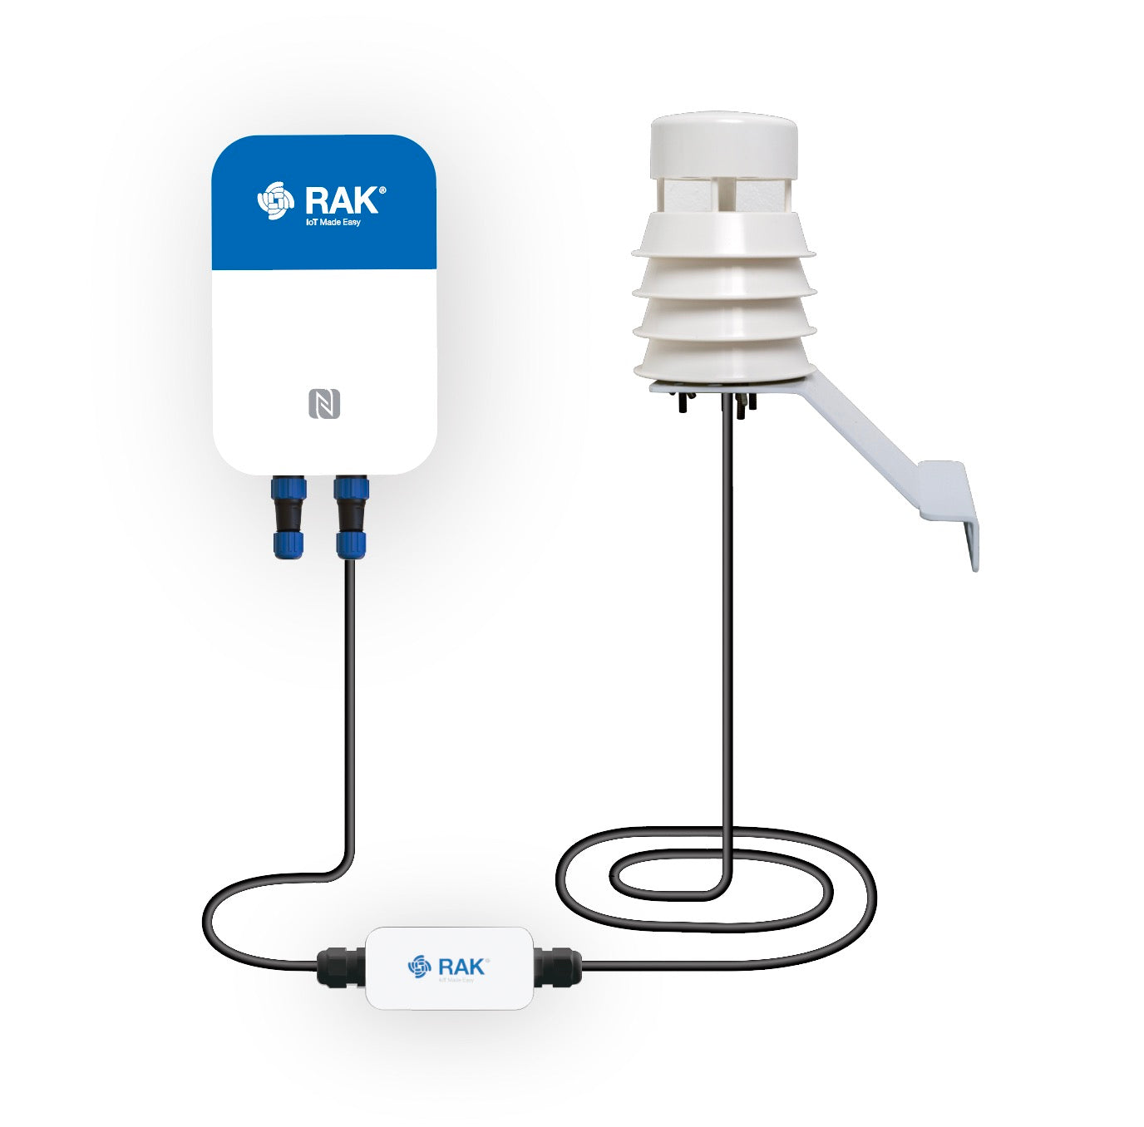
RAKSensorHub + Meshtastic POC Demo Plug & Play · Wireless Sensor Aggregation
What is it？
What have we done？
What do we support now？
What does the data look like？
What is the future？

Slide 3
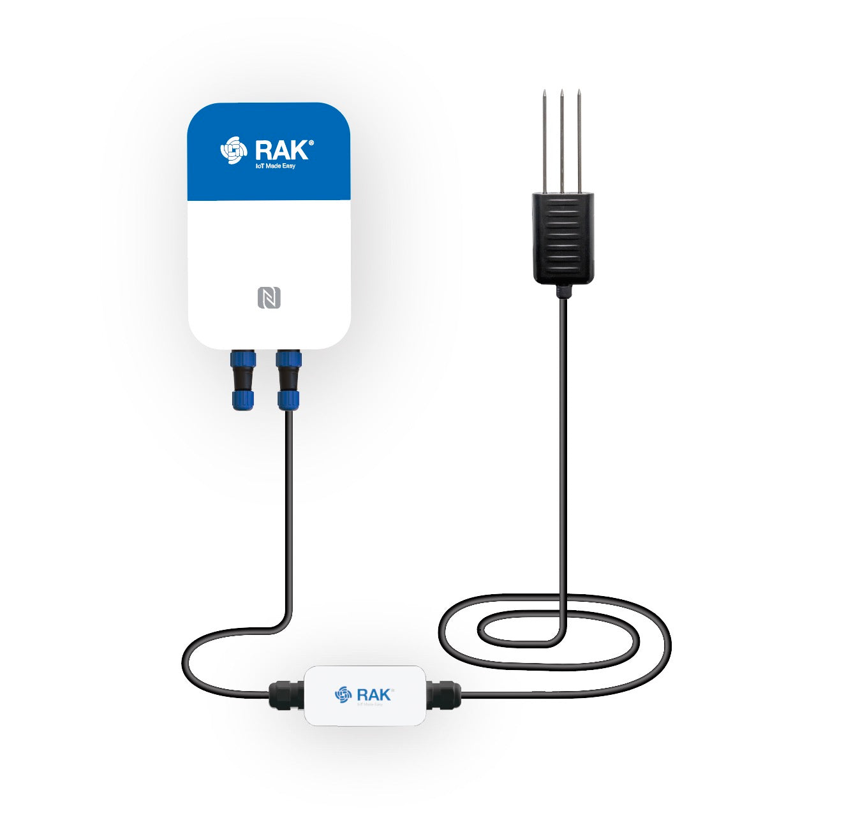
What is it? – A wireless translator that makes every sensor “speak”
RAK2560 SensorHub is like a “universal sensor translator”.
Soil sensors, weather stations, water quality testers… they all speak different “dialects” (RS485, SDI-12, 4-20mA).
SensorHub translates all these dialects into standard data, then sends it to your phone or computer via LoRa radio (like a walkie-talkie).
No need for cables or Wi-Fi. You can see all the data from your field – remotely.

Slide 4

What have we done? – Plug in a sensor, see data on your phone
Optional code location diagram：
We have enabled plug-and-play data reading on SensorHub:
Plug in any supported sensor (temperature, humidity, soil, wind, CO₂…), it is automatically recognized – no manual config needed.
Data is displayed in real-time on the Meshtastic App and can be stored in Grafana dashboards for historical trends.
We have covered 6 categories, 20+ parameters (temperature, humidity, pressure, wind speed, wind direction, solar radiation, soil moisture, EC, pH, salinity, CO₂, voltage, current…).
One sentence: Plug in the sensor, see the data on your phone.
firmware
src
modules
Telemetry
Sensor
RAKSensorHub.cpp
RAKSensorHub.h

Slide 5
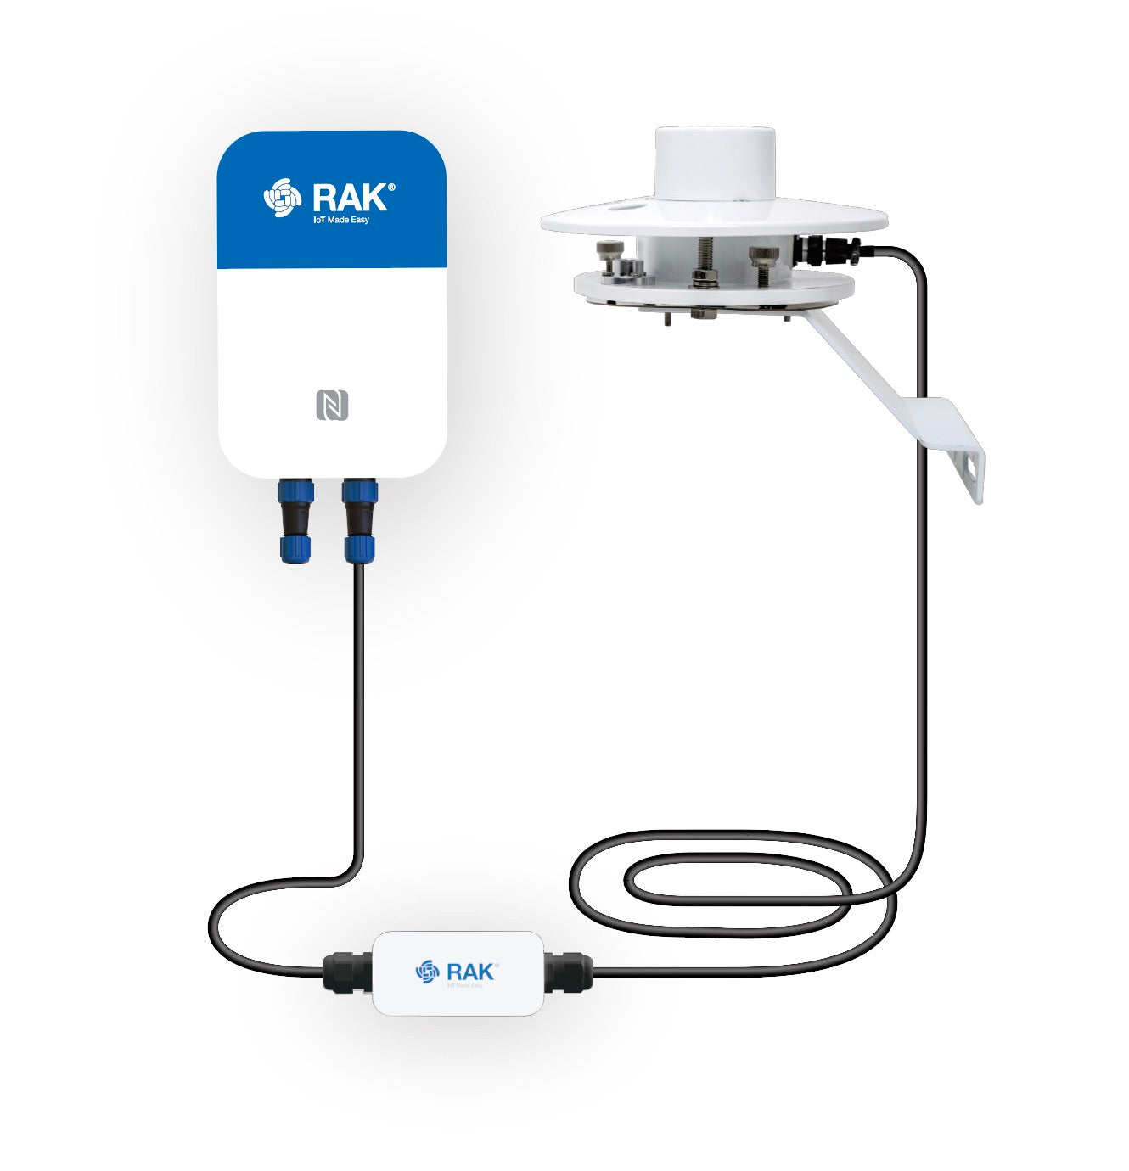
What do we support now? – 6 sensor categories, plug & play
Probe + Sensor(WisBlock direct connect)
Supported parameters list：
WisBlock module | Measurement Parameters
RAK1901 | Temperature + Humidity
RAK1902 | Temperature + Pressure
RAK1904 | 3-axis acceleration
🌡️ Temp -40℃ ~ 125℃
💧 Hum 0 ~ 100%
🌬️ Press 260 ~ 1260 hPa
📦 3-axis accel ±16g
🫧 CO₂ 0 ~ 5000 ppm
💨 Wind speed 0 ~ 40 m/s
🧭 Wind direction 0 ~ 360°
☀️ Solar radiation 0 ~ 2000 W/m²
⚡ EC 0 ~ 10 mS/cm
🌱 Soil moisture 0 ~ 100%
🧪 pH 0 ~ 14（0.01）
📏 Water level 0 ~ 5 m
ProbeIO + Sensor
built-in third-party | Interface Type | Measurement Parameters
RK900-09 Weather station | RS485 | wind speed/direction, T/H/P
RK300-03 CO₂ | RS485 | CO2 concentration
JXBS-3001-pH | RS485 | high/low precision pH
UTOP ULB16 | 4-20mA | water level
RK200-03 | SDI-12 | solar radiation

Slide 6
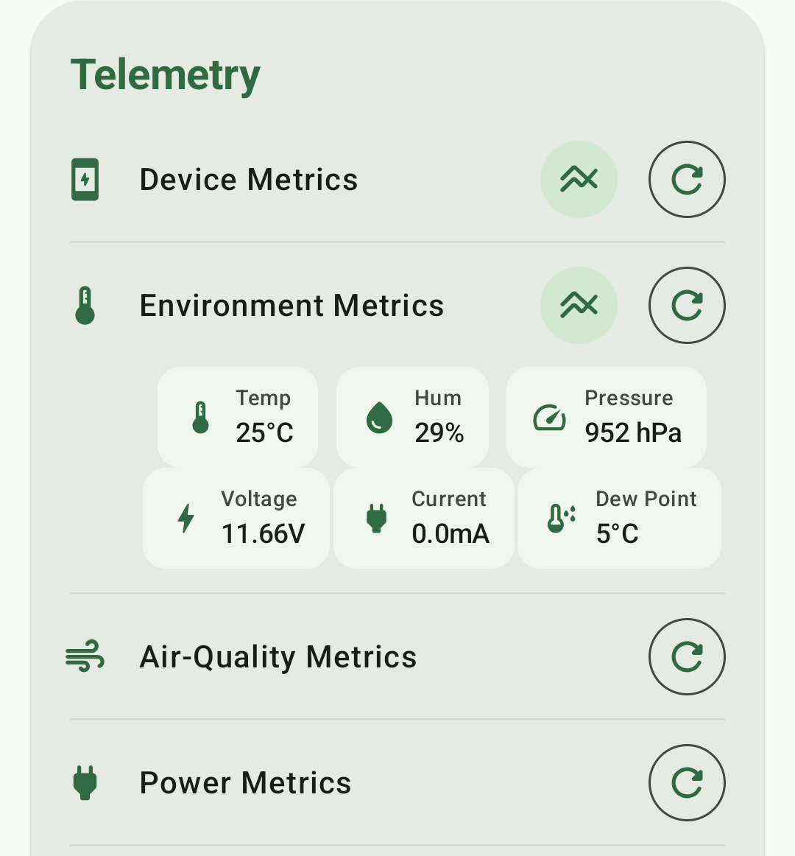
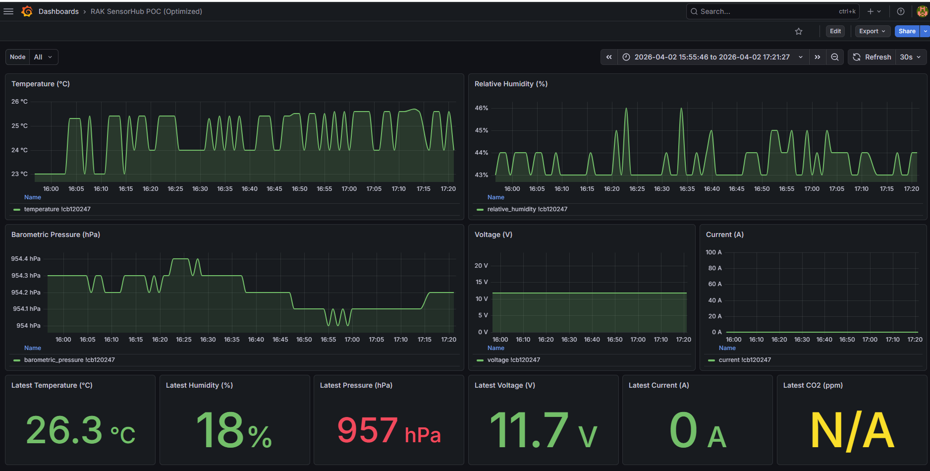
What does the data look like? – Mobile App + Dashboard live view
📊 Grafana Dashboard (historical trends) ：
• Multi-parameter time-series charts
POC-Meshtastic-APP_en
📱 Meshtastic App real-time：
• Temperature: 25°C
• Humidity: 29%
• Pressure: 952 hPa
• Voltage: 11.66V

Slide 7
What is the future? – You can “teach” it new sensors from your phone
Right now, SensorHub can only read sensors we have pre-configured.In the future, we give it the ability to learn by itself:
Use your phone to remotely configure any new RS485 sensor.
For example: you buy a new water quality meter. No need to ask the factory. Just enter its communication parameters (baud rate, register address, data format) in the App - and SensorHub will understand it immediately.
Final goal:
Move from “what sensors we support” to “you can use whatever sensor you want”.
Cover 90%+ of industrial/agricultural sensors – a truly universal sensor gateway.
Release roadmap：POC passed → Early Apr (Upstream) → Late Apr (Downstream)
Upstream version (Early April) – “Plug & use”
7+ built-in sensors, plug & play
Data reported to phone, no configuration needed
Downstream version (Late April) – “Configure anything”
Remotely configure new sensors from your phone
Truly a “universal sensor gateway”
1
2

Slide 8

Thanks

