Slide 1
General Emergency Services
Slides 1 – 26
Test Prep for GES 116
(CAPT 116)
Adapted from the
National Emergency Services Curriculum Project

Slide 2
Part 1
General Emergency Services
Missions
Qualifications
Activation
Sign-In
Risks
Responsibility
Bloodborne Pathogens
Negligence
Posse Comitatus
Media & Bystanders
Reimbursement
Partner Agencies
Notes:
This is the first class that any member planning to be involved in CAP Emergency Services (ES) Operations should take. It is geared for the entry level personnel primarily, but also discusses hot topics in ES that all members need to know about who will work ES missions.
This course is expected to take 3 to six hours including written examinations and question and answer periods.
Upon completion of this course, students should take the CAPT 116. Once a member has passed the current CAPT 116, they are considered 101 qualified in the GES specialty qualification, and can then continue on to receive training in other specialties as outlined on the appropriate CAPF 101Ts.

Slide 3
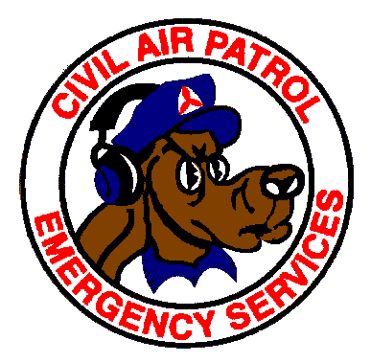
Missions
P-0001
Search and Rescue (ground and air)
Disaster Relief
Reconnaissance
Counterdrug
Transportation
Notes:
CAP has a variety of ES missions that it is involved in. CAP is primarily known for it’s aviation Search And Rescue (SAR) capability, but we also routinely are involved in several other areas. During disasters CAP members are often called out to provide communications or mission management support, establish shelters in heavily damaged areas, transport specialty teams or government officials to disaster sites, or take overhead photos of damage done by storms or other calamities.
CAP participates in the War on Drugs in the US as well through it’s Counterdrug program. Using the skills learned to support search and rescue and disaster relief operations, our aircrews routinely fly spotting missions to locate drug plots and clandestine airfields, and our crews also transport DEA and Customs agents along with many other law enforcement personnel when requested. Remember though that CAP does not actively participate in law enforcement matters like detention and surveillance, and is normally not doing anything that normal citizens couldn’t do, we’re just organized.
The CAP will not normally be used for routine patient transfers or medical evacuations. (24)

Slide 4
Missions (Continued)
MOUs
  Air Force Rescue Coordination Center (AFRCC)
  Federal Emergency Management Agency (FEMA)
  Red Cross
  Federal Aviation Administration (FAA)
  National Oceanic and Atmospheric Admin. (NOAA)
  National Weather Service (NWS)
  Salvation Army
  U.S. Customs
  Drug Enforcement Administration (DEA)
  State Agencies
  Others
Notes:
CAP routinely works with many agencies throughout the United States. The main players in the ES arena are listed above, but we have many others at the national level, never mind several hundred at the local level.
A Memorandum of Understanding (MOU) is a written agreement that establishes the basis for mutual cooperation and coordination between CAP and supported organizations and agencies. (6 and 41) Wing/state MOU’s should not be signed by a state official until after it is approved by HQ CAP-USAF. (33)
These MOUs tell us the requirements for both agencies when working joint operations including things like contact information for resources, reimbursement procedures, and liability coverage.

Slide 5



Missions (Continued)
Three areas of qualification
  Ground and Urban Direction Finding Teams
    Ground Team Leader
    Ground Team Member
    Urban DF Team
  Aircrews
    Scanner
    Observer
    Mission Pilot
  Mission Base Personnel
Notes:
CAP personnel participating in ES operations primarily fall into three categories: Ground & Urban DF Teams, Aircrews, and Mission Base Staff. Ground teams are often used on disaster relief operations when air operations are precluded due to weather. (15) Ground teams should not be dispatched with less than four individuals. (31)
CAP mission managers and flight crews should refer to CAPR 60-1 for flight time and duty limitations. (25) CAP observers/scanners may not use night vision devices. (26) At least ten hours of aircrew rest is mandatory before going on another mission. (48)
All personnel qualified in emergency services specialties should have a record of this kept in their Emergency Services Specialty Qualification Record, the CAPF 114. (28) Not every position is required for every mission, but these are the areas that you can train to support our efforts in.
Also,if any of you have any specialty skills that you are bringing to the table early on like training in Critical Incident Stress Management, Collapse Rescue, or other useful areas let your unit ES staff know so that they can pursue getting that technical specialty added on to your 101 card as well and get you listed as a resource in that area. It takes several personnel to make every mission happen, and the requirements vary depending on the type and depth of the mission. Each of these specialties has requirements for training and qualification as they have specific job requirements. These are outlined in our emergency services regulations.

Slide 6
Qualifications
P-0002
CPPT/Level I for senior members
Achievement 1 for cadets
Pass CAP Test 116 (GES 116 / CAPT 116)
Current CAP Membership
CAPF 101 (or computer roster)
Trainee status for other specialties
  Mission Staff Assistant recommended for those without a planned specialty
Maintaining Proficiency (last day of 36th month)
Notes:
Specialty ratings on CAPF 101 generally remain valid through the last day of the 36th month from the date issued. Authority to approve the initial CAPF 101 in each specialty above General ES may not be delegated below wing level. Subsequent CAPFs 101 will be approved at the unit level unless the wing commander limits this action via an approved supplement to this regulation. Once final approval for a CAPF 101 is granted, the member, unit commander or other designated staff officers can print the CAPF 101. It is recommended that the member or units laminate the printed 101 card for extended use by the member. CAPFs 101 for incident commanders and agency liaisons must be approved at the wing level or higher.
Keep copies of your qualification documentation; you may want to transfer your qualifications out
of state, and it is possible your files will get lost or damaged.

Slide 7
Qualifications Continued
Most specialty qualifications generally expire 3 years from the date the qualification was attained. Exceptions are:
Specialty Exceptions | Reason for Exception
General Emergency Services | Specialty expires only in a new CAPT 116 is issued
Transport Mission Pilot | Specialty expires if CAP pilot status is revoked
SAR/DR Mission Pilot | Specialty expires if CAP pilot status is revoked or CAPF 91 lapses
Air or Ground Radiological Monitor | Currency requirements as approved by CAP/DOS
Critical Incident Stress Team | Specialty expires when the member is removed from a CAP CIST

Slide 8
General ES (GES)
The General Emergency Services rating is required of all individuals qualifying in emergency services and will be completed prior to commencing training of any other specialty.
Successful completion of the CAPF 116 ES Questionnaire (corrected to 100%) along with basic membership requirements qualifies the member in the General Emergency Services rating
Notes:
To participate in emergency services training or operations, personnel must be current members having completed level one and cadet protection training (senior members) or achievement one (cadets). Individuals in temporary membership are not eligible for liability coverage under the FECA. Individuals in temporary membership status are eligible to accomplish academic training activities but are not authorized to observe mission base training and operations due to liability issues. In addition, they may not participate in any flight activities (including flight line activities) or ground team field activities. Other than these, there are no prerequisite requirements for GES. CAPF 101 with the
General ES rating will be approved by the unit commander or his or her designee(s) upon completion of the requirements for the specialty.

Slide 9
Specialty Rating Requirements
All personnel will conduct training using the National Task Guides.
(check National Ops website)
Prerequisites must be completed prior to initial training requirements.
Familiarization and preparatory training
Advanced training
Participation in two missions
Notes:
Once trainees have met the prerequisites, they will be required to complete familiarization and preparatory training for the specialty before serving in that position on actual or training missions under supervision. Familiarization and preparatory training is the minimum set of tasks that the member must master prior to acting as a supervised trainee on practice or actual missions. These tasks represent those skills that will keep the member safe and allow the member to function under supervision without jeopardizing the mission. This requirement avoids placing personnel not ready to perform certain jobs or those who work for them at risk. Once familiarization and preparatory training is completed, trainees must complete advanced training and participate satisfactorily in two missions before a CAPF 101 is approved and a member is considered “Qualified.”

Slide 10
Specialty Training
Personnel are authorized to train for the specialty rating qualifications by their unit commander (including approved emergency services school directors) except incident commander or agency liaison
Training to qualify is expected to take place within two years.
All training must be certified as complete by a qualified evaluator (members cannot certify their own training)

Slide 11



Partner Agencies
P-0006
FEMA
AFNSEP
AFRCC
NTSB
Federal Emergency Mgt Agency
Air Force National Security Emergency Prep.
Air Force Rescue Coordination Center
National Transportation Safety Board
Notes:
In a Presidential disaster declaration, a Federal Coordinating Officer (FCO) is appointed to coordinate all federal assistance to local/state governments. This FCO is usually from FEMA. (13) FEMA is the Federal Emergency Management agency and is the coordinator for federal response to disasters. Basic policy for peacetime disaster relief (DR) operations assigns the primary responsibility for Military Support to Civil Authority (MSCA) within the Continental U.S. (CONUS) to the Department of the Army. (10)
The agency or organization responsible coordinating missing aircraft search and rescue (SAR) of the Inland Region of the Continental United States is the U.S. Air Force. (7) The Air Force National Security Emergency Preparedness office, at state and federal requests, coordinates use of Air Force resources to mitigate disasters. The organization that handles the Air Force Response to disaster relief in the continental U.S. is the AFNSEP. (2 and 11) The Air Force Rescue Coordination Center (AFRCC) is the controlling agency for inland search and rescue, located at Langley AFB, Virginia. It has a SAR agreement with each state. It contacts the responsible agency or organization in the area, which, in turn, calls the individual units and members to support the mission. (34 and 40) The National Transportation Safety Board (NTSB) is responsible for investigating aircraft accidents. After CAP finds a crashed aircraft, it becomes the responsible of the NTSB. CAP often provides site monitoring for NTSB.
The intent of the State and Regional Disaster Airlift (SARDA) Plan is the efficient usage of all available “air” resources including CAP aircraft. It is a plan for the state to use all available general aviation (non-air carrier) resources, including pilots, aircraft, and airports, in meeting disaster airlift requirements. (14)
Search and rescue missions for Civil Air Patrol are executed pursuant to CAPR 60-3 and the U.S. Supplement to the International Aviation and marine SAR Manual. (8)

Slide 12
Activation
P-0004
Agency
  CAP does not activate itself
CAP Wing
  An Incident Commander is assigned
  Using wing notification roster/pager/website
Mission qualified wing members answer the response
Notes:
CAP does not just activate itself. It is called upon by a lead agency to run missions. In regard to SAR mission coordination, AFRCC/CC, AFRCC controller, and CAP incident commander fill the roles of SAR coordinator, SAR mission coordinator, and on-scene commander, respectively. (9)
Each wing decides who will be it’s primary personnel deciding whether or not the wing can support the mission. The wing keeps a complete roster of emergency services resources that are available for use. The contact information for those personnel is provided to our lead agencies, normally on a quarterly basis. The lead agencies then use this list to call upon the wing for support as necessary.
An imminently serious condition means conditions requiring immediate action to save lives, prevent human suffering, and/or mitigate great property damage. (12) 911T Imminently Serious Missions must be authorized by the wing commander and the wing LO/LNCO (or higher CAP-USAF official). (21)
Missions are stressful. Critical Incident Stress Management (CISM) is a part of CAP. A member feeling stressed or having participated in or been exposed to a mission with fatalities or less than favorable results should seek help from a CISM team or the local chaplain or other suitable individual(s). Do not keep it bottled up inside of you.
When the lead agency calls, the point of contact for the wing, normally an alerting officer, contacts the appropriate resources to get the mission accomplished. These resources include not only aircraft and equipment, but also mission qualified personnel, who have the responsibility to keep themselves prepared (equipment, clothing, training).
There are many missions other than flying, such as filling sandbags, communications, and transporting EMA personnel. If a state requests CAP assistance in transporting SAR dog teams, and the AFRCC is not able to issue a mission number, CAP-USAF liaison regions are authorized to issue air Force assigned reimbursed mission numbers, if sufficient region SAR/DR training funds are available, or non-reimbursed mission numbers if funds are not available. (22)

Slide 13
Sign-In
P-0003
Individual qualifications need to be known to mission planners, and thus personnel are normally requested individually to participate
Sign-in confers FECA/FTCA coverage
  Personnel and vehicles will be logged on the ICS Forms 211 and 218 respectively with incoming team or aircrew paperwork
  Personnel need to be sure that they are recorded on the Unit Log by the assigned supervisor on the ICS Form 214
Further assignment at sign-in
Notes:
Personnel are normally hand picked to participate in missions based on the skills required to accomplish the mission. The first thing you are to do when you arrive at the mission base is to sign in.
Each member participating in ES missions must be logged in to receive credit towards their training and qualification, and to also receive FECA and FTCA coverage. The FTCA only covers select members involved in Air Force assigned missions. (35 and 39) Members over the age of 18 or their heirs are eligible for compensation should you on the slim chance be injured or killed on an approved mission, or your equipment is damaged. Sign-in also lets us know who to contact for you in case of an emergency.
Individual personnel and teams are normally logged onto the ICS From 211 and vehicles (aircraft or auto) are logged onto the ICS Form 218. (38 and 37) If you are coming to a mission as an individual that is where you will first get signed in, but if you are coming as part of an aircrew your supervisor should log you onto the unit log and the dispatch paperwork (CAPF 104 for aircrews or CAPF 109 for ground teams) to make sure you get credit. Once you have a job you will report to your unit and get logged onto the 214. Sign-in of vehicles is don on ICS Form 218 and tracked by the ground support unit of the logistics section. Aircraft should be specifically requested and tracked as individual resources or crews.
Once you re signed in, you may get re-assigned based on your qualifications. Those people with many qualifications are often pulled to fill gaps based on their experience.

Slide 14
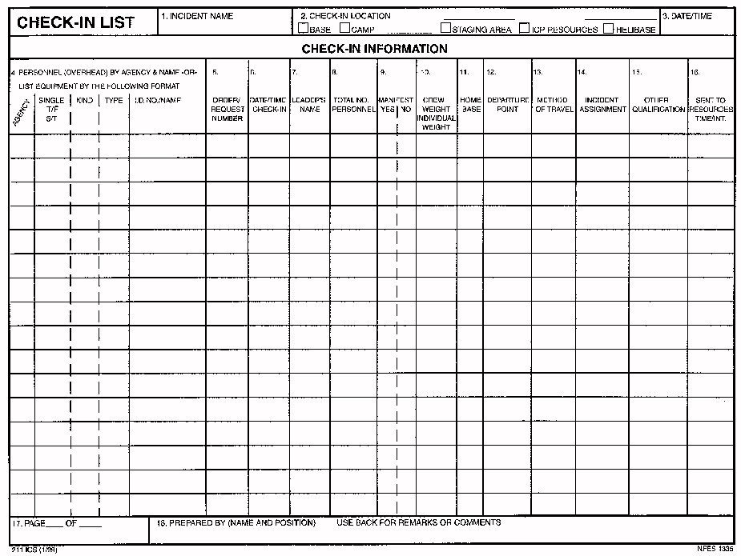
ICS Sign In Form 211

Slide 15
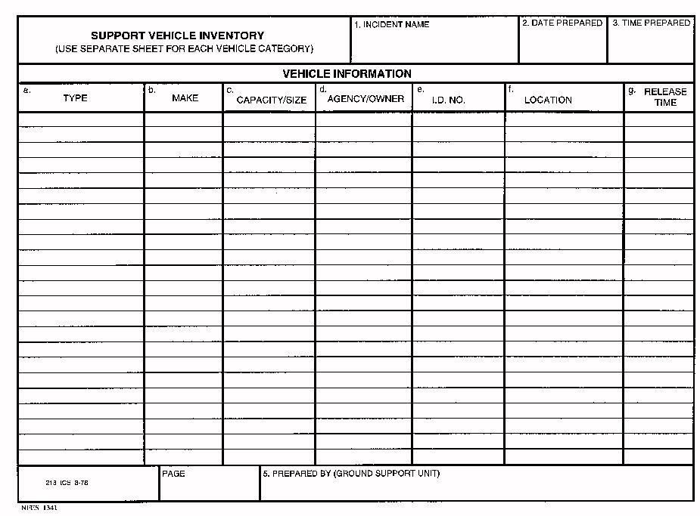
ICS Form 218 Vehicle Sign In

Slide 16
Risks
P-0007
Travel to and from mission base
Operating without proper rest or nourishment
Electrical or antenna wires
Turning propellers
Do not take unnecessary risks
SAFETY IS OUR NUMBER ONE PRIORITY
Notes:
Safety is a major concern for our operations. CAPR 60-3 outlines the policies and procedures for execution of various CAP operational missions and establishes a foundation for expansion into joint operations using the Incident Command System and other management tools. Some situations may dictate variations in the procedures contained in this regulation, in which common sense and prudent judgment shall be used to ensure effective management of CAP resources. Safety should always be a primary concern. (1) HQ CAP/DO must approve all supplements to CAPR 60-3 except those specifically authorized in the regulation. (32)
If you get hurt on a CAP mission, yes you have coverage, but you also detract from the mission. Remember that there are many possible hazards involved in participating in ES missions and you need to be aware of what is going on around you. The above are just a few examples of some of the common hazards on our missions.

Slide 17
Responsibility
P-0010
CAP ES members should obtain and read copies of the current operations and emergency services publications
Again, CAP members have NO special dispensations over an ordinary citizen
Individuals who put themselves, other members, or the corporation in jeopardy by disregarding laws and policies will be targeted for restraining action
Notes:
CAP has certain obligations to make on missions, but so doesn’t the membership. Every person involved in CAP ES Missions needs to understand their job, and our basic requirements. These are outlined in our governing ES regulations and training materials.
CAPR 60-1 Flight Operations
CAPR 60-3, CAP Emergency Services Training and Operational Missions
CAPR 60-4 Volume 1, Part 1, CAP Emergency Service Mission Forms
CAPR 60-4 Volume 1, Part 2, CAP Emergency Service Training Forms
CAPR 60-4 Volume 2, Emergency Service Training Forms
CAPR 60-5, Critical Incident Stress Management
Approved Policy Letters, Supplements, Operating Instructions, etc.
National Task Guides for each specialty
Remember also that CAP members are normal citizens, and must operate within the law.
If you don’t operate within the regulations and/or the law, there are consequences. You could have your membership suspended or terminated, privileges revoked, or even worse you could be hurt or killed. Laws, rules and regulations are normally written to protect the public, including you. Follow them.

Slide 18
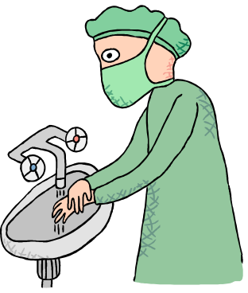
Bloodborne Pathogens
O-0901
Diseases transferred by contact with human blood and body fluids
  Hepatitis B
  AIDS
  Others
Exposure exists at accident/crash sites
Notes:
You need to know that we do have missions that can put you in contact with blood or blood products and thus the issue needs to be addressed. Ground teams working at a crash site or aircrews transporting blood need to understand the precautions necessary are to protect themselves.
Every member of each ground team must receive Bloodborne pathogen training from a knowledgeable person. (16) More detailed information is available through basic and advanced first aid training provided by organizations like the National Safety Council, American Red Cross, or the Department of Defense. (17)
Essentially, stay away or use the right equipment to protect yourself, which we will show you how to use should you become involved in that area.

Slide 19
Bloodborne Pathogens (Continued)
Prevent by staying away from blood and body fluids
  Engineering controls
    Hand washing facilities, eye wash stations, etc.
  Work practice controls
    Using sharps containers, hand washing, using barriers, etc
  Personal protective equipment
    Gloves, masks, gowns, face shields, tyvek suits, etc.
  Universal precautions
    Treat all blood and body fluids as if contaminated
Notes:
Should you get involved in missions where you could get exposed to Bloodborne pathogens, we will provide training in these areas so that you know how to protect yourself. Engineering controls are the Structural or mechanical devices CAP provides for its’ ES personnel
Hand washing facilities -Eye wash stations -Sharps containers -Biohazard labels
Work Practice Controls are the behaviors necessary to use engineering controls effectively.
Using sharps containers -Using an eye wash station
Washing your hands after removal of personal protective equipment
Personal Protective Equipment is equipment provided by CAP at no cost to you, which it is to your advantage to use, and should be reported to supervisors when not in working order
Latex gloves -Masks -Aprons,Gowns, or Tyvek suits -Face shields
Universal precautions is the concept that all blood and certain body fluids are to be treated as if contaminated with Human Immunodeficiency Virus (HIV), Hepatitis B Virus (HBV), or other Bloodborne pathogens.

Slide 20
Negligence
P-0008
Failure to exercise that degree of care that a reasonable person would exercise under the same circumstances
Degrees - Slight, Ordinary, Gross
Key = perform to your level of training
Not normally a problem
Protection through “Good Samaritan” laws
Notes:
The key to members or CAP not being sued or to having coverage when you are is to operate to your level of training and to operate within the law and our regulations. You can be held accountable when something goes wrong to varying degrees from the unintentional mistake to specific decision to do something wrong. Either way, you must accept the consequences of your actions – nobody else can do that for you.
In many states there are laws to protect volunteer responders at varying levels, and they are commonly referred to as Good Samaritan laws. You are encouraged to find out what the legal coverage is in your area before your participate. Good Samaritan laws vary from one jurisdiction to another, but for the jurisdictions that do have them they normally grant some level of immunity from prosecution as long as you did what a normal person with your skills in a similar situation would do. This is sometimes limited to people who have completed a certain level of training or members of certain groups so know what your local requirements are. If you can’t find it, contact your wing legal counsel – they probably know what it is, or can get it for you.

Slide 21

Posse Comitatus
P-0009
Prohibits CAP from engaging in law enforcement activities other than reconnaissance of property or transport of personnel and equipment, while on an Air Force mission
CAP members may not carry firearms, participate in detention or arrest of persons or seizure of property or conduct surveillance of personnel and equipment
Notes:
Remember that because CAP is federal organization chartered by congress we accept certain limitations in the scope of our duties. We cannot participate in active law enforcement efforts. Firearms are strictly prohibited on CAP missions except where required by law for survival purposes, and even then in controlled settings as outlined in CAPR 900-3.
CAP assistance to law enforcement agencies that may lead to someone’s criminal prosecution is restricted to reconnaissance and reporting, only.
Reconnaissance is distinguished from surveillance I that surveillance involves continuous observation while reconnaissance involves momentary observation, like the difference between a surveillance camera and a transitory snapshot.
CAP can do reconnaissance. This is passive observation for general activity. An example of CAP’s Counterdrug mission where CAP aircraft perform a general search for marijuana over a large area.
CAP cannot do surveillance. This is active search for a specific objective. An example would be conducting a search for an orange van that has fugitives in it.
The only exception to this is where CAP, upon request of local/controlling officials,k provide site surveillance in crash and disaster situations in order to protect the scene or property. Such arrangements should be temporary and specify that CAP members have no power to arrest or detain anyone, but only to report to authorities those who decline to obey requests not to enter the area.

Slide 22
Posse Comitatus (Continued)
CAP members may not be deputized
No authority to restrict persons by force
May provide passive assistance to law enforcement
Can do passive site surveillance (NTSB)
No trespassing allowed
NO special dispensations
Notes:
Though CAP members cannot be deputized or restrict persons by force, actual or implied, they can assist law enforcement at the accident scene. (46)
As a general rule, CAP members are subject to the well-known rules that prohibit trespass on or seizure of private property. While entry upon private property may be justified if such an act is for the purpose of saving life, every effort should be made to obtain the controlling agency’s approval and property owner’s consent. Entry and activities on private property during training missions should always be arranged in advance with the owner. (47)
CAP has no authority to trespass or enter onto private property. If a distress beacon is tracked to a locked vehicle, aircraft, or building, contact the AFRCC. If entry is required, local law enforcement will preside over any entry. Essentially, CAP members have no special dispensations from the laws of the land when conducting missions. We will contact local law enforcement for support as required.

Slide 23
Media & Bystanders
C-0001
Why must information be controlled?
  Family privacy, discriminate false reports, etc
To whom do we direct inquisitor and why?
  Only the Incident Commander or Information Officer may release details
  Target details influence witness interviews
  Undue speculation
  Family needs to know first
Can answer general questions about CAP
Notes:
Information to be released on missions is controlled for many reasons. In some cases the families of those that were lost that we are searching for or those affected by a disaster do not want their names or pertinent information released, and that is their right.
We will also limit some information released so that we can discriminate false reports coming into the mission base. For example we often don’t release the tail number, type or markings of missing aircraft that we are looking for so that we know when someone reports one that doesn’t fit the description that we can put aside the report as invalid, or at least inaccurate and not near the top of our clue file.
To prevent these problems, only the incident commander or information officer will release specific details or the target, the mission, or the search results to the press. You may tell them your name, but then direct them to the appropriate points of contact for the mission, namely the Incident Commander and/or the Information Officer. (42 and 43) Those personnel will release information when it is appropriate. This avoids problems of confusion as well as bad publicity. Just saying no comment is often an indicator of someone trying to cover something up.
Do not lie about what CAP is doing. There is no reason to try to over-glorify what we do – we save many lives every year through our efforts nationwide and the only thing lying does is make us look bad when you get caught.
Don’t be afraid to answer general questions about CAP though. (44 and 45)

Slide 24

Media & Bystanders (Continued)
You Should Not:
  Discuss target description or events
  Discuss search or results
  Give opinions
  Be rude or bossy
Never say “No Comment” - Direct them to appropriate leader.
Notes:
See the notes for the opening slide to the Interacting with the Media set.

Slide 25

Media & Bystanders (Continued)
You Should:
  Be friendly and courteous
  You are a CAP member and working a mission
  Direct them to person responsible for media
  Be alert for information bystanders may have

Slide 26
Reimbursement
F-0001
Limited reimbursement available on AF reimbursable missions for:
  Aircraft flight hours
  Member-owned aircraft maintenance
  Communications
  Vehicle fuel and oil
    Equipment and personnel MUST be properly signed in to the mission for reimbursement
CAPF 108 (turned in a timely manner)
Notes:
Reimbursement policies and procedures for CAP are found in CAPR 173-3. (3) Mission records shall be maintained at least seven years after the mission is closed or suspended except where they are involved in actual or potential litigation and then they will be retained until that issue is resolved. (23)
CAPF 108 is used to file for mission reimbursement. (49) It provides for reimbursement for official telephone calls and gas and oil for the aircraft. (50) It also reimburses for aircraft oxygen service, automotive fuel and oil, and member-owned aircraft maintenance.

