Slide 1
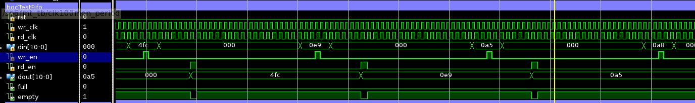
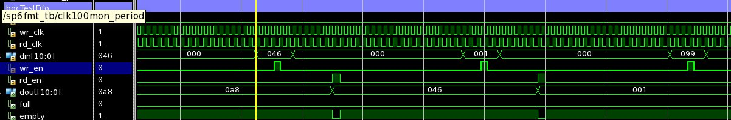
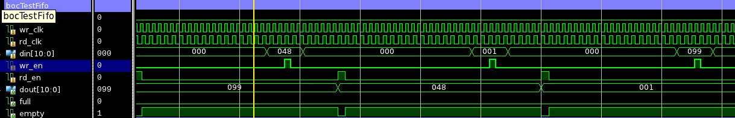

Slide 2
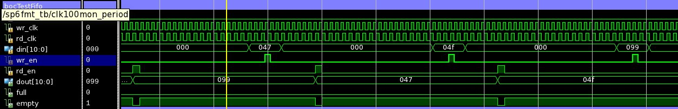
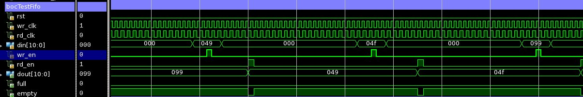
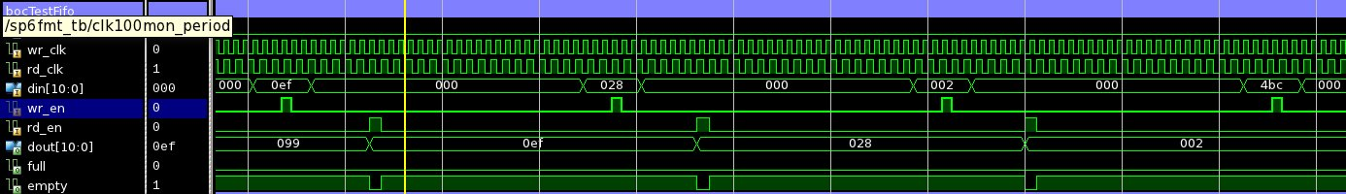

Slide 3
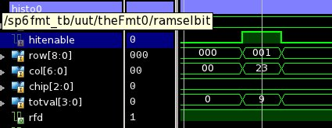
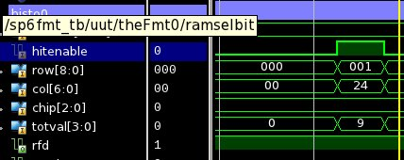
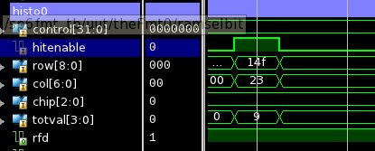

Slide 4
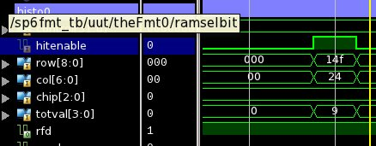
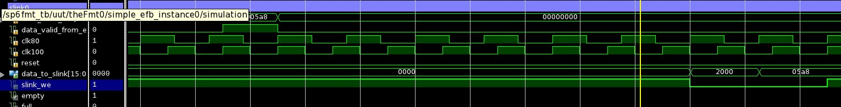
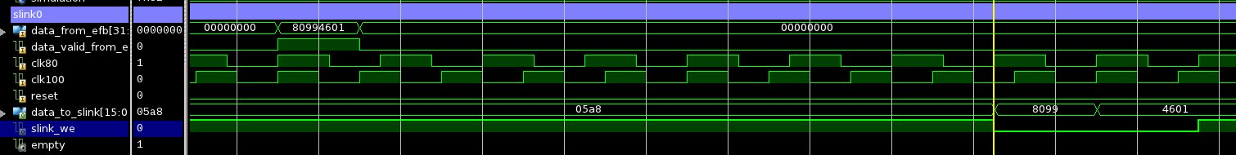

Slide 5
histTest.c
#include <stdio.h>
#include "platform.h"
#include "xparameters.h"
#include "xbasic_types.h"
#include "xaxidma.h"
#include "../../../sw/rodSlave.hxx"
void print(char *str);
static XAxiDma axiDma;
#define TEST_PIXELS 10
static unsigned long pixRowOne[TEST_PIXELS];
static unsigned long pixColOne[TEST_PIXELS] = {1,2,3,4,5,76,77,78,79,80};
static unsigned long pixRowAll[TEST_PIXELS];
static unsigned long pixColAll[TEST_PIXELS] = {1,2,3,4,5,6,7,8,9,10}; //need to add 20,40,60
static unsigned long pixChipAlll[TEST_PIXELS] = {0,0,1,1,2,3,4,5,6,7};
static unsigned long pixTot[TEST_PIXELS] = {1,2,3,4,5,11,12,13,14,15};
static unsigned long pixAddr[TEST_PIXELS];
static unsigned long pixIters[TEST_PIXELS];
static unsigned long bocData[] = {
0x4fc,
0x0e9,
0x0a5,
0x0a8,
0x046,
0x01,
0x099,
0x048,
0x01,
0x099,
0x047,
0x04f,
0x099,
0x049,
0x04f,
0x099,
0x0ef,
0x028,
0x02,
0x4bc
};
int main()
{
init_platform();
int rc;
int i,j;
int dmaSize;
volatile unsigned long *histo0CtlReg = (volatile unsigned long *)MB_HIST0_CTL_REG;
volatile unsigned long *histo0TestReg = (volatile unsigned long *)MB_HIST0_TEST_REG;
volatile unsigned long *histo1CtlReg = (volatile unsigned long *)MB_HIST1_CTL_REG;
volatile unsigned long *histo1TestReg = (volatile unsigned long *)MB_HIST1_TEST_REG;
volatile unsigned long *bocTestReg = (volatile unsigned long *)MB_BOC_TEST_REG;
// use tx address as info
volatile unsigned long *infoReg = (volatile unsigned long *)MB_TX_REG;
// init EPC
volatile unsigned long *epcIdReg = (volatile unsigned long *)MB_DESIGN_REG;
volatile unsigned long *epcCtlReg = (volatile unsigned long *)MB_CTL_REG;
volatile unsigned long *epcStatReg = (volatile unsigned long *)MB_STAT_REG;
// get simulation status
int simulation = (0 != (*epcStatReg & (1 << STAT_SIMULATION_BIT)));
//if (!simulation) print("Histotest starting\r\n");
// design ID test output to tx reg
*infoReg = *epcIdReg;
// reset and clear ctl
*epcCtlReg = 1 << CTL_RESET_BIT;
*epcCtlReg = 0;
*infoReg = *epcStatReg;
while (1){
// wait for histogrammer ready
while (0 == ((1 << STAT_HIST_RFD0_BIT) & *epcStatReg)); // wait for rfd
// set hist 0 to BOC mode and send 1 word via boc test input
*epcCtlReg |= (1 << CTL_BOC_ENABLE_BIT) | (1 << CTL_BOC_TEST_BIT) | (1 << CTL_HIST_MUX0_BIT);
// write data
for (i=0;i<sizeof(bocData)/sizeof(long);i++)
*bocTestReg = bocData[i];
for (j=0;j<10;j++); // delay
*epcCtlReg = (1 << CTL_HIST_MODE0_BIT); // readout
while (0 == ((1 << STAT_HIST_ROC0_BIT) & *epcStatReg)); // wait for roc
*epcCtlReg = 0;
}
cleanup_platform();
return 0;
}

