Slide 1
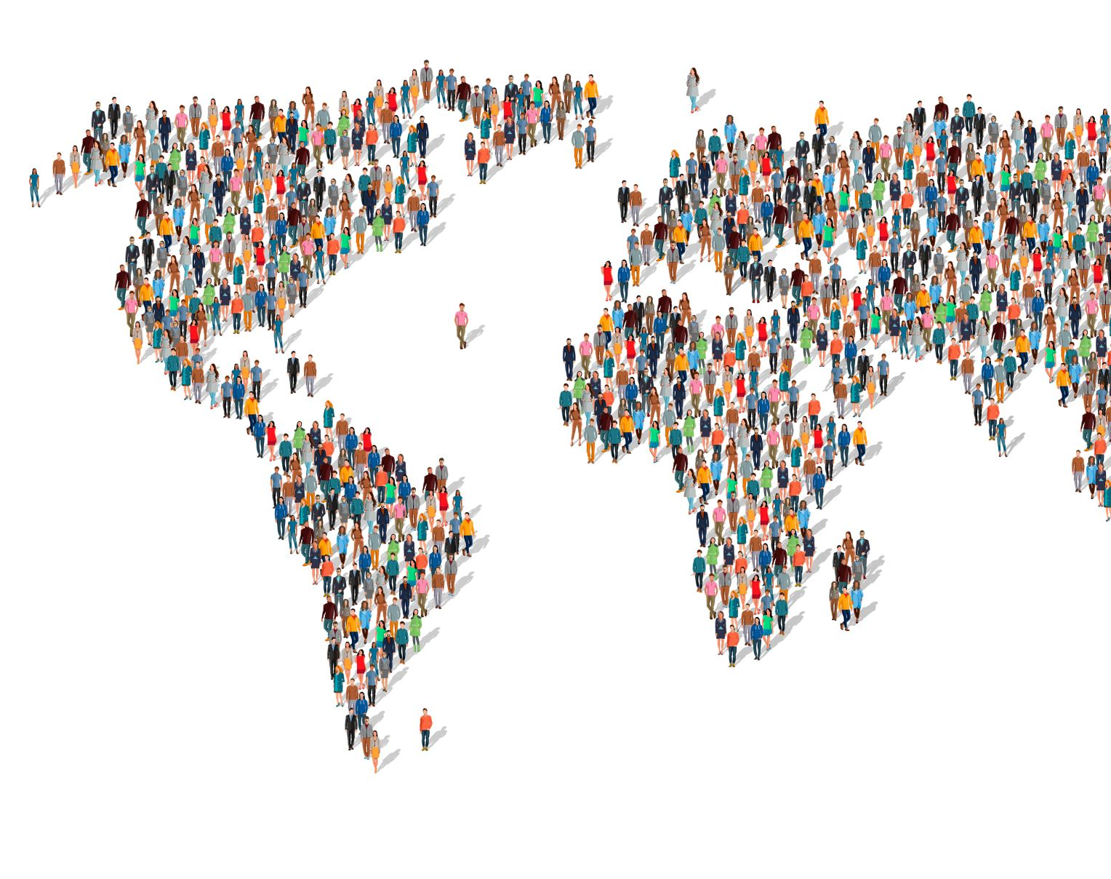
Population of each country from 2000 to 2023
16021962 - Ethan (UI / Programming)
23055860 – Jame (Data Handler / Programming)
23064166 – Sanjay

Slide 2
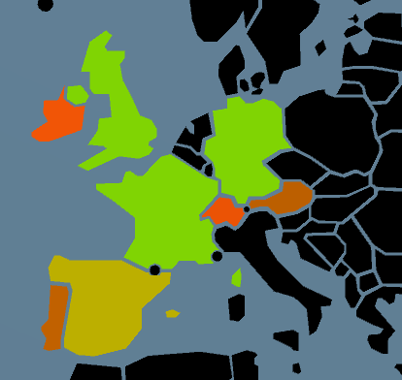
Concept
To create a visual tool to allow the user to see the population of each country.
Data includes (Population of year, Ranking and Growth)
Population data used has been tracked since the start of 2000
Use a map of Earth to easily show off data

Slide 3
Impact on Audience
This tool would be suitable for a variety of jobs, such as:
Educator
Data analysts
Governments
Its impact would be that it can visualize key statistics, towards people wanting to learn surface level knowledge of each country rather quickly and helping them come to conclusions on why certain things are happening. Etc. stagnation/growth

Slide 4
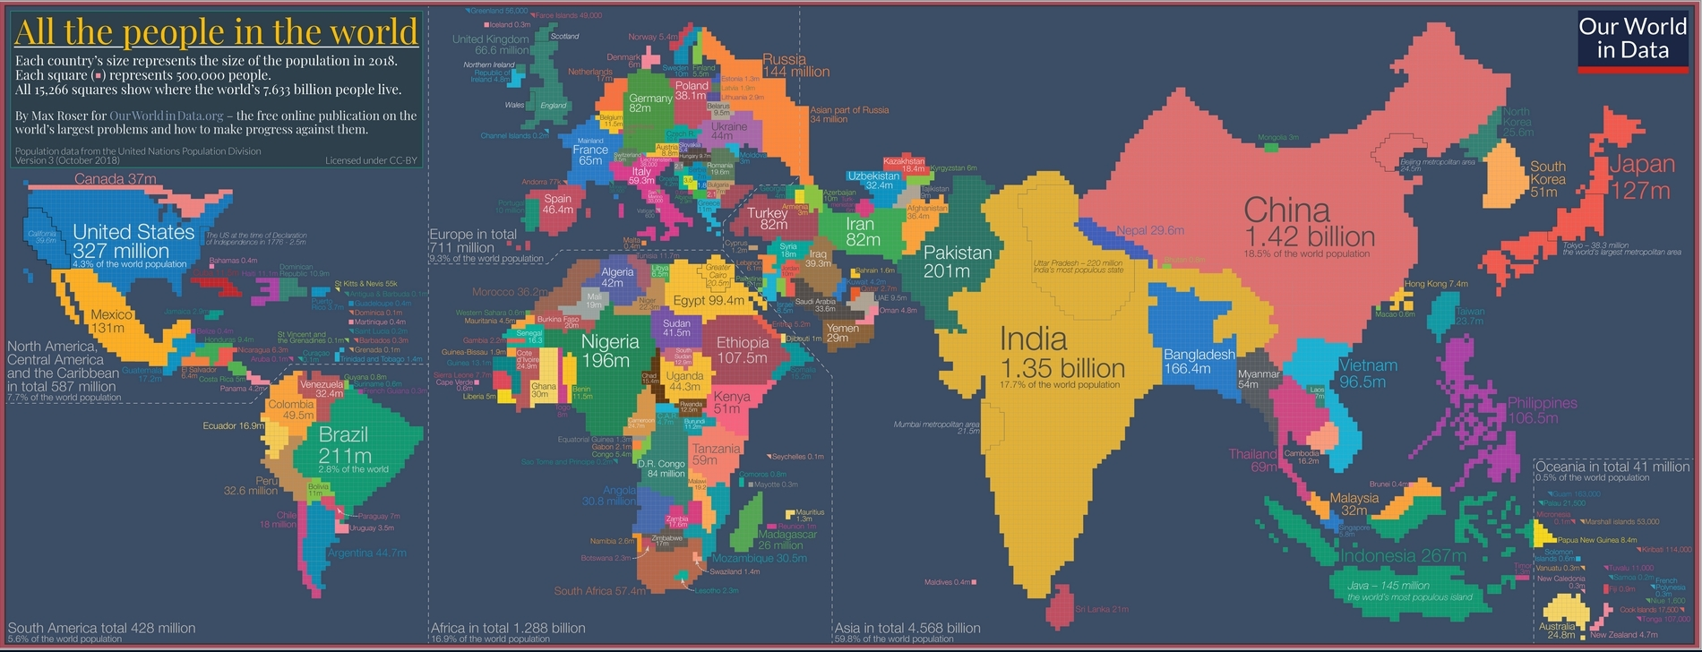
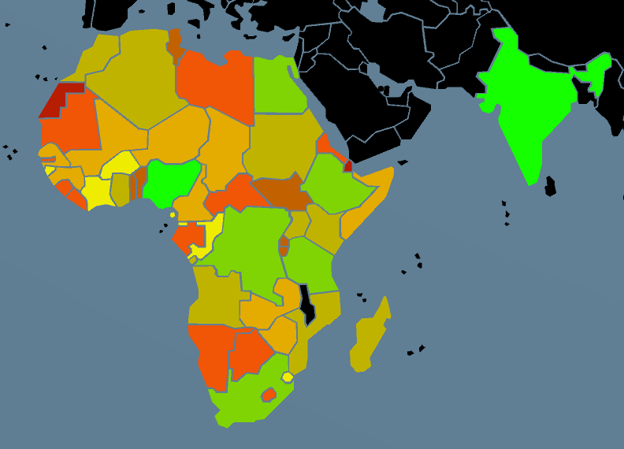
The Data (population) and current visuals
Population data is interesting !
How many people are WHERE?!
Useful for coming to broad generalizations.
Current visualizations not “accurate” i.e similar examples change size of country based on population.

Slide 5
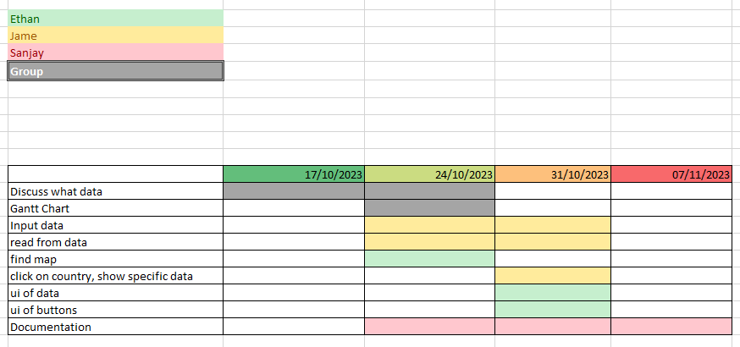
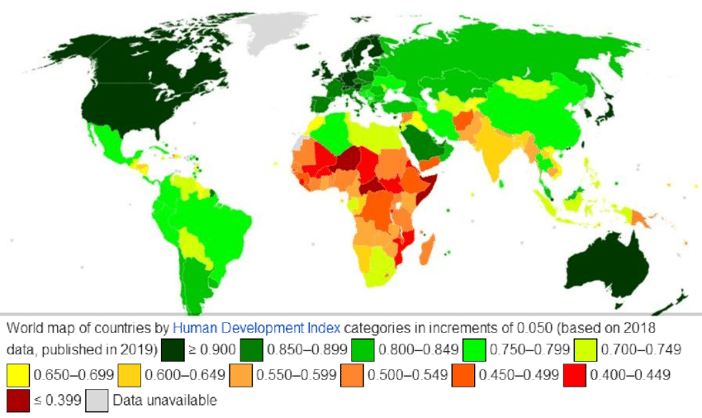
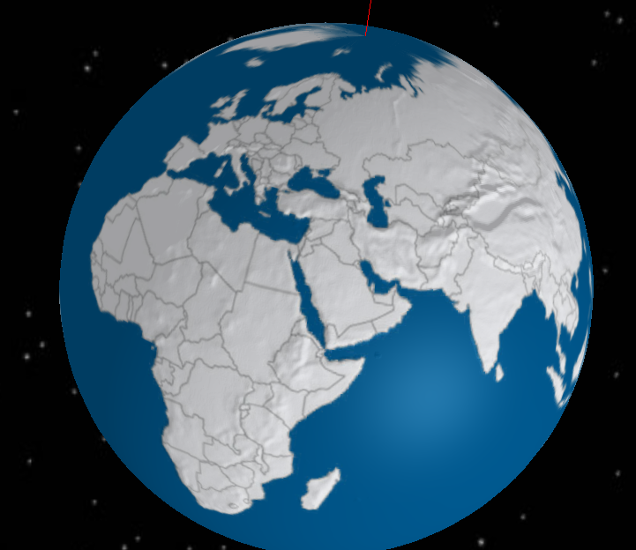
The Planning
Finding a Dataset
2d or 3d?
Are there assets of the world
Best way to show the data?
How can a user, use this tool
No AUDIO

Slide 6
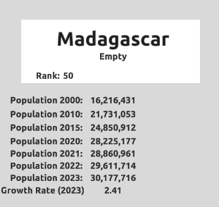
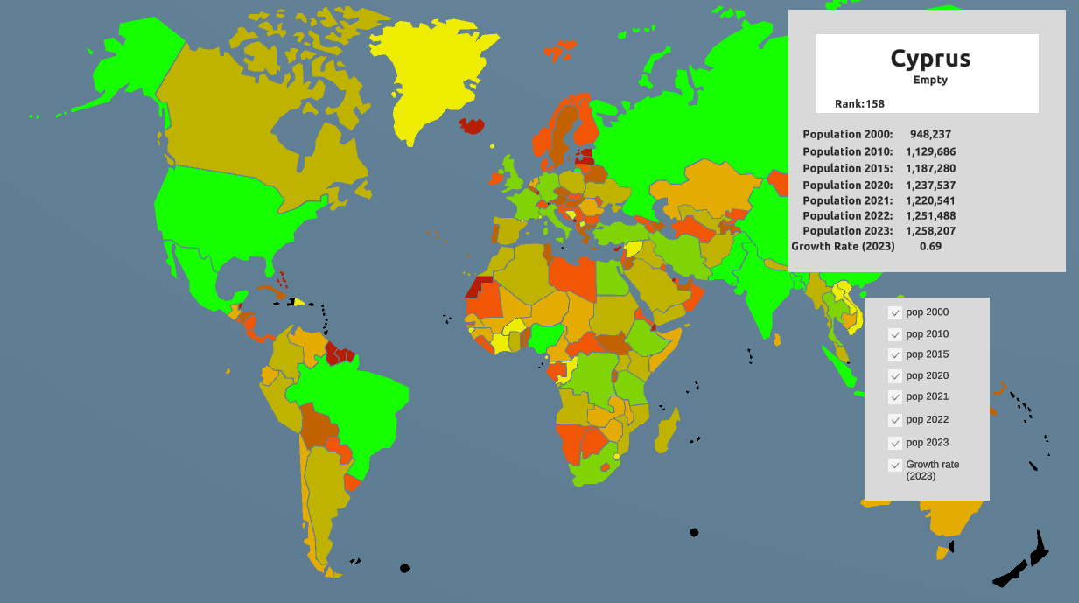
Issues
The Development
Created a way to load .CSV
Implemented a 2d world asset with clickable countries
Hooked up Data with each country
Showcased data
Using someone else's assets, couldn’t toggle whole map
Some data is missing, not applicable to certain islands

Slide 7
Future Goals
A way to visually compare data
More detailed datasets (overlap?! i.e Age Demographics)
Different ways of ranking the data , currently most population in 2023
Adding data together to create continental data

Slide 8
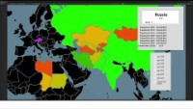
Prototype
https://www.youtube.com/watch?v=dMhy5-c515M

