Slide 1
BULLYING
WHAT IS BULLYING ?

Slide 2
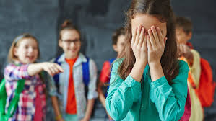

BULLYING
ANTI BULLYING SLOGAN

Slide 3
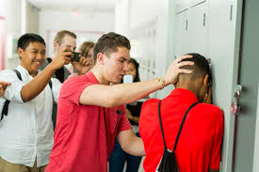
BULLYING: TYPES OF BULLYING
PHYSICAL BULLYING
CYBER BULLYING
VERBAL BULLYING

Slide 4
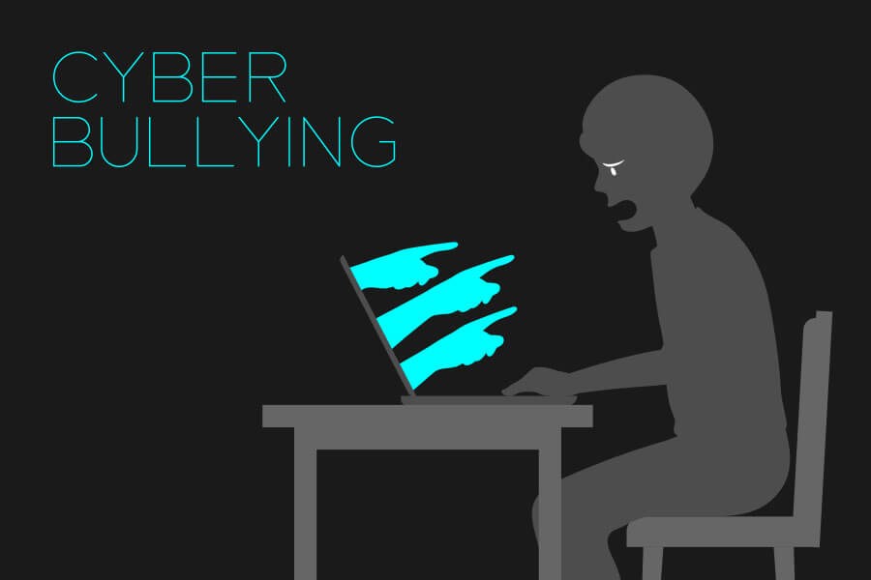

BULLYING: CYBER BULLYING
EXAMPLE OF SOCIAL NETWORK

Slide 5
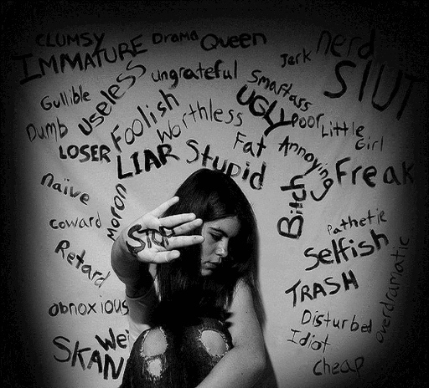

BULLYING: VERBAL BULLYING
EXAMPLES OF INSULTS

Slide 6
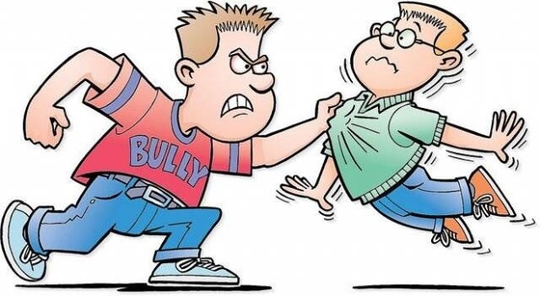
BULLYING: PHYSICAL BULLYING

Slide 7

BULLYING: SOLUTIONS
YOU NEED TO SPEEK UP!
THE BEST SOLUTION AGAINST BULLYING

