Slide 1
ApplicationMaster
NodeManager
allocate
<allocated containers>
nodeHeartbeat
ApplicationMasterService
ResourceTrackerService
STATE_UPDATE
allocate
STATE_UPDATE
RMAttemptImpl
ResourceScheduler
RMNodeImpl
RELEASE
AQUIRED
NODE_UPDATE
RMContainerImpl
ResourceManager

Slide 2
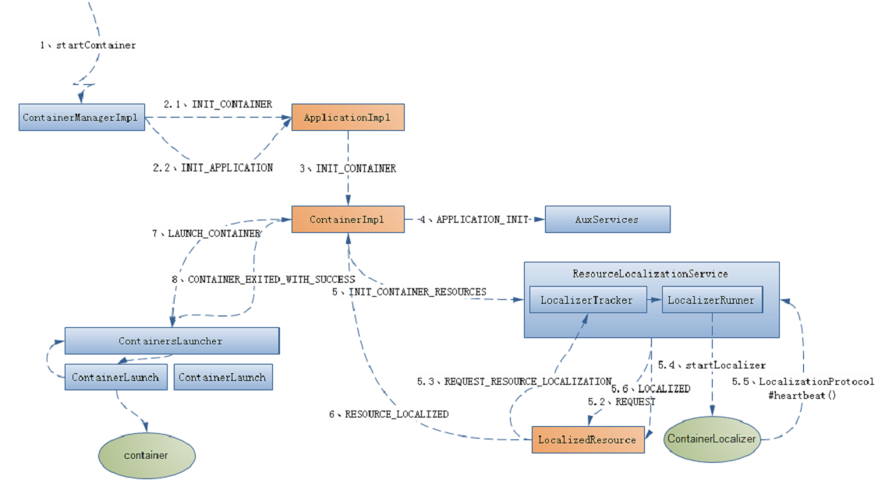
2.5 INIT_APPLICATION_RESOURCES
2.6 APPLICATION_INITED

Slide 3
ResourceLocalizationService
ContainerExecutor
LocalizerTracker
(for container0)
ContainerExecutor
ContainerExecutor
ContainerExecutor#
startLocalizer()
LocalizerTracker
(for container1)
Launch
ContainerExecutor
LocalizerTracker
(for container2)
ContainerExecutor
ContainerLocalizer
LocalizationProtocol#
heartbeat

Slide 4
JobClient
《interface》
ClientProtocol
ClientProtocolProvider
YARNRunner
ResourceMgrDeleget
YarnClient
ApplicationClientProtocol
YarnClientImpl

