Slide 1
RoamWise
A travel search prototype
with traceable sources
The Routevengers
Milestone 2 · MLOps infrastructure
Boston · Cambridge · Somerville
01 / RoamWise · AC215 MS2
Notes:
About 45 seconds. This deck records the earlier retrieval-only release. Use docs/PRESENTATION_NOTES.md for the current LLM/RAG demonstration. Introduce the Greater Boston place-search prototype and its historical sources. State the team members and their actual contributions.

Slide 2
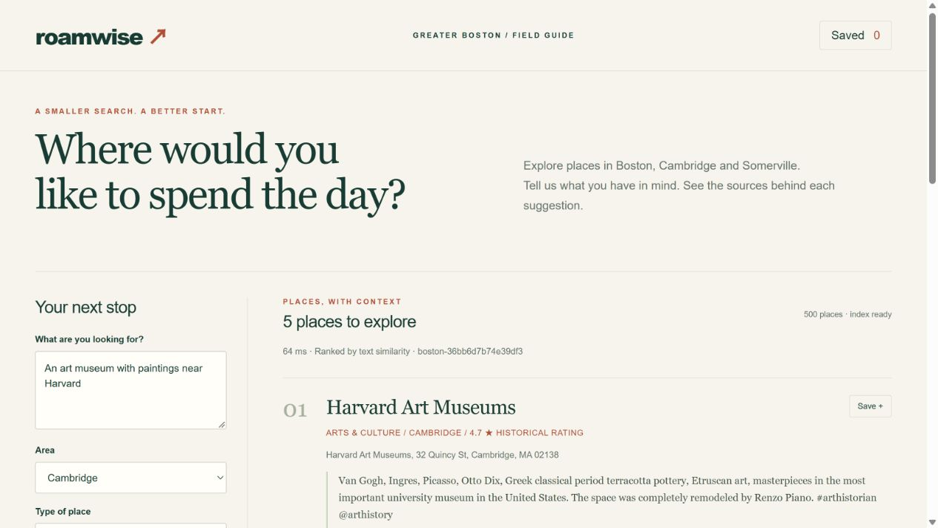
Product scope
Input
A preference in plain English,
an area and an optional type.
Output
Ranked places, source passages
and a saved shortlist.
Historical search, not live availability or route planning.
02 / RoamWise · AC215 MS2
Notes:
About 1 minute. The earlier app accepts English interests, a city and an optional category. Its API returns places and source passages. It does not generate an itinerary. Screenshot: evidence/app-overview.png. The current RAG app is documented separately.

Slide 3
Pilot dataset
500 places 3,000 reviews 3,976 chunks
City | Places
Boston | 383
Somerville | 25
Cambridge | 92
Four broad categories
Culture · Food
Lodging · Outdoors
125 places per category
Data ends in September 2021. The sample favors frequently reviewed places.
03 / RoamWise · AC215 MS2
Notes:
About 1 minute. The source is UCSD Google Local 2021 for Massachusetts: 92,520 metadata rows and 10,447,007 review rows. The pilot was rebuilt from those files. It keeps up to 125 places per category and six reviews per place. Selecting popular places introduces sampling bias. Sources: https://mcauleylab.ucsd.edu/public_datasets/gdrive/googlelocal/ ; evidence/dataset-manifest.json.

Slide 4
Container pipeline
01 Ingest
Download source files and verify SHA-256
02 Prepare
Filter places, deduplicate reviews and chunk text
03 Index
Encode text with MiniLM and write to Chroma
04 Serve
FastAPI returns places, citations and context
05 Evaluate
Run the fixed baseline/semantic comparison
docker compose up --build
04 / RoamWise · AC215 MS2
Notes:
About 90 seconds. Open compose.yaml and explain service_completed_successfully and service_healthy. Each Python service has a Dockerfile, pyproject.toml and uv.lock. Volumes retain data and model files. CPU computation and tests run in containers. Sources: compose.yaml; services/*/Dockerfile.

Slide 5
Reproducible by construction
Python container
Versioned inputs
FROM <pinned uv/Python image>
WORKDIR /app
COPY pyproject.toml uv.lock ./
RUN uv sync --frozen --no-dev
COPY roamwise ./roamwise
CMD ["uv", "run", ...]
Source file checksums
Selection and chunk settings
Model archive checksum
Dependency lockfiles
Dataset and index IDs
No host Python, GPU, cloud account or API key required.
05 / RoamWise · AC215 MS2
Notes:
About 1 minute. Docker fixes the runtime environment; uv.lock fixes Python dependencies. Data and model checksums serve different purposes. Validate caches before reuse. Changes to data or processing parameters require a rebuild. Sources: config/sources.json; services/index/Dockerfile; evidence/index-manifest.json.

Slide 6
A complete query → context example
Query
“art museum with paintings near Harvard”
1 Harvard Art Museums
Cambridge · cosine similarity 0.815
Source: review-Massachusetts.json.gz
Each passage includes a source line, chunk ID and citation.
384-dimensional MiniLM vectors · Chroma cosine search · place deduplication
06 / RoamWise · AC215 MS2
Notes:
About 1 minute. Show sample-input.json and sample-output.json. Harvard Art Museums ranks first in this saved example. Each passage has a source file and line. Similarity is not a probability. This earlier release returns context without a generative LLM. Sources: evidence/sample-input.json; evidence/sample-output.json; https://huggingface.co/sentence-transformers/all-MiniLM-L6-v2.

Slide 7
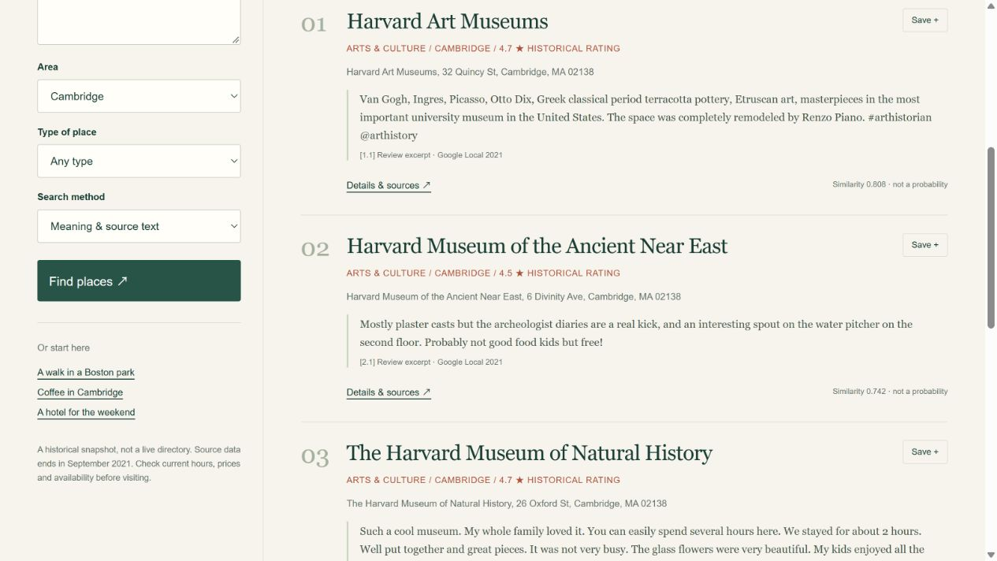
Working web app
Search
Compare
Inspect sources
Save places
07 / RoamWise · AC215 MS2
Notes:
About 90 seconds. For the earlier retrieval demo, search for museums, compare the baseline, inspect sources, save a place and export. For the current app, follow docs/PRESENTATION_NOTES.md. Screenshot: evidence/app-search.png; source: frontend/app.js.

Slide 8
Initial benchmark
Method | Category hits @5 | Median HTTP latency
Category + rating | 0.95 | 3.54 ms
MiniLM retrieval | 0.92 | 95.98 ms
20 fixed queries per method · zero duplicate places returned
This is a category proxy, not human Precision@5.
The query wording favors the keyword baseline.
08 / RoamWise · AC215 MS2
Notes:
About 90 seconds. This is not human recommendation accuracy. The 20 queries contain category words, and the expected categories are proxy labels. That wording favors the baseline. The benchmark does not establish whether semantic retrieval captures finer preferences. Sources: evaluation/queries.json; evidence/evaluation.json.

Slide 9
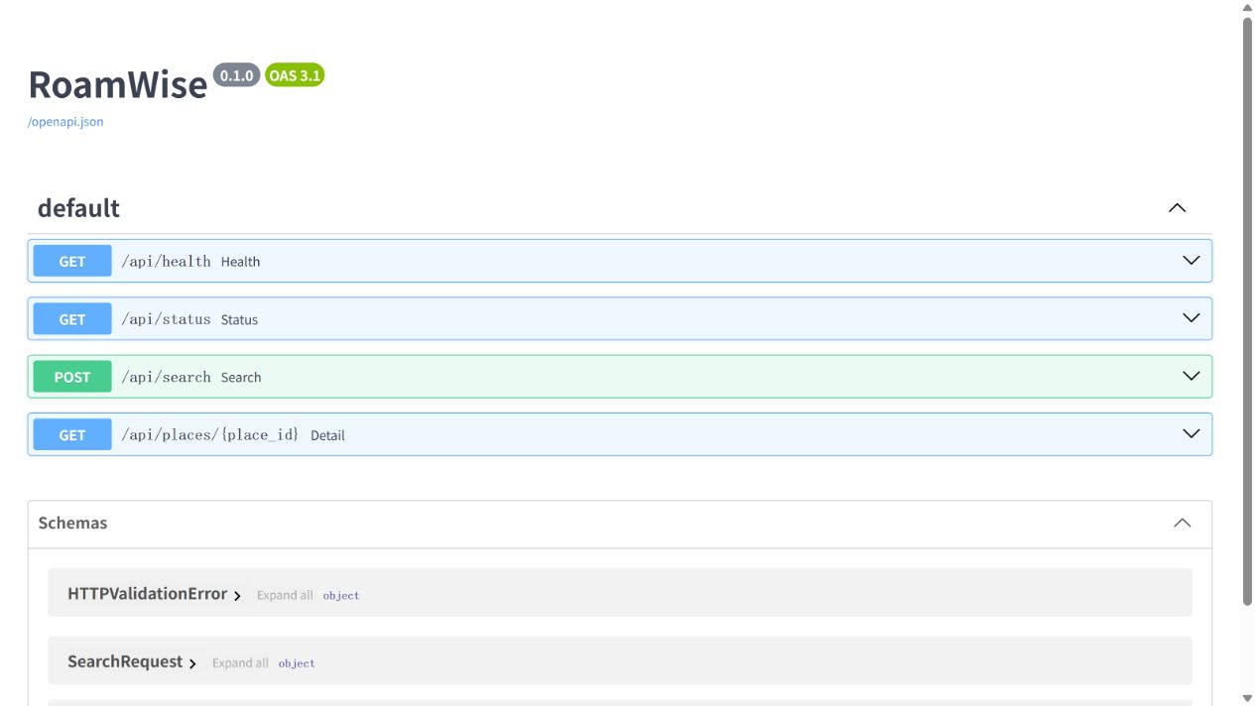
Verification and evidence
18 tests passed
Data rules and chunk boundaries
Source checksum failures
API validation and place lookup
Deduplication and source citations
Saved input/output JSON, manifests, logs and browser screenshots
09 / RoamWise · AC215 MS2
Notes:
About 1 minute. The earlier release passed 18 tests covering filters, missing values, chunks, contact removal, checksums, input rejection, deduplication and citations. These checks are not a complete end-to-end quality evaluation. The screenshot shows the running API. Sources: tests/; evidence/tests.txt; evidence/containers.txt; evidence/api-running.png. See docs/RAG_RESULTS.md for later verification.

Slide 10
Limits and next experiment
Current limits
MS3 experiment
Historical source data
Popularity-biased sampling
English encoder and proxy labels
No generated itinerary or routing
Collect independent relevance labels
Train a lightweight reranker
Track experiments and held-out results
Prepare monitored API deployment
Repository: EthanCHEN6/ac215-roamwise · submission branch: milestone2
10 / RoamWise · AC215 MS2
Notes:
About 1 minute. Historical data and popularity-biased sampling limit the results. This slide describes the earlier release and its proposed next steps. Current RAG generation and cloud hosting are covered in separate notes; routing is still estimated. Confirm the hybrid assessment path with the TF. Submit the full milestone2 commit hash on Canvas; do not claim submission before it occurs. Sources: docs/DATA.md; docs/DEMO.md; https://harvard-iacs.github.io/2026-AC215/milestone2/.

