Slide 1
RoamWise
A travel search prototype
with traceable sources
The Routevengers
Milestone 2 · MLOps infrastructure
Boston · Cambridge · Somerville
01 / RoamWise · AC215 MS2
Notes:
约45秒。介绍 RoamWise 是 Boston 周边地点检索原型；这一阶段展示可复现的检索流程。资料来自真实历史地点和评论。团队需按实际情况介绍成员及分工。

Slide 2
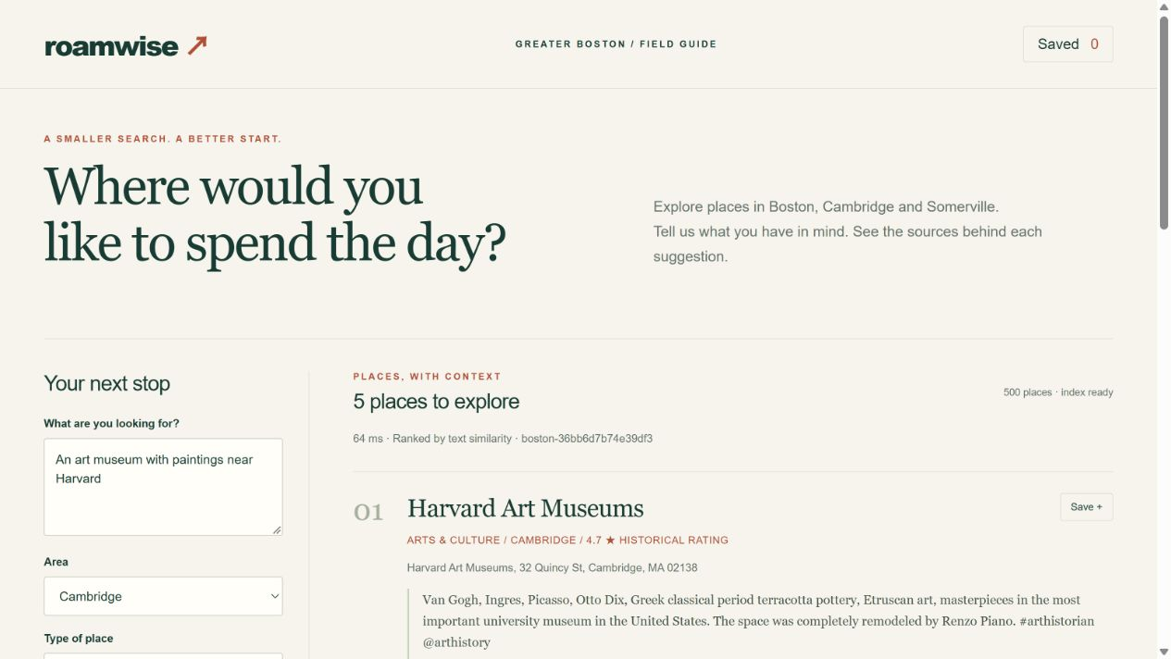
Product scope
Input
A preference in plain English,
an area and an optional type.
Output
Ranked places, source passages
and a saved shortlist.
Historical search, not live availability or route planning.
02 / RoamWise · AC215 MS2
Notes:
约1分钟。输入英文兴趣、城市和可选类别；输出地点和来源片段。检索来自真实 API，没有生成完整行程。Screenshot: evidence/app-overview.png.

Slide 3
Pilot dataset
500 places 3,000 reviews 3,976 chunks
City | Places
Boston | 383
Somerville | 25
Cambridge | 92
Four broad categories
Culture · Food
Lodging · Outdoors
125 places per category
Data ends in September 2021. The sample favors frequently reviewed places.
03 / RoamWise · AC215 MS2
Notes:
约1分钟。原始文件为 UCSD Google Local 2021 Massachusetts，92,520 地点行、10,447,007 评论行。这里展示的是本次从原始文件重新处理的子集，不是之前 Excel 报告的筛选结果。每类125个地点，每个最多6条评论；按评论数取热门地点，有抽样偏差。Sources: https://mcauleylab.ucsd.edu/public_datasets/gdrive/googlelocal/ ; evidence/dataset-manifest.json.

Slide 4
Container pipeline
01 Ingest
Download source files and verify SHA-256
02 Prepare
Filter places, deduplicate reviews and chunk text
03 Index
Encode text with MiniLM and write to Chroma
04 Serve
FastAPI returns places, citations and context
05 Evaluate
Run the fixed baseline/semantic comparison
docker compose up --build
04 / RoamWise · AC215 MS2
Notes:
约1.5分钟。打开 compose.yaml 解释 service_completed_successfully 和 service_healthy；每个 Python 步骤独立 Dockerfile、pyproject 和 uv.lock。数据与模型用 volume 保存。CPU运算和测试也在容器中。Source: compose.yaml; services/*/Dockerfile.

Slide 5
Reproducible by construction
Python container
Versioned inputs
FROM <pinned uv/Python image>
WORKDIR /app
COPY pyproject.toml uv.lock ./
RUN uv sync --frozen --no-dev
COPY roamwise ./roamwise
CMD ["uv", "run", ...]
Source file checksums
Selection and chunk settings
Model archive checksum
Dependency lockfiles
Dataset and index IDs
No host Python, GPU, cloud account or API key required.
05 / RoamWise · AC215 MS2
Notes:
约1分钟。Docker 固定运行环境，uv.lock 固定 Python 依赖。数据校验与模型校验是不同层次。缓存使用前验证，数据/参数变更触发重建。Dockerfile 的每行要能解释。Sources: config/sources.json; services/index/Dockerfile; evidence/index-manifest.json.

Slide 6
A complete query → context example
Query
“art museum with paintings near Harvard”
1 Harvard Art Museums
Cambridge · cosine similarity 0.815
Source: review-Massachusetts.json.gz
Each passage includes a source line, chunk ID and citation.
384-dimensional MiniLM vectors · Chroma cosine search · place deduplication
06 / RoamWise · AC215 MS2
Notes:
约1分钟。展示保存的 sample-input.json 和 sample-output.json。Harvard Art Museums 排名第一；点击来源可以查看评论文件行号。相似度不是概率。输出context可供未来生成器使用，本版本没有生成式LLM。Sources: evidence/sample-input.json; evidence/sample-output.json; https://huggingface.co/sentence-transformers/all-MiniLM-L6-v2.

Slide 7
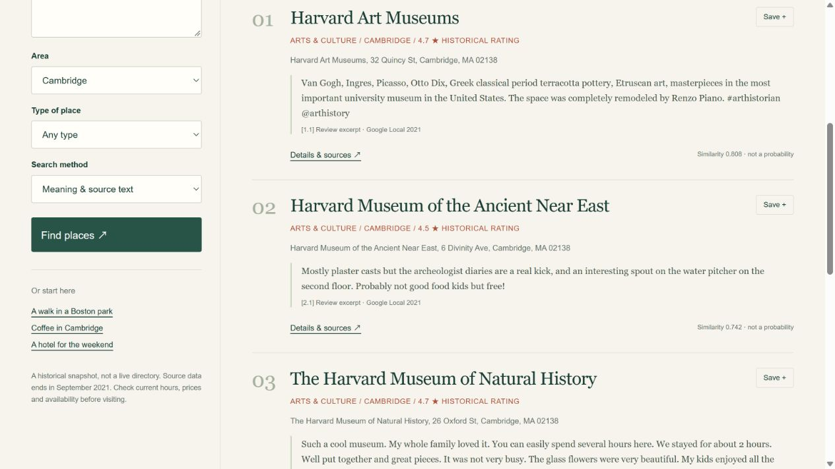
Working web app
Search
Compare
Inspect sources
Save places
07 / RoamWise · AC215 MS2
Notes:
约1.5分钟现场演示。查询博物馆，切换baseline，查看来源，保存一个地点并导出。若演示电脑不在本机，先git clone并运行。Screenshot: evidence/app-search.png; source: frontend/app.js.

Slide 8
Initial benchmark
Method | Category hits @5 | Median HTTP latency
Category + rating | 0.95 | 3.54 ms
MiniLM retrieval | 0.92 | 95.98 ms
20 fixed queries per method · zero duplicate places returned
This is a category proxy, not human Precision@5.
The query wording favors the keyword baseline.
08 / RoamWise · AC215 MS2
Notes:
约1.5分钟。不能把这个表叫人工推荐准确率。20条查询含类别词；类别标签来自预定义问题类别，是自动代理指标。baseline略高是合理结果。语义检索可能理解细节，但当前测量没有充分考察这个优势。不要事后修改查询来提高分数。Source: evaluation/queries.json; evidence/evaluation.json.

Slide 9
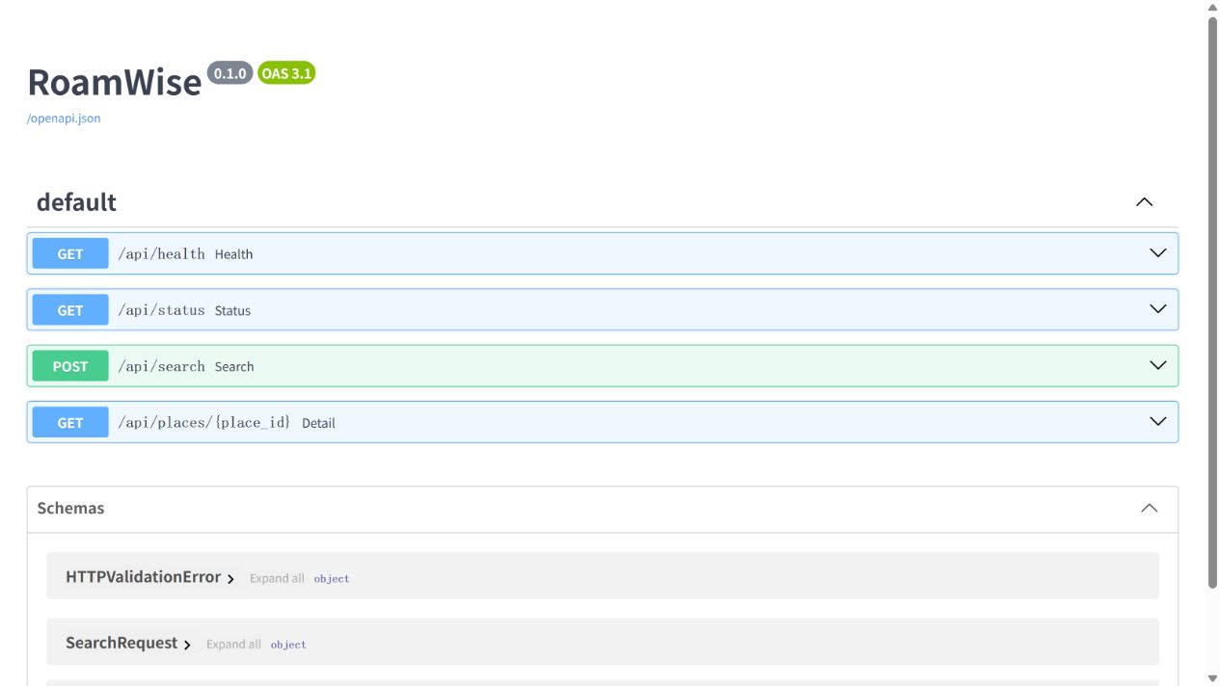
Verification and evidence
18 tests passed
Data rules and chunk boundaries
Source checksum failures
API validation and place lookup
Deduplication and source citations
Saved input/output JSON, manifests, logs and browser screenshots
09 / RoamWise · AC215 MS2
Notes:
约1分钟。18项测试涵盖城市/闭店/坐标过滤、缺失值、分块重叠、联系方式清理、文件校验、输入拒绝、地点去重和引用。还有浏览器手动验证，不能说这些等价于全部端到端自动测试。截图为实际运行中的 API。Sources: tests/; evidence/tests.txt; evidence/containers.txt; evidence/api-running.png.

Slide 10
Limits and next experiment
Current limits
MS3 experiment
Historical source data
Popularity-biased sampling
English encoder and proxy labels
No generated itinerary or routing
Collect independent relevance labels
Train a lightweight reranker
Track experiments and held-out results
Prepare monitored API deployment
Repository: EthanCHEN6/ac215-roamwise · submission branch: milestone2
10 / RoamWise · AC215 MS2
Notes:
约1分钟。过去资料和偏样本限制结果的适用性；没有路线优化和实时营业状态。MS3先建立独立人工标签，再训练小reranker，记录实验并做API部署计划。与TF确认hybrid项目的评估路线。课程要求分支milestone2以及Canvas完整hash，不在演示时声称已提交Canvas。Sources: docs/DATA.md; docs/DEMO.md; https://harvard-iacs.github.io/2026-AC215/milestone2/.

