Slide 1
编译（H） COMP130014h.01
复旦大学计算机科学技术学院
2024-2025第二学期（2025年春季）
主讲：王晓阳（江湾叉二A3021）
xywangcs@fudan.edu.cn
https://daslab.fudan.edu.cn
助教：林琰钧、王雨晨
课堂：周一6-8节（下午13:30开始，HGX303 教室）
实验：周四1-2节（上午8:00开始，H逸夫楼305）

Slide 2


Slide 3

基本要求与目标
学生需要对汇编语言、数据结构有一定的了解，懂得一些面向对象语言概念与编程，并对C++语言编程很熟悉。
通过这门课程的学习，理解编译过程的基本原理与方法，掌握常用的技巧，并能在实践中综合运用。
本课程编程要求：强度很大
基本每周都有编程作业
循序渐进，要求每位同学都独立做出一个编译器

Slide 4
为什么要学习Compiler
深入理解计算机如何执行高级语言程序
指导编程、纠错、优化高级语言程序
编写新的Compiler、优化已有Compiler
解决“卡脖子”问题
计算机系统“寒武纪”需要compiler人才
许多应用需要新的DSL（Domain Specific Language）
越来越多的企业需要compiler人才

Slide 5
课程的基本设计
使用C++语言编写编译器（g++）
另外需要 Lex/Yacc（Flex/Bison）
目标：Raspberry PiB （ARM架构）
被编译语言：一个简单的Java子集
FDMJ2025
参考
全国大学生计算机系统能力大赛—— 编译系统设计赛 https://compiler.educg.net

Slide 6
工具要求
Linux系统
g++，lex/yacc
ARM emulator
课程Git Repo
上机课时将有详细指导
注意版本要求
网上也有大量的材料

Slide 7
教科书与参考材料
教科书
（虎书C版）Modern Compiler Implementation in C, Andrew W. Appel. Cambridge University Press, ISBN: 0521607655
参考材料
教科书的中文翻译版，人民邮电出版社
虎书的Java版
编译原理第3版教材+习题精选与解析 第三版 陈意云、张昱，高等教育出版社（2本）
Raspberry Pi Assembly 介绍
全国大学生计算机系统能力大赛—— 编译系统设计赛相关材料

Slide 8
诚信要求
作业需独立完成（特殊许可除外）
不得抄写别人的作业，包括代码（包括其他同学的、网上的）
同学们之间的讨论是鼓励的，但不得相互帮助具体完成作业
考试时遵守考场纪律
违法者将根据学院、学校规定处理

Slide 9
背景调查小问卷
进入微信群查看

Slide 10
考核和评价方式
学期成绩 = 作业成绩*60%（包括评教参与3%）+ 4次quizzes*20% + Final PJ成绩20%
最后成绩的确定程序:
考虑学期成绩，95%为A+（每5分降一级）
另外：学校鼓励学生进行与课程相关的科创活动，分数往上浮一级，如B+（85%）上浮到A-
我们将组织这类课程科创

Slide 11
Lex
Parse
Semantic Actions
Semantic Analysis
Frame layout
Translate
Canonicalize
Instruction Selection
Control Flow Analysis
Dataflow Analysis
Register Allocation
Code Emission
Compiler Phases
Source Code
Abstract Syntax
Intermediate Rep
Target Code

Slide 12
Course Schedule
见PDF 文件 on elearning

Slide 13
The Path of This Course
FDMJ 2025 Source (Fudan MiniJava 2025)
FDMJ AST (Abstract Syntax Tree)
Tiger IR+ (Intermediate Representation)
Assem+ ((Abstract) Assembly Instructions)
Raspberry Pi Assembly (Arm instruction set)

Slide 14
Warm-Up（HW1） FDMJ-SLP (Straight-line Program)
目标：
假设：已有 Abstract Syntax（SLP-AST）表示的程序（从FDMJ-SLP源程序转换为SLP-AST的程序代码已经发布）
对程序进行“转换”和“运行”
简版“Constant Propagation”
输出Return结果

Slide 15
FDMJ-SLP Grammar
Main Method (`MM`)
Defined with the keywords `public int main`
Statement List: Can be empty or consist of one or more statements.
Statement
Can be an assignment or a return statement
Expression:
Binary operations: addition, subtraction, multiplication, division.
A non-negative integer.
A unary minus operation.
An expression enclosed in parentheses.
A block of statements followed by an expression.
An identifier.
Identifier
A terminal that represents an identifier.
PROG → MM
MM → public int main ( ) { SL }
SL → empty
| STM SL
STM → ID = EXP ;
| return EXP ;
EXP → ( EXP OP EXP )
| NONNEGATIVEINT
| ( minus EXP )
| ( { SL } EXP )
| ID
<ID> ::= IDENTIFIER

Slide 16
FDMJ-SLP Program Examples
test3.fmj
public int main() {
x=1;
y=2;
z=(x+y);
return ({x=1; y=2;} (x*y));
}
test1.fmj
public int main() {
x = ((-1)+((-2)*3));
return x;
}
test2.fmj
test4.fmj
public int main() {
x = ((-(-1))*(-(-(-2))));
return x;
}
public int main() {
x=1;
y=2;
z=((x+y)*z);
z=({x=1; y=({z=(z*z);} 2);} (x*y));
return z;
}

Slide 17
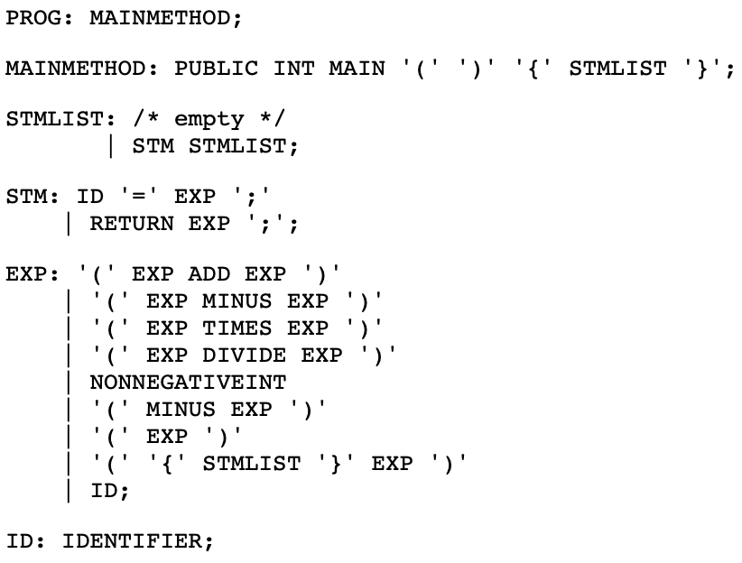
FDMJ-SLP Grammar

Slide 18
Abstract Syntax Tree (AST) Node Classes
AST: abstract class (all other classes are derived classes from AST)
Program: Represents the entire program
With a MainMethod node.
MainMethod: Represents the main method
with a list of statements (Stm).
Stm (Statements): abstract class (all statement classes are derived from it)
Assign: Assignment statement with left (IdExp) and right (Exp) expressions.
Return: Return statement with an expression (Exp).
Exp (Expressions): abstract class (all expression classes are derived from it)
BinaryOp: Binary operation with left and right (Exp) and operator (OpExp).
UnaryOp: Unary operation with an expression (Exp) and operator (OpExp).
Esc: Escape expression with a list of statements (Stm) and an expression (Exp).
IdExp: Identifier expression containing a string.
IntExp: Integer expression containing an integer value.
OpExp: Operator expression with an operator (string).
All nodes have a position member (pos: sline, scolumn, eline, ecolumn)

Slide 19
Start
test1.fmj
public int main() {
x = ((-1)+((-2)*3));
return x;
}
Prigram
MainMethod
Assign
Return
IdExp(x)
Binary (+)
IdExp(x)
Unary (-)
Binary (*)
IntExp(1)
Unary (-)
IntExp(3)
Parsing process
IntExp(2)

Slide 20
Example: test1.fmj
<?xml version="1.0" encoding="UTF-8"?>
<Program>
<MainMethod>
<StmList>
<Assign>
<IdExp id="x"/>
<BinaryOp>
<UnaryOp>
<OpExp op="-"/>
<IntExp val="1"/>
</UnaryOp>
<OpExp op="+"/>
<BinaryOp>
<UnaryOp>
<OpExp op="-"/>
<IntExp val="2"/>
</UnaryOp>
<OpExp op="*"/>
<IntExp val="3"/>
</BinaryOp>
</BinaryOp>
</Assign>
<Return>
<IdExp id="x"/>
</Return>
</StmList>
</MainMethod>
</Program>
public int main() {
x = ((-1)+((-2)*3));
return x;
}
Prigram
MainMethod
Print out
Assign
Return
IdExp(x)
Binary (+)
IdExp(x)
Unary (-)
Binary (*)
IntExp(1)
Unary (-)
IntExp(3)
IntExp(2)

Slide 21
Visitor Design Pattern
Allows for new operations to be defined on the elements of an object structure with the contents of those elements unchanged.
The Key is Double Dispatch.
Suitable for the various tree structures in a compiler.
Each tree node may be of a different type
Each tree may be operated on multiple times with different operations.

Slide 22
Code Example
class Visitor {
public:
virtual void visit(EA* element) = 0;
virtual void visit(EB* element) = 0;
virtual ~Visitor() = default;
};
class E {
public:
virtual void accept(Visitor* visitor) = 0;
virtual ~E() = default;
};
class CV : public Visitor {
public:
void visit(EA* element) override {
std::cout << "Visiting EA.\n";
element->oA();
}
void visit(EB* element) override {
std::cout << "Visiting EB.\n";
element->oB();
}
};
class EA : public E {
public:
void accept(Visitor* visitor)
override { visitor->visit(this); }
void oA() {
std::cout << "EA oA executed.\n";
}
};
class EB : public E {
public:
void accept(Visitor* visitor)
override { visitor->visit(this); }
void oB() {
std::cout << ”EB oB executed.\n";
}
};
int main() {
std::vector<E> es;
es.push_back(EA());
es.push_back(EB());
CV visitor;
for (auto& e : es) {e->accept(&visitor); }
return 0;
}

Slide 23
A Visitor Example on FDMJ-SLP AST
See HWRepo “MinusIntConverter” (under include and lib, also see main)
The goal is to reduce a unary “-” operation with an intExp to an intExp node, as follows:
Unary (-)
IntExp(-1)
IntExp(1)
*Need to do this recursively (bottom up)

Slide 24
MinusIntConvert Example
public int main() {
x = ((-(-1))*(-(-(-2)))); return x;
}
Prigram
Prigram
MainMethod
MainMethod
Assign
Return
Assign
Return
IdExp(x)
Binary (*)
IdExp(x)
IdExp(x)
Binary (*)
IdExp(x)
Unary (-)
Unary (-)
Unary (-)
Unary (-)
IntExp(1)
IntExp(-2)
Unary (-)
IntExp(1)
Note: In the visitor code (HWRepo), a variable is used to remember the (converted) subtree. Also: the new tree is actually a “clone” of the old tree (try not to change the original tree).
IntExp(2)

Slide 25
Homework One
See “Homework Assignment One” on Gitee and eLearning.
A simple “constant propagation”
One visitor: Similar to MinusIntConvert, but when see a binary operation on two constants, reduce the binary operation into a constant node (recursively from bottom up).
Also (another visitor): Run the program and print the returned value.
Need to remember the current values of the variables in a table
Use a member in the visitor to remember the table.
Prigram
Prigram
MainMethod
MainMethod
Assign
Return
Assign
Return
IdExp(x)
Binary (*)
IdExp(x)
IdExp(x)
intExp(-2)
IdExp(x)
IntExp(1)
IntExp(-2)
Print 2

