Slide 1
编译（H） COMP130014h.01 Week 10
复旦大学计算机科学技术学院
2024-2025第二学期（2025年春季）
主讲：王晓阳（江湾叉二A3021）
xywangcs@fudan.edu.cn
https://daslab.fudan.edu.cn
助教：林琰钧、王雨晨
课堂：周一6-8节（下午13:30开始，HGX303 教室）
实验：周四1-2节（上午8:00开始，H逸夫楼305）

Slide 2
本周内容: Liveness & SSA
Review: Instruction Selection (for Quad)
Liveness analysis
Static Single-Assignment
注意：
HW6 周四（4月24日）晚due
HW7 周四（5月8日）晚due
注意：4月27日（周日）上课（调课，补5月5日课）

Slide 3
Overview
Intermediate Representation:
Only low-level machine-level instructions, but with nested expressions
IR
Canonicalization
Instruction Selection
Quad
Quadruple Representation:
Simple machine-level instructions
Block formation
SSA form
Control/Data Flow Analysis
Optimization
今天的主要内容

Slide 4
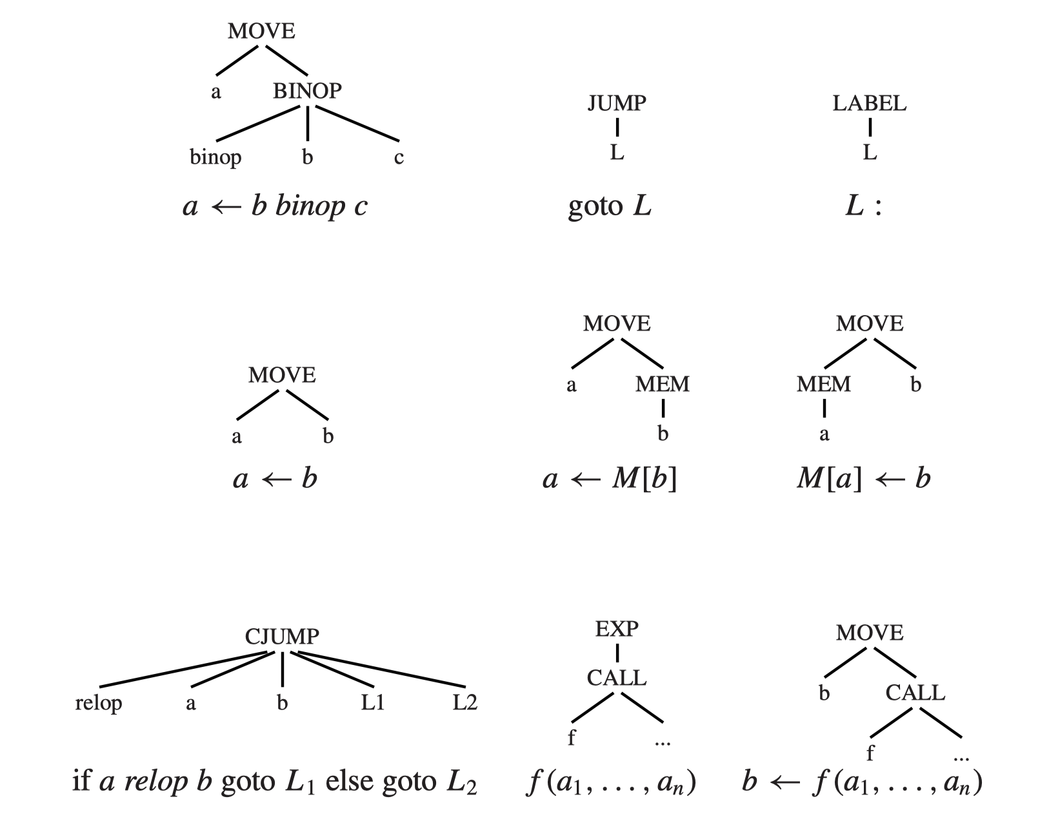
Quadruple Representation (TILES for “Instruction Selection”)

Slide 5
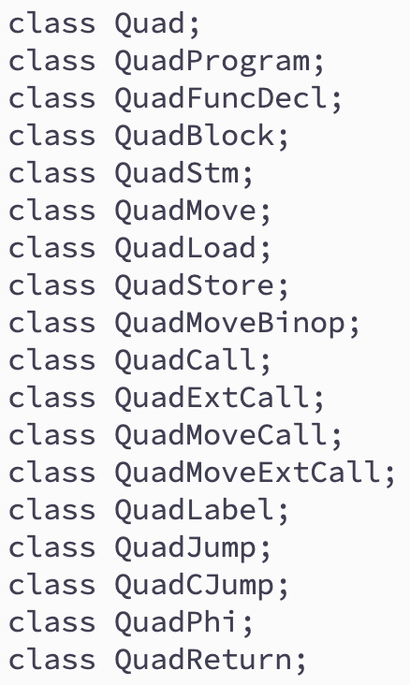









Quadruple Classes
1. a, b, c are temp, const, or name
2. L is a label
3. f is a method_name [ temp ] , or external method name

Slide 6
Instruction Selection (for Quad)
To select instructions for an IR tree
We do it on the Tree+ IR after Canon
How to do it:
Each instruction corresponds to a set of tree patterns (each is called a tile)
We want to cover an IR-tree with a set of tiles
Different machine instruction sets will have different “tiles”
The output will be a QuadProgram
Very close to an assembly language
But remember which temps are defined and used, and where the next instruction may be (for Control Flow Graph, and Liveness Analysis)

Slide 7
Block Formation
A block is a straight-line program (no jumps)
The first instruction must be a label
The last instruction must be:
Jump/CJump
Return
Simplified depiction

Slide 8
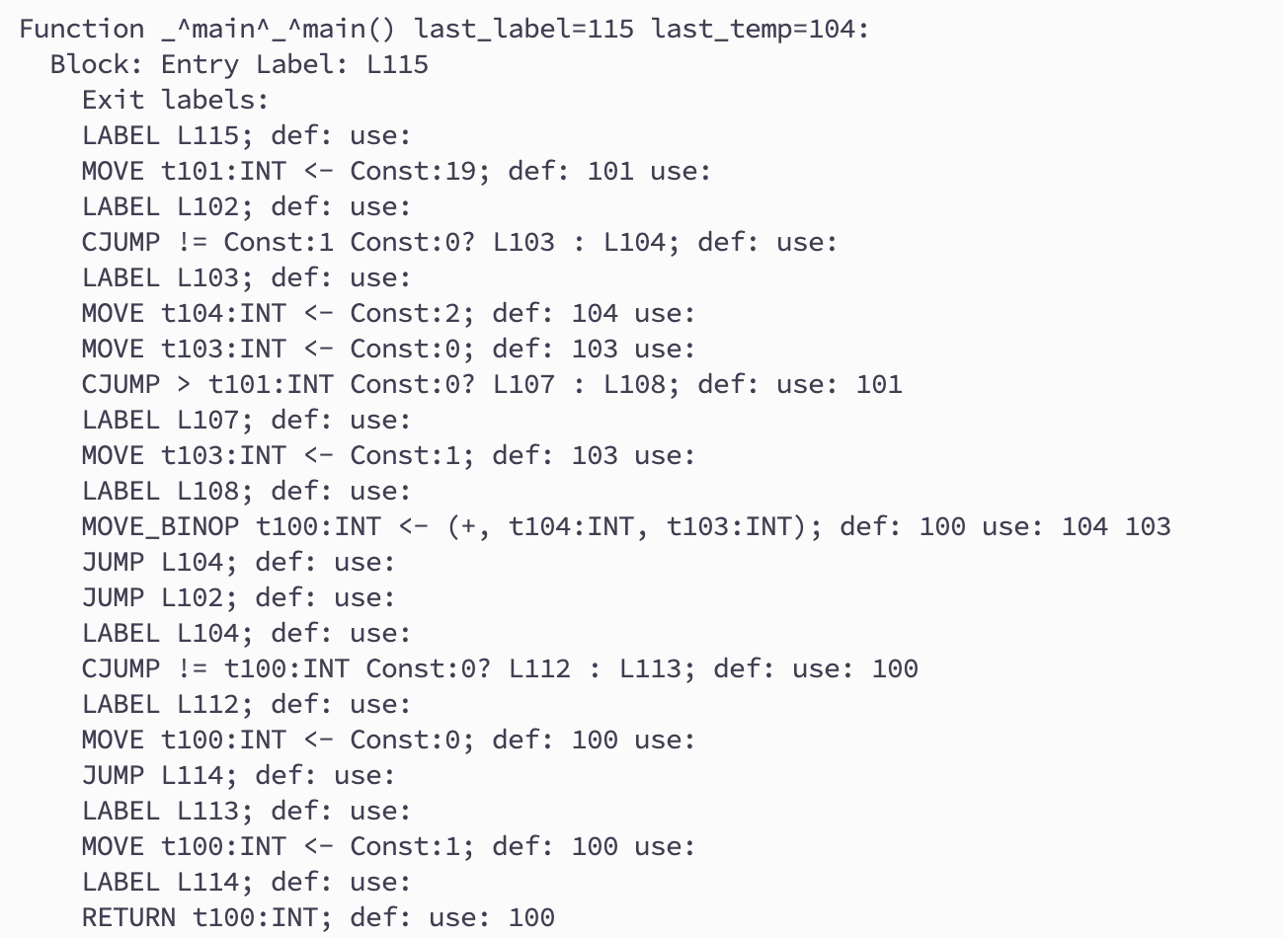
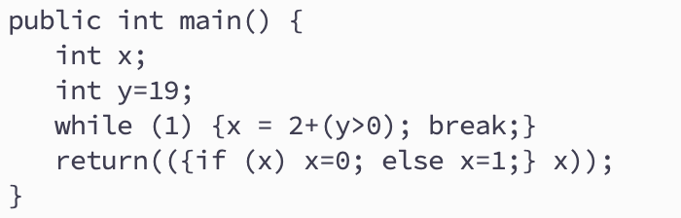
Example 3
1
2
1
3
2
4
5
3
6
4
7
5
8
6
7
9
10
8
9
10

Slide 9
Control Flow vs Data Flow
Control Flow
What’s the next instruction
Useful in analyzing data flow
Data Flow (or data dependency)
Where was the value defined when a value is used?
Useful in analyzing/optimizing the code
For example: Constant propagation

Slide 10
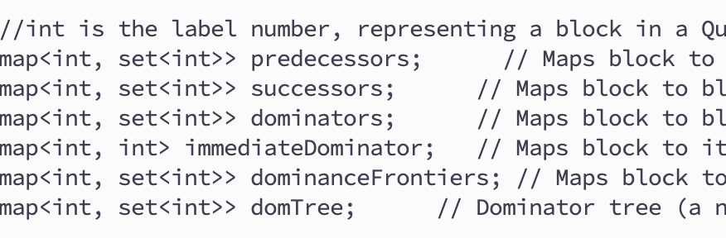
Control Flow: Block Level
Repo: HW7/{include,lib}/flowinfo.hh
Note: each block is represented by (the number in) the entry label
NOT the label object!

Slide 11
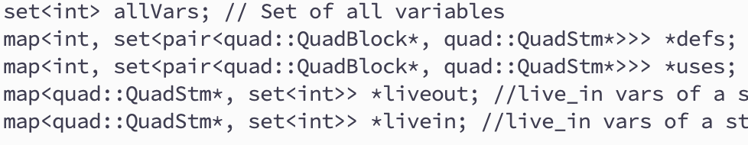
Data Flow: Statement Level
Note: each variable is represented by (the number in) the Temp
NOT the temp object!

Slide 12
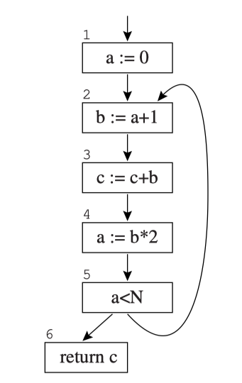
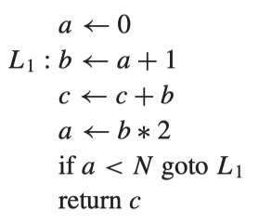
Liveness Analysis – Control-Flow Graph

Slide 13
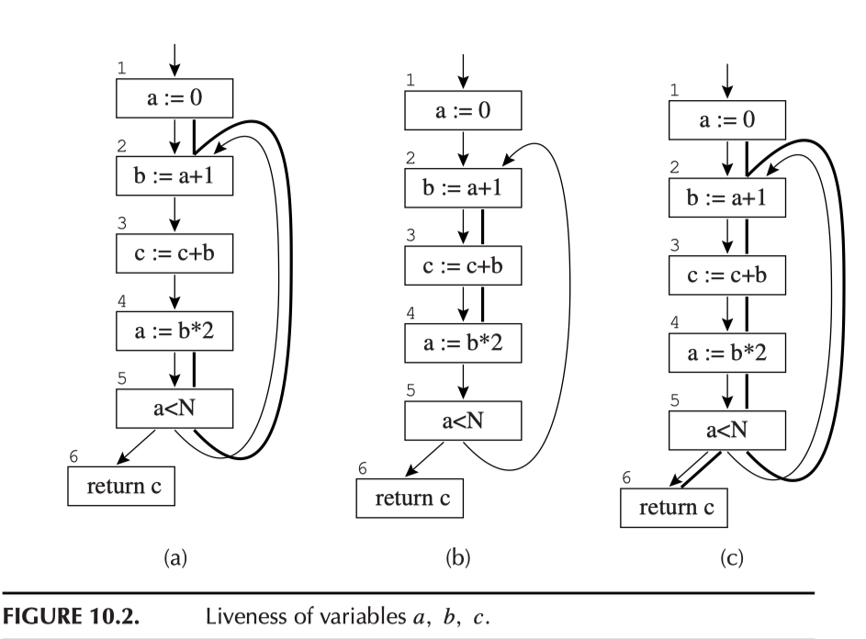
Liveness Analysis – Control-Flow Graph
Each node may
Define some vars
and/or
Use some vars
This node
define: b use: a

Slide 14
Liveness Analysis
Liveness. A variable is live on an edge if there is a directed path from that edge to a use of the variable that does not go through any def. A variable is live-in at a node if it is live on any of the in-edges of that node; it is live-out at a node if it is live on any of the out-edges of the node.

Slide 15
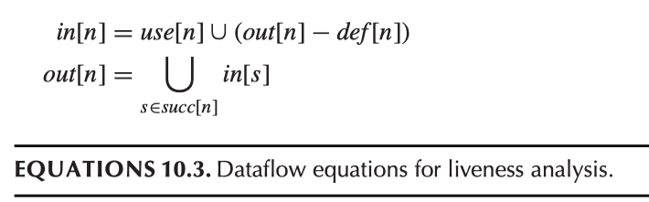
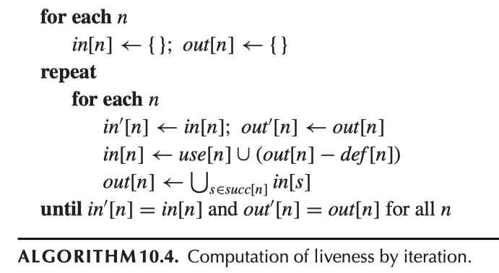
Dataflow Equation

Slide 16
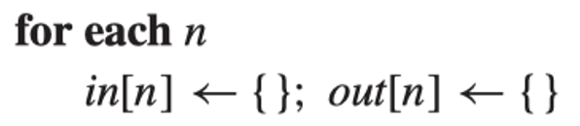
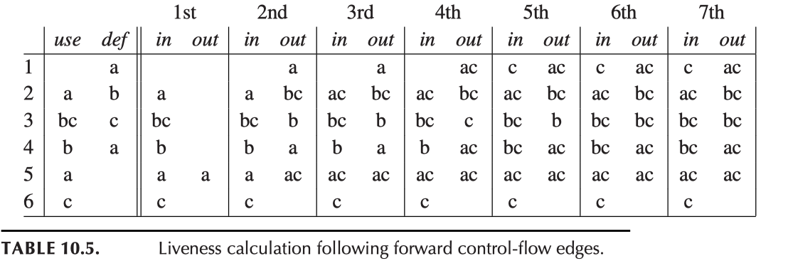
Example (using loop 1…6)
Initialization:

Slide 17
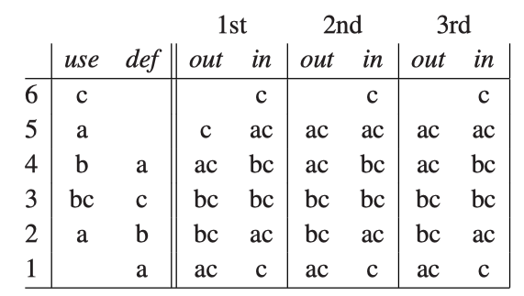
Example (using loop 6…1)

Slide 18
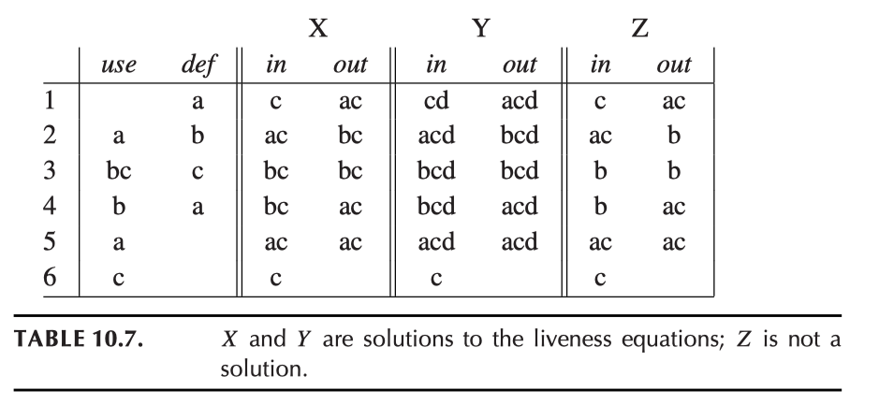
Theory
The algorithm always converges
And finds the least fixed point
The least fixed point is the solution we want
There are other fixed points!
The time complexity of the algorithm is O(n⁴) (in practice, much faster)
There are other ways to optimize the algorithm
Block-at-a-time, variable-at-a-time etc.
The information is useful in many optimization tasks

Slide 19
Control Flow: Dominance Relation
Dominance relation: A node d dominates a node n if every path from the start node to n goes through d.
Example:
Node 1 dominates all nodes.
Node 2 dominates nodes 2, 3 and 4
Node 3 doesn’t dominate any other nodes
Node 4 either
Note: a node dominates itself

Slide 20
The Dominance Frontier

Slide 21
Another Example

Slide 22
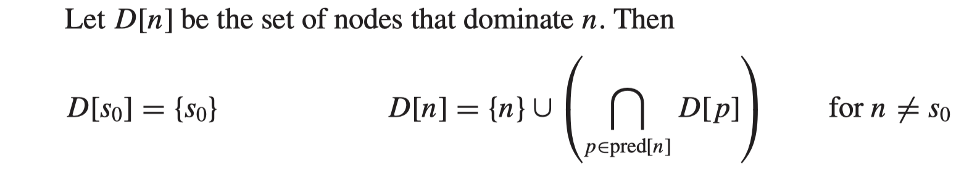
Algorithms: Dominators
Iteratively recomputing D[n]
Initially: all D[n]=all blocks (nodes)
(except for D[s0]={s0}, which is the entry node/block)

Slide 23
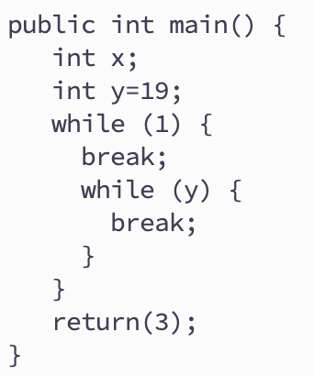
Unreachable Blocks
Some programs may have unreachable blocks
y=19
if (1)
jump
if (y)
Return 3
jump
We can easily (and need) remove unreachable blocks

Slide 24
Exam the Code in Repo
quadflow

Slide 25
Final Remarks
HW6 本周四 due

