Slide 1
编译（H） COMP130014h.01 Week 11
复旦大学计算机科学技术学院
2024-2025第二学期（2025年春季）
主讲：王晓阳（江湾叉二A3021）
xywangcs@fudan.edu.cn
https://daslab.fudan.edu.cn
助教：林琰钧、王雨晨
课堂：周一6-8节（下午13:30开始，HGX303 教室）
实验：周四1-2节（上午8:00开始，H逸夫楼305）

Slide 2
本周内容: Liveness & SSA
Review: Liveness analysis
SSA algorithms
注意：
HW7 周四（5月8日）晚due

Slide 3
Review： Control Flow vs Data Flow
Control Flow
What’s the next instruction
Useful in analyzing data flow
Data Flow (or data dependency)
Where was the value defined when a value is used?
Useful in analyzing/optimizing the code
For example: Constant propagation

Slide 4
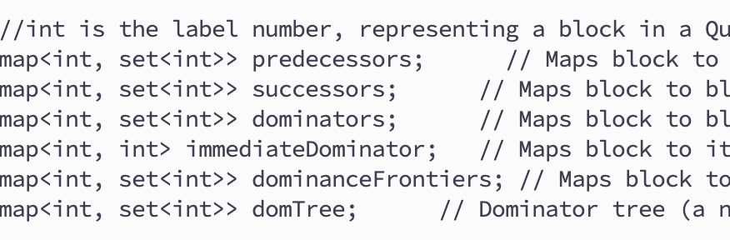
Control Flow: Block Level
Repo: HW7/{include,lib}/flowinfo.{hh,cc}
Note: each block is represented by (the number in) the entry label
NOT the label object!

Slide 5
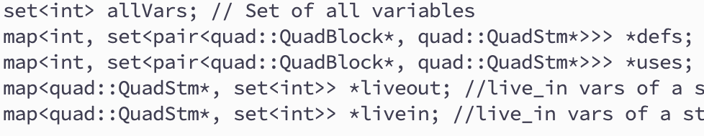
Review: Data Flow: Statement Level
Note: each variable is represented by (the number in) the Temp
NOT the temp object!

Slide 6
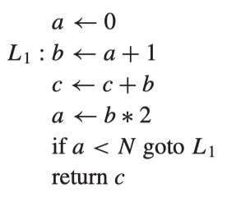
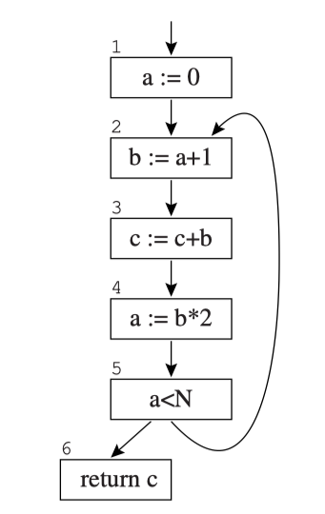
Liveness Analysis
Liveness. A variable is live on an edge if there is a directed path from that edge to a use of the variable that does not go through any def. A variable is live-in at a node if it is live on any of the in-edges of that node; it is live-out at a node if it is live on any of the out-edges of the node.
Assumption: all variables are defined before the entrance.

Slide 7
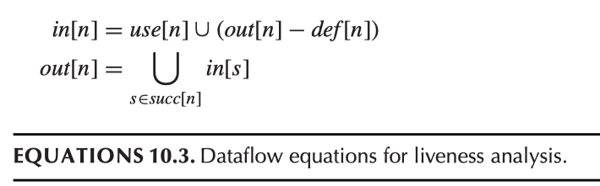
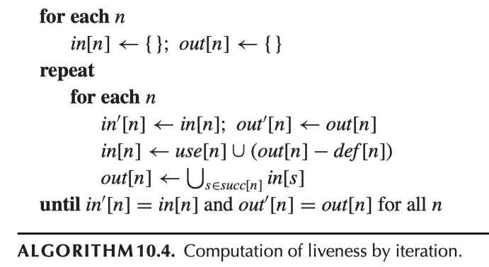
Dataflow Equation

Slide 8
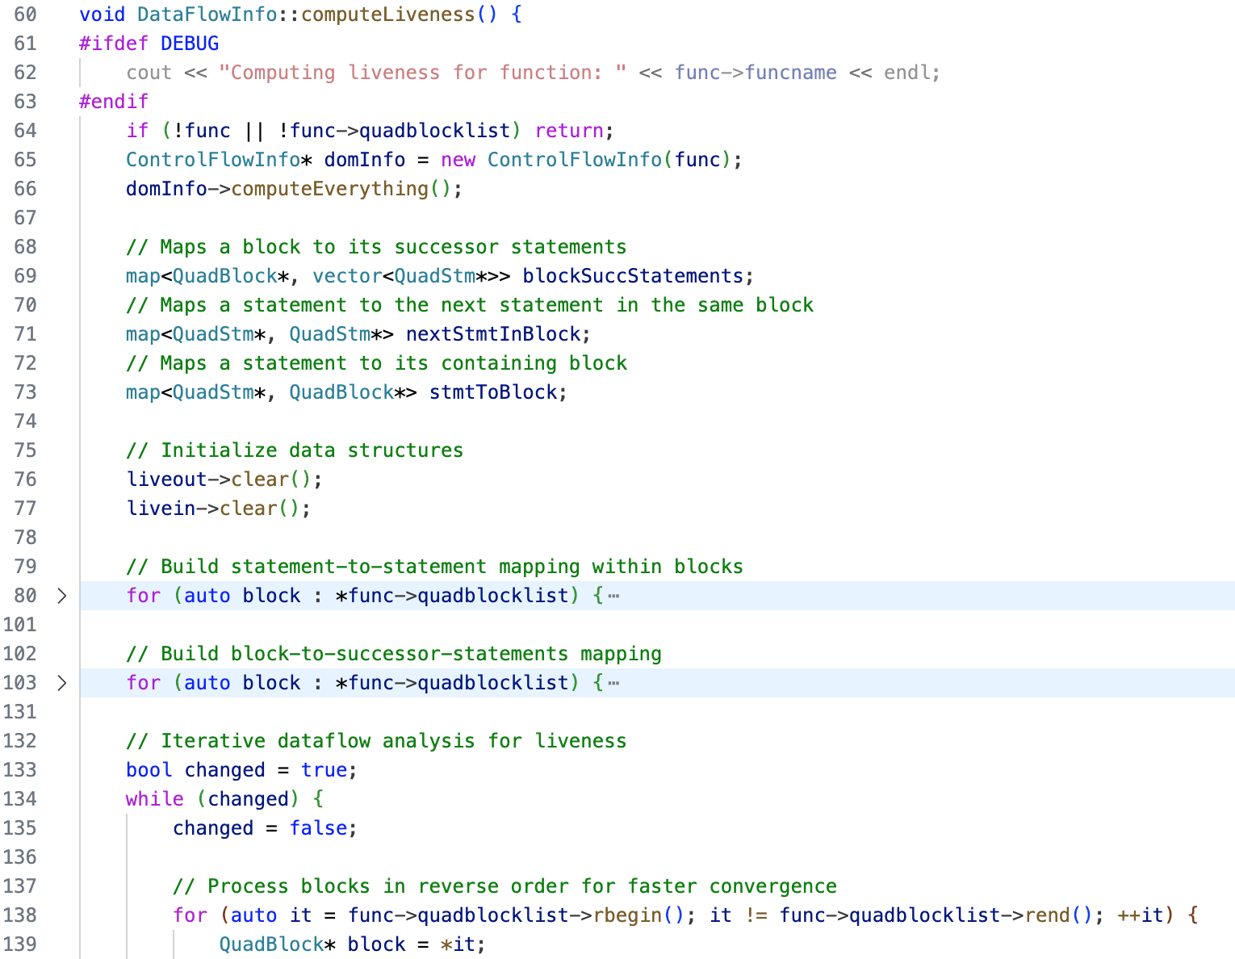
Code: dataflowinfo.cc
Build basic info
Iterate

Slide 9
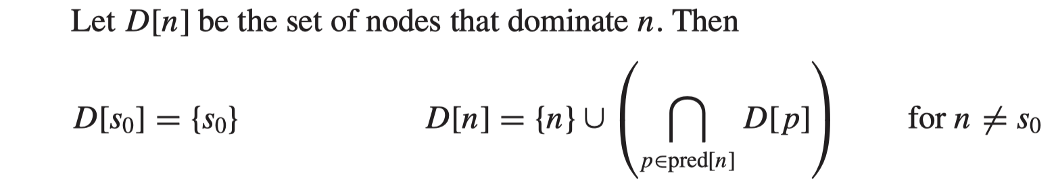
Example & Algorithm Block Level CFG: Dominance Relation
Initially: all D[n]=all blocks (nodes)

Slide 10
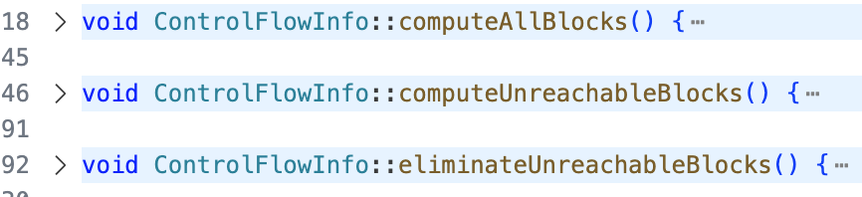
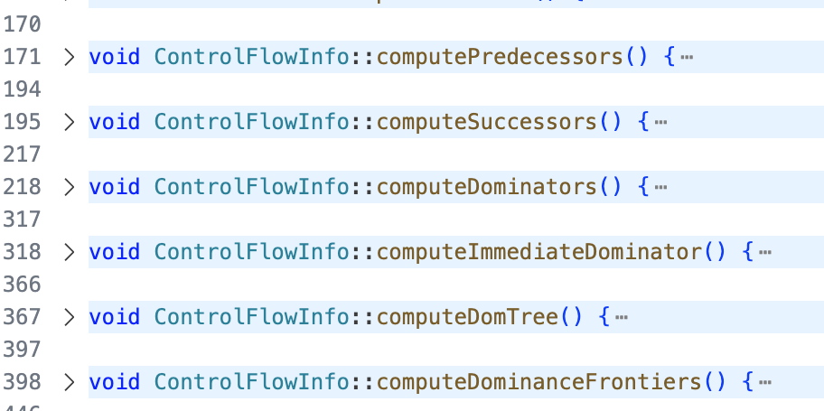
Code: controlflowinfo.cc
Prepare
Main Step
Derived Information

Slide 11
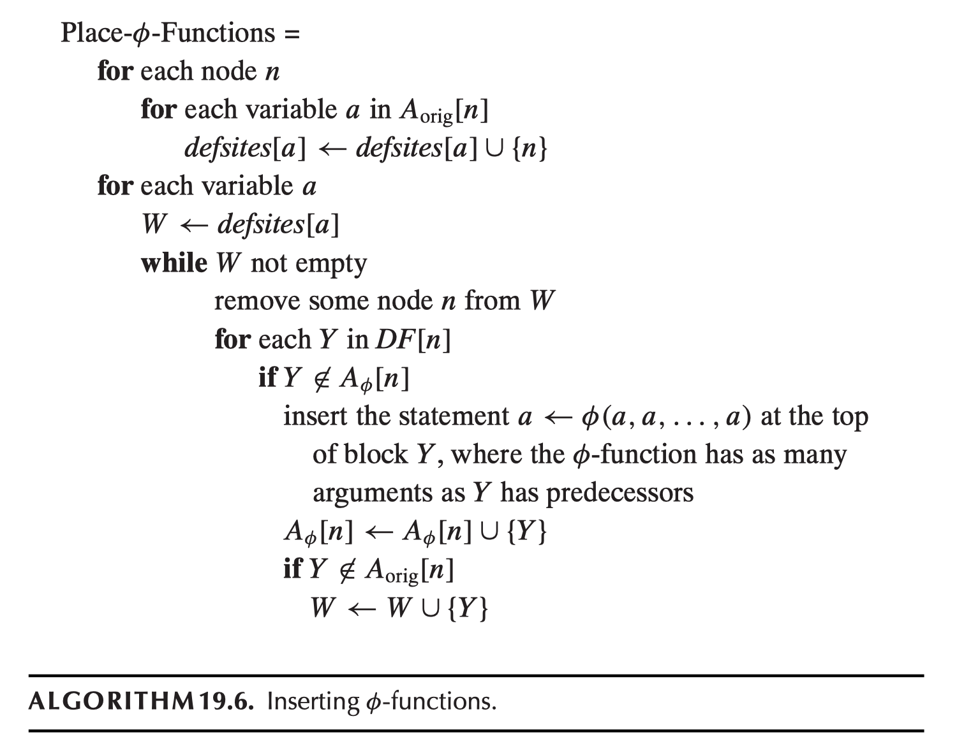
SSA Algorithms: Placing Phi
A _{orig}[n]: the variables deﬁned in node n.
Compute: A_{φ}[n], the set of variables to have φ-functions at node n.
DF: Dominance Frontier
In Quad: after the block label stmt
A new def introduced

Slide 12
SSA Algorithms: Placing Phi
Add a condition:
Only if a is in the live-out set of the entry label stmt

Slide 13
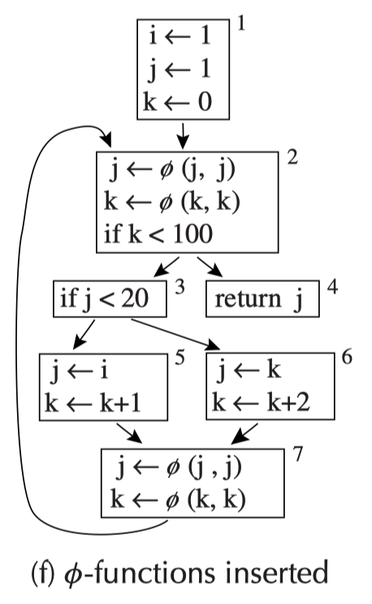
Placing Phi: Example

Slide 14
Placing Phi: Example 2
y ← 0
z ← 0
y ← 0
z ← 0
1
1
DF(1) = {}
DF(2) = {2}
DF(3) = {2}
DF(4) = {}
y ← 1
z ← y+1
2
put z
2
y ← 1
z ← y+1
put z
3
3
Return
4
Return
4
Need of phi for ?
Need phi for ?

Slide 15
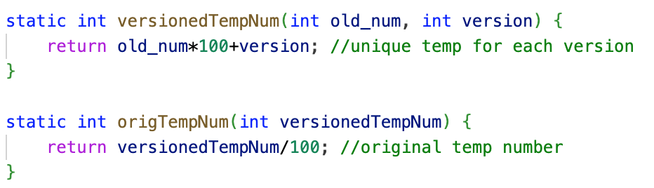
SSA Algorithms: Rename Vars
In quadssa.hh, two helper functions:
We use a simple method to generate temps with versions with the assumption that the number of versions is small (<=100)

Slide 16
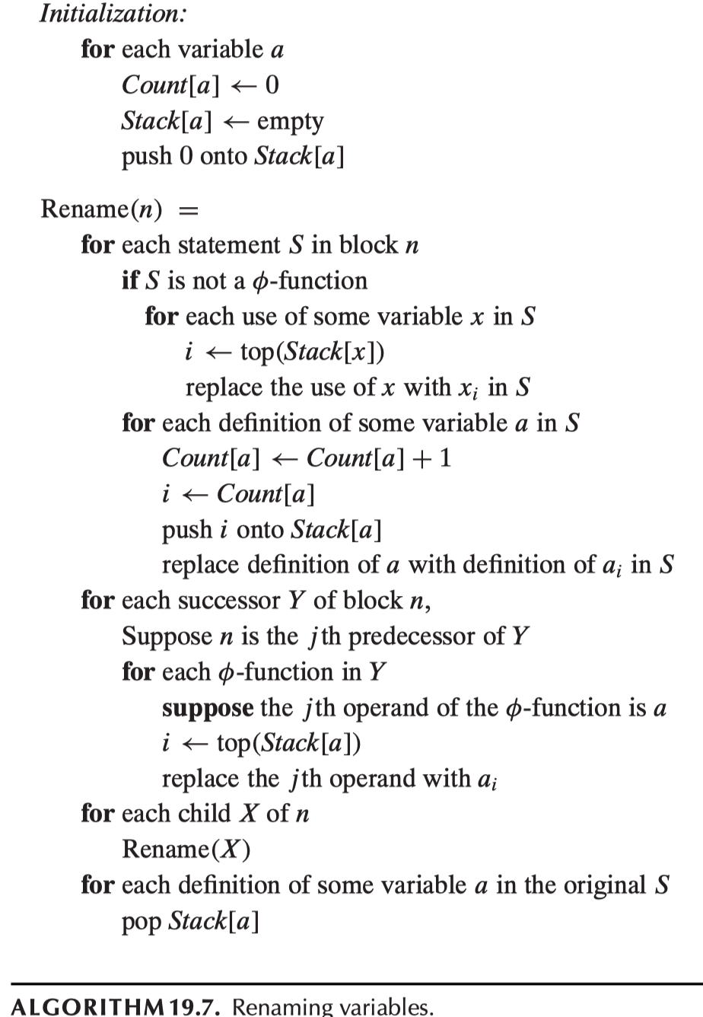
Rename Vars
newest version number
current version number to use
use the current version
new define, new version

Slide 17
Rename Vars
Successor in Control Flow Graph
Change the input var to current version
Child in the DomTree recurse!
After coming back from recursion, revert the current version to the beginning of the block

Slide 18
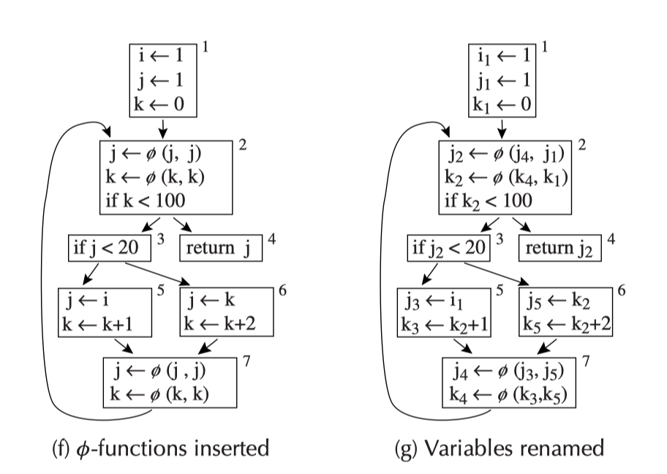
Rename Vars: Example
domTree

Slide 19
SSA Algorithms: Remove Unused Phi
Finally, just in case…
If a phi function defines a variable, but it’s not used in the subsequent statements, then it should be eliminated.
This shouldn’t happen if all the phi functions are placed when the variable is in live-out set of the entry label statement…

Slide 20
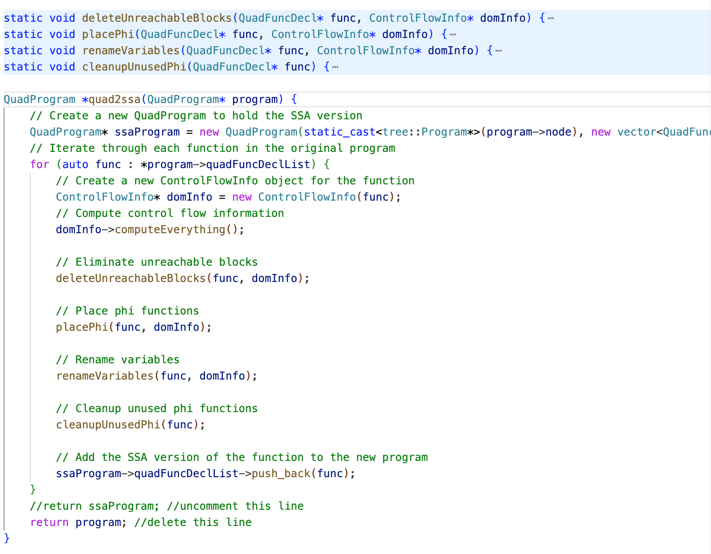
SSA Algorithms: Code
Set up flow info
Delete unreachable blocks
Find the places to place Phi
Rename all variables
Clean up just in case (you may choose to skip this)

Slide 21
Look at Some Examples
See repo

Slide 22
Final Remark
Start your HW7 coding…

