Slide 1
编译（H） COMP130014h.01 Week 12
复旦大学计算机科学技术学院
2024-2025第二学期（2025年春季）
主讲：王晓阳（江湾叉二A3021）
xywangcs@fudan.edu.cn
https://daslab.fudan.edu.cn
助教：林琰钧、王雨晨
课堂：周一6-8节（下午13:30开始，HGX303 教室）
实验：周四1-2节（上午8:00开始，H逸夫楼305）

Slide 2
本周内容: Activation Record & Register Allocation
ARM Architecture Instructions (vs. Quad)
Activation Records
Register Allocation
注意：
HW7 周四（5月8日）晚due

Slide 3
Overview
Source
AST
Intermediate Representation:
Only low-level machine-level instructions, but with nested expressions
IR
Quadruple Representation:
Simple machine-level instructions
Quad
HW7
SSA form
Optimization
放在后面
Activation Records
Register Allocation
ARM Assembly
今天与下周的内容（HW8）

Slide 4
ARM Instructions for FDMJ
We will (only) use a small subset of ARM instructions for our class
A careful use of ARM instructions can be advantageous in generating optimized code (which is beyond the scope of this class)

Slide 5
ARM Instructions for FDMJ (Integers)
Arithmetic instructions
add, sub, rsb, neg, mul
ARM doesn’t have division instruction
Logical instructions
and, orr
These are actually bit-wise logical operations
Move
mov
Compare and branch
cmp, beq, bne, bge, bgt, ble, blt
b, bx, bl, blx
“eq”, “ne” etc are suffix to instructions (conditioned on CPSR). So it’s possible to do, e.g., bxne
Memory instructions
ldr, str
These are the only instructions operating on memory locations, and all the above instructions are on registers

Slide 6
Arithmetic Instructions (Integers)
Instruction | Meaning
add destReg, srcReg, op2 | destReg = srcReg + op2
sub destReg, srcReg, op2 | destReg = srcReg - op2
rsb destReg, srcReg, op2 | destReg = op2 - srcReg
mul destReg, srcReg1, srcReg2 | destReg = srcReg1 * srcReg2
Notes:
All arithmetic operations are done in 2’s complement (i.e., we are dealing with a signed int, same as i32 in LLVM)
rsb (reverse subtract) useful for negate a number (rsb r0, r0, #0, which can be written as neg r0, r0 in assembly)
op2 can be:
a register or a <imm8m> constant (formed by 8bit right rotate: e.g., 0x0F000000)
allow different kinds of shift operations (e.g., r0, ASL #1, which is r0*2)
A register can appear at multiple positions (except mul: destReg cannot be the same as srcReg1)：OK: add r0, r0, r0, NOT OK: mul r0, r0, r0
For division, there is an external function we use (integer division): bl __aeabi_idiv

Slide 7
Logical Instructions (Integers)
Instruction | Meaning
and destReg, srcReg, op2 | destReg = srcReg AND op2
orr destReg, srcReg, op2 | destReg = srcReg OR op2
Notes:
All logical instructions are bit operations
op2 is the same as for arithmetic instructions
A register can appear at multiple positions: and r0, r0, r1

Slide 8
Move and Memory Instructions (Integers)
Instruction | Meaning
mov destReg, op2 | destReg = op2
ldr destReg, [locationReg[, offset]] | destReg = content in mem location
ldr destReg, =<label> | destReg = address of the label
str srcReg, [locationReg[, offset]] | Mem location = srcReg
Notes:
Same op2 as arithmetic instructions (or a 16 bit constant)
Another instruction is movt that moves a 16bit constant to the upper 16 bits of a register
offset can be an immediate, or a register, and is optional. Examples:
ldr r0, [r1]
ldr r0, [r1, #12]
ldr r0, [r1, r2]
No such an instruction: str destReg, =<label>

Slide 9
Compare and Branch Instructions (Integers)
Instruction | Meaning
cmp Reg1, op2 | perform reg1-op2 and store the result status into CPSR
b =label | simple branch
bl =label | branch with next address stored in lr register
bx register | branch to the location in the register
blx register | same as bx but with next address stored in lr
Notes:
All of the above may be followed by the suffix used as condition for branching (conditioned on the CPSR register, usually the result of cmp instruction)
eq, ne, ge, gt, le, lt
E.g., blxeq r3， bgt =fun
在其他指令也可以用：addeq r0, r0, r0

Slide 10
Instruction Summary (Integers)
Instruction | Meaning
add destReg, srcReg, op2 | destReg = srcReg + op2
sub destReg, srcReg, op2 | destReg = srcReg - op2
rsb destReg, srcReg, op2 | destReg = op2 - srcReg
mul destReg, srcReg1, srcReg2 | destReg = srcReg1 * srcReg2
and destReg, srcReg, op2 | destReg = srcReg AND op2
orr destReg, srcReg, op2 | destReg = srcReg OR op2
mov destReg, op2 | destReg = op2
ldr destReg, [locationReg[, offset]] | destReg = content in mem location
ldr destReg, =<label> | destReg = address of the label
str srcReg, [locationReg[, offset]] | Mem location = srcReg
cmp Reg1, op2 | perform reg1-op2 and put result status in CPSR
b =label | simple branch
bl =label | branch with next address stored in lr register
bx register | branch to the location in the register
blx register | same as bx but with next address stored in lr
nop | No operation (useful)

Slide 11
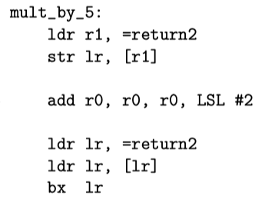
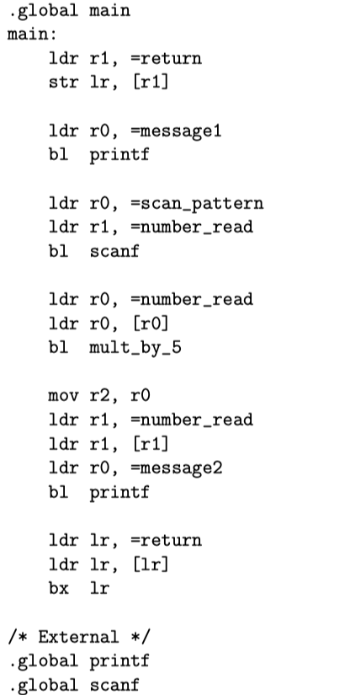
Quad functions VS RPi functions
Function _^main^_^main()
Block: Entry Label: L102
Exit labels:
LABEL L102; def: use:
。。。
MOVE_EXTCALL t119:PTR <- malloc(t136:INT); def: 119 use: 136
。。。
MOVE_CALL t100:PTR <- m1[t138:PTR] (t103:PTR); def: 100 use: 138 103
。。。
RETURN Const:1; def: use:
Function C^m1(t101)
Block: Entry Label: L100
Exit labels:
LABEL L100; def: use:
。。。
RETURN t104:PTR; def: use: 104
Return becomes simply branch
Call becomes branch & link
Where do the
parameters and
the return value go?

Slide 12
Activation Records
We will talk about general ideas and concepts
We will emphasize on FDMJ on RPi

Slide 13
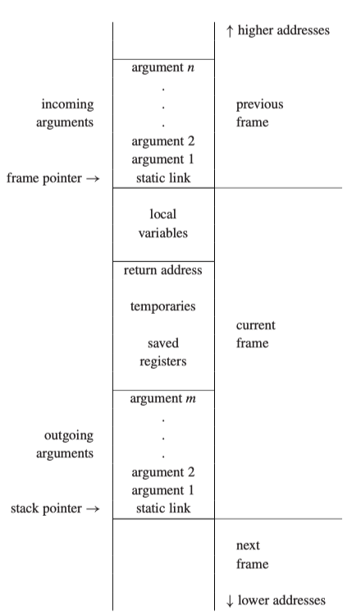
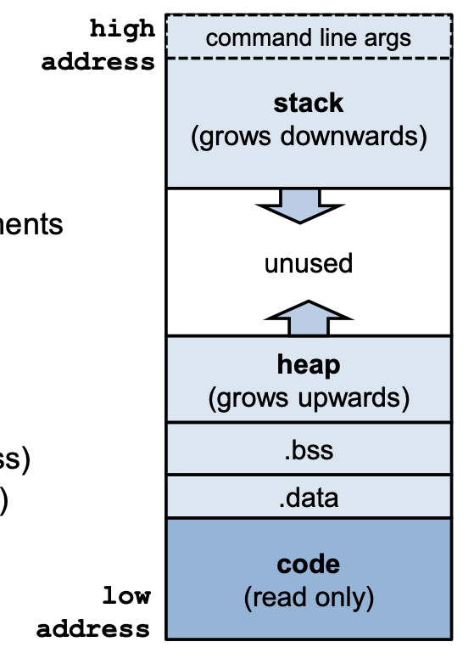
Stack Frame
Process memory segments

Slide 14
Activation Records
A function may have local variables (including formal parameters) that are created upon entry to the function
Several invocations of the function may exist at the same time
Each invocation has its own instantiations of local variables
The life of local variables (for the particular invocation) usually ends after that (particular invocation of) the function exits
public int f(n) {
if (n==1) return (1);
else if (n==2) return(2);
return (f(n-1)+f(n-2));
}

Slide 15
Function as return value
In some languages, return value of a function can be a function (e.g., C language)
typedef int (*ptr)(int*);
ptr f1()
{ return &f2;} //assume f2 has the right signature
But in this case, function f2 is a “static” function. And all the local variables still end their lives after the function ends.

Slide 16
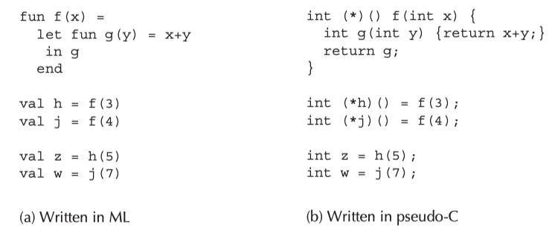
Higher-order function and nested function definition
A function that can return a function is called a higher–order function.
A function defined within another function is called a nested function.
In the above case, the local variable (x) must “live” even after f ends.
Luckily, we don’t have such a problem in FDMJ (or C)

Slide 17
AAPCS (ARM Architecture Procedure Call Standard) (Integers)
To support: Cross language procedure calls
A function must adhere, at least, to the following rules if we want it to be AAPCS compliant.
A function should not make any assumption about the contents of the cpsr. So, when we enter a function the condition codes N, Z, C and V are unknown.
A function can freely modify registers r0, r1, r2 and r3.
A function cannot assume anything about the contents of r0, r1, r2 and r3 unless they are playing the role of a parameter.
A function can freely modify lr but the value upon entering the function will be needed when leaving the function (so such value must be kept somewhere if changed within the function).
A function can modify all the remaining general purpose registers as long as their values are restored before leaving the function. This includes sp and registers r4 to r11. That means that, after calling a function, we have to assume that (only) registers r0, r1, r2, r3, lr and pc may have been overwritten and changed.

Slide 18
ARM Registers (Integers)
pc: r15 (program counter)
lr: r14 (link register)
sp: r13 (stack pointer)
fp: r11(frame pointer)
caller saved registers: r0-r3
r0-r3 are for parameter passing
r0 for return value (and sometimes also: r1)
(After the call, r0, r1, r2, r3, lr and pc may have been overwritten and changed)
callee saved registers
r4-r11, sp

Slide 19
Can we always use registers to pass parameters?
No. We only have 4 registers (r0-r3) in ARM to pass parameters (in any architecture, there is a fixed number of such registers).
No. Even if we only have less than 4 parameters, we probably need a location for the parameter.
f(x) { return g(&x);}
In this case, we say that “x escapes”.
There are other cases that a local variable escapes. But luckily (again), no local variables in FDMJ escape!
Why is this good?

Slide 20
When a variable need to be in memory
the variable will be passed by reference, so it must have a memory address (or, in the C language the & operator is anywhere applied to the variable);
the variable is accessed by a procedure nested inside the current one;
the value is too big to ﬁt into a single register;
the variable is an array, for which address arithmetic is necessary to extract components;
the register holding the variable is needed for a speciﬁc purpose, such as parameter passing (as described above), though a compiler may move such values to other registers instead of storing them in memory;
or there are so many local variables and temporary values that they won’t all ﬁt in registers, in which case some of them are “spilled” into the frame.
Red: in these cases, we say a variable escapes.
All values in FDMJ can fit in a register

Slide 21
How large is a frame?
Depends on the numbers of
Local variables
decided at semantic analysis phase
Temporaries
decided when registers are allocated (almost at the last step of compilation)
Outgoing arguments
decided at semantic analysis phase
return address + (caller or callee?) saved registers + static link:
a fixed number

Slide 22
Space for Saved Registers
It’s easier to simply reserve a space for all the registers (caller & callee save registers)
But, we may not need to save the register
If we don’t need to value after the call
If the function (to be called) won’t change the register
We can let the register allocation algorithm to figure this out

Slide 23
Parameter Passing (Integers)
We store the parameters in reversed order
Usually, k parameters are passed by register (4 in ARM)
Do we still reserve the space for r1, …, rk in the stack frame? Usually yes.
Consider printf() in C. The number of parameters can actually change. To get to the parameters, we need to ensure they are arranged in a sequential order (actually can be “parsed”)… BTW, the size of the frame is “dynamic” in this case

Slide 24
How to Load an Arbitrary Constant into a Register
#include <stdio.h>
union ufloat {
int i;
float f;
unsigned u;
};
int main( ) {
union ufloat u;
char s[20];
u.f = -3.14159f; //or
u.i=-12209;
sprintf(s, "%.8x", u.u);
printf("s_up=%.4s, s_low=%.4s\n", s, &s[4]);
}
Use the “trick” here to get the bit pattersn.
Move an integer to an integer register
Move a float to a float register
mov r0, #low16bits
movt r0, #up16bits
vmov s0, r0
mov r0, #low16bits
movt r0, #up16bits
Also see: https://developer.arm.com/documentation/ka001136/latest/

Slide 25
For FDMJ
No local variables and parameters escape. So we don’t need to store any local variables or parameters in the stack frame
unless:
When the available registers are not enough for the local variables and parameters
Or when registers are caller saved
(see register allocation part)

Slide 26
Stack Frame for FDMJ and RPi
All implemented by temporaries

Slide 27
Some Auxiliary Comments
In the Temp, we can specify a particular register, by using the number 0 is for r0, etc. Remember:
Temp {int num;};
Later, when we do register allocation, we need to give each Temp a register, or memory location (in the stack frame).
We have to treat these Temp that are for our registers in special ways.

Slide 28
Converting Quad to RPi mini
Each instruction in Quad is almost like a RPi mini instruction
More sophisticated instruction selection may be done
This class skips this ”sophisticated” instruction selection
Three kinds of nodes need different treatment:
For the func declaration instructions, we need instructions to “build” the (initial part of the) stack frame
For each function call (Call or ExtCall) node, we need instructions to finish building the stack frame, and then give the control to the callee (i.e., jump to the callee)
For each return node, we need instructions to restore “callee-saved registers”, put the return value to the designated register(s), and then return the control to the caller (i.e., jump back)

Slide 29
How to deal function declaration in Quad?
To convert a funcDecl node, we need to have the following series instructions (in the form of prolog):
push fp to the stack
move parameters registers r0-r3 to the first 4 temps in the argument list
Add instructions to fetch the rest of the parameters (if any) from the frame stack (locations: fp-i, i=5, 6, …)
Move lr to a new return_temp (to be used by the return stm)
** all words are 4 bytes, so location offsets need multiply by 4
In this class, to simplify, we assume registers fp & sp are not going to be used for purposes other than the frame stack pointers.

Slide 30
How to deal with function calls in Quad?
To convert a Call/ExtCall node, we need to have the following series of instructions
move parameters 1-4 to r0-r3
Add instructions to push the all the parameters to stack (if Call, then don’t need to push r0-r3, an optimization.)
Use bl to call the function
If function returns a value to a temp, then add an instruction to move r0 to the temp.

Slide 31
How to deal with return in Quad?
To convert a return node, we need to have the following series of instructions
move return parameter to r0
Add instructions to restore sp and fp of the previous frame
Use bx return_temp to return

Slide 32
Example1
m1:
push {t11}
mov t11, t13
mov t109, t14
lbegin:
mov t100, #9
mov t101, #8
mov t102, #7
mov t103, #6
mov t104, #2
add t105, t100, t101
add t106, t105, t102
add t107, t106, t103
mul t108, t107, t104
mov t0, t108
mov t13, t11
pop {t11}
bx t109
lend:
mov t0, #-2
mov t13, t11
pop {t11}
bx t109
Save the “frame pointer” from the previous frame (static link)
t11 = fp
public int main() {
class c1 x;
return x.m1();
}
public class c1 {
public int m1() {
int a0=9;
int a1=8;
int a2=7;
int a3=6;
int m=2;
int sum;
sum=(a0+a1+a2+a3)*m;
return sum;
}
}

Slide 33
Example 2
m1:
push {t11}
mov t11, t13
mov t109, t14
lbegin:
mov t100, #9
mov t101, #8
mov t102, #7
mov t103, #6
mov t104, #2
add t105, t100, t101
add t106, t105, t102
add t107, t106, t103
mul t108, t107, t104
mov t0, t108
mov t13, t11
pop {t11}
bx t109
lend:
mov t0, #-2
mov t13, t11
pop {t11}
bx t109
Copy the stack pointer value to frame pointer (the new frame starts)
t13 = sp
public int main() {
class c1 x;
return x.m1();
}
public class c1 {
public int m1() {
int a0=9;
int a1=8;
int a2=7;
int a3=6;
int m=2;
int sum;
sum=(a0+a1+a2+a3)*m;
return sum;
}
}

Slide 34
Example test01_m1.rpi (from irp2rpitests.zip)
m1:
push {t11}
mov t11, t13
mov t109, t14
lbegin:
mov t100, #9
mov t101, #8
mov t102, #7
mov t103, #6
mov t104, #2
add t105, t100, t101
add t106, t105, t102
add t107, t106, t103
mul t108, t107, t104
mov t0, t108
mov t13, t11
pop {t11}
bx t109
lend:
mov t0, #-2
mov t13, t11
pop {t11}
bx t109
Save the return address to a temp
(t14 = lr)
public int main() {
class c1 x;
return x.m1();
}
public class c1 {
public int m1() {
int a0=9;
int a1=8;
int a2=7;
int a3=6;
int m=2;
int sum;
sum=(a0+a1+a2+a3)*m;
return sum;
}
}

Slide 35
Example test01_m1.rpi (from irp2rpitests.zip)
m1:
push {t11}
mov t11, t13
mov t109, t14
lbegin:
mov t100, #9
mov t101, #8
mov t102, #7
mov t103, #6
mov t104, #2
add t105, t100, t101
add t106, t105, t102
add t107, t106, t103
mul t108, t107, t104
mov t0, t108
mov t13, t11
pop {t11}
bx t109
lend:
mov t0, #-2
mov t13, t11
pop {t11}
bx t109
Do the calculation of sum.
public int main() {
class c1 x;
return x.m1();
}
public class c1 {
public int m1() {
int a0=9;
int a1=8;
int a2=7;
int a3=6;
int m=2;
int sum;
sum=(a0+a1+a2+a3)*m;
return sum;
}
}

Slide 36
Example test01_m1.rpi (from irp2rpitests.zip)
m1:
push {t11}
mov t11, t13
mov t109, t14
lbegin:
mov t100, #9
mov t101, #8
mov t102, #7
mov t103, #6
mov t104, #2
add t105, t100, t101
add t106, t105, t102
add t107, t106, t103
mul t108, t107, t104
mov t0, t108
mov t13, t11
pop {t11}
bx t109
lend:
mov t0, #-2
mov t13, t11
pop {t11}
bx t109
Move the return value to t0
t0 = r0
public int main() {
class c1 x;
return x.m1();
}
public class c1 {
public int m1() {
int a0=9;
int a1=8;
int a2=7;
int a3=6;
int m=2;
int sum;
sum=(a0+a1+a2+a3)*m;
return sum;
}
}

Slide 37
Example test01_m1.rpi (from irp2rpitests.zip)
m1:
push {t11}
mov t11, t13
mov t109, t14
lbegin:
mov t100, #9
mov t101, #8
mov t102, #7
mov t103, #6
mov t104, #2
add t105, t100, t101
add t106, t105, t102
add t107, t106, t103
mul t108, t107, t104
mov t0, t108
mov t13, t11
pop {t11}
bx t109
lend:
mov t0, #-2
mov t13, t11
pop {t11}
bx t109
Restore stack pointer to where it was.
public int main() {
class c1 x;
return x.m1();
}
public class c1 {
public int m1() {
int a0=9;
int a1=8;
int a2=7;
int a3=6;
int m=2;
int sum;
sum=(a0+a1+a2+a3)*m;
return sum;
}
}

Slide 38
Example test01_m1.rpi (from irp2rpitests.zip)
m1:
push {t11}
mov t11, t13
mov t109, t14
lbegin:
mov t100, #9
mov t101, #8
mov t102, #7
mov t103, #6
mov t104, #2
add t105, t100, t101
add t106, t105, t102
add t107, t106, t103
mul t108, t107, t104
mov t0, t108
mov t13, t11
pop {t11}
bx t109
lend:
mov t0, #-2
mov t13, t11
pop {t11}
bx t109
Restore the frame pointer value. And jump back.
public int main() {
class c1 x;
return x.m1();
}
public class c1 {
public int m1() {
int a0=9;
int a1=8;
int a2=7;
int a3=6;
int m=2;
int sum;
sum=(a0+a1+a2+a3)*m;
return sum;
}
}

Slide 39
How to deal with phi-function?
Add “mov” instructions to the end of the predecessor blocks (before the last jump).
Remove phi-function
add
mov tempa3, tempa1
before jump
add
mov tempa3, tempa2
before jump

Slide 40
Assumption for this class (IMPORTANT)
All methods have at most 3 parameters
So we use r0, r1, r2, r3 for parameter passing (why four?!)
If they are all integers

Slide 41
Modify the Def/Use of Quad
We need to add special registers to the use and def sets of some instructions.
We need to add the move instructions of special registers to and from the function formal parameters, call parameters and return values.
We will come back to this later

Slide 42
The Register Allocation Problem
Given: a Quad program (or any program) that uses an unbounded number of variables
Find: a mapping from variables to machine registers such that
the program behaves the same when temps are replaced with registers
as many variables as possible are in registers
moves between registers (like move r1, r2) are minimized
architecture requirements are obeyed (e.g., zero register always has the value 0, argument registers are overwritten on function calls)
Stack Spilling
If there are k registers available and m > k variables are live at the same time, then not all of them will fit into registers
So we must "spill" the excess variables to the stack

Slide 43
Interference
“Interference” is a general term, meaning “a condition that prevents two variables being allocated to the same register.
For example: two variables that are live at the same time cannot be assigned with the same registers
For example, in ARM instruction “mul temp1, temp2, temp3”, we cannot assign the same register to both temp1 and temp2
Even if they are not live at the same time! Unlike “add temp1, temp2, temp3”.
We may generally model interference as an interference graph between temporaries (and special registers)
Based on live analysis
Other special requirement

Slide 44
Register Allocation by Graph Coloring on the interference graph
Given an interference graph
Vertices: the temporaries (and machine registers, also modeled as special temporaries)
Edges: two temporaries have an edge between them (i.e. adjacent) if they cannot be assigned to the same register.
Graph coloring:
Color all the vertices of a graph with k colors such that no two adjacent vertices are assigned with the same color
In our case, some vertices are already colored.

Slide 45
Interference Graph
m1:
push {t11}
mov t11, t13
mov t109, t14
lbegin:
mov t100, #9
mov t101, #8
mov t102, #7
mov t103, #6
mov t104, #2
add t105, t100, t101
add t106, t105, t102
add t107, t106, t103
mul t108, t107, t104
mov t0, t108
mov t13, t11
pop {t11}
bx t109
lend:
mov t0, #-2
mov t13, t11
pop {t11}
bx t109
101
108
109
Interferes with everyone
104
11
0
100
107
More on r0 (and the other registers) at registration allocation
102
103
106
------Interference Graph-11, (0): 2 1 (fp)
14, (1): (lr)
109, (2): 0
100, (3): 0 2
101, (4): 3 2 0
102, (5): 0 2 3 4
103, (6): 4 3 2 0 5
104, (7): 5 0 2 6 3 4
105, (8): 6 2 0 7 5
106, (9): 7 0 2 6
107, (10): 2 0 7
108, (11): 0 2
0, (12): 2 0 (r0)
13, (13): 2 (sp ignored)
105

Slide 46
Interference Graph
main:
push {t11}
mov t11, t13
mov t103, t14
main_begin:
mov t0, #4
bl malloc
mov t100, t0
str =m1, [t100]
ldr t101, [t100]
bl t101
mov t102, t0
mov t0, t102
mov t13, t11
pop {t11}
bx t103
lend:
mov t0, #-2
mov t13, t11
pop {t11}
bx t103
14
103
Interferes with everyone
101
0
11
100
102
More on r0 (and the other registers) at registration allocation
------Interference Graph---------
11, (0): 2 1 (fp)
14, (1): (lr)
103, (2): 0
0, (3): 0 2 (r0)
100, (4): 0 2
101, (5): 3 0 2
102, (6): 0 2
13, (7): 2 (sp)

Slide 47
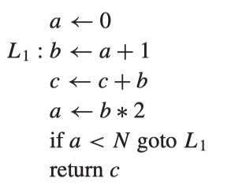
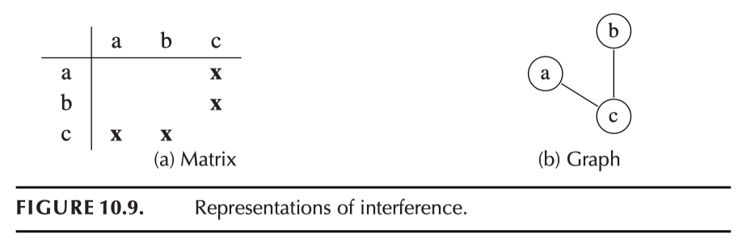
Interference Graph
Interference
If there is a node n, variables in def(n) all interfere with all the “live out” variables at the variable.
Two variables that interfere with each other can’t be assigned to the same register (otherwise OK)
Move (copy) needs special treatment (mov a, b doesn’t necessarily mean they interfere with each other)

Slide 48
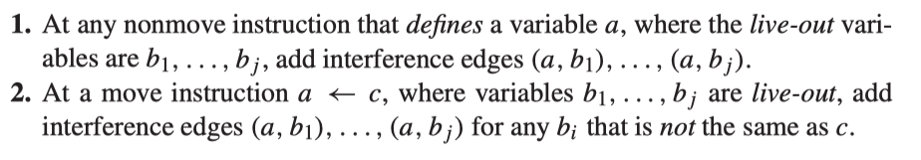
Interference Graph
Two colors are enough
Formally:
We are going to do register allocation by “coloring” the interference graph
(each register is a different color: r0-r11, sp, fp, lr, etc.)

Slide 49
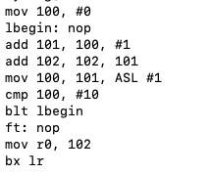
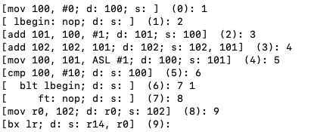
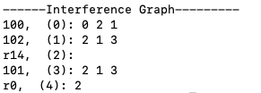
Number of iterations=20
----------------------
(0): def=100, use=
In=102, r14,
Out=102, r14, 100,
----------------------
(1): def= use=
In=100, r14, 102,
Out=100, r14, 102,
----------------------
(2): def=101, use=100,
In=102, r14, 100,
Out=101, 102, r14,
----------------------
(3): def=102, use=102, 101,
In=r14, 102, 101,
Out=101, 102, r14,
----------------------
(4): def=100, use=101,
In=r14, 102, 101,
Out=100, r14, 102,
----------------------
(5): def= use=100,
In=102, r14, 100,
Out=102, r14, 100,
----------------------
(6): def= use=
In=100, r14, 102,
Out=100, r14, 102,
----------------------
(7): def= use=
In=102, r14,
Out=102, r14,
----------------------
(8): def=r0, use=102,
In=r14, 102,
Out=r0, r14,
----------------------
(9): def= use=r14, r0,
In=r14, r0,
Out=
InstrList
0
1
2
3
a: 100
b: 101
c: 102
Fixed: r0, lr
4
5
6
7
8
9
Flowgraph output

Slide 50
Example
InstrList
r14
4
r0
2
0
3
a (r0)
b (r0)
a: 100
b: 101
c: 102
Fixed: r0, lr
1
c (r1)
r14
4
r0
2
0
3
A (r1)
b (r1)
1
c (r0)

Slide 51
Final Remarks
HW7 is due on May 8
Quiz 3 will be on May 15

