Slide 1
编译（H） COMP130014h.01 Week 13
复旦大学计算机科学技术学院
2024-2025第二学期（2025年春季）
主讲：王晓阳（江湾叉二A3021）
xywangcs@fudan.edu.cn
https://daslab.fudan.edu.cn
助教：林琰钧、王雨晨
课堂：周一6-8节（下午13:30开始，HGX303 教室）
实验：周四1-2节（上午8:00开始，H逸夫楼305）

Slide 2
本周内容: Activation Record & Register Allocation
ARM Architecture Instructions (vs. Quad)
Activation Records
Register Allocation
注意：
HW8 5月22日（周四）晚due

Slide 3
Overview
Source
AST
Intermediate Representation:
Only low-level machine-level instructions, but with nested expressions
IR
Quadruple Representation:
Simple machine-level instructions
Quad
HW7
SSA form
Optimization
放在后面
Activation Records
Register Allocation
ARM Assembly
今天的内容（HW8）

Slide 4
Instruction Summary (Integers)
Instruction | Meaning
add destReg, srcReg, op2 | destReg = srcReg + op2
sub destReg, srcReg, op2 | destReg = srcReg - op2
rsb destReg, srcReg, op2 | destReg = op2 - srcReg
mul destReg, srcReg1, srcReg2 | destReg = srcReg1 * srcReg2
and destReg, srcReg, op2 | destReg = srcReg AND op2
orr destReg, srcReg, op2 | destReg = srcReg OR op2
mov destReg, op2 | destReg = op2
ldr destReg, [locationReg[, offset]] | destReg = content in mem location
ldr destReg, =<label> | destReg = address of the label
str srcReg, [locationReg[, offset]] | Mem location = srcReg
cmp Reg1, op2 | perform reg1-op2 and put result status in CPSR
b =label | simple branch
bl =label | branch with next address stored in lr register
bx register | branch to the location in the register
blx register | same as bx but with next address stored in lr
nop | No operation (useful)

Slide 5
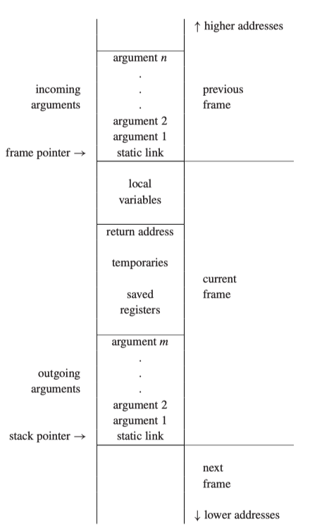
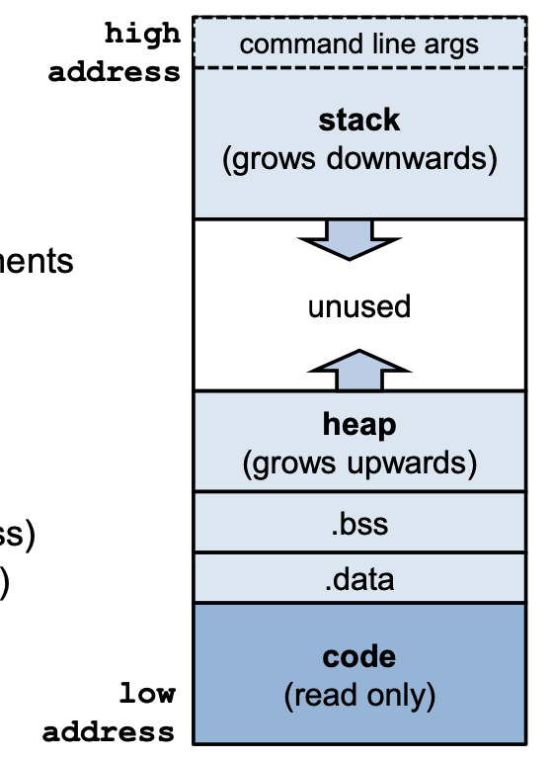
Stack Frame
Process memory segments

Slide 6
ARM Registers (Integers)
pc: r15 (program counter)
lr: r14 (link register)
sp: r13 (stack pointer)
fp: r11(frame pointer)
caller saved registers: r0-r3
r0-r3 are for parameter passing
r0 for return value (and sometimes also: r1)
(After the call, r0, r1, r2, r3, lr and pc may have been overwritten and changed)
callee saved registers
r4-r11, sp

Slide 7
Stack Frame
fp
Caller Stack
From a method’s perspective:
(1) when the method “wakes up”, it’s a callee.
(2) When the method calls some other method, it’s a caller.
sp
Callee Stack

Slide 8
When a method is being called:
fp
When being called
Caller Stack
Caller Stack
sp
fp
sp
Callee Stack
We use the stack here
When return

Slide 9
For FDMJ-RPi: When a method is being called
fp
When being called
Caller Stack
Caller Stack
What do use to store:
fp, lr
Callee saved registers (r4-r10)
Temporary variables (that can’t fit in the registers)
sp
fp
sp
Callee Stack
When return

Slide 10
For FDMJ-RPi: When a method is being called
For 1-2, we may use
The push instruction
For 3, each temporary variable is a given an offset (from fp), so we know where to retrieve it (each such a variable is essentially assigned an offset number)
Caller Stack
What do use to store:
fp, lr
Callee saved registers (r4-r10)
Temporary variables (that can’t fit in the registers)
fp
sp
So: each variable (temp) is either given a register or an offset. This is the job of register allocation.

Slide 11
For FDMJ for RPi: When a method is being called
fp
Registers r0-r3 have the parameters
Return address is in lr
Caller Stack
Caller Stack
sp
fp
sp
Callee Stack
When return
We use the stack here
Return value must be in r0
To simplify: we assume our methods have at most 3 parameters.

Slide 12
For FDMJ for RPi: When a method is being called
fp
Caller doesn’t need to callee to keep r0-r3, and lr contents
Caller Stack
Caller Stack
sp
fp
sp
Callee Stack
When return
We use the stack here
Caller expects r4-r10, fp, sp be put back their original values

Slide 13
For FDMJ for RPi: When a method is being called
We will use
push/pop{r4-r10, fp, lr} and adjust sp
To accomplish this
when the assembly program is built
fp
Caller Stack
Caller Stack
sp
fp
sp
Callee Stack
When return
We use the stack here
Caller expects r4-r10, fp, sp be put back their original values

Slide 14
To Prepare Quad For RPi (1)
Move the incoming parameters to the right temps on entrance
Move the return values to the right register
On entrance:
For each parameter, we need to add
move temp ← ri (i=0..3)
instructions
On return:
We need to add
move r0 ← temp/value
Instruction
And make r0 to be the return value
Here we have introduced machine registers to mix with our temps

Slide 15
To Prepare Quad For RPi
Some other considerations:
1) Stitch the blocks back into one block
2) Add necessary temps to adhere to the RPi instruction requirements
3) For function calls, we need to add extra “def/use” temps

Slide 16
(1) Stitch the Blocks Together
Also called “tracing”
Try to make the block immediately follow the block that jumps to it (may save a jump)
Try to make the “false” block immediately follow a block that makes a conditional jump (since assembly conditional jump does a “true: jump, false: fall through”)

Slide 17
How to deal with phi-function?
Add “mov” instructions to the end of the predecessor blocks (before the last jump).
Remove phi-function
add
mov tempa3, tempa1
before jump
add
mov tempa3, tempa2
before jump

Slide 18

(2) Instruction Requirements
For example, add instruction doesn’t allow const as the left operand
So if we have a Quad:
Move_Binop: dest, +, const, right
We need to add a temp and a move:
Move new_temp ← const
Move_Binop: dest, +, new_temp, right
We need to exam each instruction type to add necessary temps.
Why?

Slide 19
(3) Add Extra Def/Use Temps
When we make a method call, we must assume r0-r3 are changed once returned. Therefore, we should add r0-r3 in the “define” set of the call quads.

Slide 20
Examples
Now we are ready to see some examples: Quad programs after being prepared (HW8 test/input examples)

Slide 21
The Register Allocation Problem
Given: a Quad program (or any program) that uses an unbounded number of variables
Find: a mapping from variables to machine registers such that
the program behaves the same when temps are replaced with registers
as many variables as possible are in registers
moves between registers (like move r1, r2) are minimized
architecture requirements are obeyed (e.g., zero register always has the value 0, argument registers are overwritten on function calls)
Stack Spilling
If there are k registers available and m > k variables are live at the same time, then not all of them will fit into registers
So we must "spill" the excess variables to the stack

Slide 22
Interference
“Interference” is a general term, meaning “a condition that prevents two variables being allocated to the same register.
We may generally model interference as an interference graph between temporaries (and machine registers)
Based on liveness analysis
Other special requirement

Slide 23
Register Allocation by Graph Coloring on the interference graph
Given an interference graph
Vertices: the temporaries (and machine registers, also modeled as special temporaries)
Edges: two temporaries have an edge between them (i.e. adjacent) if they cannot be assigned to the same register.
Graph coloring:
Color all the vertices of a graph with k colors such that no two adjacent vertices are assigned with the same color
In our case, some vertices are already colored.

Slide 24
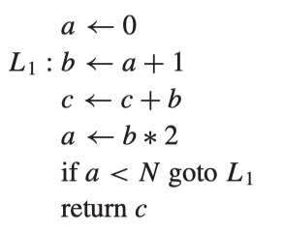
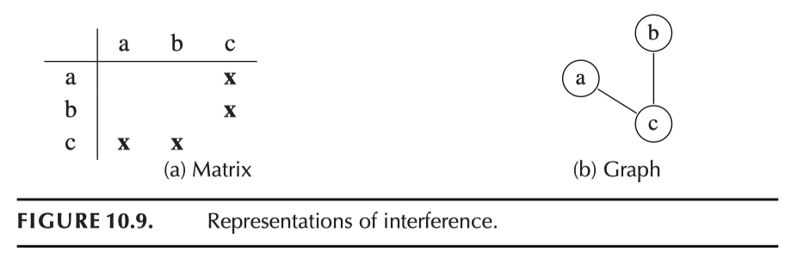
Interference Graph
Interference
If there is a node n, variables in def(n) all interfere with all the “live out” variables at the variable.
Two variables that interfere with each other can’t be assigned to the same register (otherwise OK)
Move (copy) needs special treatment (mov a, b doesn’t necessarily mean they interfere with each other)

Slide 25
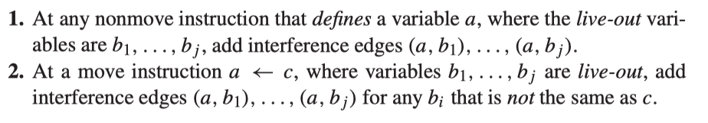
Interference Graph
Two colors are enough
Formally:
We are going to do register allocation by “coloring” the interference graph
(each register is a different color: r0-r11, sp, fp, lr, etc.)

Slide 26
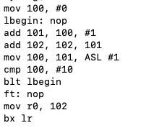
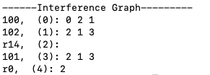
Example
InstrList
r14
4
r0
2
0
3
a (r0)
b (r0)
a: 100
b: 101
c: 102
Fixed: r0, lr
1
c (r1)
r14
4
r0
2
0
3
A (r1)
b (r1)
1
c (r0)

Slide 27
Questions Before We Proceed
How many colors do we have?
As many as there are registers that we can use
Can we efficiently find a k-coloring of the graph whenever possible?
Answer: in general the problem is NP-complete
But we can do an efficient approximation using heuristics
Can we just assign color to register arbitrarily?
In general yes, but if done carefully, we can eliminate some extra move instructions
What do we do when there aren’t enough colors/registers?
We have to use stack space, but how do we do this effectively?

Slide 28
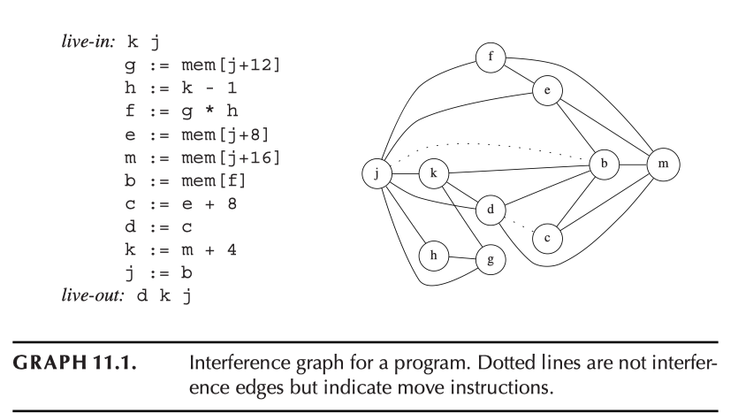
Another Example

Slide 29
Simplify-spill-select Algorithm
The algorithm has three steps:
Step 1: Find a node with degree < k and cut it out of the graph
It has fewer neighbors than there are colors, so we’ll always have a color left for it once we color the rest of the graph
Remove the node and all its edges
This is called simplifying the graph
Step 2: When all nodes have degree >= k, we select some nodes to “spill” (i.e., don’t assign register to it) and remove them from the graph. Repeat step 1.
Step 3: Once the graph is colored, we rebuild the graph by repeatedly adding back (in reversed order). Since the removed nodes have degree <k (at the time of removal), we can always select a color for it. If a spilled node is selected, we still try to color it (if not successful, actual “spill” happens).
If some nodes are “spilled”, then the program is rewritten (to add the instructions for spilling) and then do the above again!

Slide 30
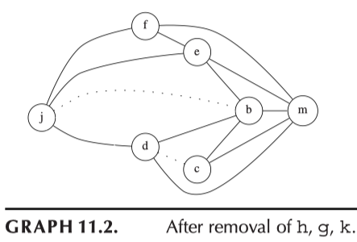
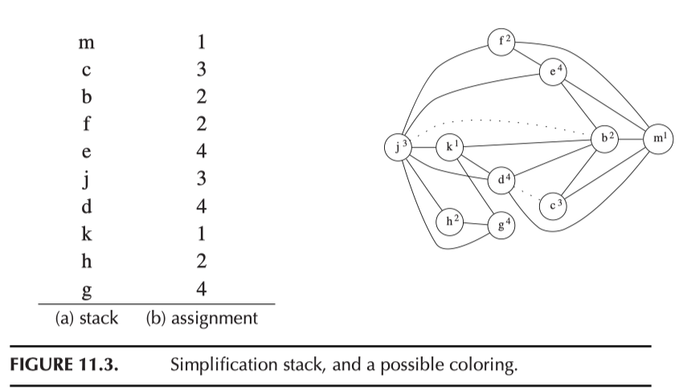
Example (k=4)

Slide 31
Spilling
Idea: If we can’t k-color the graph, we need to store (at least) one temporary variable on the stack.
Which variable to spill?
Pick one that isn’t used very frequently
Pick one that isn’t used in a (deeply nested) loop
Pick one that has high interference (since removing it will make the graph easier to color)
In practice: some weighted combination of these criteria

Slide 32
Spilling Example (k=3)
X

Slide 33
Optimistic Coloring
The algorithm is a heuristic one, so sometimes “spill” may not be necessary!
Example (k=2)
…
X
X

Slide 34
How to Spill
Change the program (the instruction list):
Add instructions to store the temporary to stack (to a fixed offset of sp), and when needed, fetch to a temporary.
We may choose one of the two ways afterwards:
After changing the program, do the whole register allocation again (more effective)
Or, we reserve some registers (say in ARM, 3 registers will be enough) simply for dealing with these cases (less effective)

Slide 35
Example Spill Code
Suppose t is marked for spilling to stack slot fp + o
Approach 1: Changing the program and do the whole register allocation again (more effective)
Spilled code with new temps:
Original code:
…
add t,a,b
str t,[fp + o] //store after any def … ldr t1,[fp + o] // load before any use of t with different temp each time mul x, t1, c
…
ldr t2,[fp + o] // load before any use of t add y,d,t2
…
…
add t, a, b
…
mul x,t,c
…
add y,d,t
…

Slide 36
Example Spill Code
Suppose t is marked for spilling to stack slot fp + o
Approach 2: in this case, we use r9 for spilled temps (in general, since our ARM instructions use 3 registers at the most, we need to reserve three registers for spilled temps)
Spilled code with reserved registers:
Original code:
str r9, [fp+o_r9] //beginning of the method
…
add r9,a,b
str r9,[fp + o] //store after any def … ldr r9,[fp + o] // load before any use of t mul x,r9,c
…
ldr r9,[fp + o] // load before any use of t add y,d,r9
…
ldr r9, [fp+o_r9] //end of the method
…
add t, a, b
…
mul x,t,c
…
add y,d,t
…

Slide 37
Method Comparison
Approach 1: Rewrite the program to use a new temporary variable for each access to a spilled variable, and then do register allocation again
Pro: Need to reserve fewer registers
Con: Introducing a variable changes live ranges, so must recompute liveness & recolor graph
Approach 2: Reserve specific registers for loading/storing to spilled variables
Pro: Only need to color the graph once
Con: Need three registers (one for each source operand of an instruction), so decreases total number of available registers by 3
Not good on x86 (especially 32-bit) because there are too few registers & too many constraints on how they can be used

Slide 38
An idea: Spill to Float Register
Since there are many more float registers, the unused float register may be used to “spill” integer registers

Slide 39
Reduce the “Copy” Instructions
InstrList
r14
4
r0
2
0
3
a (r0)
b (r0)
a: 100
b: 101
c: 102
Fixed: r0, lr
This is better:
1
c (r1)
r14
4
r0
2
0
3
A (r1)
b (r1)
1
c (r0)

Slide 40
Another Example: Can we do better?

Slide 41
Coalescing Interference Graphs
A more aggressive strategy
coalesce the nodes connected by “copy” edges
force the two temporaries to be assigned the same register
Method:
interleave simplification and coalescing to maximize the number of “copies” that can be eliminated
Problem:
coalescing can sometimes increase the degree of a node
x
y
x,y

Slide 42
Coalesce Example
InstrList
4
r0
r14
2
a
0
3
b
a: 100
b: 101
c: 102
Fixed: r0, lr
1
c
r14
2
0
3
a (r1)
b (r1)
1,4
c
r0

Slide 43
Conservative Coalescing
Two strategies are guaranteed to preserve the k-colorability of the interference graph:
Brigg’s strategy: coalesce x and y if the resulting node will have fewer than k neighbors with degree ≥ k.
So the combined node can be picked to simplify after its neighbors are picked to simplify.
George’s strategy: coalesce x and y if for every neighbor t of x, either t already interferes with y or t has degree < k.
So if t already interferes with y, then the coalescing doesn’t change the k-colorability of t in the process
And if t has degree < k, then t has “no problem” in k-coloring.

Slide 44
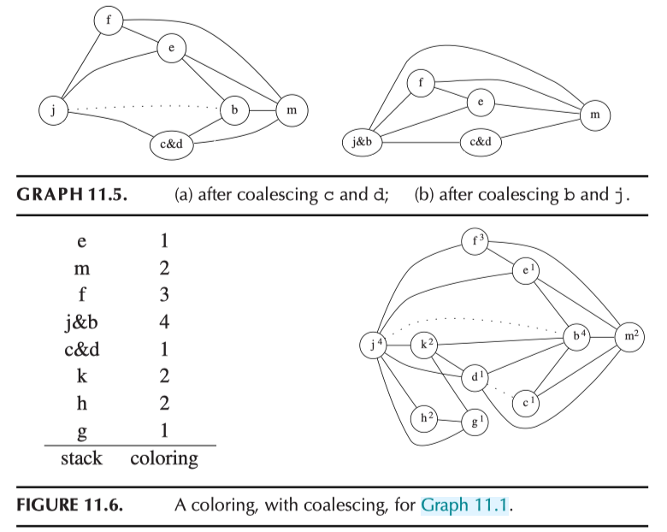
Example k=4

Slide 45
Precolored Nodes
Some variables must be pre-assigned to registers
Following the standard of ARM procedure call (r0-r3, sp, lr, fp, s0-s3)
We have already used them in our AS_* instructions.
We can still use these registers for other purposes as long as they’re available when we need them.
To properly allocate temporaries, we can treat registers as nodes in the interference graph with pre-assigned colors
Pre-colored nodes can’t be removed during simplification, and should never be spilled
When the graph is empty except for the pre-colored nodes, then we start coloring the rest of the nodes.

Slide 46
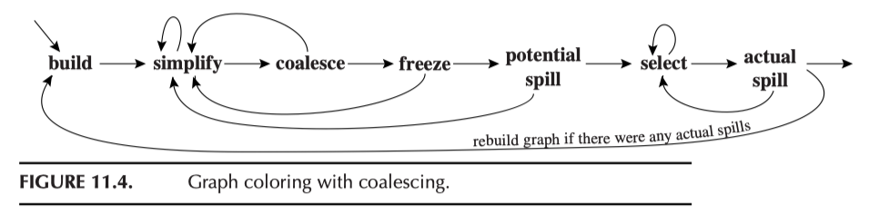
The whole process

Slide 47
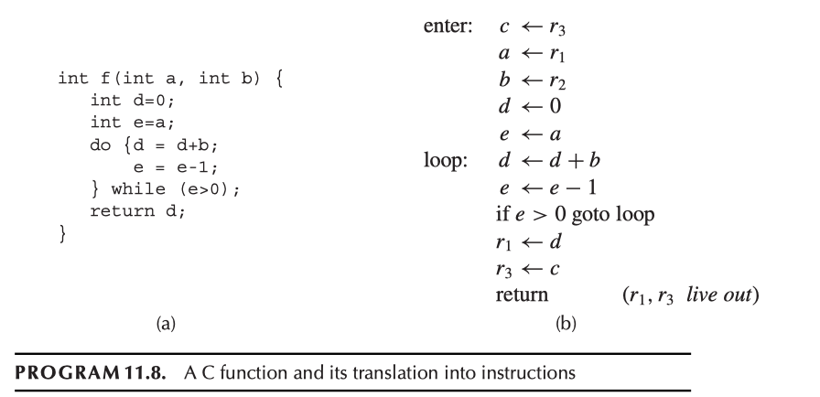
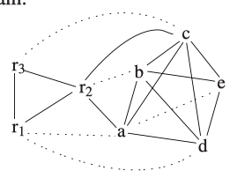
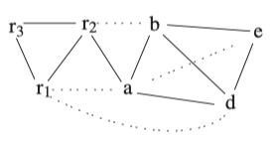
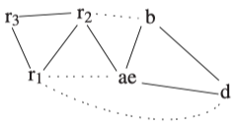

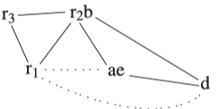

Example
1 Spill c
2
3
5
4

Slide 48
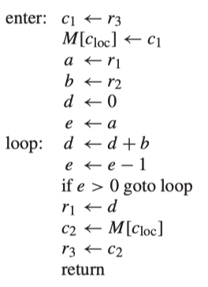
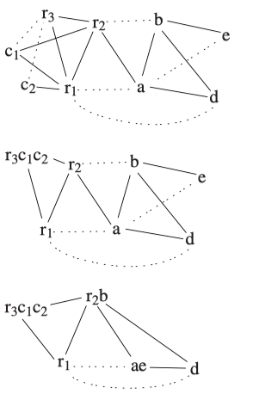
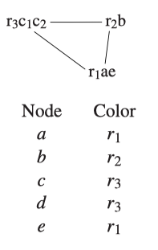
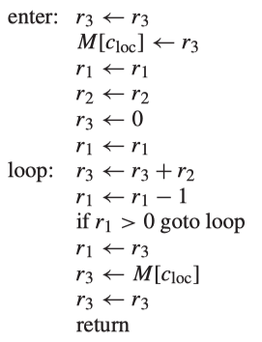
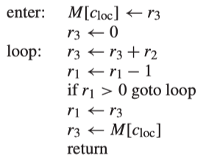
Example
(continued)

Slide 49
To Our Code
We have the following classes:
DataFlowInfo
Interference Graph
Coloring
RegAlloc
Let’s look at each one to get familiarize ourselves.

Slide 50
Simplifying
Work in the Coloring class.
Keep the original ig (so we can get back to), and make a working copy in Coloring (called graph).
Basically: find a node that has less than k neighbors, and push it into a stack (called “simplifiedNodes” stack).

Slide 51
Coalescing
The moves are dealt with in a special way.
When simplifying, don’t “simplify out” the nodes that are involved in moving (as recorded in the movePairs)
Coalescing is to merge the two nodes of a move pair into one node.
Use coalescedMoves to record this
To allow “recursive coalescing”: a node is picked as a “lead” node, and all others are coalesced into this “lead” node. Note that no machine registers can only be a “lead” node.
When coalescing, make sure the “working” graph and the movePairs are updated correctly.

Slide 52
Freezing
This is when no simplifying and coalescing can be done, we “freeze” a move (i.e., remove it movePairs, i.e., from coalescing considerations).
And hopefully, simplifying can continue (why?)

Slide 53
Spilling
When not possible to simplify, coalesce, or freeze, we select a node (usually a “heavily interfering node) to spill.
But we still push it on to the simplifiedNodes stack (why?)

Slide 54
Select
Finally, when no more nodes to be reduced (i.e., only machine registers are in the graph), we pop the simplifiedStack one node at a time, and select a color based on the colors already assigned to its neighbors (in the original IG).
If not possible to assign color (constrained by k colors), make it into a spill (spilled set).
Finally, use CheckColoring to make sure the coloring is done correctly and output to an xml file (for the next step of converting to RPi code: HW9).

Slide 55
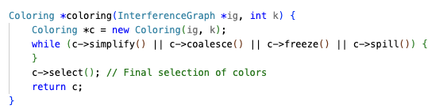
To put it together
We do one node at a time when simplifying, coalescing, freezing, and spilling.

Slide 56
Concluding Remarks
Please start early on HW8
Due : May 22.

