Slide 1
编译（H） COMP130014h.01 Week 14
复旦大学计算机科学技术学院
2024-2025第二学期（2025年春季）
主讲：王晓阳（江湾叉二A3021）
xywangcs@fudan.edu.cn
https://daslab.fudan.edu.cn
助教：林琰钧、王雨晨
课堂：周一6-8节（下午13:30开始，HGX303 教室）
实验：周四1-2节（上午8:00开始，H逸夫楼305）

Slide 2
本周内容: RPi Assembly and Code Generation
RPi （ARM）Assembly Code
RPi （ARM）Code Generation
Code Optimization (I)
注意：
HW9 5月29日（周四）晚due
本学期余下的工作：
HW10：Code Optimization（6月5日due）
Quiz #4：6月5日（周四）上午8时
课程 Project ：6月19日due

Slide 3
ARM Registers (Integers)
pc: r15 (program counter)
lr: r14 (link register)
sp: r13 (stack pointer)
fp: r11(frame pointer)
caller saved registers: r0-r3
r0-r3 are for parameter passing
r0 for return value (and sometimes also: r1)
(After the call, r0, r1, r2, r3, lr and pc may have been overwritten and changed)
callee saved registers
r4-r11, sp

Slide 4
ARM Assembly Example 1
.section .note.GNU-stack
@ Here is the RPI code
@ Here's function: _^main^_^main
.balign 4
.global main
.section .text
main:
push {r4-r10, fp, lr}
add fp, sp, #32
main$L100:
mov r0, #0
sub sp, fp, #32
pop {r4-r10, fp, pc}
public int main() {
int i=0;
return i;
}

Slide 5
Function Entrance
fp
fp
Caller Stack
Caller Stack
main:
push {r4-r10, fp, lr}
sp = orig_sp + 36
sp
lr
fp
r10
r9
r8
r7
r6
r5
sp
r4

Slide 6
Function Entrance
fp
main:
push {r4-r10, fp, lr}
sp = orig_sp + 36
(push: sp-4 then store)
add fp, sp, #32
fp = sp + 32
Note: sp&fp point to the lowest address of the 4 bytes each register (32 bits) occupies.
Caller Stack
Caller Stack
sp
fp
lr
fp
r10
r9
r8
r7
r6
r5
sp
r4

Slide 7
Return
fp
Return:
sub sp, fp, #32
Why necessary?
Caller Stack
Caller Stack
sp
fp
lr
fp
r10
r9
r8
r7
r6
r5
sp
r4

Slide 8
Return
fp
fp
Return:
sub sp, fp, #32
pop {r4-r10, fp, pc}
Restore r4-r10 and fp
put saved lr value to pc (jump back)
Caller Stack
Caller Stack
sp
sp
lr
fp
r10
r9
r8
r7
r6
r5
r4

Slide 9
ARM Assembly Example 3
.section .note.GNU-stack
@ Here is the RPI code
@ Here's function: _^main^_^main
.balign 4
.global main
.section .text
main:
push {r4-r10, fp, lr}
add fp, sp, #32
main$L100:
mov r4, #0
mov r0, r4
bl putint
mov r0, r4
sub sp, fp, #32
pop {r4-r10, fp, pc}
public int main() {
int i=0;
putint(i);
return i;
}
No spill

Slide 10
ARM Assembly Example 4
main:
push {r4-r10, fp, lr}
add fp, sp, #32
sub sp, sp, #4
main$L100:
mov r10, #0
str r10, [fp, #-36]
ldr r9, [fp, #-36]
mov r0, r9
bl putint
ldr r9, [fp, #-36]
mov r0, r9
sub sp, fp, #32
pop {r4-r10, fp, pc}
public int main() {
int i=0;
putint(i);
return i;
}
k=0: force to spill

Slide 11
Spill
Caller Stack
main:
push {r4-r10, fp, lr}
add fp, sp, #32
sub sp, sp, #4
main$L100:
mov r10, #0
str r10, [fp, #-36]
ldr r9, [fp, #-36]
mov r0, r9
bl putint
fp
lr
fp
r10
r9
r8
r7
r6
r5
r4
sp
for spilled i
Whenever a new define, store
Whenever a use, load
(Here we assume the number of spilled temps is small)
Why necessary here?

Slide 12
Treating methods
public int main() {
class C c;
c.m();
return 0;
}
public class C {
public int m() {
return 0;
}
}
main:
push {r4-r10, fp, lr}
add fp, sp, #32
main$L100:
mov r0, #4
bl malloc
add r1, r0, #0
ldr r2, =C$m
str r2, [r1]
ldr r1, [r0, #0]
blx r1
mov r0, #0
sub sp, fp, #32
pop {r4-r10, fp, pc}
@ Here's function: C^m
.balign 4
.global C$m
.section .text
C$m:
push {r4-r10, fp, lr}
add fp, sp, #32
C$m$L100:
mov r0, #0
sub sp, fp, #32
pop {r4-r10, fp, pc}
Note the method name, label name convention

Slide 13
ARM Assembly Bubble Sort
Look at the HW Repo example_output

Slide 14
Two Code Optimization Topics
Dead-code elimination
Delete a computation whose result will never be used
Constant folding
If the operands of an expression are constants, do the computation at compile time

Slide 15
Dead-Code Elimination (with SSA)
Given an instruction s, if all the vars in its def list are not in the live-out list of s, then s can be deleted
Including the instruction for phi function
We do this before register allocation
Why?
The above elimination assumes the instruction s does not have any side effect
How about: a call statement
Or: a divide by zero instruction…

Slide 16
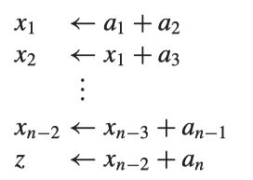
Cascaded Dead Code
Assume x₁, …, x_{n-2} and z are all NOT in the live-out of the last statement
Then: all the instructions are “dead”.
But none of the instructions (except the last one) satisfies the elimination condition given earlier: unless we do liveness analysis again
How many liveness analysis do we need to do?

Slide 17
A Possible Solution Without Repeated Liveness Analysis
Refined Liveness Analysis
At each point where a variable d is deﬁned, we keep track of exactly what uses it might have
Let uses(v) be the set of all the uses of variable v in the program
If an instruction s defines a (i.e., a in def(s))
Then: live-out(s) ⌒ uses(a) contains all the uses of a that could possibly be reached by this deﬁnition.

Slide 18
Use the Earlier Example
If all the uses of x₁, …, x_{n-2} and z are in the above code segment, then we do not need to perform liveness analysis in order to eliminate all the above instructions (assuming z is not in the live-out of the last instructions)
Question: does this work for non-SSA?

Slide 19
Constant Propagation
Suppose we have a statement d : t ← c where c is a constant, and another statement n that uses t, such as n : y ← t ⊕ x.
If we know that t is constant in n if d reaches n, and no other deﬁnitions of t reach n,
In this case, we can rewrite n as y ← c ⊕ x.

Slide 20
Copy Propagation
This is like constant propagation, but instead of a constant c we have a variable z.
Suppose we have a statement d : t ← z. and another statement n that uses t, such as n : y ← t ⊕ x.
If d reaches n, and no other deﬁnition of t reaches n, and there is no deﬁnition of z on any path from d to n (including a path that goes through n one or more times), then we can rewrite n as n : y ← z ⊕ x.
This is better done after register allocation. Why?

Slide 21
Constant Propagation with SSA
Whenever there is a statement of the form v ← c for some constant c, then all use of v can be replaced by a use of c.
Any φ-function of the form v ← φ(c₁ , c₂ , . . . , c_{n} ), where all the c_{i} are equal, can be replaced by v ← c.

Slide 22
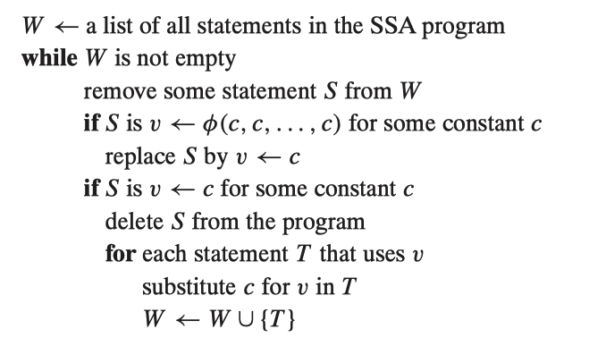
Algorithm

Slide 23
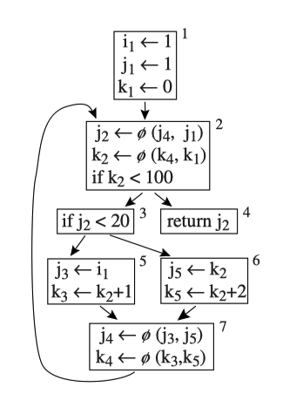
We can delete i1←1, and replace j3←i1 with j3← 1
(deletion of other instructions are not useful. Why?)

Slide 24
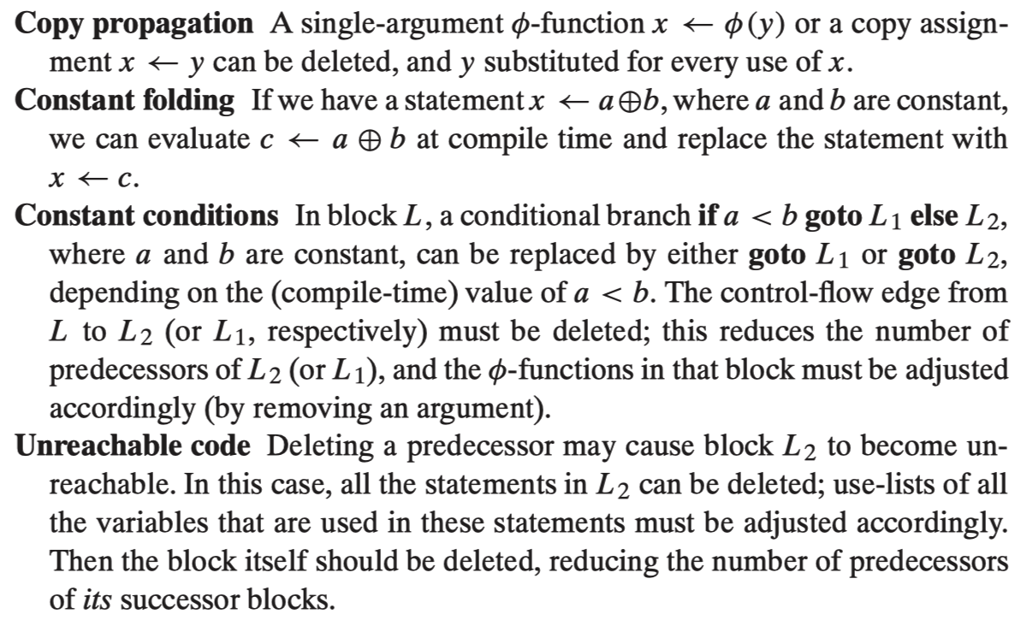
Do All These at the Same Time

Slide 25
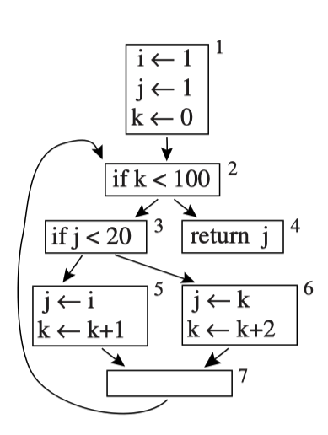
Conditional Constant Propagation
Actually: block 6 can never be reached. How do we find out?

Slide 26
The Idea of the “Least Fixed Point”
We start to assume that no block can be reached, and each variable has no def.
Then we iteratively/gradually find evidence that a variable has a single specific value (i.e., constant), or multiple values, and a block can indeed be reached.

Slide 27
The Idea of the “Least Fixed Point”
k←0
if k<100
k←k+1
return 1

Slide 28
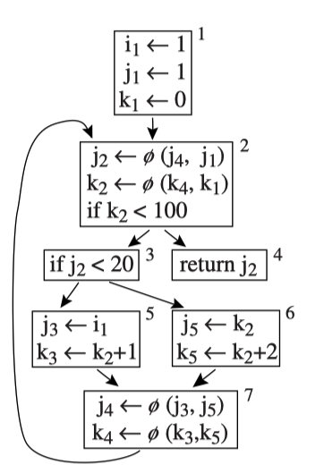
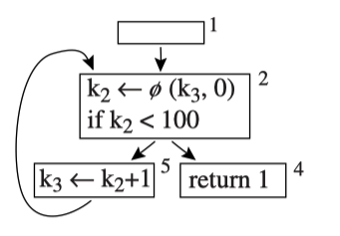
Similar with SSA

Slide 29
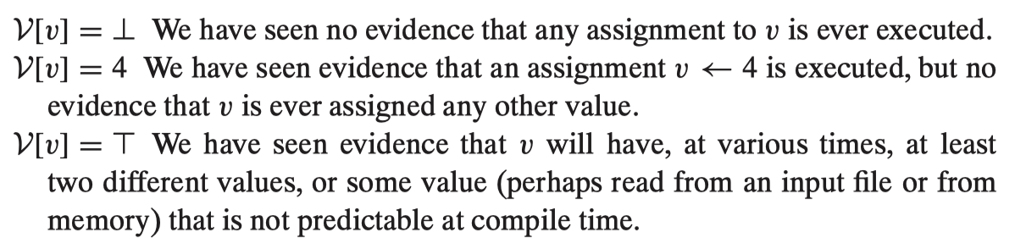
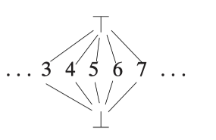
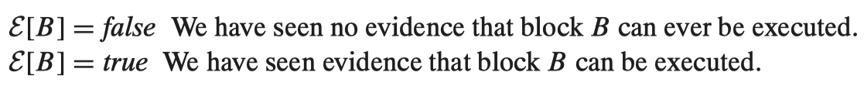
Algorithm with V and E

Slide 30
Algorithm
Any variable v with no deﬁnition, set V[v] ← ⊤.
The start block B1 is executable, set E[B1] ← true.
For any executable block B with only one successor C, set E[C] ← true.
For any executable assignment v ← x ⊕ y where V[x] = c1and V[y] = c2, set V[v] ← c 1 ⊕ c 2 .
For any executable assignment v ← x ⊕ y where V[x] = ⊤ or V[y] = ⊤, set V[v] ← ⊤.
For any executable assignment v ← φ(x1 , . . ., xn ), where V[xi ] = c1, V[xj ] = c2 , c1 <> c2 , the ith predecessor is executable, and the jth predecessor is executable, set V[v] ← ⊤.
For any executable assignment v ← MEM () or v ← CALL(), set V[v] ← ⊤.

Slide 31
Algorithm
For any executable assignment v ← φ(x 1 , . . ., xn ) where V[xi ] = ⊤ and the ith predecessor is executable, set V[v] ← ⊤.
For any assignment v ← φ(x1 , . . ., xn ) whose ith predecessor is executable and V[xi ] = c1; and for every j either the jth predecessor is not executable, or V[xj ] = ⊥, or V[x j ] = c1 , set V[v] ← c1 .
For any executable branch if x < y goto L1 else L2 , where V[x]=⊤ or V[y]=⊤, set E[L1] ← true and E[L 2 ] ← true.
For any executable branch if x < y goto L1 else L2 , where V[x]= c1 and V[y] = c2 , set E[L1 ] ← true or E[L2] ← true depending on if c1 < c2.

Slide 32
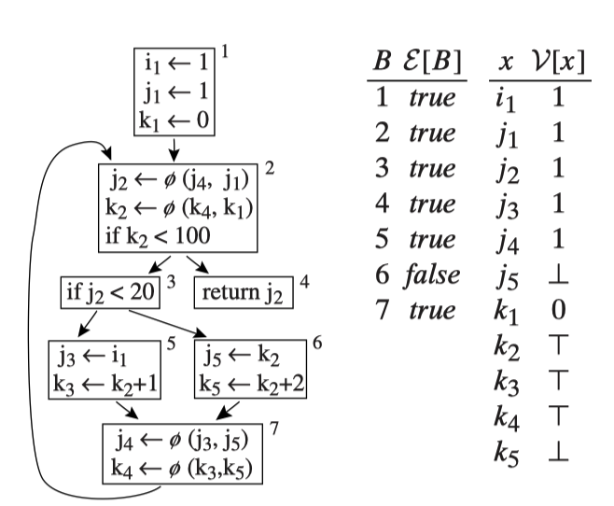
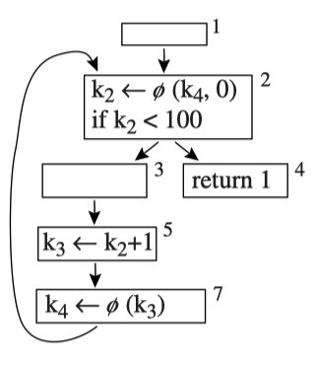

Slide 33
Coalesces in Register Allocation
k2←0
if k2<100
k3←k2+1
k2←k3
return 1
r1←0
Interference Graph:
if r1<100
k2
k3
r1
r1←r1+1
return 1

Slide 34
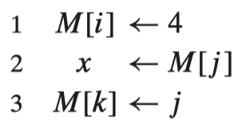
Memory Dependence
Can we view each memory location as a “temp” to apply SSA? (So we may use the same tricks to optimize the code.)
No: because we don’t know if i, j, k have the same or different values.

Slide 35
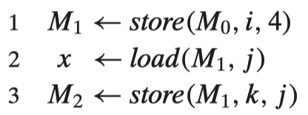
Memory Dependence
May we view the entire memory as a (big) “temp”, like this:
But there is a problem: 3 must be executed after 2, although 3 doesn’t use the value “defined” in 2.
A naïve solution is to avoid touching any memory load/store (e.g., no dead-code elimination on memory store/load)

Slide 36
Conclusion Remarks
Homework 8 is due on this Thursday
Homework 9 is due next Thursday

