Slide 1
编译（H） COMP130014h.01 Week 15
复旦大学计算机科学技术学院
2024-2025第二学期（2025年春季）
主讲：王晓阳（江湾叉二A3021）
xywangcs@fudan.edu.cn
https://daslab.fudan.edu.cn
助教：林琰钧、王雨晨
课堂：周一6-8节（下午13:30开始，HGX303 教室）
实验：周四1-2节（上午8:00开始，H逸夫楼305）

Slide 2
本周内容: Conditional Constant Propagation & Loop Optimizations
Conditional Constant Propagation (HW10)
Loop Optimizations
注意：
本学期余下的工作：
HW10：6月5日due
Quiz #4：6月5日（周四）上午8时
Final Report：6月19日due

Slide 3
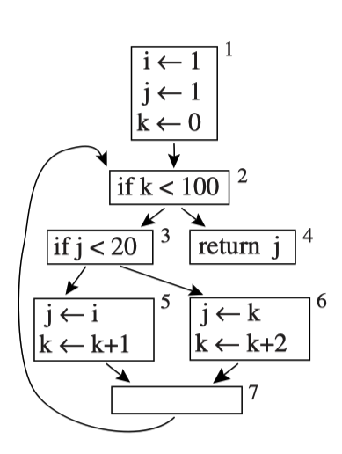
Conditional Constant Propagation (review)
Actually: block 6 can never be reached. How do we find out?

Slide 4
The Idea of the “Least Fixed Point”
We start to assume that no block can be reached, and each variable has no def.
Then we iteratively/gradually find evidence that a variable has a single specific value (i.e., constant), or multiple values, and a block can indeed be reached.

Slide 5
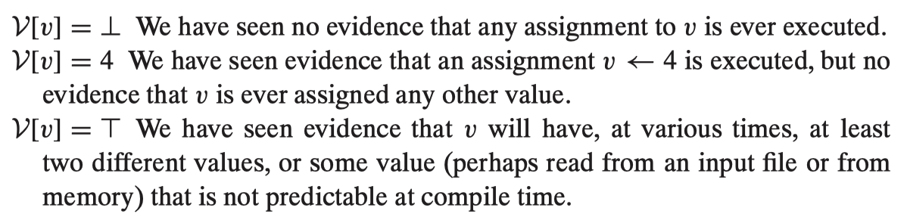
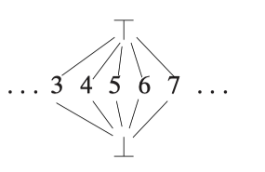
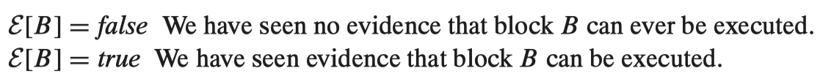
Algorithm with V and E

Slide 6
Algorithm
Any variable v with no deﬁnition, set V[v] ← ⊤.
The start block B1 is executable, set E[B1] ← true.
For any executable block B with only one successor C, set E[C] ← true.
For any executable assignment v ← x ⊕ y where V[x] = c1and V[y] = c2, set V[v] ← c 1 ⊕ c 2 .
For any executable assignment v ← x ⊕ y where V[x] = ⊤ or V[y] = ⊤, set V[v] ← ⊤.
For any executable assignment v ← φ(x1 , . . ., xn ), where V[xi ] = c1, V[xj ] = c2 , c1 <> c2 , the ith predecessor is executable, and the jth predecessor is executable, set V[v] ← ⊤.
For any executable assignment v ← MEM () or v ← CALL(), set V[v] ← ⊤.

Slide 7
Algorithm
For any executable assignment v ← φ(x 1 , . . ., xn ) where V[xi ] = ⊤ and the ith predecessor is executable, set V[v] ← ⊤.
For any assignment v ← φ(x1 , . . ., xn ) whose ith predecessor is executable and V[xi ] = c1; and for every j either the jth predecessor is not executable, or V[xj ] = ⊥, or V[x j ] = c1 , set V[v] ← c1 .
For any executable branch if x < y goto L1 else L2 , where V[x]=⊤ or V[y]=⊤, set E[L1] ← true and E[L 2 ] ← true.
For any executable branch if x < y goto L1 else L2 , where V[x]= c1 and V[y] = c2 , set E[L1 ] ← true or E[L2] ← true depending on if c1 < c2.

Slide 8
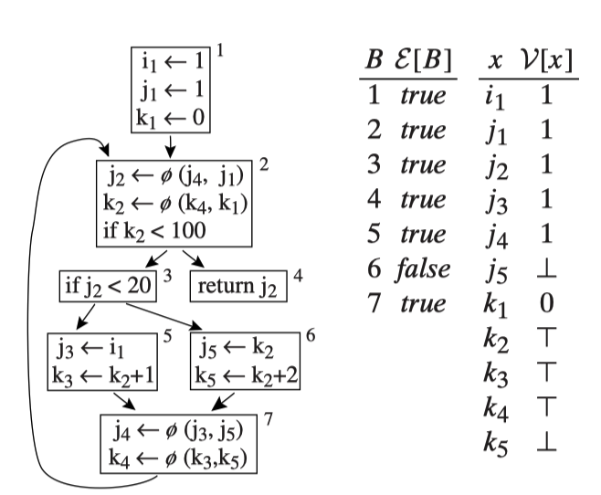
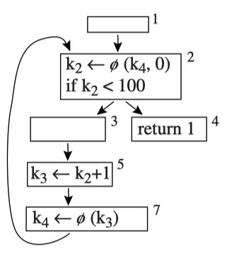
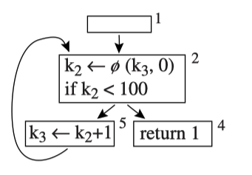

Slide 9
Homework 10 Code Base
Input: *.4-ssa-xml.quad
i.e., conditional constant propagation after SSA formation
Output: *.4-ssa-opt.quad

Slide 10
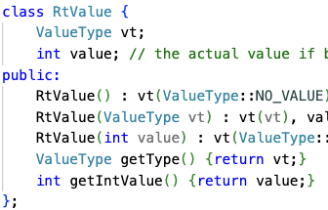
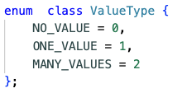
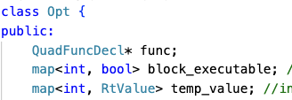
Opt Class
void calculateBT();
void modifyFunc();
This is to calculate (1) the executable blocks and (2) the temp values
This is to change the temp values to consts (if it is const), and remove instructions and blocks when possible

Slide 11
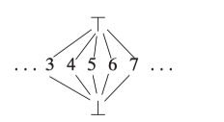
calculateBT: Basic Idea
Compute the fixed point
Basically: “run” each instructions, with operands having three possible values (no_value, one_value, many_values)
If anything changes (any block becomes executable, any temp has “higher” values), then rerun all the instructions.
in terms of
many_values
SSA makes the task much easier!
A lattice of values
no_value

Slide 12
Phi Function: Special Consideration
Due to its “pseudo” instruction nature, we need to be careful about its “computation”.
an input temp has a “useful” value only when the corresponding predecessor is executable
the output temp has “one_value” if all the (“useful”) input temps have the same “one_value” (unless it have “no_value”, why?)
Otherwise, the output temp is “many_values”

Slide 13
Final Comment about RtValues
Each variable is assumed to be defined (before use)
The function parameters are assumed to have “many_values”
All call/load are assumed to generate “many_values”.
Cross function optimization is possible, but not required for HW10

Slide 14
About Executability
Each block is “jumped to” (except for the entry block). So:
A block is executable only if its predecessor is executable, and
If it’s Cjump, then the condition in cjump needs to be “possible” to make the jump
A block has two possible “states”: executable or not. Once it’s executable, it won’t become unexecutable.
executable
Also a “lattice”
unexecutable
j has only one value possible: 1

Slide 15
About Executability: CJump
If the two operands of Cjump are “one_value”, we can compute which branch can be made executable.
If any one operand is “many value”, then we need to assume both branches are executable.
Note that these can change: For example, if one operand changes from “one_value” to “many_values”, then the executability changes.
Remember: we are computing the fixed point

Slide 16
Modify Code: modifyFunc()
Once the fixed point is reached with calculateBT(), we go to every block and instruction to see if we can eliminate the instruction.
If the output of an instruction is “one_value”, then the instruction can be eliminated.
For Cjump, if both operands have “one_value”, then it can be changed to jump.
If a block is not executable, then the block can be deleted.

Slide 17
About the Phi Function
In our Quad design, Phi function doesn’t take constants as parameters
Even if it does take constants, it’s almost the same effect when Quad is prepared for translating to assembly.
We need to insert an instruction that moves the constant to a new temp in the predecessor block, to keep the SSA form
Do this after all the changes are done to the instructions and blocks.
This is very similar to when we prepare Quad for assembly translation (where we delete Phi functions)

Slide 18
Loop Optimizations
Why important?
Most of the execution time spent in some form of loops.
What’s a loop?
Part of a code that’s executed repeatedly.

Slide 19
Loop: Formal Definition with CFG
A loop in a control-ﬂow graph is a set of nodes S including a header node h with the following properties:
From any node in S there is a path of directed edges leading to h.
There is a path of directed edges from h to any node in S.
There is no edge from any node outside S to any node in S other than h.

Slide 20
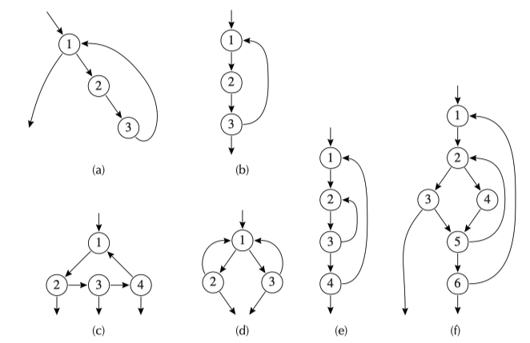
Some loops: in each case, 1 is the header node.

Slide 21
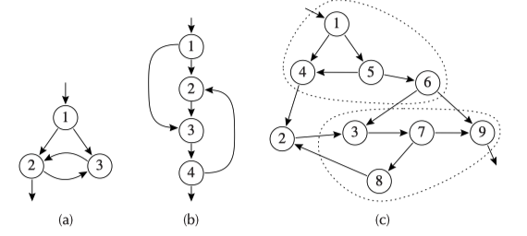
None of these contains a loop
Irreducible ﬂow graph
Delete edges and collapse together pairs of nodes (x, y), where x is the only predecessor of y.
We reach (a) in the end: Also an irreducible flow graph

Slide 22
Natural Loop
The natural loop of a back edge n → h, where h dominates n, is the set of nodes x such that:
h dominates x and
there is a path from x to n not containing h. The header of this loop will be h.
A back edge is an edge in the CFG that’s from a node pointing back to its dominator.

Slide 23
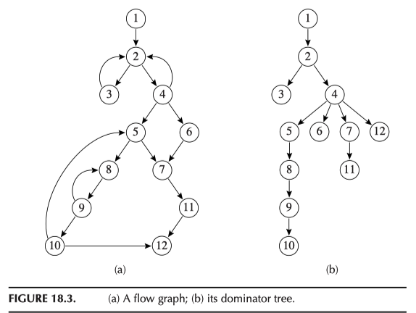
Example Natural Loops
Nested loops If A and B are loops with headers a and b respectively, such that a <> b and b is in A, then the nodes of B are a proper subset of the nodes of A. We say that loop B is nested within A, or that B is the inner loop.

Slide 24
Algorithm to Find loop-nested tree
Compute dominators of G.
Construct the dominator tree.
Find all the natural loops, and thus all the loop-header nodes.
For each loop header h, merge all the natural loops of h into a single loop, loop[h].
Construct the tree of loop headers (and implicitly loops), such that h1 is above h2 in the tree if h2 is in loop[h1].
So we can find the inner most loop at the leaf level.
For convenience, we say the whole function is a loop (at top of the tree)

Slide 25
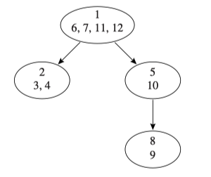
Loop-nested Tree Example

Slide 26
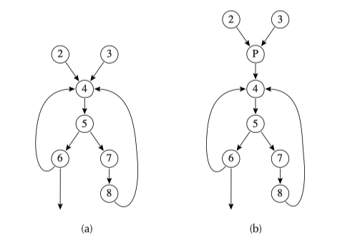
Loop with a preheader
So instructions that may be hoisted out of the loop can be put in node P.

Slide 27
Loop-Invariant Computation
The deﬁnition d : t ← a1⊕ a2 is loop-invariant within loop L if, for each operand ai
ai is a constant,
or all the deﬁnitions of ai that reach d are outside the loop,
or only one deﬁnition of ai reaches d, and that deﬁnition is loop-invariant.

Slide 28
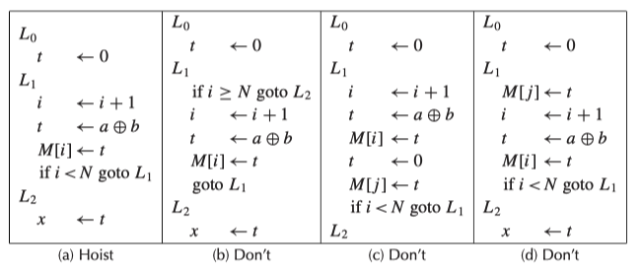
Hoisting
Suppose t ← a ⊕ b is loop-invariant. Can we hoist it out of the loop?

Slide 29
Hoisting Condition
The criteria for hoisting d : t ← a ⊕ b to the end of the loop preheader:
d dominates all loop exits at which t is live-out;
and there is only one deﬁnition of t in the loop,
and t is not live-out of the loop preheader

Slide 30
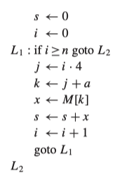
Basic Induction Variables
A variable i is a basic induction variable in a loop L with header node h if the only deﬁnitions of i within L are of the form i ← i + c or i ← i − c where c is loop-invariant.
i is a basic induction variable

Slide 31
Derived Induction Variables
A variable k is a derived induction variable in loop L if:
There is only one deﬁnition of k within L, of the form k ← j ·c or k ← j +d, where j is an induction variable and c, d are loop-invariant;
and if j is a derived induction variable in the family of i, then:
(a) the only deﬁnition of j that reaches k is the one in the loop,
(b) and there is no deﬁnition of i on any path between the deﬁnition of j and the deﬁnition of k.
j is a derived induction variable.
k too

Slide 32
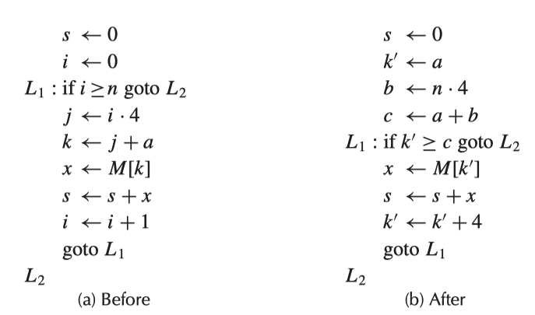
Optimization Example
Replace i ≥ n by k ≥ 4n +a since k=4i+a

Slide 33
Steps Used in the Above Example
Induction-variable analysis (definition)
Strength reduction
Induction-variable elimination
Copy propagation

Slide 34
Strength Reduction
On many machines, multiplication is more expensive than addition. So we would like to take a derived induction variable whose deﬁnition is of the form j ← i · c and replace it with an addition.
e.g.，i ← i+1; j ←j+c
instead of j ←(i+1) · c

Slide 35
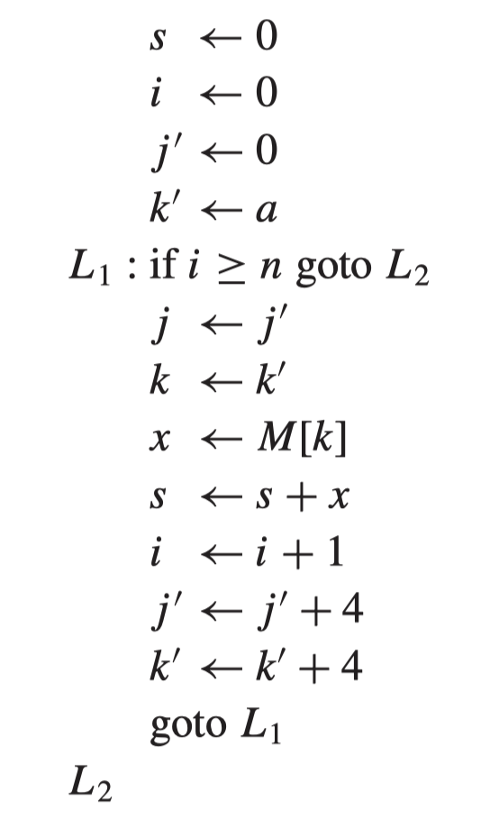
Induction-variable Elimination & Copy Propagation
A variable is useless in a loop L if it is dead at all exits from L, and its only use is in a deﬁnition of itself. All deﬁnitions of a useless variable may be deleted.
Copy propagation: If there is j←j’, replace uses of j by uses of j′ where there is no intervening deﬁnition of j′

Slide 36
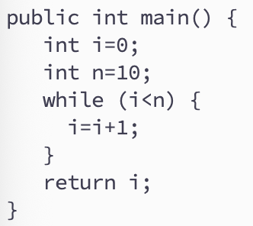
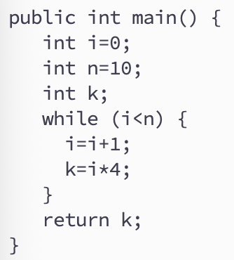
Rewriting Comparisons
A variable k is almost useless if it is used only in comparisons against loop invariant values and in deﬁnitions of itself, and there is some other induction variable in the same family that is not useless.
An almost-useless variable may be made useless by modifying the comparison to use the related induction variable.
no
yes
almost useless

Slide 37
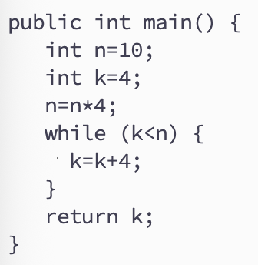
Rewriting Comparisons
i <n => i*4 < n*4 => k < n*4
We may replace i<n with k<n*4
and n*4 may be hoisted out
and replace k=i*4 with k=k+4

Slide 38
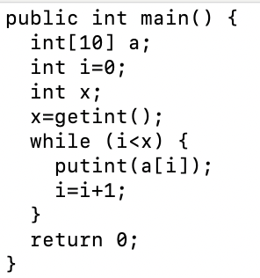
Array-Bound Checks
When using a[i], we need to know if 0<= i<length(a), where length(a) is loop-invariant (if i is unsigned: i<length(a)).
If i is inductive, then bound check may be hoisted out of the loop.
We only need to check outside of the loop if: x-1<length(a)

Slide 39
Array-Bound Checks
Look more closely at the situation:
i is a basic induction var
length(a) is loop invariant
We have exit condition i >= x for the loop
And inside the loop, there is “bound check”: if (i>=length(a)) goto L_{exit}.
We have: i starts with 0 and and i increments by 1 each time, but when i>=x, we exit the loop.

Slide 40
Array-Bound Checks
Therefore,
i always satisfies i>=0
i is at most is x-1
Hence, if x-1 <= length(a), then we are safe: meaning, we can delete this statement:
if (i>=length(a)) goto L_{exit}
And we know x and length(a) are loop invariant, therefore we can do the bound check before the loop.

Slide 41
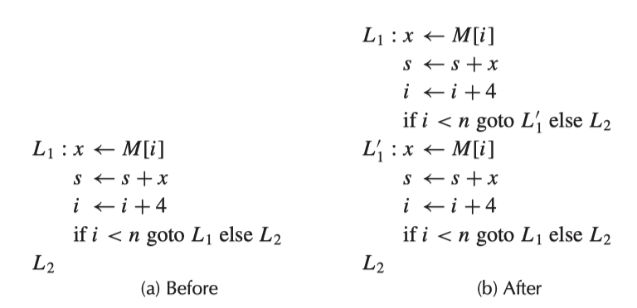
Loop Unrolling
Small loops body
Can save time maintaining the loop counter and testing the exit condition
Idea: unrolling, i.e., putting two or more copies of the loop body in a row.
May use induction vars idea to simplify this

Slide 42
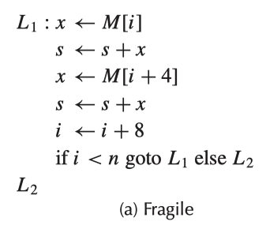
Loop Unrolling
Only works for even number of iterations

Slide 43
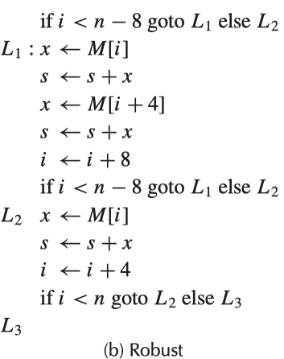
Loop Unrolling
K=2
When a loop is unrolled by a factor of K, then the epilogue is a loop (much like the original one) that iterates up to K − 1 times.

Slide 44
Cross Function Optimization
Inline function
Expand call into the function body
Tail recursion optimization
Convert into a loop

Slide 45
Concluding Remarks
This is the final lecture
See you on June 5 (quiz #4)
尽早告知报名参加编译设计赛

