Slide 1
编译（H） COMP130014h.01 Week 2 (Feb. 24)
复旦大学计算机科学技术学院
2024-2025第二学期（2025年春季）
主讲：王晓阳（江湾叉二A3021）
xywangcs@fudan.edu.cn
https://daslab.fudan.edu.cn
助教：林琰钧、王雨晨
课堂：周一6-8节（下午13:30开始，HGX303 教室）
实验：周四1-2节（上午8:00开始，H逸夫楼305）

Slide 2


Slide 3
本周内容: Program source to abstract syntax (1)
Regular expressions & CF languages
Lexical analysis & Lex
Parsing basics
HW2 (due on March 13, in 2.5 weeks)
Writing & coding assignments parsing
注意： HW1周四晚截止（晚交的将没有分）

Slide 4
Lexical Analysis and Parsing (Lex & Yacc)
Source Code
Lexical Analysis
Based on Regular Expressions
Parsing
Based on Context-Free Grammars
Lexical Analysis
Parsing
Abstract Syntax
Intermediate Rep
Target Code

Slide 5
Two Steps: Lex & Parsing
Lex: Convert text to a stream of “tokens” that the Parser understands (with the help of Regular Expressions)
E.g., the SLP grammar doesn’t deal with instances of id and num
Parsing: Convert the “token” stream to a tree structure (abstract syntax) based on the given grammar

Slide 6
Regular Expressions
Characters + ε (epsilon)
Operators:
Concatenation (﹒, often omitted)
Alternation ( | )
Repetition ( * , 0 or more)
Using parentheses for precedence
ab|c
((ab) | ε) d)*
a* | b*
(a|b)*

Slide 7
Regular Expressions (short hands)
Short hands are usually used, e.g.,
non-empty repetition (+ , 1 or more)
a+ means: aa*
a range of characters [start-end]
[a-z] means: (a|b|c|…|z)
and much more (we will see soon)
[a-z]+
[a-z]+|[a-z]*
a* | b+
(ε|b)[a-b]+

Slide 8
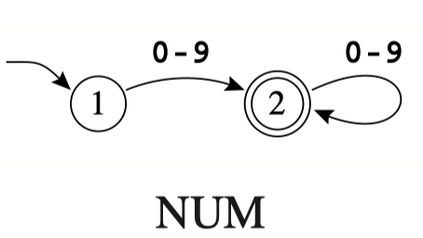
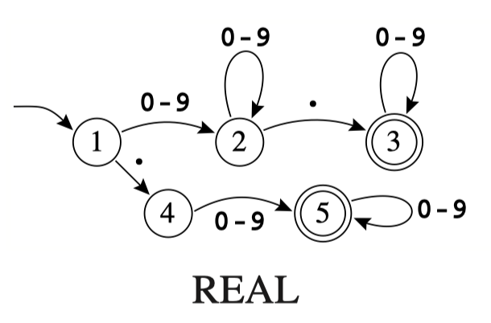
Finite (State) Automata: FA
Deterministic: DFA
Every (state, symbol) pair transit to one state
[0-9]+
([0-9]+"."[0-9]*)|([0-9]*"."[0-9]+)

Slide 9
Finite (State) Automata: FA
Non-deterministic: NFA
A (state, symbol) pair may transit to multiple states
The “symbol” in the above pair may be ε
ε
[0-9]+ | ([0-9]+"."[0-9]*)|([0-9]*"."[0-9]+)

Slide 10


Finite (State) Automata: FA
For each NFA there is always an equivalent DFA
ε
[0-9]+ | ([0-9]+"."[0-9]*)|([0-9]*"."[0-9]+)

Slide 11
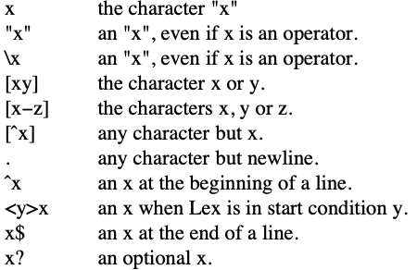
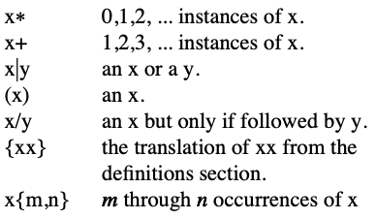
Regular Expressions in Lex
Different text books may use different notations (and short hands)
We use Lex notation (Lex: a program)
Lex Manual: https://www.csee.umbc.edu/~chang/cs431/Lex_Manual.pdf

Slide 12
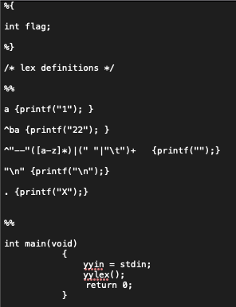
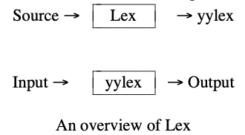
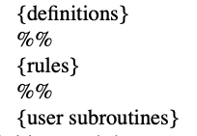
Lex Program Structure
Try this out

Slide 13
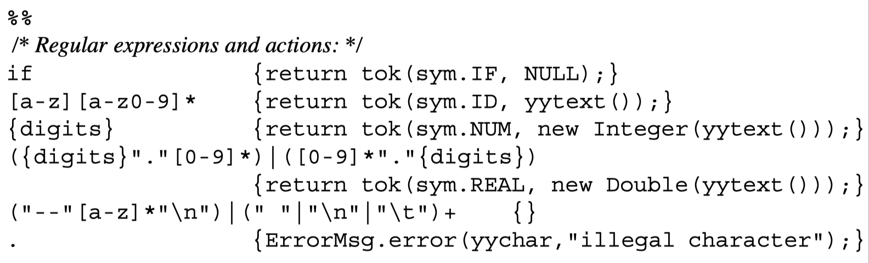
Lex Program Rules
Rule:
regular express {action in C code}
Rules:
A list of rules

Slide 14
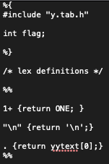
Lex Program Structure
Working with Yacc

Slide 15
Lex: Extra Stuff
Lex may be viewed to parse a simple grammar, like this:
S1 → Re1 S2 | S2 | Empty
S2 → Re2 S3 | S3
S3 → Re3 S4 | S1 (note this goes back)
Etc

Slide 16
Lex: Extra Stuff
S1 → Re1 S2 | S2 | Empty
S2 → Re2 S3 | S3
S3 → Re3 S4 | S1 (note this goes back)
What is a string matches both Re1 and Re2?
First match, and longest match
e.g., Re1 [0-9]+ {intger} Re2 [0-9]*.[0-9]+ {real}
Is “10.9” an integer 10 AND a real .9, or a real 10.9?

Slide 17
Show Some Action
Use try0.lex under hw2/doc/example/someDemocode
make try0
Use t.lex t.yacc
make t

Slide 18
Lex: Extra Stuff
Lex State
<state> Re {action}
Meaning: only in <state>, when Re is matched, do the action
The action part may change the Lex state
If a rule is without a state, then the rule works in all states

Slide 19
Lex State Example
%START AA BB CC
%%
ˆa {ECHO; BEGIN AA;}
ˆb {ECHO; BEGIN BB;}
ˆc {ECHO; BEGIN CC;}
\n {ECHO; BEGIN 0;}
<AA>magic printf("ﬁrst");
<BB>magic printf("second");
<CC>magic printf("third");
%%

Slide 20
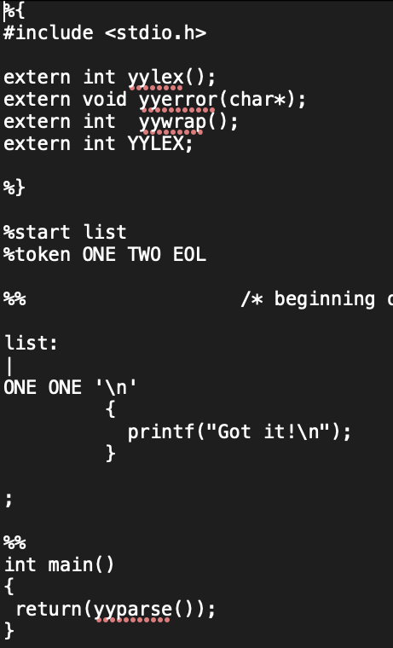
Lex & Yacc

Slide 21
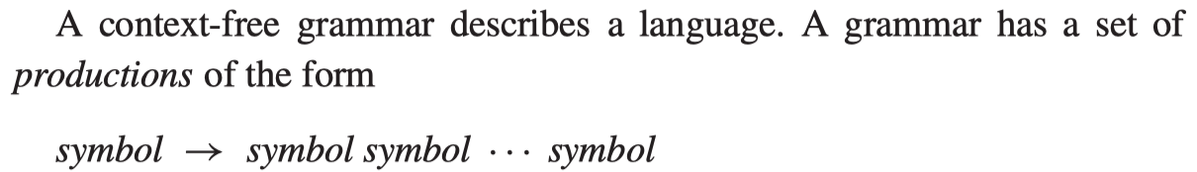
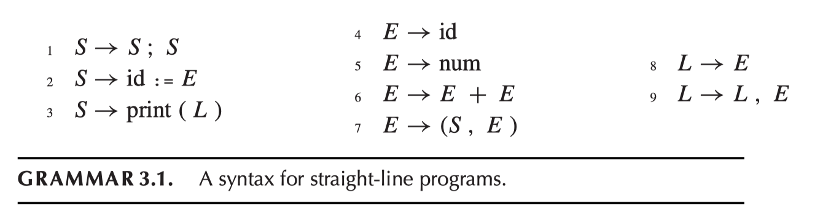
Yacc: Parsing with CFG
A language is a set of character strings
Context Free Grammar

Slide 22
Context-Free Grammar
Derivation
From the “production rule” perspective: how a string is “generated” by using the grammar rules
Left-most derivation, right-most derivation
Parse Tree
Each derivation gives a parse tree

Slide 23

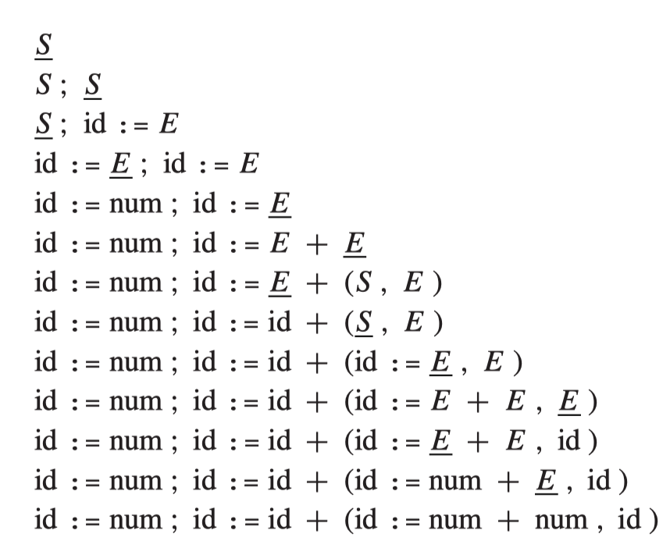
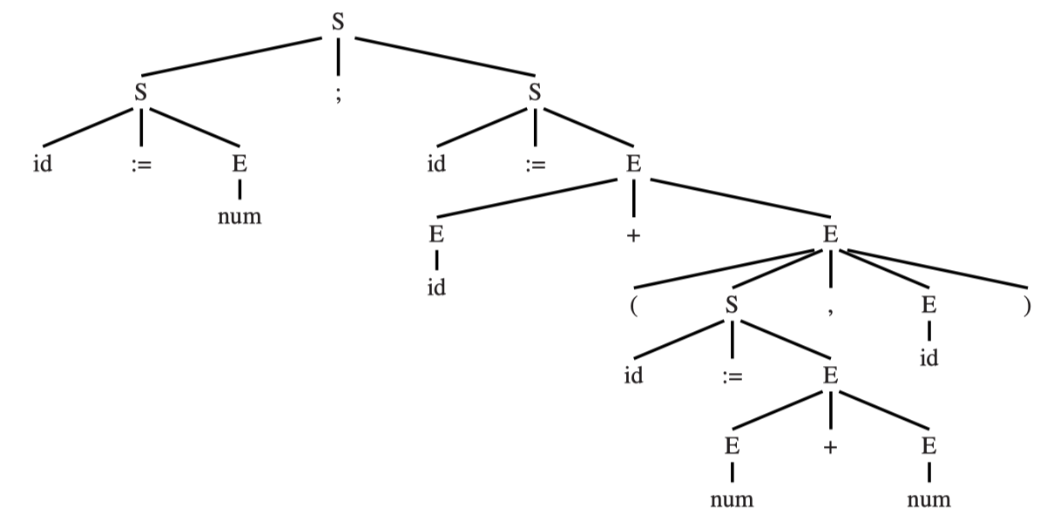
Derivation & Parse Tree Example

Slide 24
Parsing
The core problem:
Often times we don’t know which rule to use when looking at an input symbol
Example: in the previous example, when looking at input symbol “a” (at state S), it’s not clear which rule (of the three rules with S at the head) we should use?
Some grammars are easier (in terms of this core problem) than the others.
Some grammars are “ambiguos”
A string in the language has more than one parse tree

Slide 25
LL(1) Parsing Left-to-right, left-most parsing with 1 token look ahead
First(γ)
the set of the first terminals that can begin strings derived from γ
Follow(X)
the set of the terminals that can immediately follow X
nullable(X)
X can produce an empty word

Slide 26
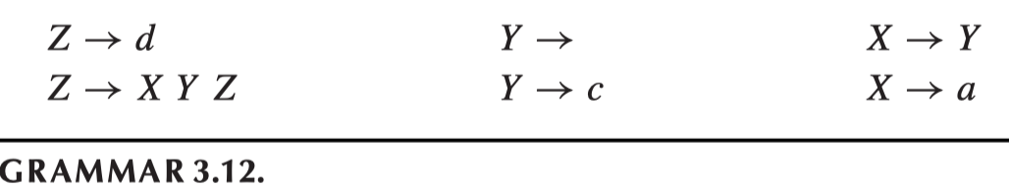
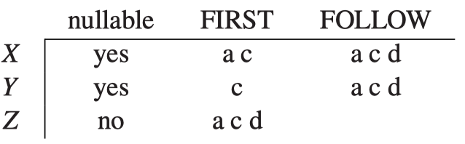
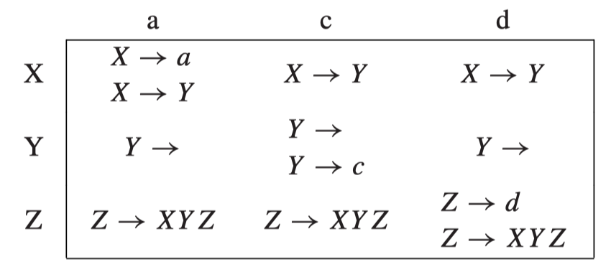
Example and Parsing Table
Parsing Table
String “d” has infinite possible derivations! (“ad” too.) So not LL(1).
Is it LL(2)?

Slide 27
Interesting Transformations
Left recursion:
E → E + T
E → T
T → a
This is not LL(1) (is it LL(2)?)
Change to below (becomes LL(1)):
E → T E’
E’ → + T E’
E’ →
T → a
Note:
S → E $
E → E + E
E → a
is ambigous.
“End of file $” is important!
Add a rule: S → E $

Slide 28
Interesting Transformations
Left factoring:
S → if E then S else S
S → if E then S
Not LL(1) (and ambigous)
Change to
S → if E then S X
X →
X → else S

Slide 29
LR(1) Parsing Left-to-right, right-most parsing with 1 token look ahead
Yacc does this:
“when not sure, postpone the decision”
Use a stack to temporarily hold the input
In state S, looking at “a”, what do we do?

Slide 30
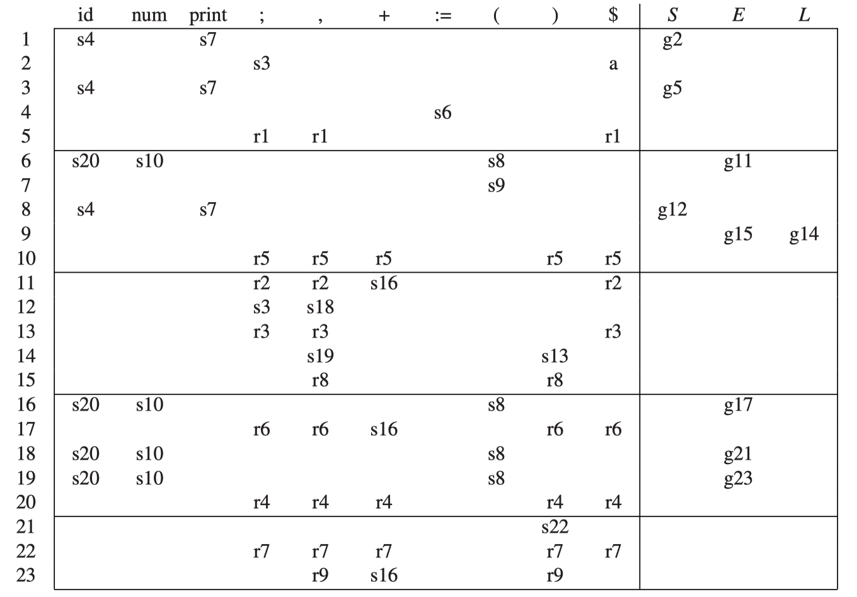
LR(1) Parsing Example

Slide 31
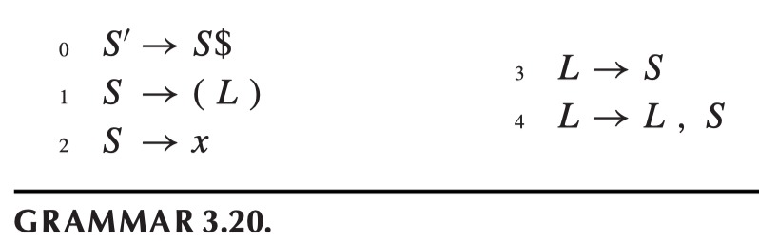
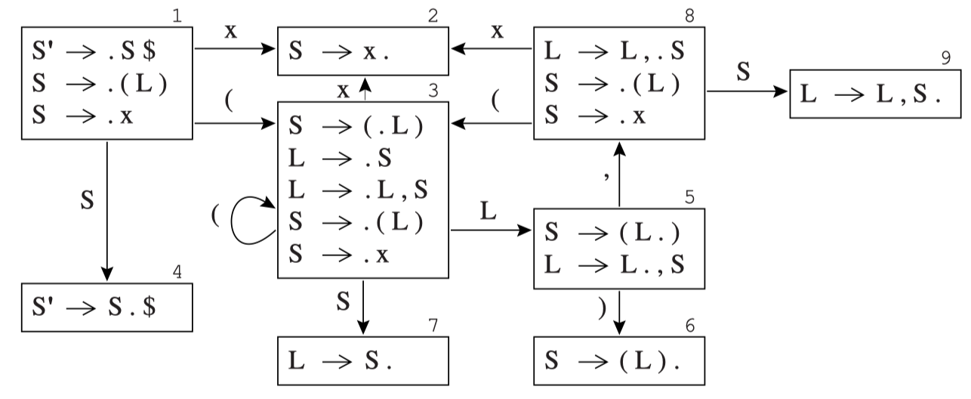
LR(0) Construction Example

Slide 32
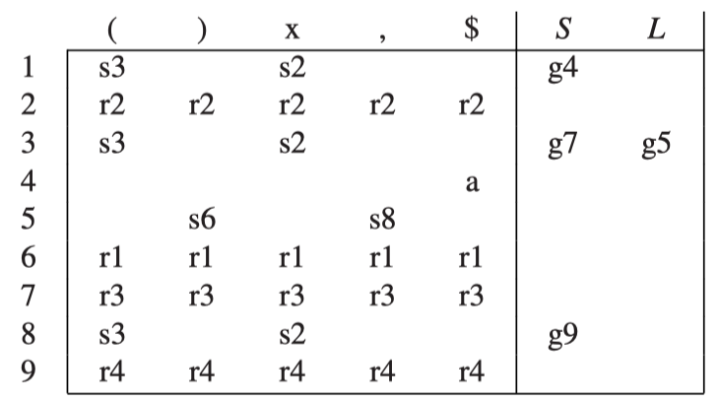
LR(0) Construction Example

Slide 33
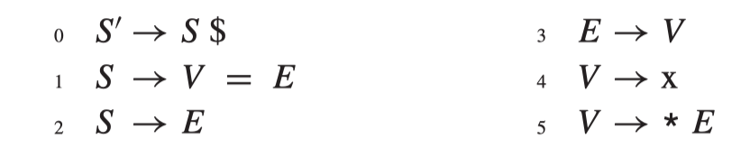
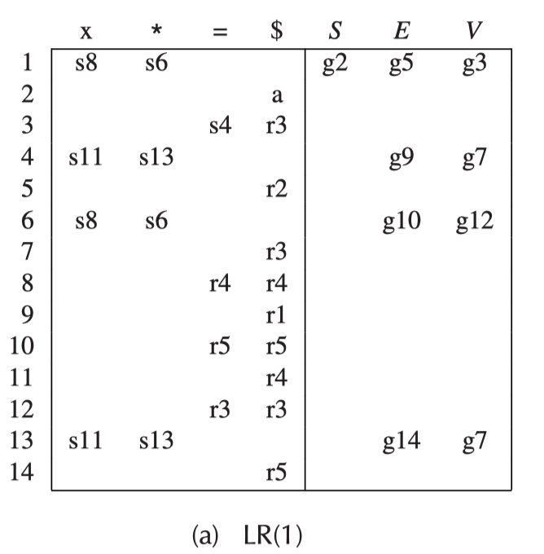
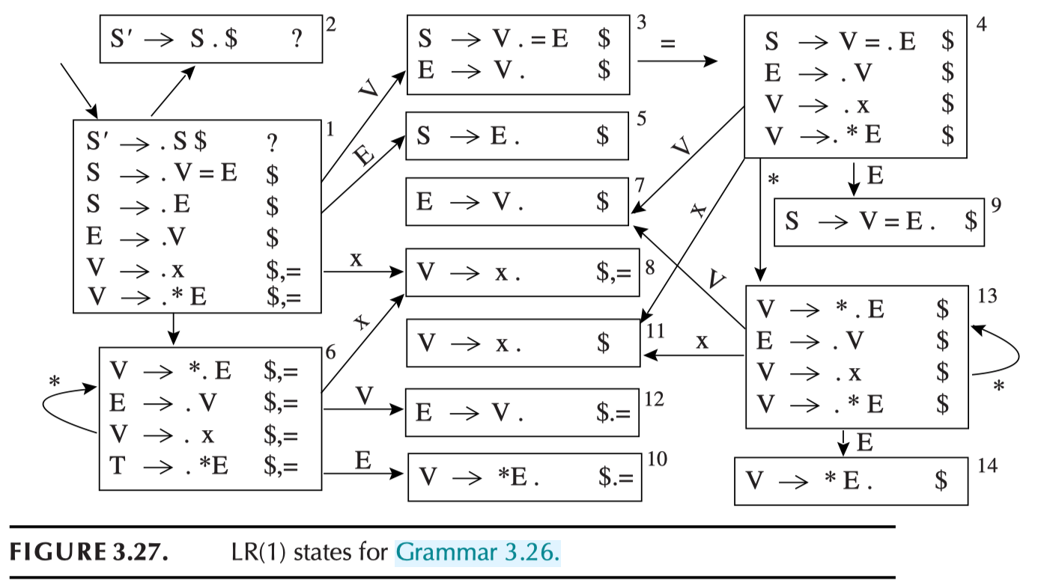
LR(1) Example
Try this: *a = **b

Slide 34
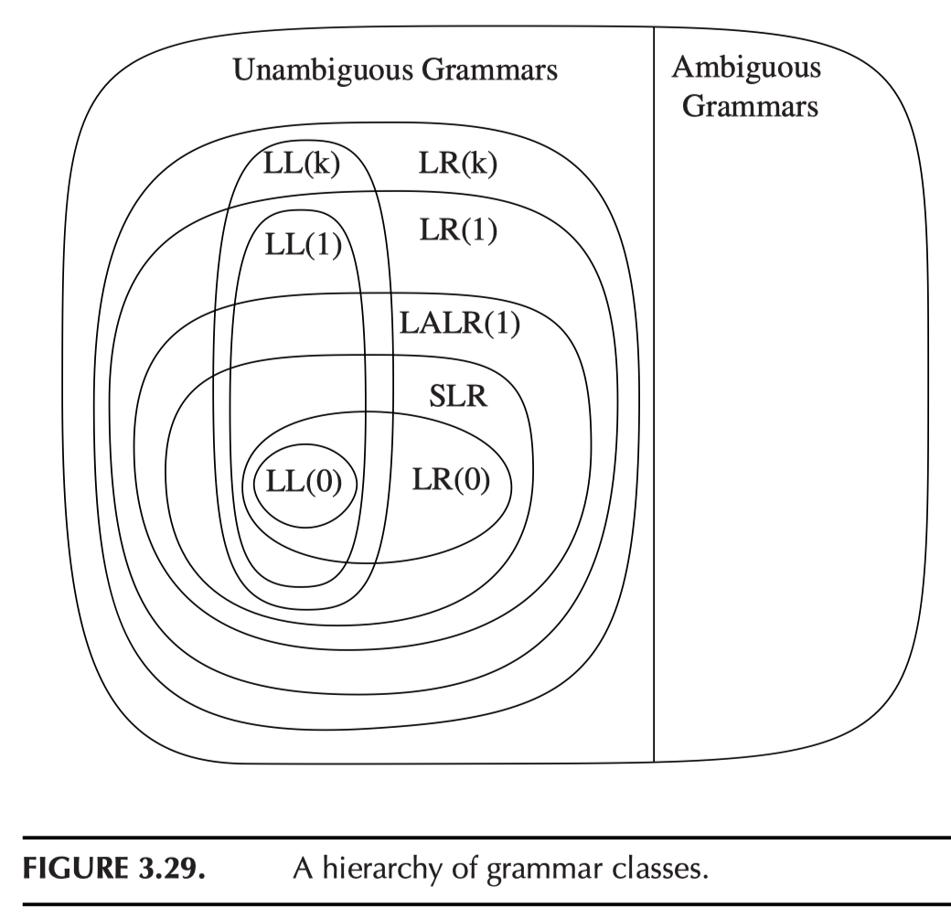
Grammar Classes (NOT language classes)

Slide 35
Parsing & Abstract Syntax
While parsing, whenever there is a “reduce”, it means a node in the abstract syntax tree should be added.
Let’s try the previous two parsing examples

Slide 36
Yacc Structure
Let’s see the calc.yacc example
How do we turn this calc.yacc to produce a syntax tree (based on SLP abstract syntax)?

Slide 37
Homework 2
See assignment text (repo/hw2)
HW2 is due on March 13th (Thursday)
Writing assignment (with some coding)

