Slide 1
编译（H） COMP130014h.01 Week 3 (March 3)
复旦大学计算机科学技术学院
2024-2025第二学期（2025年春季）
主讲：王晓阳（江湾叉二A3021）
xywangcs@fudan.edu.cn
https://daslab.fudan.edu.cn
助教：林琰钧、王雨晨
课堂：周一6-8节（下午13:30开始，HGX303 教室）
实验：周四1-2节（上午8:00开始，H逸夫楼305）

Slide 2
本周内容: Program source to abstract syntax (continued )
Parsing with LL, LR, SLR, LALR (the theory part)
Lex & Parsing conflict resolution
注意： HW2下周周四晚截止

Slide 3
LL(1) Parsing Left-to-right, left-most parsing with 1 token look ahead
First(γ)
the set of the first terminals that can begin strings derived from γ
Follow(X)
the set of the terminals that can immediately follow X
nullable(X)
X can produce an empty word

Slide 4
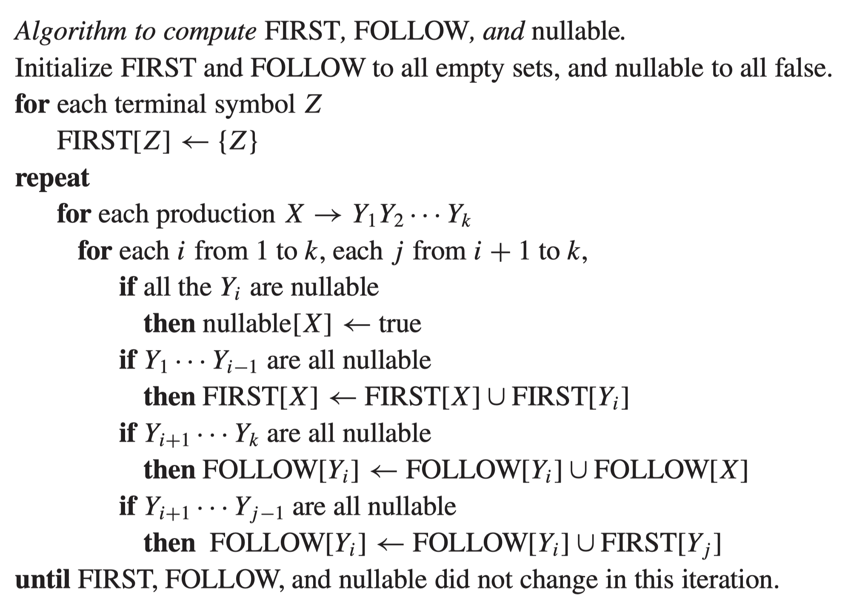
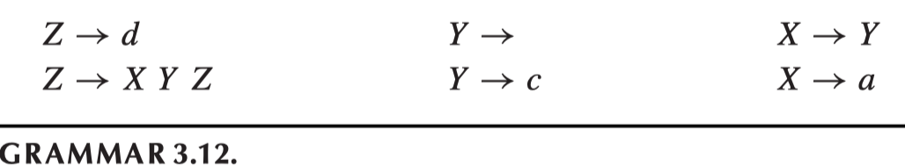

Slide 5
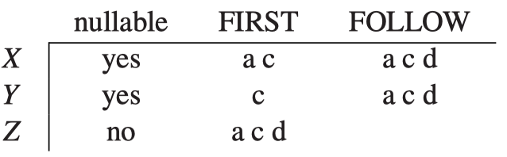
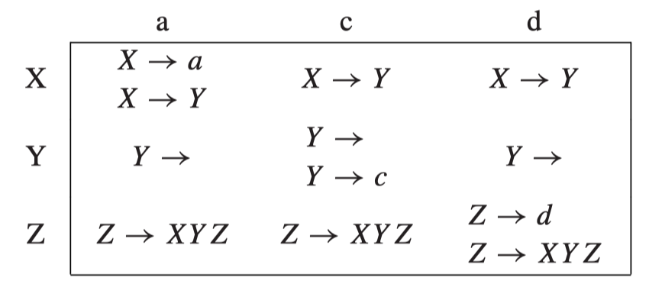
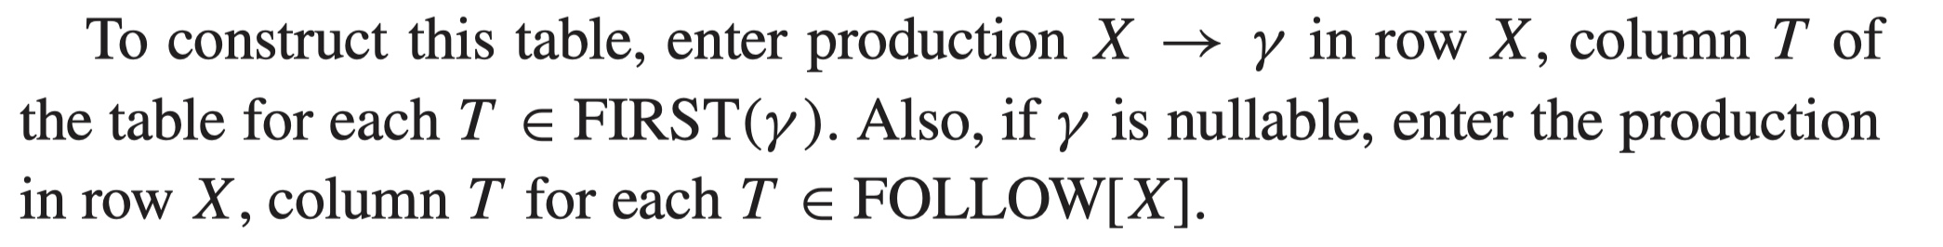
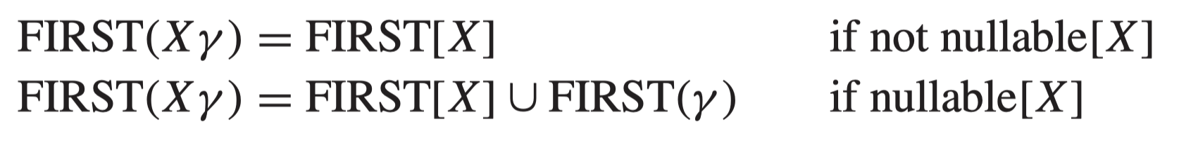
Example and Parsing Table
Predictive Parsing Table

Slide 6
Interesting Transformations
Left recursion:
E → E + T
E → T
T → a
This is not LL(1) (is it LL(2)?)
Change to below (becomes LL(1)):
E → T E’
E’ → + T E’
E’ →
T → a
Note:
S → E $
E → E + E
E → a
is ambigous.
“End of file $” is important!
Add a rule: S → E $

Slide 7
Interesting Transformations
Left factoring:
S → if E then S else S
S → if E then S
Not LL(1) (and ambigous)
Change to
S → if E then S X
X →
X → else S

Slide 8

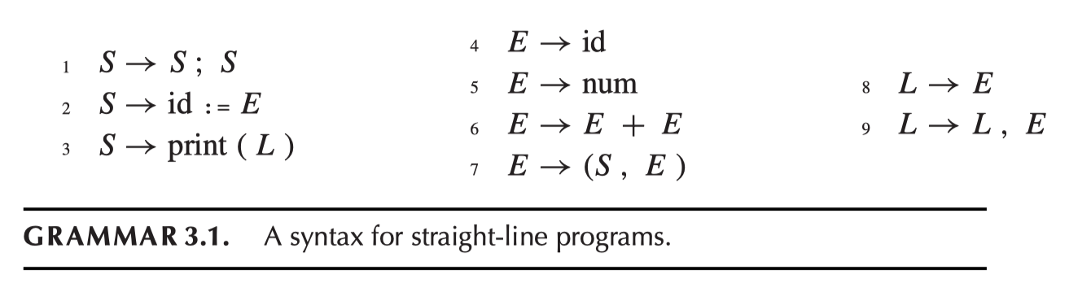
LR(1) Parsing Left-to-right, right-most parsing with 1 token look ahead
Yacc does this (actually it does LALR(1)):
“when not sure, postpone the decision”
Use a stack to temporarily hold the input
In state S, looking at “a”, what do we do?

Slide 9
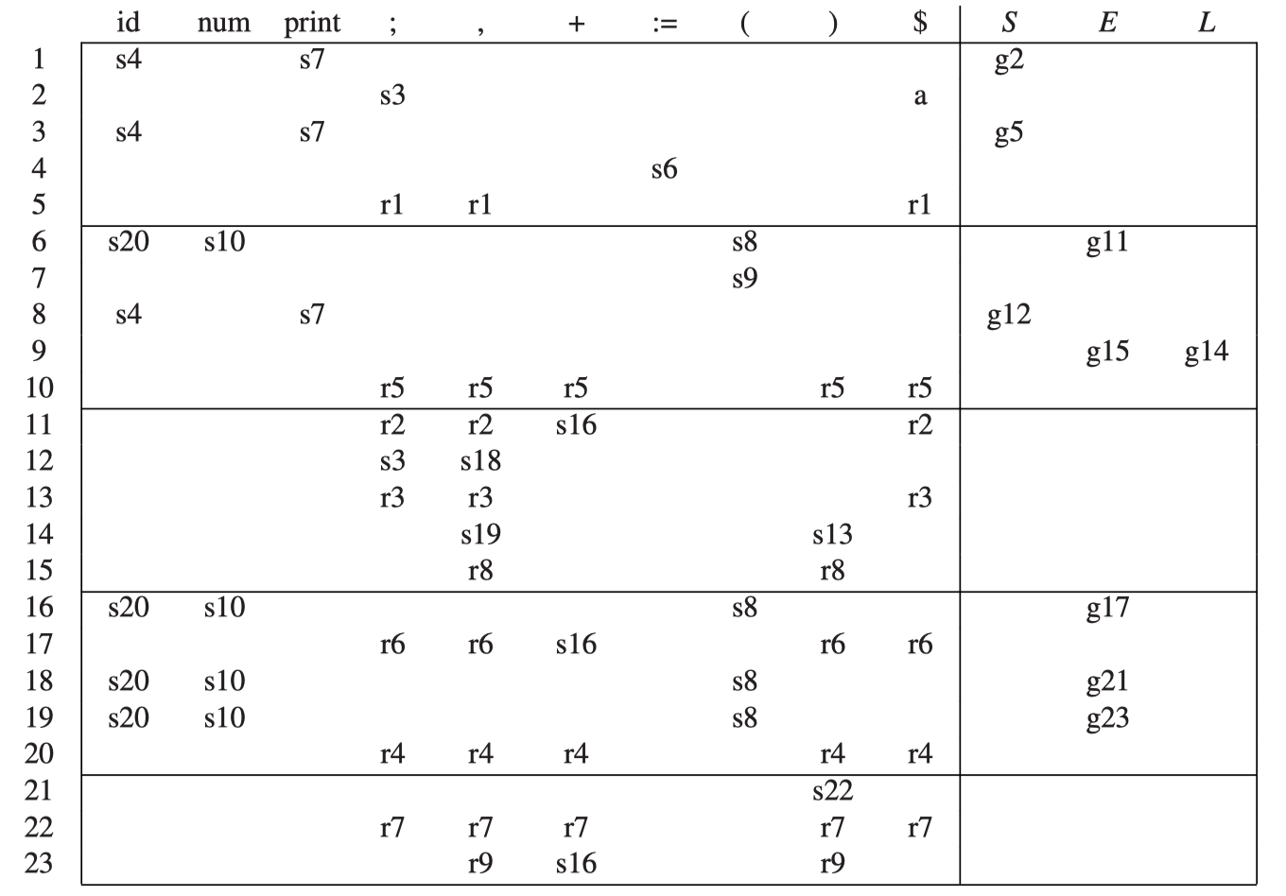
LR(1) Parsing Example

Slide 10
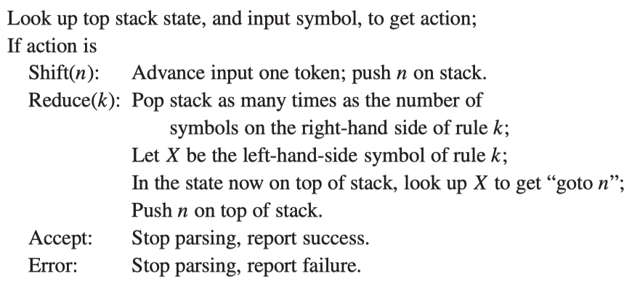
LR(1) Parsing Algorithm

Slide 11
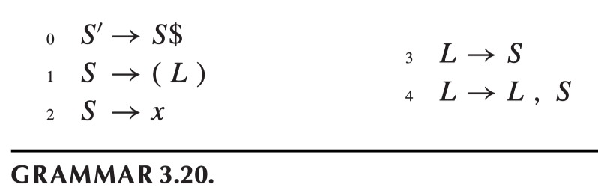
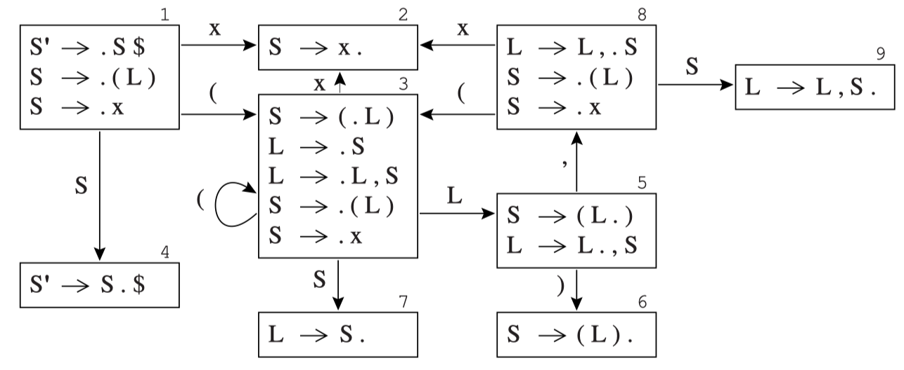
LR(0) Construction Example

Slide 12
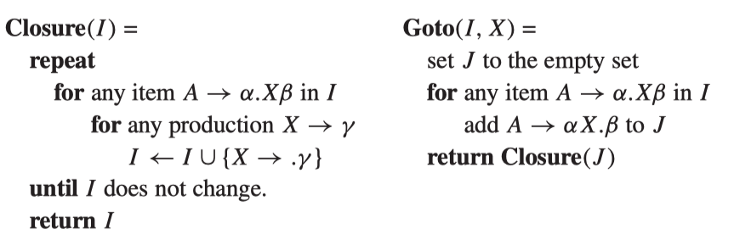
LR(0) Parsing Table Construction
A grammar rule, combined with the dot that indicates a position in its right-hand side, is called an item (speciﬁcally, an LR(0) item). A state is just a set of items.

Slide 13
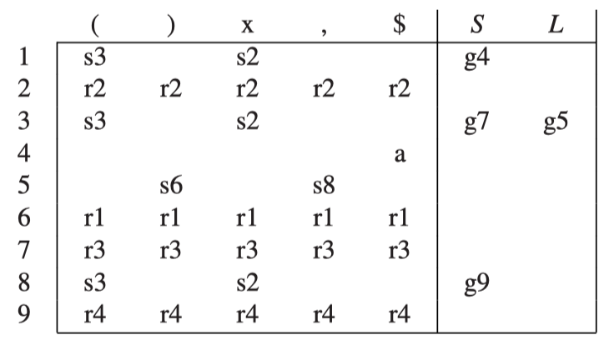
LR(0) Construction Example
(x)
((x,x),x,(x))
(x,(x,(x,x)),x)

Slide 14
SLR-Simple LR
A simple way of constructing better-than-LR(0) parsers is called SLR, which stands for Simple LR. Parser construction for SLR is almost identical to that for LR(0), except that we put reduce actions into the table only where indicated by the FOLLOW set.

Slide 15
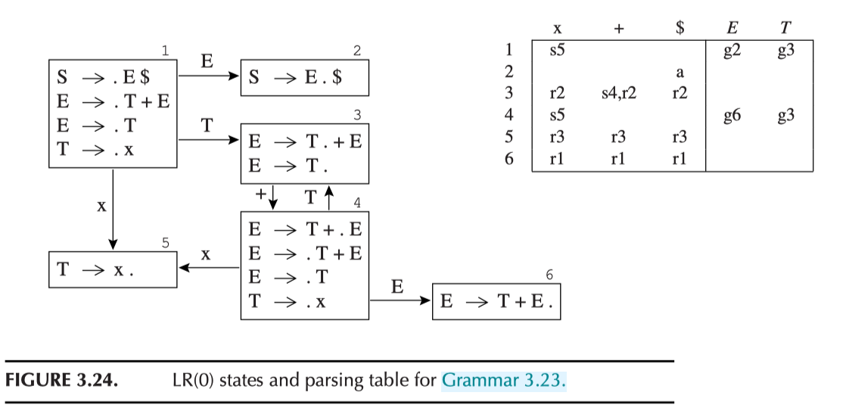
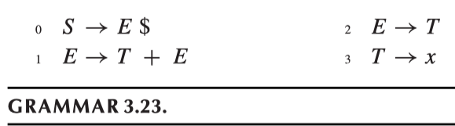
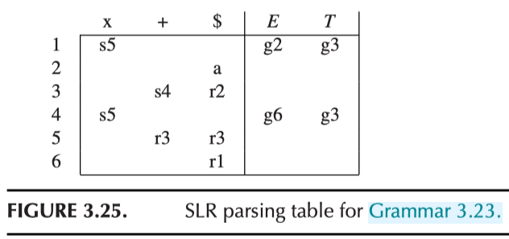
x
x+x
x+x+x+x

Slide 16
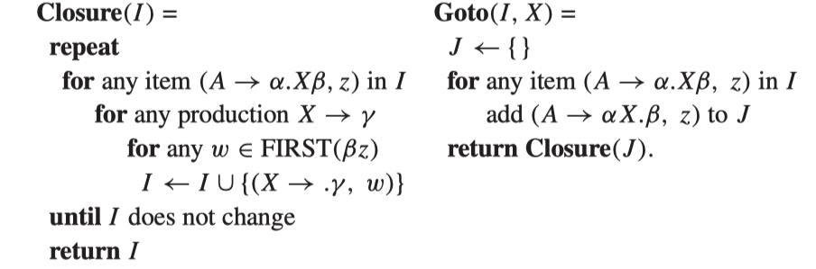
LR(1) Parsing Table Construction
An LR(1) item consists of a grammar production, a right-hand-side position (represented by the dot), and a lookahead symbol.

Slide 17
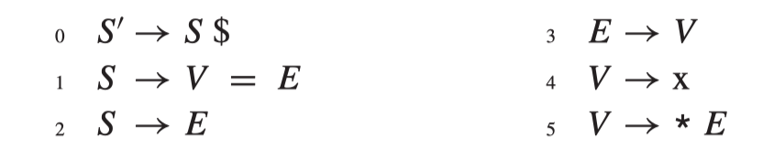
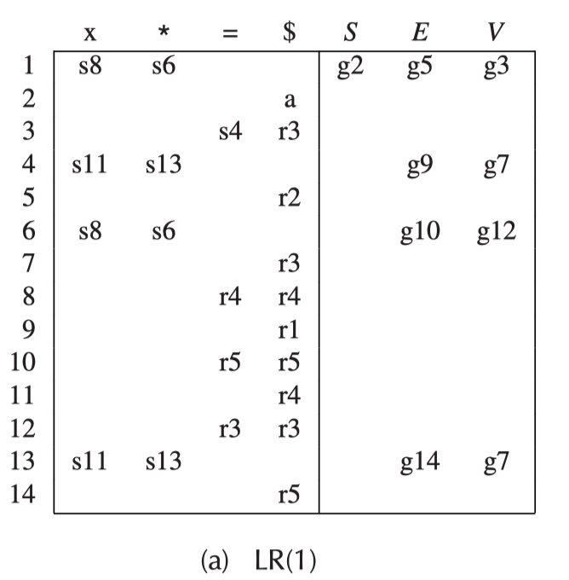
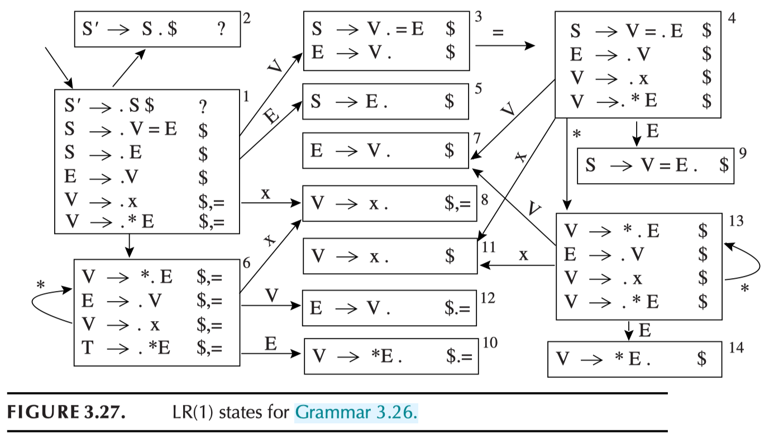
LR(1) Example
Try this: *a = **b

Slide 18
LALR(1)
LR(1) parsing tables can be very large, with many states. A smaller table can be made by merging any two states whose items are identical except for lookahead sets. The result parser is called an LALR(1) parser, for Look-Ahead LR(1).
Yacc does LALR(1)

Slide 19
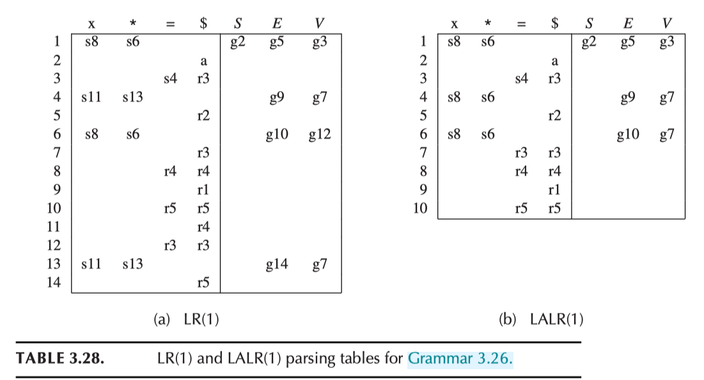
x
*x
**x
x=x
**x=*x

Slide 20
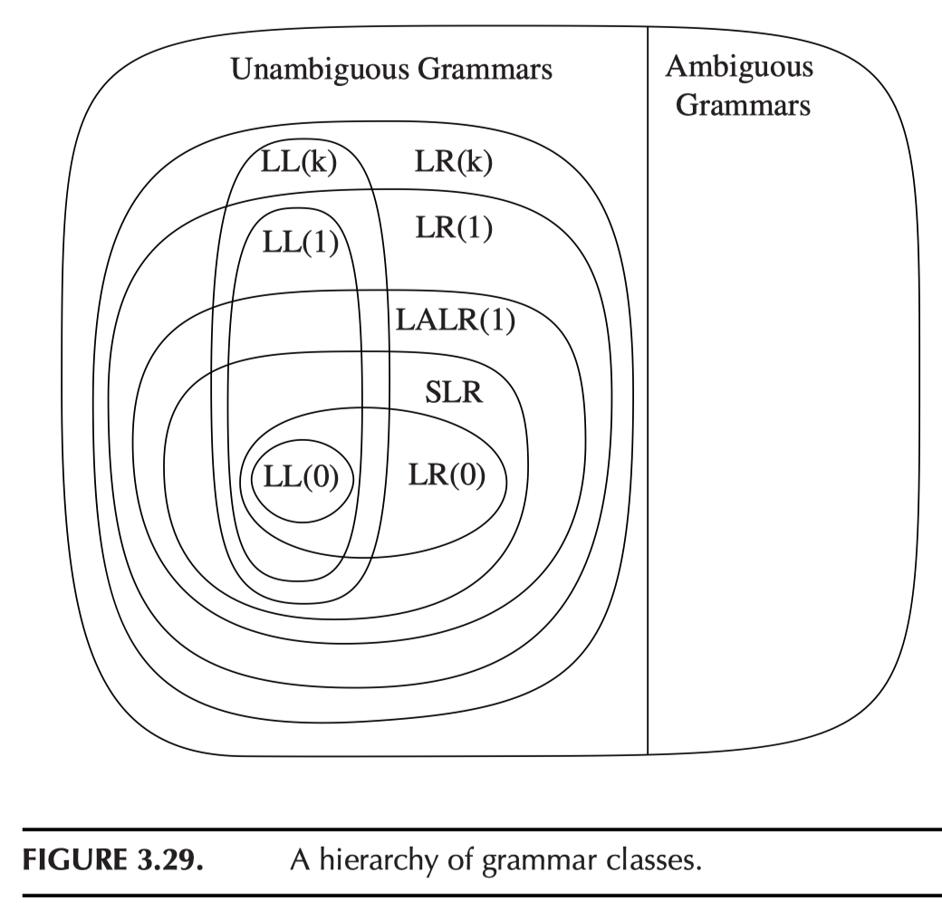
Grammar Classes (NOT language classes)

Slide 21
Lex & Yacc Programs & Parsing Table
Parsing table
Yacc builds a LALR(1) parsing table
LALR(1) = look ahead LR(1)
LR(1) = left-to-right parse, right-most derivation, 1-token lookahead
LALR(1) is built by combining the states of LR(1)
Use –v option of yacc and look into the y.output file.

Slide 22
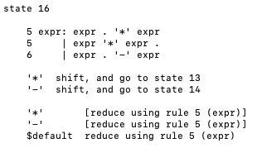
Example 1 (See hw2 on repo)
Grammar below:
expr → expr - expr expr → expr * expr expr → - expr expr → DIGIT | number
This is an ambiguous grammar (why?)
Let’s see the conflicts from running yacc
Use calc1.yacc
copy calc1.yacc to calc.yacc and make
Look at state 11, 16, 17 in y.output

Slide 23
Conflict Resolution in Yacc
Two kinds of conflicts
Reduce-reduce/Reduce-shift
（There is no shift-shift conflict. Why?)
Precedence of rules
Decided by the last “terminal” of the rule
Same terminal token may be left/right associative (or nonassoc) %left +
The precedence of two different “terminals” is based on the order they appear in the file (the later ones have higher priority)
A “trick” is to use a %prec to “give” a token to the rule

Slide 24
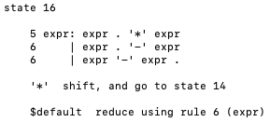
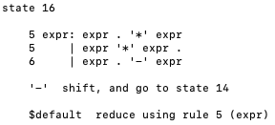
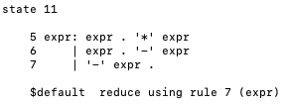
Example 1 (Continued)
Let’s add precedence rules
First: add the rules for tokens
(See: calc2.yacc)
Let’s change the precedence by putting “-” ahead of “*”
(See: calc3.yacc)
Now let’s exam the rule:
“expr → - expr”
Still ambiguous! (why?)
Yacc takes a default reduce action
calc2.yacc
calc3.yacc
calc3.yacc

Slide 25
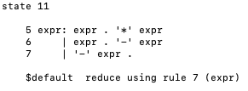
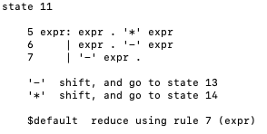
Example 1 (Continued)
This is a “unary operation”
expr → - expr
which should be done before binary ops.
So yacc did the right thing (by default).
How to explicitly make this choice?
Add a “dummy” token and specify the precedence.
See calc4.yacc
Now we can “force” unary operation is always done last (strange, but…)!
See calc5.yacc
calc4.yacc
calc5.yacc

Slide 26
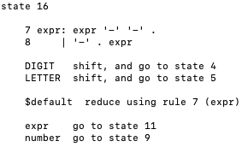
Example 1 (Continued)
Let’s add “--” (like C syntax) into our expression
expr → - - expr
See calc6.yacc
Very ambiguous (why?)
How do we force it into “x-(y-1)”?
What about “x--y”? How about “x-----y”?
What if we want the unary operation to have the highest precedence? (Possible?)
Yacc default action:
calc6.yacc
Think about “x---y”…

Slide 27
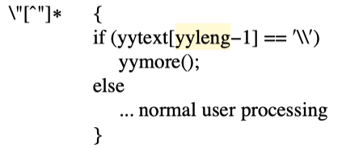
Error Reporting/Correction in Lex
Lex & Yacc has the (global) variable for reporting errors
yytext : the text matched
So: always catch all the text with a rule
yyleng gives the length
So yacc can know the position of the token (by accumulating yyleng value)
yyless(k): function that “returns” text (in yytext) to lex analyzer
k: is the number of tokens to consume (i.e., return everything in yytext except for the first k symbols)
So: we can parse the text a few times, and can even change the text in the input (by changing yytext before calling yyless).
Example: calc1.lex
yymore(): making whatever in the current yytext to attach to the next matched token
To process the strings like: “abc\”de”

Slide 28
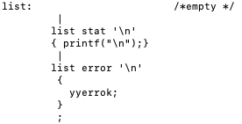
Error Correction in Yacc
The “error” token
If there is an error, yacc behaves as if there is a token “error” is returned by lex
Yacc grammar may use it to its rules to “catch” errors
In our calculator example:
yyerrok is the action to go back to “normal” parsing

Slide 29
Error Behavior of Yacc
When the LR parser reaches an error state, it takes the following actions:
Pop the stack (if necessary) until a state is reached in which the action for the “error” token is “shift”
Shift the “error” token
Discard the input symbols (if necessary) until a lookahead is reached that has a non-error action in the current state
Resume the normal parsing
yyerrok
yyclearin

Slide 30
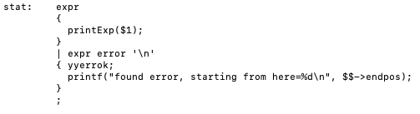
Some More We Can Do
Partial expression may be matched and error message may be more meaningful
If the syntax tree of expr has position information

Slide 31
Add Position Information to AST
See HW1 repo

Slide 32
Homework 2
HW2 due on March 13 (Thursday)
Next assignment (HW3): Parsing FDMJ 2024 to AST

