Slide 1
编译（H） COMP130014h.01 Week 4
复旦大学计算机科学技术学院
2024-2025第二学期（2025年春季）
主讲：王晓阳（江湾叉二A3021）
xywangcs@fudan.edu.cn
https://daslab.fudan.edu.cn
助教：林琰钧、王雨晨
课堂：周一6-8节（下午13:30开始，HGX303 教室）
实验：周四1-2节（上午8:00开始，H逸夫楼305）

Slide 2
本周内容: Parsing & Semantic Analysis
Parsing review & continue
Data types
Semantic Analysis
How to check FDMJ2025
HW3: Semantic analysis for FDMJ programs
HW2本周四晚截止

Slide 3

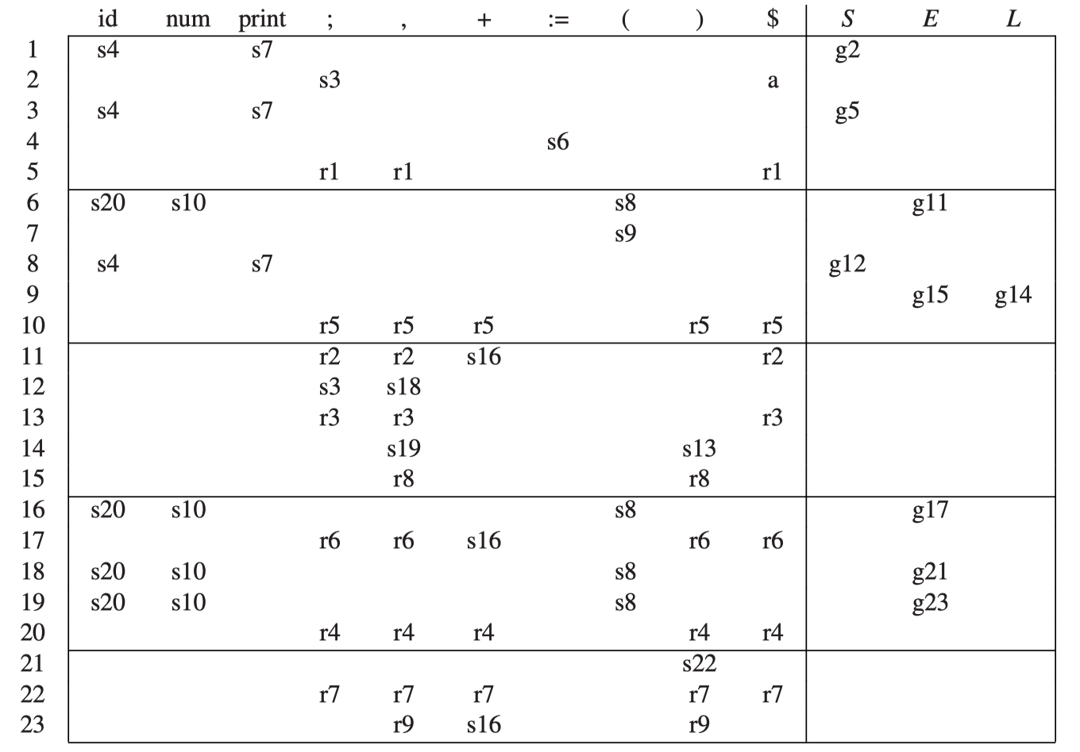
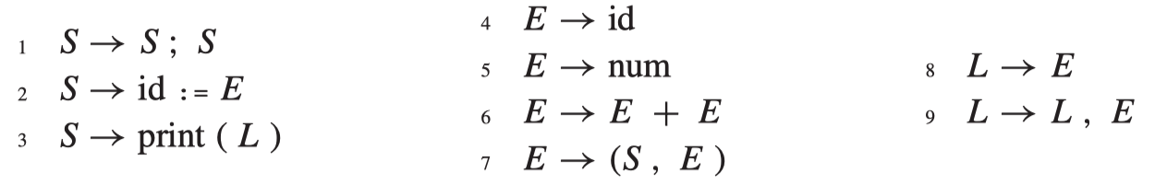
LR(1) Parsing Example

Slide 4
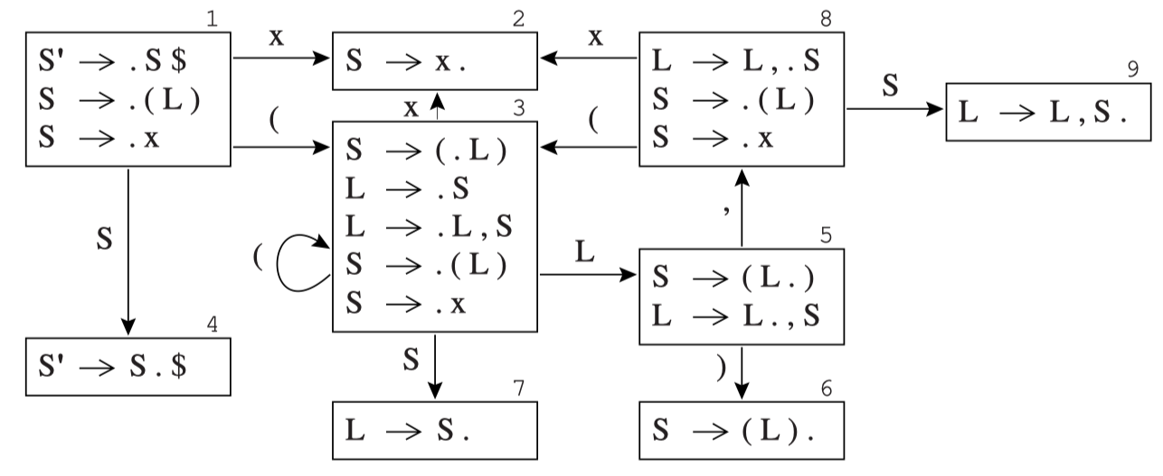
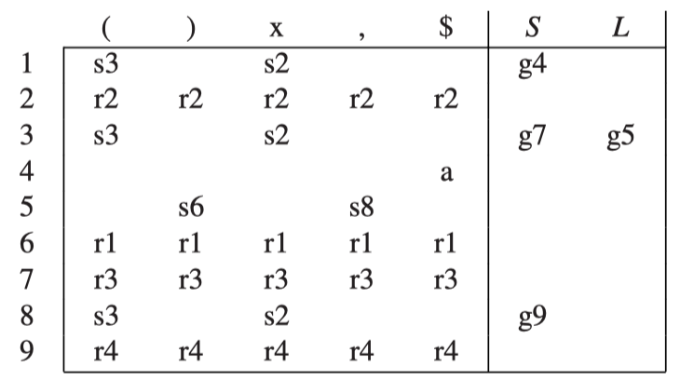
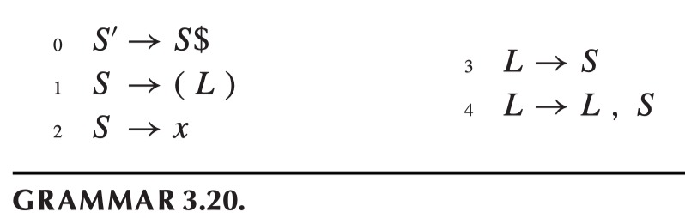
LR(0) Construction Example
(x)
((x,x),x,(x))
(x,(x,(x,x)),x)

Slide 5
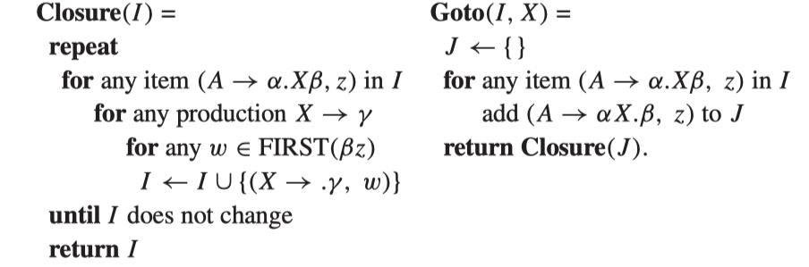
LR(1) Parsing Table Construction
An LR(1) item consists of a grammar production, a right-hand-side position (represented by the dot), and a lookahead symbol.

Slide 6
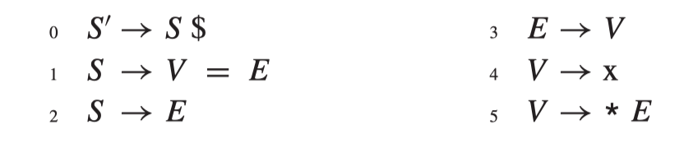
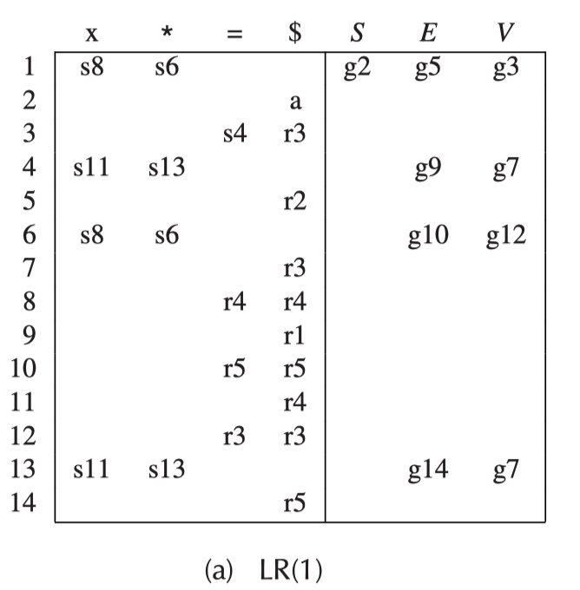
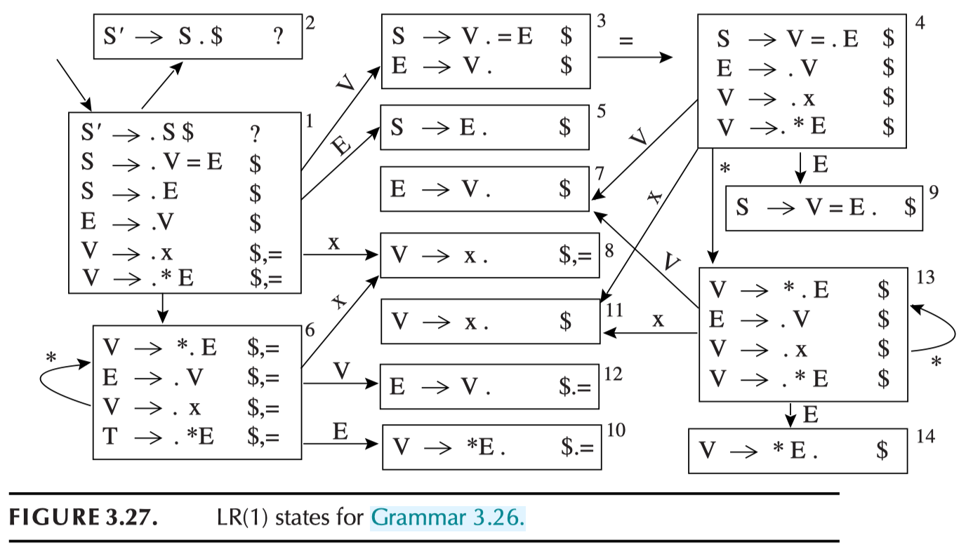
LR(1) Example
S
*
Try this: *x = **x $

Slide 7
LR(0) and LR(1) Construction Example
S’ → S $
S → Aa
A → aAb
A → ε
{a^{n}b^{n}a| n>=0}

Slide 8
SLR-Simple LR
A simple way of constructing better-than-LR(0) parsers is called SLR, which stands for Simple LR. Parser construction for SLR is almost identical to that for LR(0), except that we put reduce actions into the table only where indicated by the FOLLOW set.

Slide 9
LALR(1)
LR(1) parsing tables can be very large, with many states. A smaller table can be made by merging any two states whose items are identical except for lookahead sets. The result parser is called an LALR(1) parser, for Look-Ahead LR(1).
Yacc does LALR(1)

Slide 10
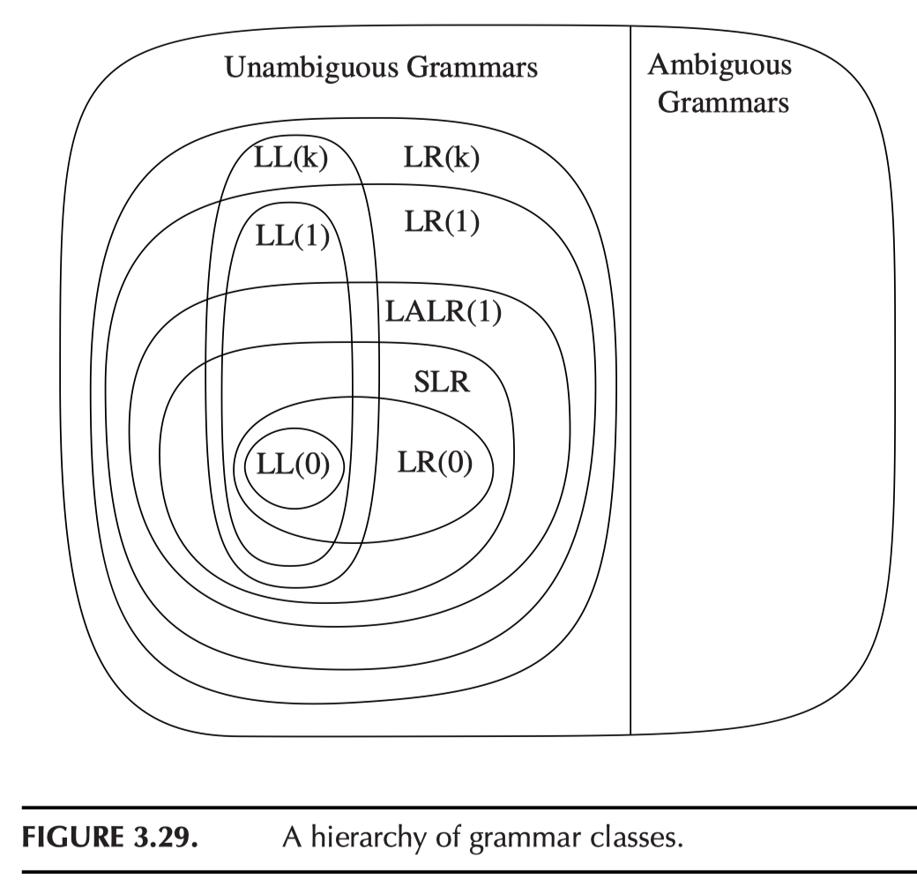
Grammar Classes (NOT language classes)

Slide 11
Lex & Yacc Programs & Parsing Table
Parsing table
Yacc builds a LALR(1) parsing table
LALR(1) = look ahead LR(1)
LR(1) = left-to-right parse, right-most derivation, 1-token lookahead
LALR(1) is built by combining the states of LR(1)
Use –v option of yacc and look into the y.output file.

Slide 12
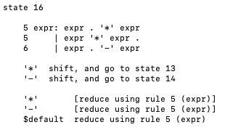
Example 1 (See hw2 on repo)
Grammar below:
expr → expr - expr expr → expr * expr expr → - expr expr → DIGIT | number
This is an ambiguous grammar (why?)
Let’s see the conflicts from running yacc
Use calc1.yacc
copy calc1.yacc to calc.yacc and make
Look at state 11, 16, 17 in y.output

Slide 13
Conflict Resolution in Yacc
Two kinds of conflicts
Reduce-reduce/Reduce-shift
（There is no shift-shift conflict. Why?)
Precedence of rules
Decided by the last “terminal” of the rule
Same terminal token may be left/right associative (or nonassoc) %left +
The precedence of two different “terminals” is based on the order they appear in the file (the later ones have higher priority)
A “trick” is to use a %prec to “give” a token to the rule

Slide 14
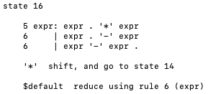
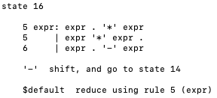
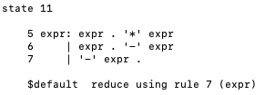
Example 1 (Continued)
Let’s add precedence rules
First: add the rules for tokens
(See: calc2.yacc)
Let’s change the precedence by putting “-” ahead of “*”
(See: calc3.yacc)
Now let’s exam the rule:
“expr → - expr”
Still ambiguous! (why?)
Yacc takes a default reduce action
calc2.yacc
calc3.yacc
calc3.yacc

Slide 15
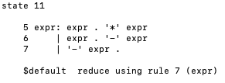
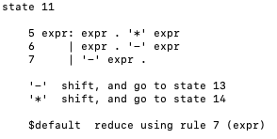
Example 1 (Continued)
This is a “unary operation”
expr → - expr
which should be done before binary ops.
So yacc did the right thing (by default).
How to explicitly make this choice?
Add a “dummy” token and specify the precedence.
See calc4.yacc
Now we can “force” unary operation is always done last (strange, but…)!
See calc5.yacc
calc4.yacc
calc5.yacc

Slide 16
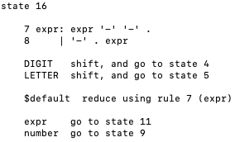
Example 1 (Continued)
Let’s add “--” (like C syntax) into our expression
expr → - - expr
See calc6.yacc
Very ambiguous (why?)
How do we force it into “x-(y-1)”?
What about “x--y”? How about “x-----y”?
What if we want the unary operation to have the highest precedence? (Possible?)
Yacc default action:
calc6.yacc
Think about “x---y”…

Slide 17
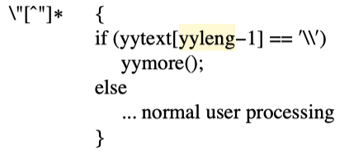
Error Reporting/Correction in Lex
Lex & Yacc has the (global) variable for reporting errors
yytext : the text matched
So: always catch all the text with a rule
yyleng gives the length
So yacc can know the position of the token (by accumulating yyleng value)
yyless(k): function that “returns” text (in yytext) to lex analyzer
k: is the number of tokens to consume (i.e., return everything in yytext except for the first k symbols)
So: we can parse the text a few times, and can even change the text in the input (by changing yytext before calling yyless).
Example: calc1.lex
yymore(): making whatever in the current yytext to attach to the next matched token
To process the strings like: “abc\”de”

Slide 18
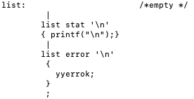
Error Correction in Yacc
The “error” token
If there is an error, yacc behaves as if there is a token “error” is returned by lex
Yacc grammar may use it to its rules to “catch” errors
In our calculator example:
yyerrok is the action to go back to “normal” parsing

Slide 19
Error Behavior of Yacc
When the LR parser reaches an error state, it takes the following actions:
Pop the stack (if necessary) until a state is reached in which the action for the “error” token is “shift”
Shift the “error” token
Discard the input symbols (if necessary) until a lookahead is reached that has a non-error action in the current state
Resume the normal parsing
yyerrok
yyclearin

Slide 20
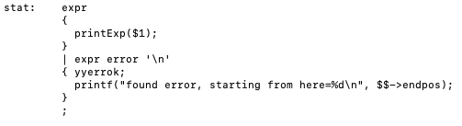
Some More We Can Do
Partial expression may be matched and error message may be more meaningful
If the syntax tree of expr has position information

Slide 21
Data Types
In a general programming language, we may have various data types:
Primitive data types: int, char, bool, float, etc.
Compound data types: array, record, etc.
Access methods are “fixed”.
In object-oriented programming languages, we may have classes and objects.

Slide 22
Data Type
A data type is all of the below:
A collection of values from a “domain”.
An internal structure of a bunch of data, described down to the level of a small set of fundamental types.
A collection of well-defined operations, that can be applied to objects of that type.
A language has
Strong Typing: means that the language prevents you from applying an operation to data on which it is inappropriate.
Static Typing: means that all variables and methods are statically declared and their use can be typed checked at compile time.

Slide 23
Examples
C is not strongly typed, but it is statically typed.
Java is strongly typed,
with a non-trivial mix of things that can be checked statically and things that have to be checked dynamically
FDMJ is strongly typed (more later)
Python is strongly typed but is dynamic and not static

Slide 24
Type Checking
Type inference
What is the type of an expression, given the types of the operands?
Example: a+b
Type correctness
What is the expected type(s) to be used in a particular context?
Example: In “x:=a”, if a is integer, then x should be a location for an integer. When the same x is used in an expression (not on the left of an assignment), x is used as an integer value.
Type compatibility
When can a value of type A be used in a context that expects type B?
FDMJ Example: In o.m() where m is a method of class C1, then o must be in class C1 or a class that’s subclass of C1 that inherits the method m from C1.
Structural equivalence vs name equivalence
Name equivalence is based on declarations (FDMJ uses this!)
Structural equivalence is based on some notion of meaning behind those declarations (we don’t use this)

Slide 25
Type Casting
FDMJ2025 does have casting
We have integer, Boolean
True & false are 1 and 0
But we do allow inheritance!
Most programming languages allow some form of type conversion (or casting), where the programmer can change one type of variable to another.
type conversions (explicit): x = (float) y;
type coercions (implicit): x=y;
sometimes the word 'cast' is used for conversions

Slide 26
Data Types in FDMJ2025
Three different data types:
Integer
Array (of integers)
Class (also called an object type, with a class name)
In FDMJ “everything represents a value”. We have four different kinds of values:
Integer value (abbreviated as “value”)
Pointer value (of two different data types, array or object, abbreviated as “pointer”)
Location value (of four different data types, abbreviated as “location”)
For a memory location (either in the stack or in heap space)
Each location is dedicated to a specific data type.
Method names
Representing function entrance location (instruction space)
Note we don’t have goto statements in FDMJ.
Strongly Typed, except that int and bool are “auto-converted”

Slide 27
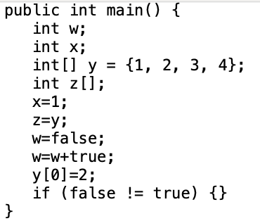
Types in FDMJ: Examples
Variable: integer type is declared
Variable: use its value
Variable: use its location
Variable: use its pointer (to array)
Each expression has a value and may have a location.
e.g. getnum() has a value, but doesn’t have a location

Slide 28
Names in FDMJ2025
Three kinds of names:
Variable name:
Associated with one of the three types
Carries two values: a location value and an integer/pointer value (if defined)
Class name
A class name is not associated with any value
Only used for defining a variable of a class type (or an object, like “class C o;”), or just a pointer value (for the object, like in “new C()”)
Method name:
Is a pointer value, which is the “address” of a “function” (or a method). No location value is associated.
The exact “address” of a method depends on the object on which it is called (also based on the inheritance hierarchy). Or it’s determined at link time (if it’s an external function).
A variable is only in the scope where it is declared
In a method, or
In a class

Slide 29
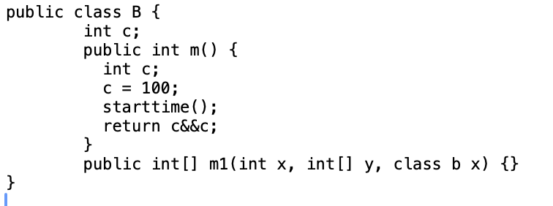
Name in FDMJ2025: Examples
Variable name.
a refers to both a location, and a pointer (for the array)
Class name
Method name
External method name

Slide 30
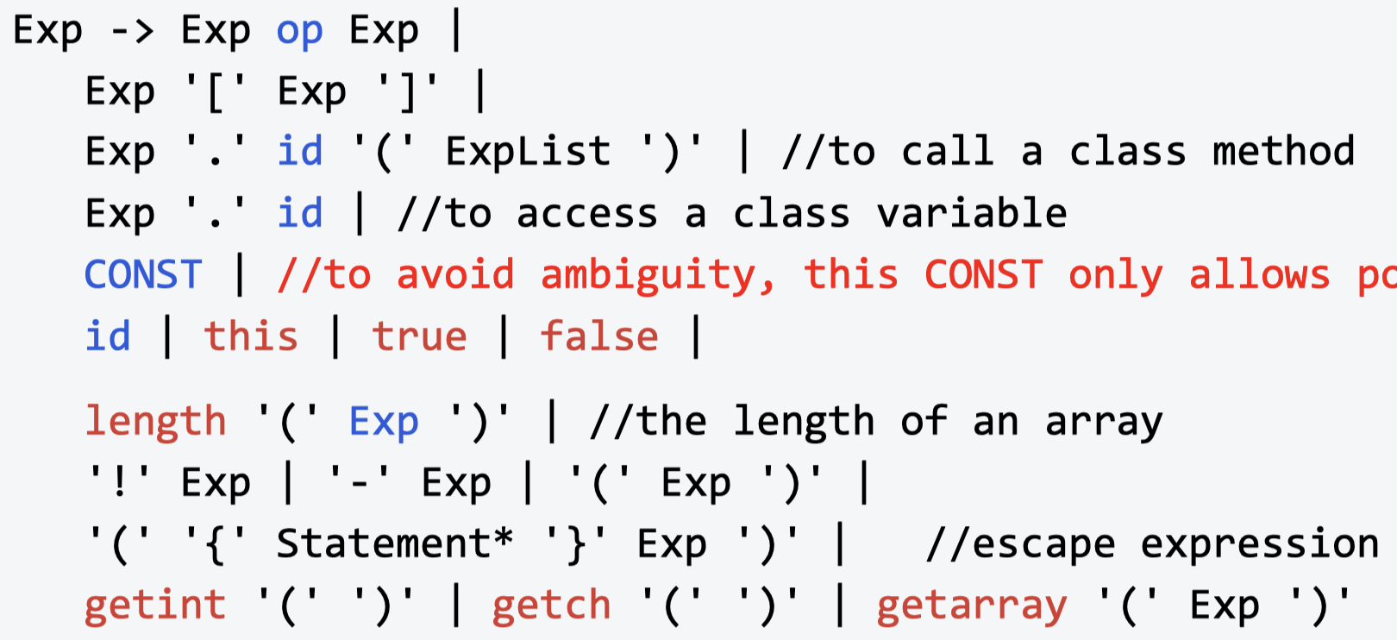
Data Types of Expressions in FDMJ (not complete annotation)
The type is determined by the type of Exp
This Exp must have a pointer to array type.
value
(only has value. No location)
Any express that has only a location but no value?

Slide 31
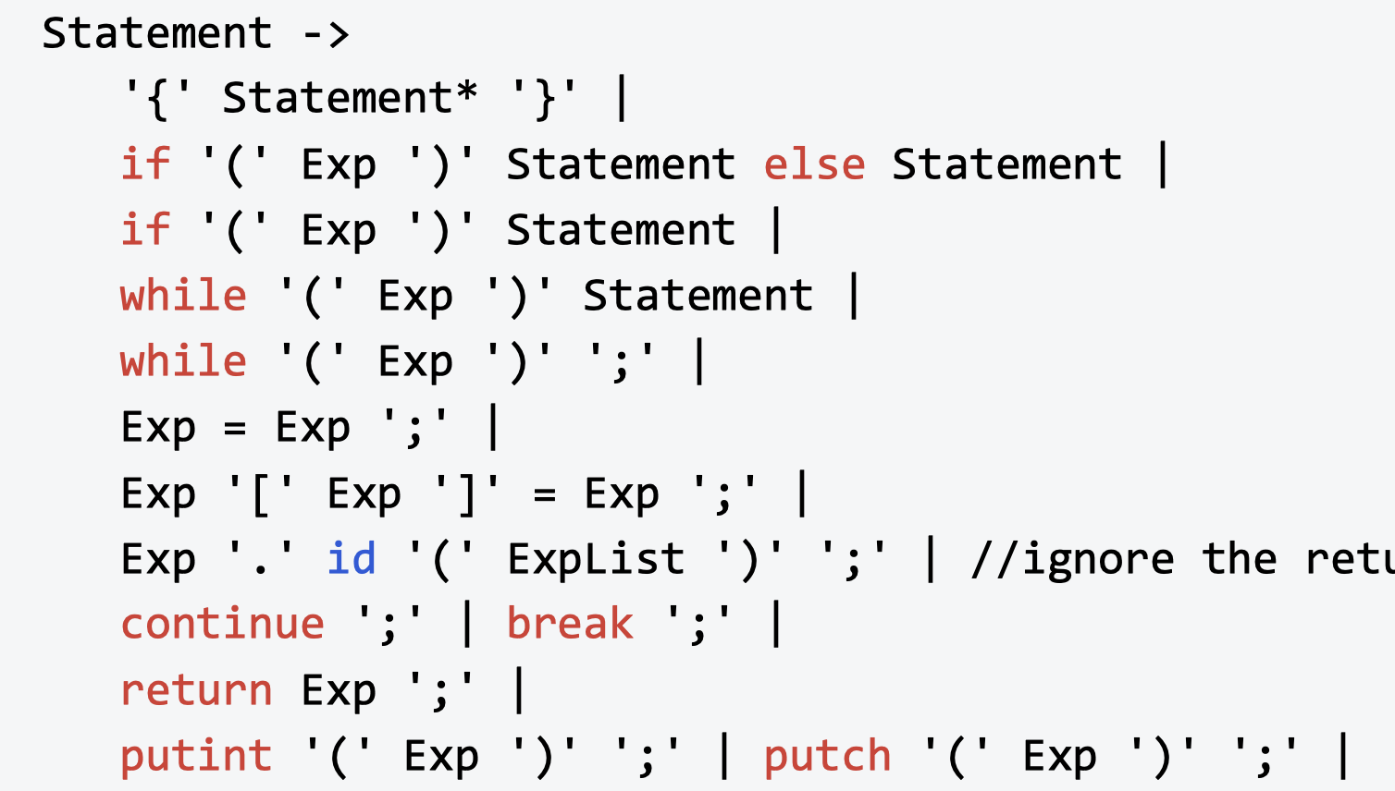
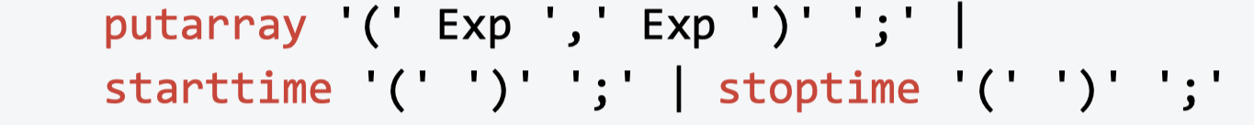
Type Checking for Statements in FDMJ
These exp must have integer (or bool) values.
The right exp must have int/float value or a pointer value, and the left must have a location value (of the same type as the right).
And so on…

Slide 32
Declarations in FDMJ
Extends relationship must be acyclic.

Slide 33
Inheritance in FDMJ
Inheritance rules:
A subclass inherits all its class variables and methods.
A subclass may declare a variable with the same name as in its superclass, overriding the definition of the variable.
Same goes with the methods.
public int main () {
}
public class C1 {
int x;
public int m1() {}
}
public class C2 extends C1 {
int[] x;
public C1 m1() {}
}

Slide 34
Basic Strategy of Type Checking for FDMJ
Build the name table for all the id’s in the source code
See the HW3 Repo for namemap class
Build a semantic object for each node of the AST tree (see semant class)
Type checking
Check each statement at a time, build a table for each expression (with value type, pointer type, and location type), from bottom up, recursively (pre-order traversal)
Then use the rules we have discussed to check the correctness

Slide 35
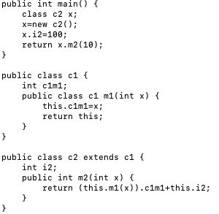
An Example
Class c1: (Variables) | Value Type | Lvalue?
c1m1 | Integer | yes
Class c2: (Variables)
c1m1 | Integer | yes
i2 | Integer | yes
Class Hierarchy
C1
C2
Class c1: (Methods) | Return Type | Formals
m1 | c1 | x: value type: integer, location type: integer
Class C2 (Methods)
m1 | c1 | x: value type: integer, location type: integer
m2 | int | x: value type: integer, location type integer
Formals have value and lvalues
After copying down from superclass, then go through the declarations of a class and fill in the table (overriding the variables and methods of the same name)

Slide 36
HW 3
See HW3 Repo
Parsing for FDMJ
Type checking for FDMJ
To simplify your code: Your program may quit once finding the first type error

