Slide 1
编译（H） COMP130014h.01 Week 5
复旦大学计算机科学技术学院
2024-2025第二学期（2025年春季）
主讲：王晓阳（江湾叉二A3021）
xywangcs@fudan.edu.cn
https://daslab.fudan.edu.cn
助教：林琰钧、王雨晨
课堂：周一6-8节（下午13:30开始，HGX303 教室）
实验：周四1-2节（上午8:00开始，H逸夫楼305）

Slide 2
本周内容: Semantic Analysis & IR
Review: Semantic analysis
FDMJ type checking
Name_Maps & AST_Semant_Map classes
Introducing Tiger IR+
注意：
本周四上午 quiz 1（长度一小时，不要迟到！）
HW3 due 时间延期至下周一（3月24日）晚

Slide 3
Go over some examples in HW3/test

Slide 4
Type Checking Classes
Inheritance rules:
A subclass inherits all its class variables and methods.
A subclass may declare a variable with the same name as in its superclass, overriding the definition of the variable.
The same goes for the methods.
public int main () {
}
public class C1 {
int x;
public int m1() {}
}
public class C2 extends C1 {
int[] y;
public C1 m2() {} }
C2 inherits x and m1 from C1

Slide 5
Type Checking FDMJ with Classes
FDMJ classes and methods
Variables in a class
Methods in a class
“Class casting” (more on this later)

Slide 6
Class Variables & Methods
Java class variables
Class-wide variables
Using static keyword
class c {static int a;…}
We don’t have these in FDMJ
Object (instance) variables
What we have in FDMJ are object variables
Act more like a record
class c {int a;} … c x; c y; x=new c(); y=new c();…

Slide 7
Class Variables & Methods
Java methods are also of class level or object level
static method
Non-static method
We only have non-static methods in FDMJ

Slide 8
Inheritance
A sub-class inherits the variables and the methods of the (super) class. This inheritance relationship is transitive.
Can override (public) variables and methods (variables: overridden by same name. methods: overridden by the same name and signature (polymorphism))
FDMJ only has public variables and methods
In FDMJ, we do not allow overriding variables (can add variables), and the overridden methods must have the same signature (so only implementation is different).
In FMJ, a class can only have at most one superclass (i.e., single inheritance)

Slide 9
Simplifying Assumption for FDMJ
Inheritance rules:
A subclass inherits all its class variables and methods.
A subclass may declare a variable with the same name as in its superclass, overriding the definition of the variable.
But we simplify in this class: No such overriding is allowed!
Same goes with the methods.
But we simplify in this class: the overriding method must have the same signature!
public int main () {
}
public class C1 {
int x;
public int m1() {return true;}
}
public class C2 extends C1 {
int[] x;
public int m1() {return false;}
}
To allow static typing

Slide 10
Class Casting
public class A {
int a=0;
public int a() {return(1);}
}
public class B extends A {
public class B c()
{putint(this.a); return(this);}
public float int a()
{return(2);}
}
class A p; class B c;
c=p; //not OK
p=c; //OK
z=p.a(); //what is x.()’s type?
w=p.c(); //how about this?
A variable, like p, can refer to an object if the object is of the same type as p or if it is a subtype of p. Therefore, “upcasting” is legal.
In FDMJ we DO allow class upcasting!

Slide 11
Class Casting
public class A {
int a=0;
public int a() {return(1);}
}
public class B extends A {
public class B c()
{putint(this.a); return(this);}
public float int a()
{return(2);}
}
Class A p; B c;
c=p; //not OK
p=c; //OK
z=p.a(); //what is x.()’s type?
w=p.c(); //how about this?
p.c() is not available, since we don’t know p has method c (under static checking)
In FDMJ we DO allow class upcasting!

Slide 12
Why should we allow upcast: Example
public class generic-color {public print() {}}
public class black extends generic-color { public print() {}}
public class red extends generic-color { public print() {} }
class generic-color g;
g=new black();
g.print();
g=new red();
g.print();

Slide 13
Go over more examples in HW3/test

Slide 14
Intermediate Representation (IR) 中间表达
Source Code
(Concrete Syntax)
Lexical Analysis
Parsing
Abstract Syntax
Intermediate Rep
Target Code

Slide 15
Intermediate Representation (IR)
Abstract machine code: hides details of the target architecture
yet retains “enough” information for optimization
Allows machine independent code generation and optimization
IR design is an “art” (as design of AST)
x86
AST
IR
Java byte-code
ARM
Optimization

Slide 16
Intermediate Representation
Also accommodate different high-level languages, even of totally different styles
It’s interesting to think about the difference between C/Java and Assembly Language, yet: all programs writing in C/Java may (must) be possible to translate to Assembly.
C AST
x86
Java AST
IR
Java byte-code
Pascal
AST
ARM
Optimization

Slide 17
Optimization and Multiple IRs
Purpose is to get closer to machine code without losing the information for analysis and optimization
Some information in source code may be lost in assembly (like what?)
Multiple intermediate representations may sometimes be used (and preferred).
x86
AST
IR 1
IR 2
Java byte-code
ARM
Optimization
Optimization
Optimization

Slide 18
Tiger IR
Tiger IR is in the form of an expression tree
with side effects
(remember the ESeqExp?)
It’s closer to machine code than to high-level programming languages
Tiger IR will be used to express FDMJ without classes
We will introduce an extension called Tiger IR+ to deal with classes (and methods), and other features.

Slide 19
Tiger IR Example
SEQ(
EXP(
CALL(
NAME starttime)),
SEQ(
MOVE(
TEMP t101,
CONST 1),
SEQ(
CJUMP(GT,
TEMP t101,
CONST 0,
L0,L1),
SEQ(
LABEL L0,
SEQ(
MOVE(
TEMP t100,
CONST 3),
SEQ(
JUMP(
NAME L2),
SEQ(
LABEL L1,
SEQ(
MOVE(
TEMP t100,
CONST 2),
SEQ(
LABEL L2,
SEQ(
LABEL L3,
SEQ(
CJUMP(LT,
TEMP t100,
CONST 10,
L4,L5),
public int main () {
int a; int b; int c;
starttime();
b=true;
if (b) a=3; else a=2;
while (a<10) a=a+1;
putint(a);
stoptime();
return a;
}
SEQ(
LABEL L4,
SEQ(
MOVE(
TEMP t100,
BINOP(PLUS,
TEMP t100,
CONST 1)),
SEQ(
JUMP(
NAME L3),
SEQ(
LABEL L5,
SEQ(
EXP(
CALL(
NAME putint,
TEMP t100)),
SEQ(
EXP(
CALL(
NAME stoptime)),
EXP(
CALL(
NAME return,
TEMP t100)))))))))))))))))))
a: t100
b: t101
c: t102

Slide 20
Tiger IR
Source Language
A program is a series of statements
Variables must be declared, have types
Arrays, but no pointers – don’t explicitly reference memory
Structured control flow: conditionals, loops
Expressions can be deeply nested and complex
Written by users
Tiger IR
A program is a series of statements
Variables aren’t declared, don’t have types
Pointers, no arrays – calculate offsets in memory
Unstructured control flow: labels, jumps
Expressions can be deeply nested and complex, might even access memory!
Nobody sees it but the compiler!
Target Language
A program is a series of statements
No variables, just a fixed set of registers
Pointers, no arrays – calculate offsets in memory
Unstructured control flow: labels, jumps
One operation (addition, subtraction, comparison, memory access) per expression
Run by the CPU

Slide 21
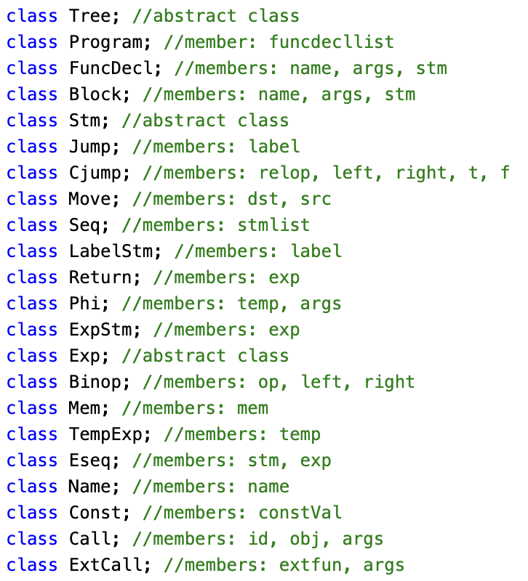

Tiger IR+ (Tree)

Slide 22
Temporaries & Labels
Before going further with Tiger IR…
Temporaries: to hold variables
Can map to registers or memory locations
Job for “Register allocation” (optimization)
Labels: to hold the code locations
For targets of jumps
These can be constructed when AST is translated to IR

Slide 23
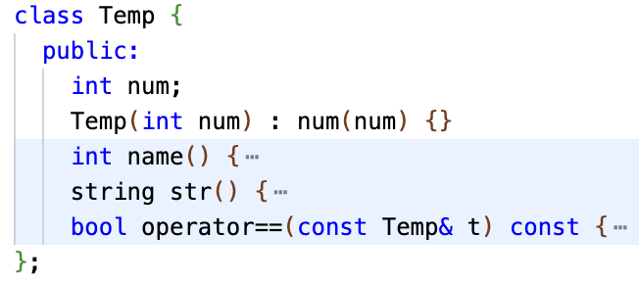
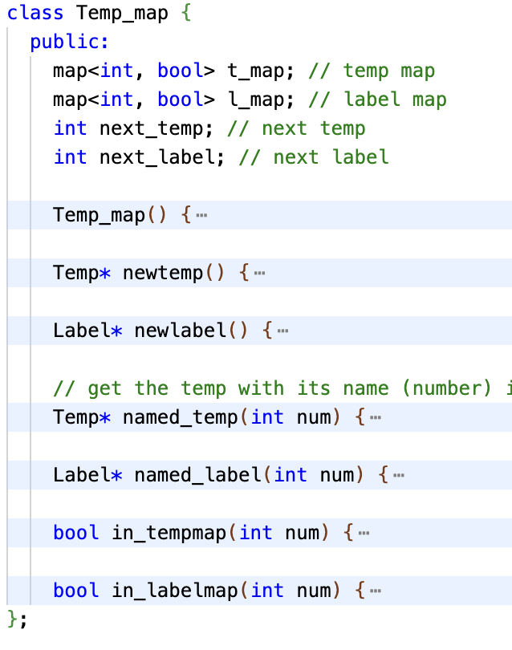

Temp & Label

Slide 24
Translate AST to IR (without classes)
This is like parsing the AST tree, with actions that generate the IR tree. This parsing is done “top-down” (instead of “bottome-up” in LR). These actions will:
Make anything with a location value (and the location value is to be used) associate with a temporary (i.e., a “register”, to hold a value)
Each variable needs to be associated with a temporary
Change array access to address calculation
And explicitly “move” the value from the memory location to a temporary to be used further
Change if and while (and continue/break) to tests and jumps
Change comparisons and Boolean operators to tests and jumps

Slide 25
Try the following example
Think about a : = b+3
Move(Temp(a),
Binop(plus, Temp(b), Const(3))
)
One possible method is to have a new Temp to hold the result of Binop(plus, Temp(b), Const(3))
Then we simply translate into a move instruction
What if the machine has an instruction that directly put the result into a?
Better to use one instruction
move
a
Binop
b
3

Slide 26
To deal with array
Think about a[i] : = b+3
Move( Binop(+, location(a),Temp(i)),
Binop(plus, Temp(b), Const(3))
)
move
Binop
Binop
a
i
b
3

Slide 27
Loops and Conditions are Harder
Think about if ( a || b ) then s1 else s2
In this case, a||b is indeed a value, but it’s really to jump to somewhere (depends on true or false)
But c = a||b will be a value
So each expression may:
Ex: Is used for its value
Nx: Its value is not used (thrown away, but retain the side effects), but the expression needs to be executed (as if it’s a statement)
Cx: translated into a conditional (jumps)
We need to be able to translate between these different types.

Slide 28
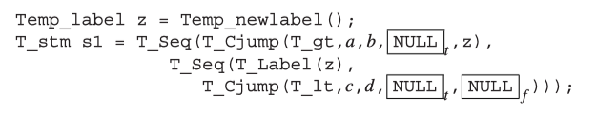
Exmple: If (a>b||c<d) a=1 else a=2;
if
Or
Assign
Assign
>
<
a
1
a
1
a
b
c
d

Slide 29
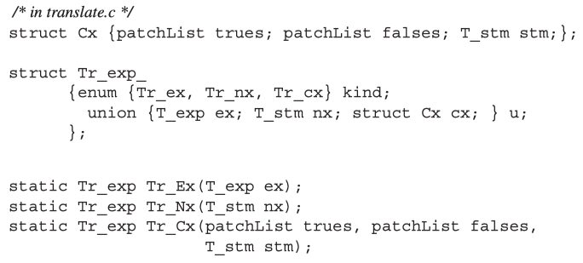
Tr_exp

Slide 30

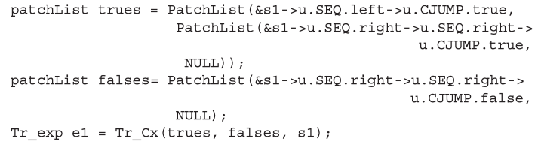
Exmple: If (a>b||c<d) a=1 else a=2;
We need to know the locations of these NULLs
Using the following patchList
The expression a>b||c<d is translated this way

Slide 31
Patch-list When Processing While while (e) statement
When “hitting” a while node, generate two patch-lists: one for start the loop (b), and one for the end of the loop (e):
label_t; e; label_b; s; (jump to label_t); label_e;
When processing e and s, add to the b/e patch list
When processing “continue”, jump to lable_t
This can be done immediately
When processing “break”, jump to label_e
This is done when patching
If you meet a continue/break node not under a while node, report error

Slide 32
NestedStm
If (e) { s1; s2;} else {s3; s4;}
e can be translated into an Tr_Cx(tlist, flist, s)
{s1; s2;} → l_true; s1; s2; Jump to l_end;
{s3; s4;} → l_false; s3; s4; l_end;
Use l_true and l_false to patch s,
Then translate the above into the following list:
(patched s); l_true; s1; s2; (Jump to l_end); l_false; s3; s4; l_end;

Slide 33
To be continued…

