Slide 1
编译（H） COMP130014h.01 Week 5
复旦大学计算机科学技术学院
2024-2025第二学期（2025年春季）
主讲：王晓阳（江湾叉二A3021）
xywangcs@fudan.edu.cn
https://daslab.fudan.edu.cn
助教：林琰钧、王雨晨
课堂：周一6-8节（下午13:30开始，HGX303 教室）
实验：周四1-2节（上午8:00开始，H逸夫楼305）

Slide 2
本周内容: AST 到 IR 转换（1）
Introducing Tiger IR+
基础框架 & 转换方法
注意：
HW3今晚due
HW4（ast2ir，只关注无array及无class的场景）

Slide 3
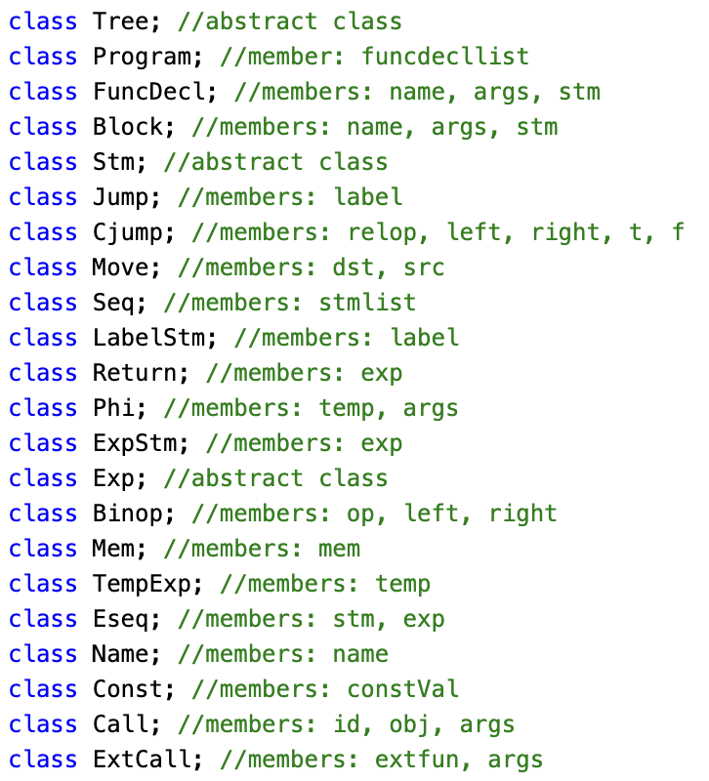

Tiger IR+ (treep.hh)

Slide 4
Structure of a Tree Program
Program
The first funcDel is for the Main(), with a name like:
“_^main^_main”
funcDecl( classname+methodname)
Block (entry label, exist labels)
Block (entry label, exist labels)
Each block is a list of stm (vector).
For now, we just put everything into one block.
(Later we will break into multiple blocks.)
. . .
Block (entry label, exist labels)
. . .
funcDecl( classname+methodname)
Block (entry label, exist labels)
Block (entry label, exist labels)
. . .
Block (entry label, exist labels)

Slide 5
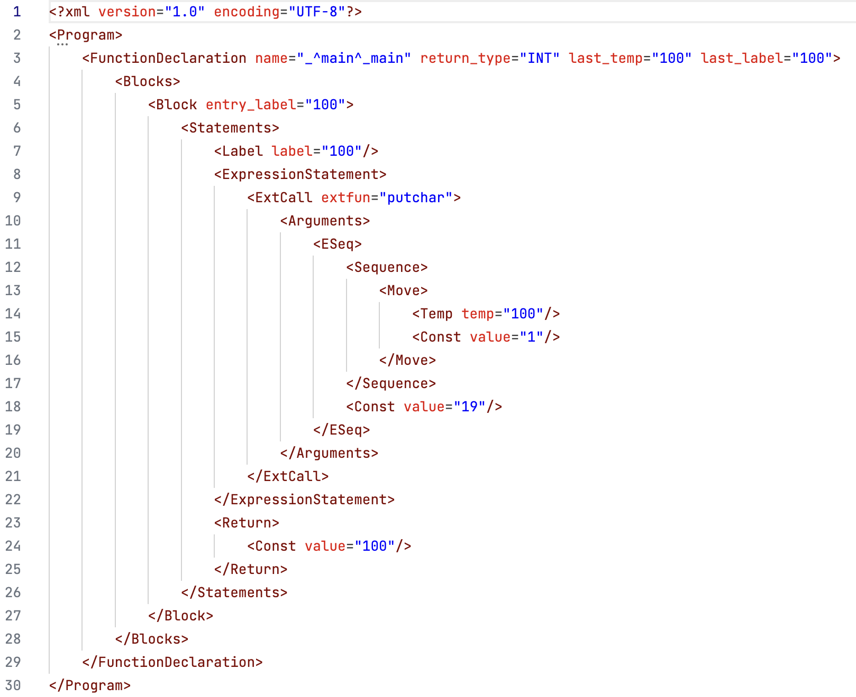
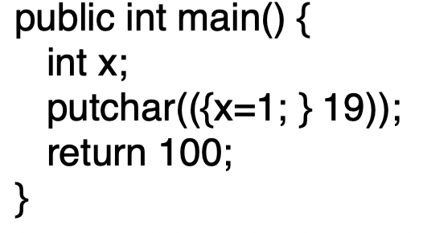
ExpStm(ExtCall(“putchar”, Eseq)

Slide 6
Temporaries & Labels
Before going further with Tiger IR…
Temporaries: to hold variables
Can map to registers or memory locations
Job for “Register allocation” (optimization)
Labels: to hold the code locations
For targets of jumps
These can be constructed when AST is translated to IR

Slide 7
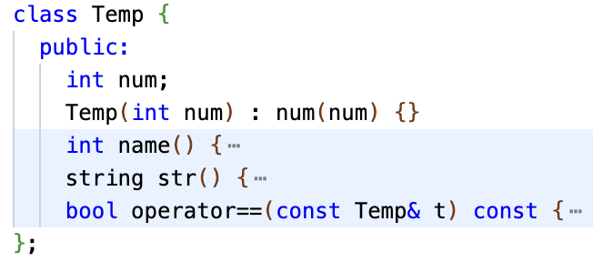
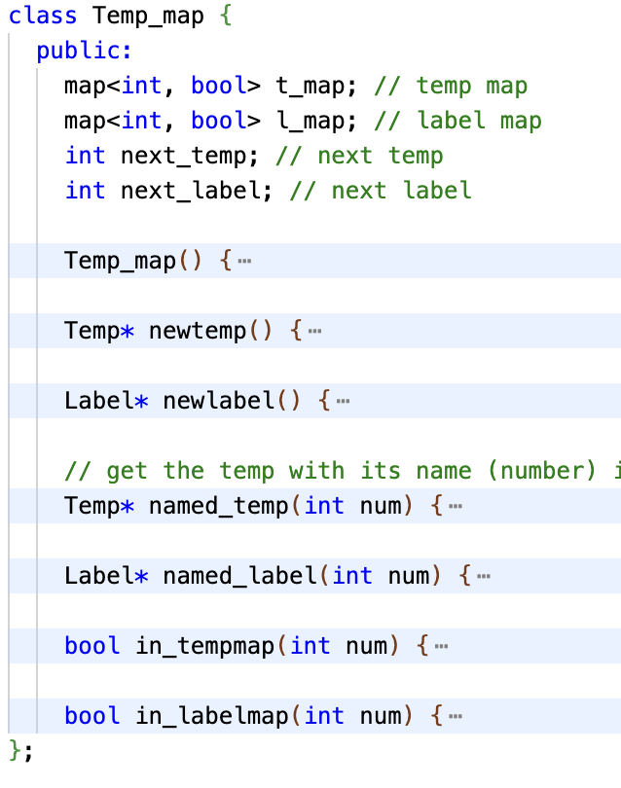

Temp & Label
Same temp/label if the same num. (There may be multiple temp/label objects with the same num.)

Slide 8
Translate AST to IR (without classes or array)
This is like parsing the AST tree, with actions that generate the IR tree. These actions will:
Make anything with a location value (and the location value is to be used) associate with a temporary (i.e., a “register”, to hold a value)
Each variable needs to be associated with a temporary
Change if and while (and continue/break) to tests and jumps
Change comparisons and Boolean operators to tests and jumps

Slide 9
Try the following example
Think about a : = b+3
Move(Temp(a),
Binop(plus, Temp(b), Const(3))
)
One possible method is to have a new Temp to hold the result of Binop(plus, Temp(b), Const(3))
Then we simply translate into a move instruction
What if the machine has an instruction that directly put the result into a?
Better to use one instruction
move
a
Binop
b
3

Slide 10
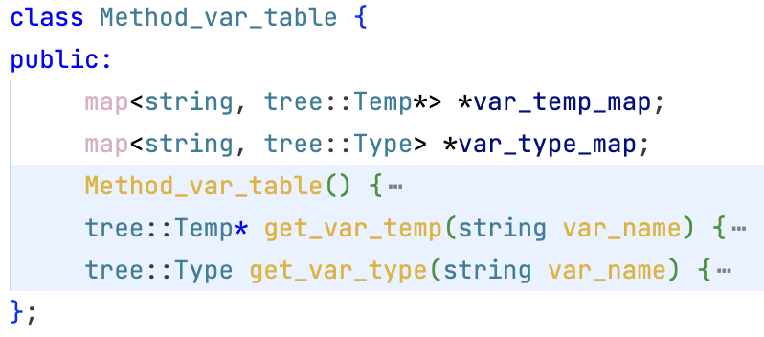
HW4/include/ir/ast2tree.hh
For each method, there is a var table, including formal and local var. (if a method local has a conflict in var name with formal, then local var is used (ignore the formal, or the semantic check has already ruled it out!)
Each local var and formal has a type as well (INT or PTR).
(for class methods) The return of a method is also taken as the last formal, with a special name _^return^_method_name. And the first parameter is always the calling object. Note: main() doesn’t need such.

Slide 11
Loops and Conditions
Think about if ( a || b ) then s1 else s2
In this case, a||b is indeed a value, but it’s really to jump to somewhere (depends on true or false)
But c = a||b will be a value
So each expression may:
Ex: Is used for its value
Nx: Its value is not used (thrown away, but retain the side effects), but the expression needs to be executed (as if it’s a statement)
Cx: translated into a conditional (jumps)
We need to be able to translate between these different types.

Slide 12
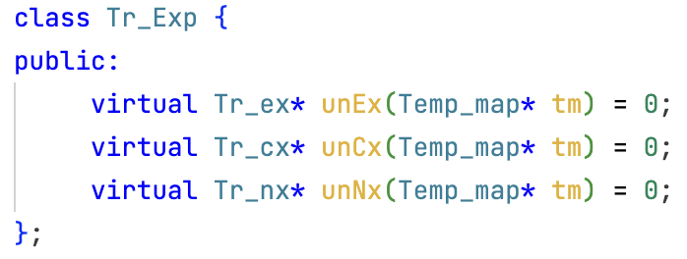
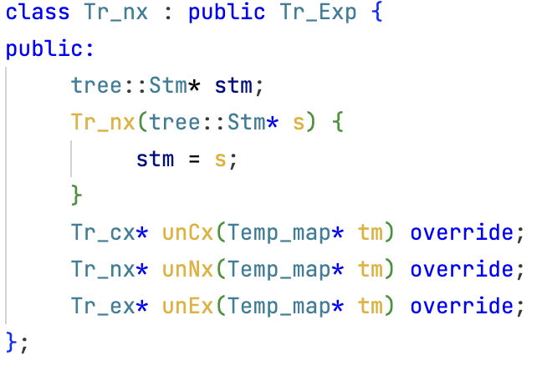
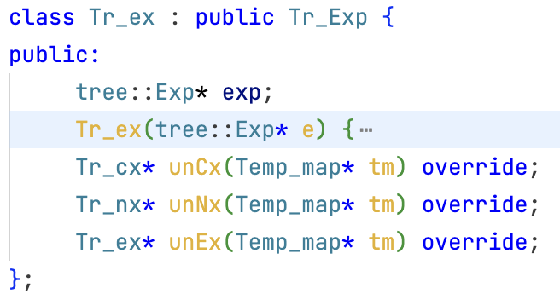
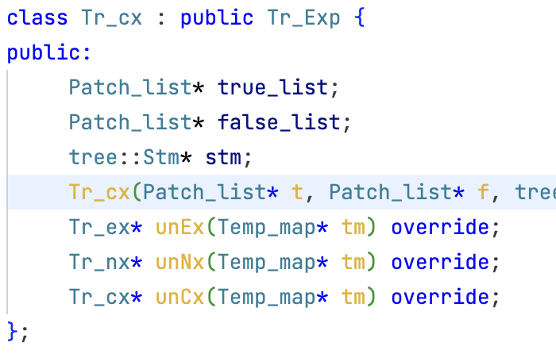
“Expression in translation” classes
tr_exp.hh/cc
An IR expression may take one of the three forms.

Slide 13
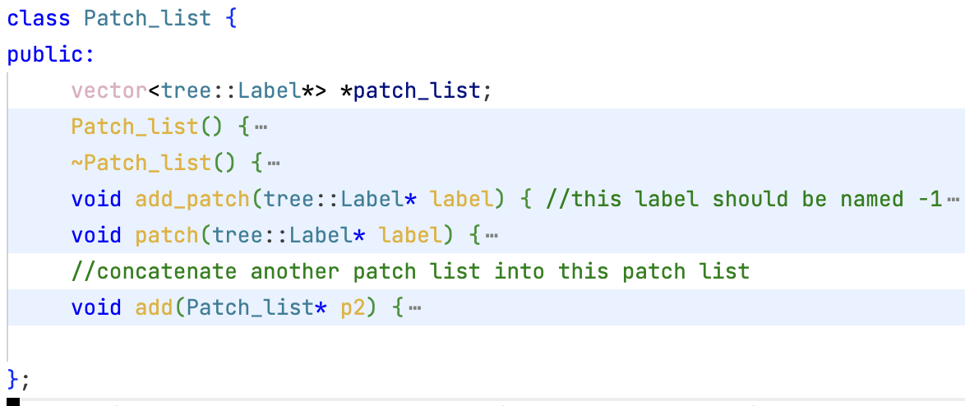

Slide 14
If (a>b||c<d) return 100; else return 200;
return
if
return
Or
200
100
>
<
Tr_cx3:
True_patch_list: *L1, *L3
False_path_list: *L4
Tr_cx1.stm [L5 patches L2]
L5:
Tr_cx2.stm
a
b
c
d
stm
Tr_cx1:
True_patch_list: *L1
False_path_list: *L2
Cjump(>, a, b, L1, L2)
Tr_cx2:
True_patch_list: *L3
False_path_list: *L4
Cjump(<, c, d, L3, L4)
stm
stm

Slide 15
If (a>b||c<d) return 100; else return 200;
return
if
return
Or
200
100
>
<
if (a>b||c<d) return 100; else return 200;
Tr_cx3.stm
[L6 patches L1 and L3, L7 patches L4]
L6:
Return 100
Jump L8
L7:
Return 200
L8:
a
b
c
d
Tr_cx3:
True_patch_list: *L1, *L3
False_path_list: *L4
Cjump(>, a, b, L1, L5)
L5:
Cjump(<, c, d, L3, L4)

Slide 16
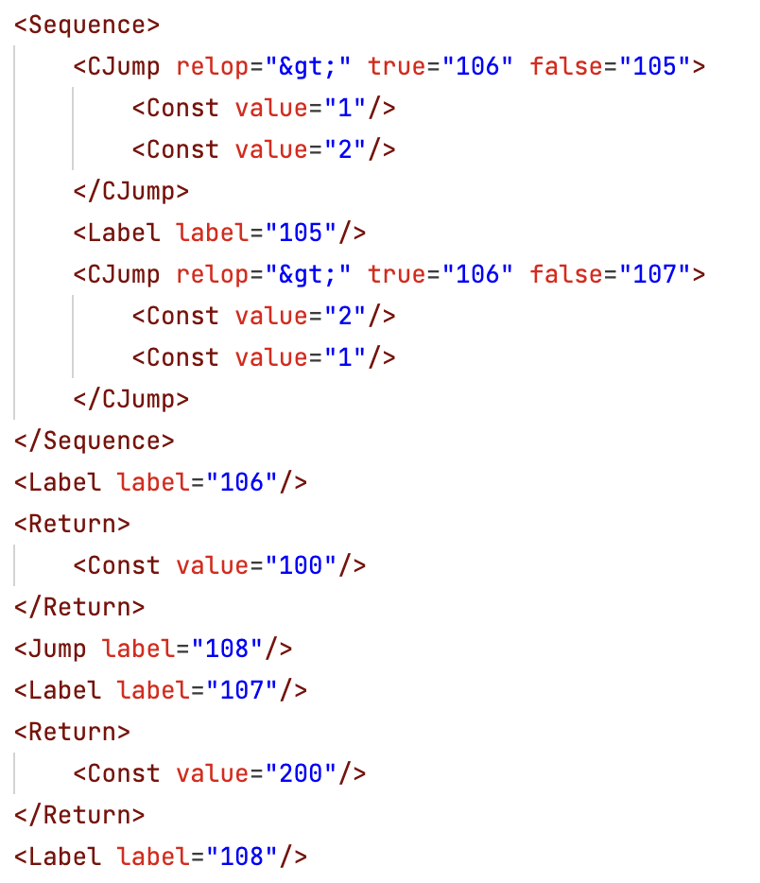
HW4/tool/patchdemo/patchdemo.cc
test/patchdemo.3.irp
if (1>2||2>1) return 100; else return 200;
Tr_cx3.stm
[L6 patches L1 and L3, L7 patches L4]
L6:
Return 100
Jump L8
L7:
Return 200
L8:
Cjump(>, a, b, L6, L5)
L5:
Cjump(<, c, d, L6, L7)

Slide 17
Patch-list When Processing While while (e) stm
While is translated into this:
l_w; cx(e); l_t; stm; (jump to l_w); l_e;
e is treated as cx, patched with l_t for true, l_e for false
l_w, l_t, l_e are generated when the “while” node is encountered.
Continue/break:
Translate “continue” to (jump to l_w)
Translate “break” to (jump to l_e)
Take care of continue/break in nested while loops
Note: we don’t allow continue/break in condition e

Slide 18
NestedStm
If (e) { s1; s2;} else {s3; s4;}
e can be translated into an Tr_Cx(tlist, flist, s)
{s1; s2;} → l_true; s1; s2; Jump to l_end;
{s3; s4;} → l_false; s3; s4; l_end;
Use l_true and l_false to patch s,
Then translate the above into the following list:
(patched s); l_true; s1; s2; (Jump to l_end); l_false; s3; s4; l_end;

Slide 19
HW4
ast2tree (no array, no class)
only main() method, and int variables
Each method should have its only temp_map
i.e., temps are local in a method
Let’s look at the Repo/HW4
Due on April 3 (Thursday)

