Slide 1
编译（H） COMP130014h.01 Week 7
复旦大学计算机科学技术学院
2024-2025第二学期（2025年春季）
主讲：王晓阳（江湾叉二A3021）
xywangcs@fudan.edu.cn
https://daslab.fudan.edu.cn
助教：林琰钧、王雨晨
课堂：周一6-8节（下午13:30开始，HGX303 教室）
实验：周四1-2节（上午8:00开始，H逸夫楼305）

Slide 2
本周内容: AST to IR+
AST2Tree (no array or class): Review (HW4)
AST2Tree: Arrays, Classes and Methods (HW5)
注意：
HW4 周四（4月3日）晚due

Slide 3
The ast2tree process
Set up a variable table: maps each variable (including the formals) to a temp
Then visit each AST tree in a pre-order manner
But build the IR tree in a post-order manner
Each expression returns a Tr_Exp*
Each statement returns a Tree::Stm*
A node is responsible to assemble all the returned values into a Tr_Exp* or Tree::Stm*
Including patch a Tr_cx
Change of the mindset: You are writing code that generates code

Slide 4
Review for HW4
Go over some examples in output_example
Note in the tree language:
Binop only works with arithmetic operations: +, -, *. /
Cjump can only use the comparisons <, <=, >, >=, !=, ==.
** this means: you can’t use Binop for comparisons or boolean operations (||, &&, !)
All operations are done with temps (no memory access is necessary when no array or class is involved).

Slide 5
Arrays in FDMJ 2025
Array declarations:
int[] a; int[5] b; int[] c={1,2,3,4,9};
Both in methods and in class
Array usages:
a[10] = 1; x= a[1];
length(b), getarray(a)
Array arithmetic: Element-wise operations
-a, b+c, b-c, b*c, b/c
Note: to simplify the operations on arrays:
Only +, -, *, / and unary – are allowed
That is, we assume logical and comparison operations will NOT be on arrays (unlike integers)
If two arrays are of different lengths, then call external function exit(-1).
Note: the Tree language doesn’t support arrays directly

Slide 6
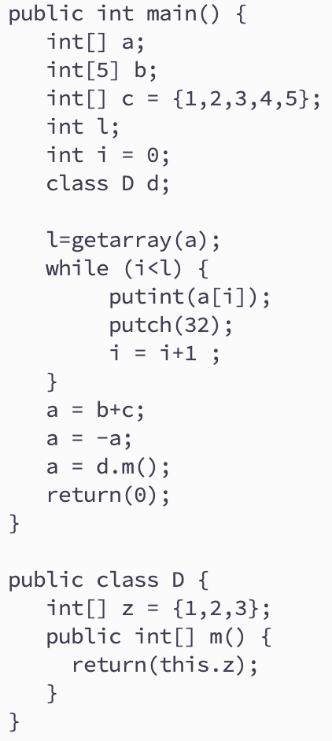
Example

Slide 7
Array length is added (for runtime bound checking)
Three integer positions.
Here 4=int_length
int[] a={1,2};
IR+:
MOVE(tempa,
Eseq(Seq(Move(tempaa, extCall(“malloc”, 3*4)),
Seq(Move(Mem(tempaa), Const(2)),
Seq(Move(Mem(tempaa+1*4), Const(1)),
Move(Mem(tempaa+2*4), Const(2)))),
tempaa)
)
See:
config.hh
in
include/util
Size=2
* Multiply by 4 (32bit, 8 if 64 bits) : see Compiler_config in util/config.hh

Slide 8
Arrays Manipulation in FDMJ
Array usage:
exp[exp]
AST
array_pos
A_arrayExp
arr_pos
IR+
Assume arr gives the location of array, then add the arr_pos to it.
IR+:
Mem(BinOp(Plus, arr, arr_pos))
Example: a[1]=1;
IR+:
Move(Mem(tempa+1*), 1))

Slide 9
Array Operations
Build the IR tree as follows:
Assume there is a tree for a and one for b.
Get their sizes (and compare the sizes to decide if continue.
Allocate space for results and move the return value from “malloc” to a TEMP
Build a tree like a while-loop will do with an index, and the body is to add the corresponding values and write into the corresponding position in the allocated space.
Build a tree like this
How to do like:
c=a+b
(all arrays)
move
temp_c
Eseq
Seq
TEMP
Stm
Stm
Stm

Slide 10
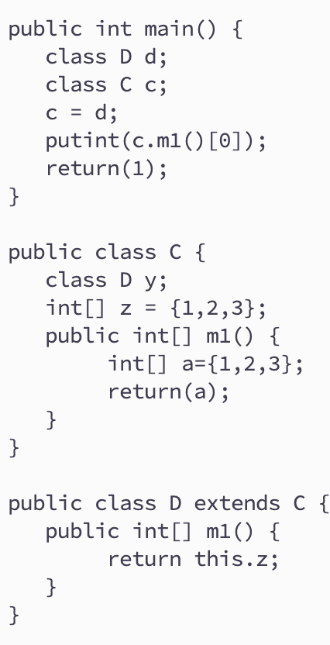
Classes in FDMJ 2025
Class declarations:
Class C [extends] PC {}
Class variables
Methods
Inheritance
Class usages:
c1 = c2
c.x
c.m()
return & parameter
this

Slide 11
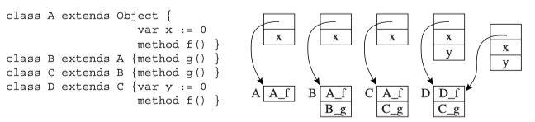
Convert Classes to IR+
Unified Object Record：
Leave space for all possible variables and methods in all classes.
So that: each name (variable or method) correspond to one offset in the record.
The unified object record for the example on the left is (x, y, f, g), 4 ints.
The locations of f and g are assigned with the “correct” function address: use the class table to find the correct method name.
Recall: Class tables for class variables and class methods.
Function addressed: use namedlabels:
e.g., label_D_f=Temp_namedlabel(“D_f”));
Example: class A ob; ob=new D();
Move(temp_ob,
Eseq(Seq(Move(temp_obob, extCall(”malloc”, 4*)),
Seq(Move(temp_obob+2*, Name(lable_D_f)),
Move(temp_obob+3*, Name(label_C_g)))),
temp_obob))

Slide 12
Method Call in FDMJ
Recall: Class tables for class variables and class methods.
IR+ for method call.
AST node: Call(string, exp, explist)
Use the unified class record (x, y, f, g) to find the “offset” of the method label.
No need to know the type of ob (i.e., which class).
Important: add the object itself (i.e., the pointer value to the object record) as the first parameter of every method call (for “this”).
Assume: class A ob; ob=new D(); The IR+ for ob.f() is:
Call(String(“f”), Mem(temp_ob+2*),
ExpList(temp_ob, NULL))
The IR+ for new.D().g() is
Call(String(“g”), Mem(BinOp(Plus,
Eseq(Move(temp_obob, Call(”malloc”, 4*)),
Seq(Move(temp_obob+2*, T_Name(lable_D_f)),
Move(temp_obob+3*, T_Name(label_C_g)))),
temp_obob), 3*),
Explist(temp_obob, NULL))

Slide 13
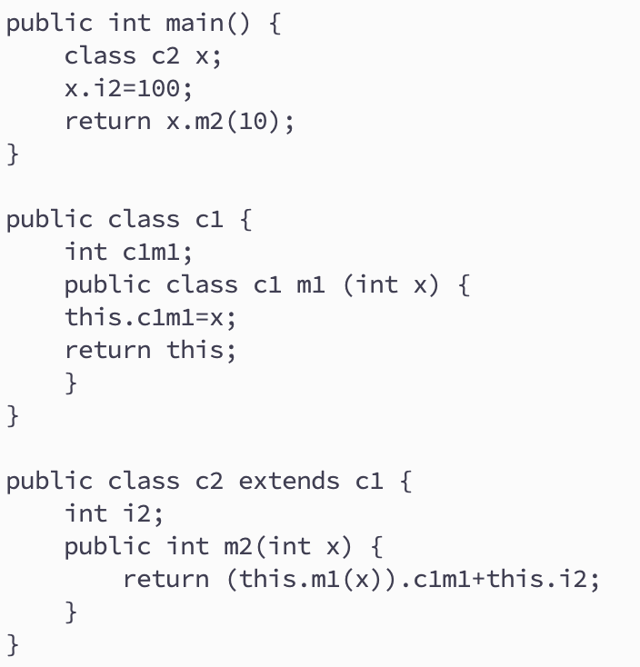
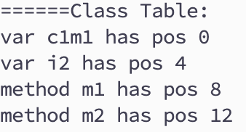
Try an Example
Unified Object Record (4* bytes)：
(vars: c1m1, i2, methods: m1, m2)
Method Labels:
For class C1: C1_m1
For class C2: C1m1, C2_m2
Try on the board…

Slide 14
HW5
To be assigned…

