Slide 1
编译（H） COMP130014h.01 Week 8
复旦大学计算机科学技术学院
2024-2025第二学期（2025年春季）
主讲：王晓阳（江湾叉二A3021）
xywangcs@fudan.edu.cn
https://daslab.fudan.edu.cn
助教：林琰钧、王雨晨
课堂：周一6-8节（下午13:30开始，HGX303 教室）
实验：周四1-2节（上午8:00开始，H逸夫楼305）

Slide 2
本周内容: AST to IR+, Canonicalization, Quad, and Instruction Selection
AST2Tree: Review and HW5
Canonicalization, Quadruple representation
(see Tiger book: Chapter 8, Chapter 17)
Instruction Selection (for Quad)
(see Tiger book: Chapter 9)
注意：
HW4 周四（4月10日）晚due
HW5 周四（4月17日）晚due

Slide 3
Arrays in FDMJ 2025 (review)
Array declarations:
int[] a; int[5] b; int[] c={1,2,3,4,9};
Both in methods and in class
Array usages:
a[10] = 1; x= a[1];
length(b), getarray(a)
Array arithmetic: Element-wise operations
-a, b+c, b-c, b*c, b/c
Note: to simplify the operations on arrays:
Only +, -, *, / and unary – are allowed
That is, we assume logical and comparison operations will NOT be on arrays (unlike integers)
If two arrays are of different lengths, then call external function exit(-1).
Note: the Tree language doesn’t support arrays directly

Slide 4
Examples
See HW5 Repo

Slide 5
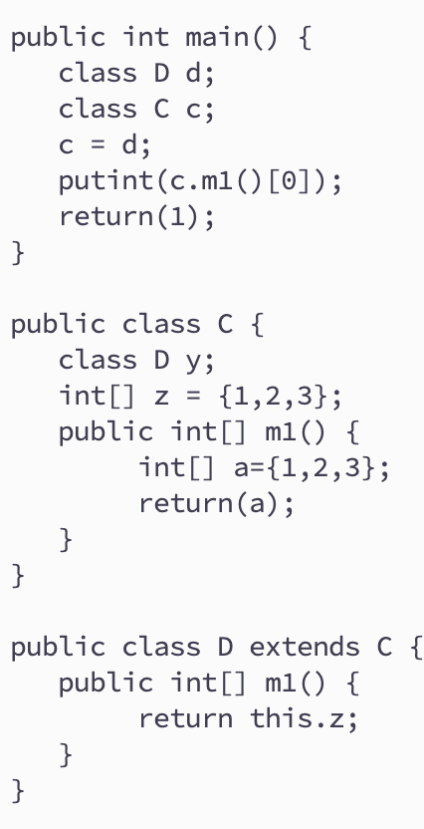
Classes in FDMJ 2025 (review)
Class declarations:
Class C [extends] PC {}
Class variables
Methods
Inheritance
Class usages:
c1 = c2
c.x
c.m()
return & parameter
this

Slide 6
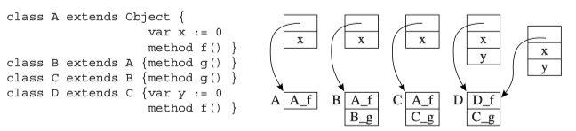
Convert Classes to IR+ (review)
Unified Object Record：
Leave space for all possible variables and methods in all classes.
So that: each name (variable or method) correspond to one offset in the record.
The unified object record for the example on the left is (x, y, f, g), 4 ints.
The locations of f and g are assigned with the “correct” function address: use the class table to find the correct method name.
Recall: Class tables for class variables and class methods.
Function addressed: use namedlabels:
e.g., label_D_f=Temp_namedlabel(“D_f”));
Example: class A ob; ob=new D();
Move(temp_ob,
Eseq(Seq(Move(temp_obob, extCall(”malloc”, 4*)),
Seq(Move(temp_obob+2*, Name(lable_D_f)),
Move(temp_obob+3*, Name(label_C_g)))),
temp_obob))

Slide 7
Examples
See HW5 Repo

Slide 8
Canonicalization Process (1) Get rid of ESeq nodes
Linearize: get rid of ESeq nodes, convert to list of statements
Goal: each statement does one simple operation (assignment/arithmetic/function call/etc.)
For example:
In C: y = (x = x + 1)
In IR: Move(y, Eseq(x=x+1, x))
Linearize: x=x+1, move(y, x)

Slide 9
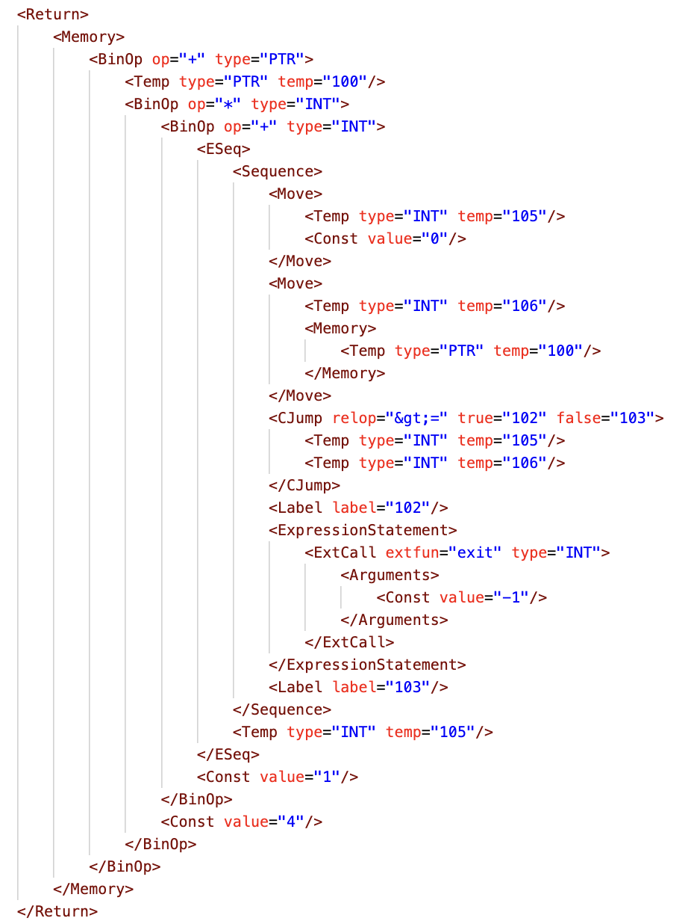
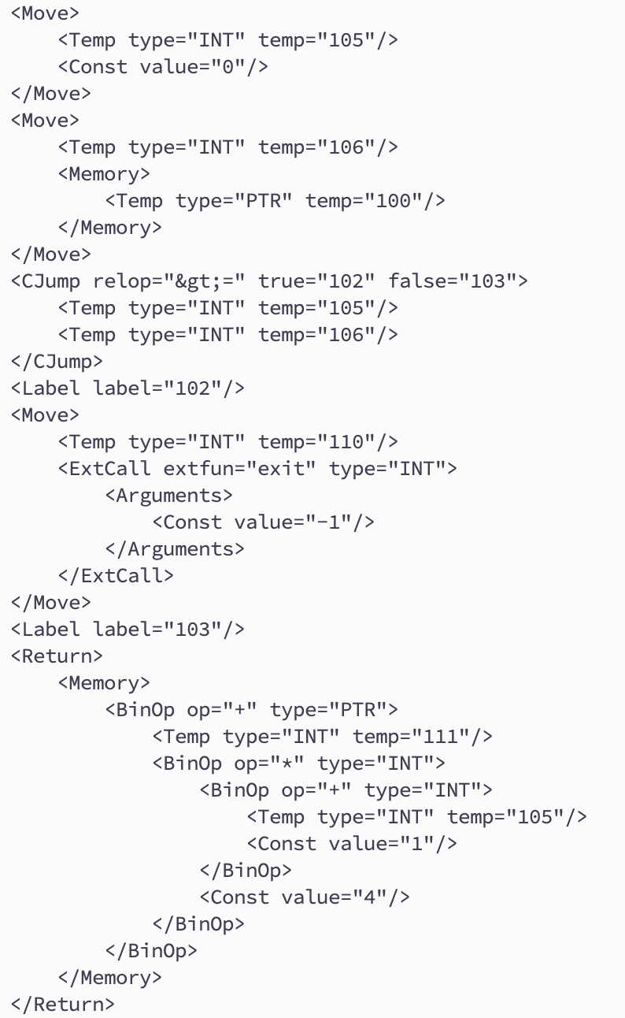
Example Segment

Slide 10
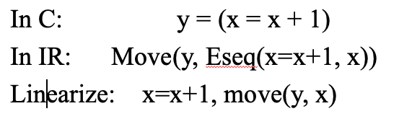
Using Rewriting Rules
Move
y
ESeq
Move
Move
Move
x
x
Plus
y
x
x
Plus
x
1
x
1
Move(Mem(e1), Eseq(s, e2))
s, Move(Mem(e1), e2)
Not always right!

Slide 11
Commutative Case
Move(Mem(e1), Eseq(s, e2))
s, Move(Mem(e1), e2)
True when e1 and s are commutative.
Otherwise?
For example: Move(Mem(a[x]), Eseq(x=x+1, x))
Not the same result as
Seq(x=x+1, Move(a[x], x))
In general
Move(Mem(e1), Eseq(s, e2))
Seq(Move(temp_new, e1), Seq(s, Move(Mem(temp_new), e2)))
The same example: Move(Mem(a[x], Eseq(x=x+1, x))
Seq(Move(Temp_a, Mem(a[x])), Seq(x=x+1, Move(Mem(Temp_a), x)))

Slide 12
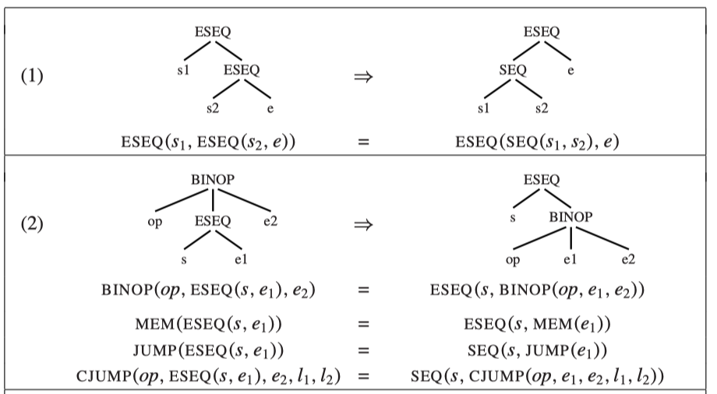
Other Examples

Slide 13
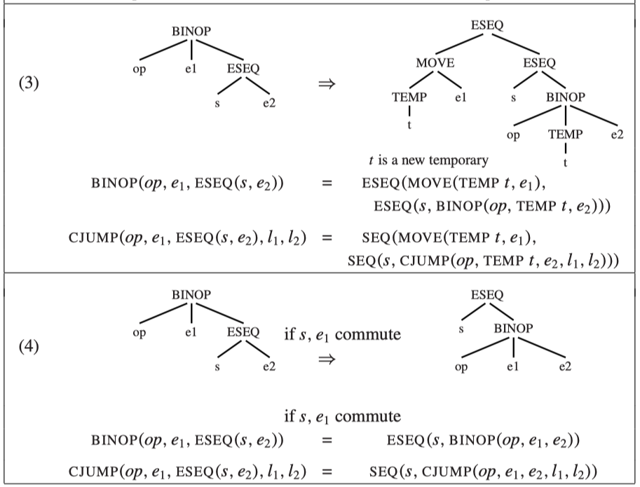
Other Examples

Slide 14
Eliminating ESeq
When the father node of Eseq is Move, then we can get rid of Eseq
As a result, we have a list of statements (linearized)
See hw5/test in Repo

Slide 15
The Call IR node
In general, we have: Call(id, e, elist)
Call(id, e, elist) should be translated to:
Eseq(Seq(Move(temp_f, e),
Seq(Move(temp_r0, id), …
Move(temp_r1, elist[1]), …,
Move(temp_rk, elist[k])),
Call(id, temp_f, expLis(temp_r0, temp_r1, …, temp_rk))
If Exp(Call(id, e, elist)) or Move(temp, Call(id, e, elist), then basically just drop Eseq (and Exp()).

Slide 16
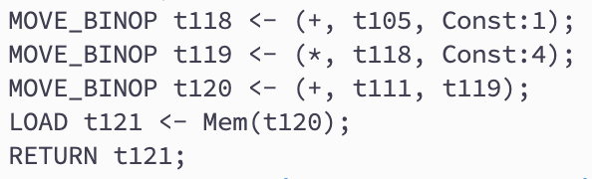
Next Step: Get Rid of Nested Expressons

Slide 17
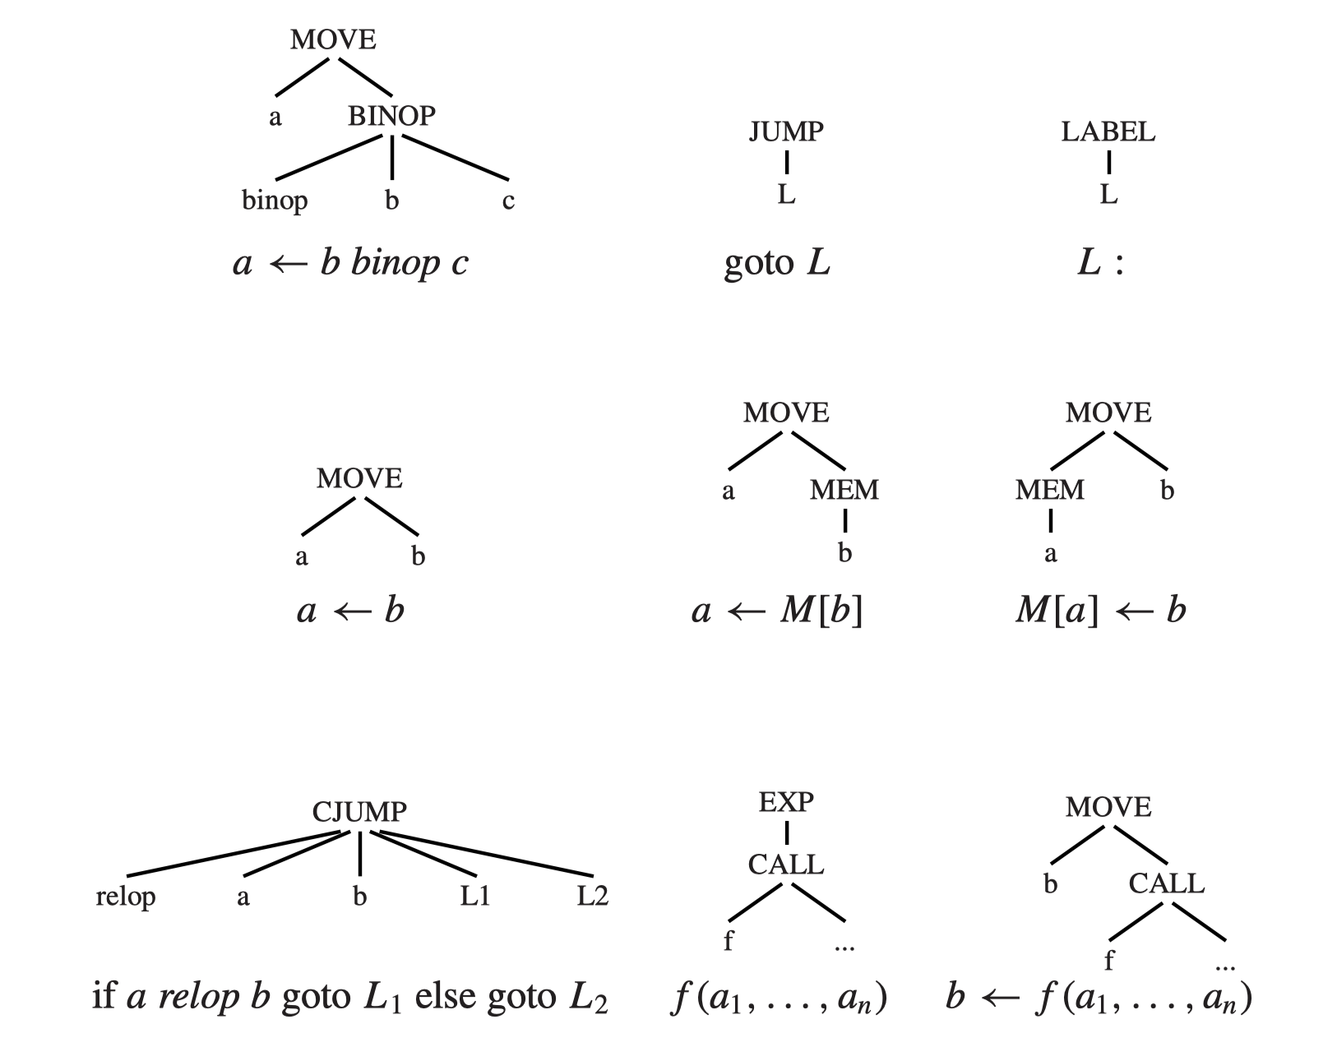
Quadruple Representation (Another IR)

Slide 18
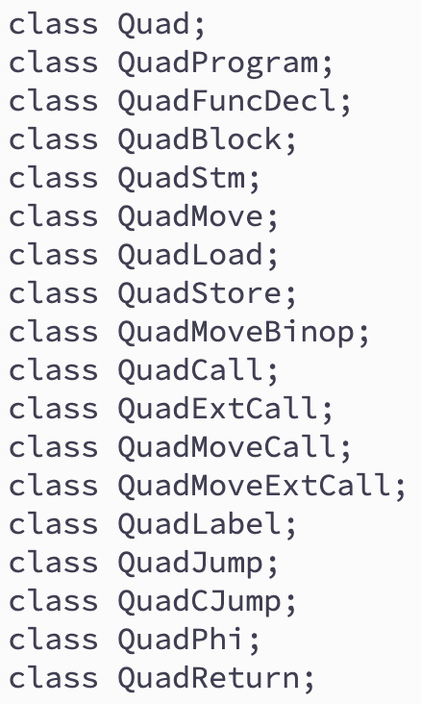









Quadruple Classes
1. a, b, c are temp, const, or name
2. L is a label
3. f is a method_name [ temp ] , or external method name

Slide 19
Instruction Selection (for Quad)
To select instructions for an IR tree
We do it on the Tree+ IR after Canon
How to do it:
Each instruction corresponds to a set of tree patterns (each is called a tile)
We want to cover an IR-tree with a set of tiles
Different machine instruction sets will have different “tiles”
The output will be a QuadProgram
Very close to an assembly language
But remember which temps are defined and used, and where the next instruction may be (for Control Flow Graph, and Liveness Analysis)

Slide 20
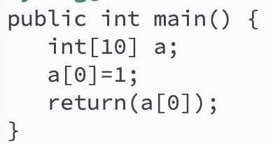
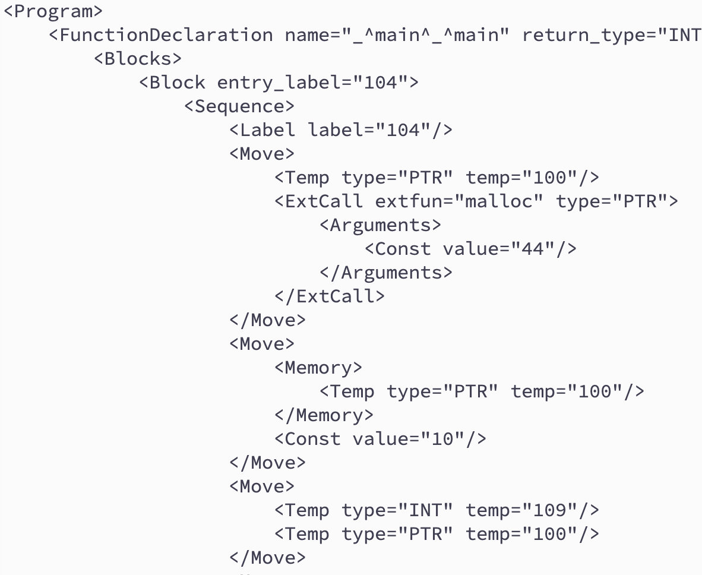
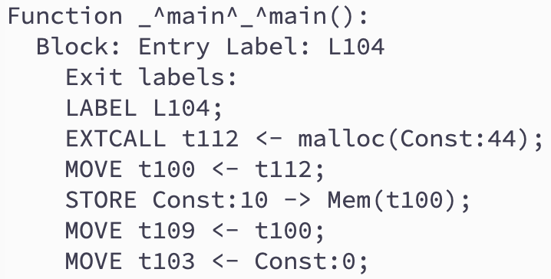
Quad Program Example

Slide 21
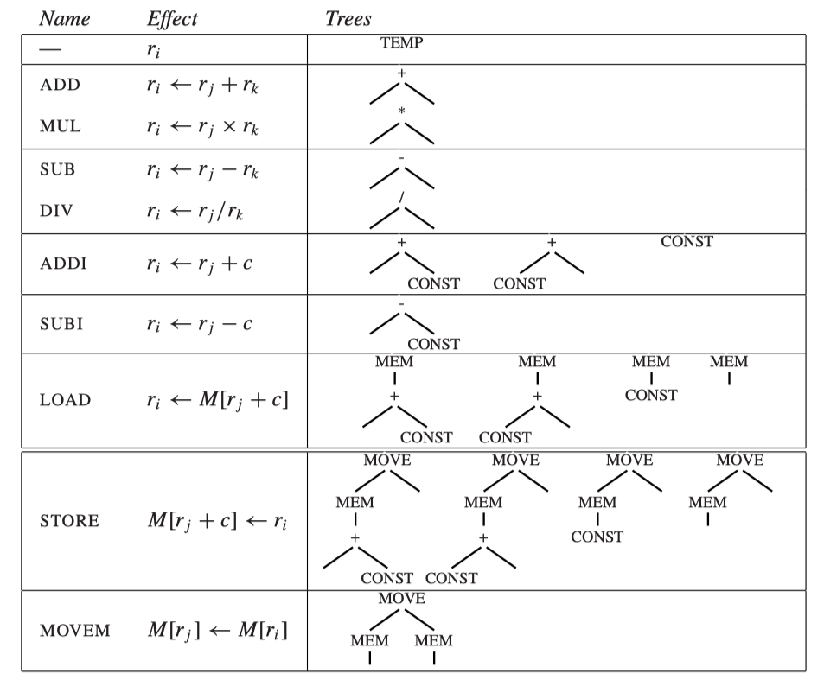
Tile Examples (Example machine, close to Quad) (r0=0 in this machine)

Slide 22
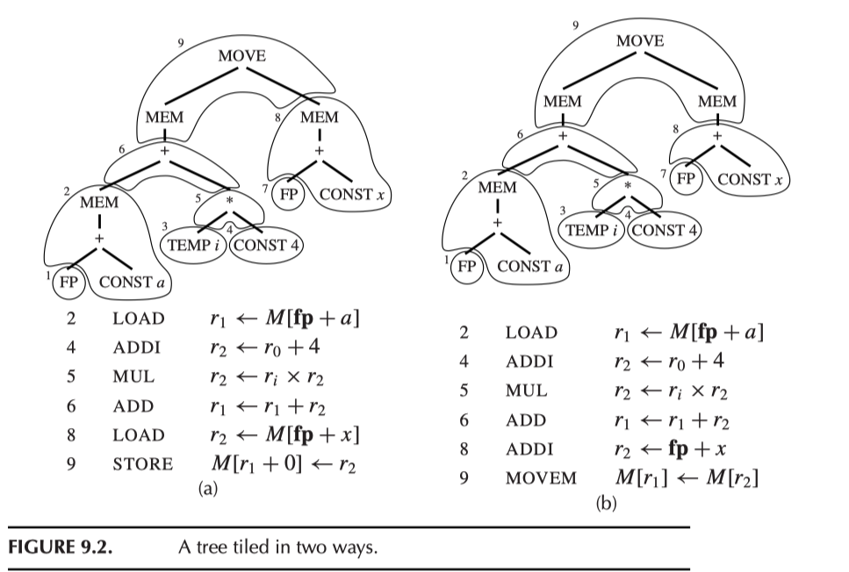
Tiling Example
Assume a and x are local vars stored in the Stack Frame (temporaries not in registers)

Slide 23
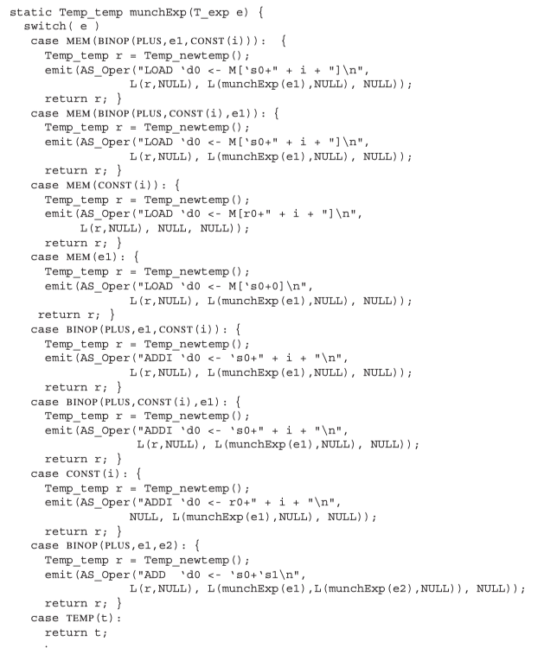
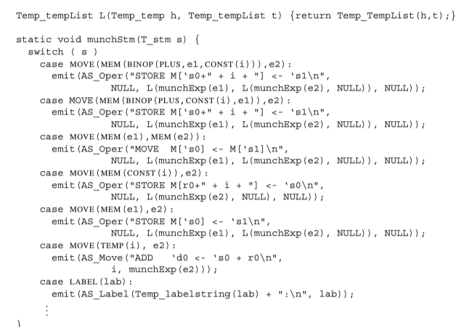
Maximum Munch Tiling Programs （放大看）
(Basically pattern matching)

Slide 24
Use, Def, and Jump to
Each instruction in the Quad program has:
List of temp defined (i.e., the left side of move)
List of temp used (i.e., the value of which used in the instruction)
List of labels that Jump and Cjump jump to.
Used for code analysis

Slide 25
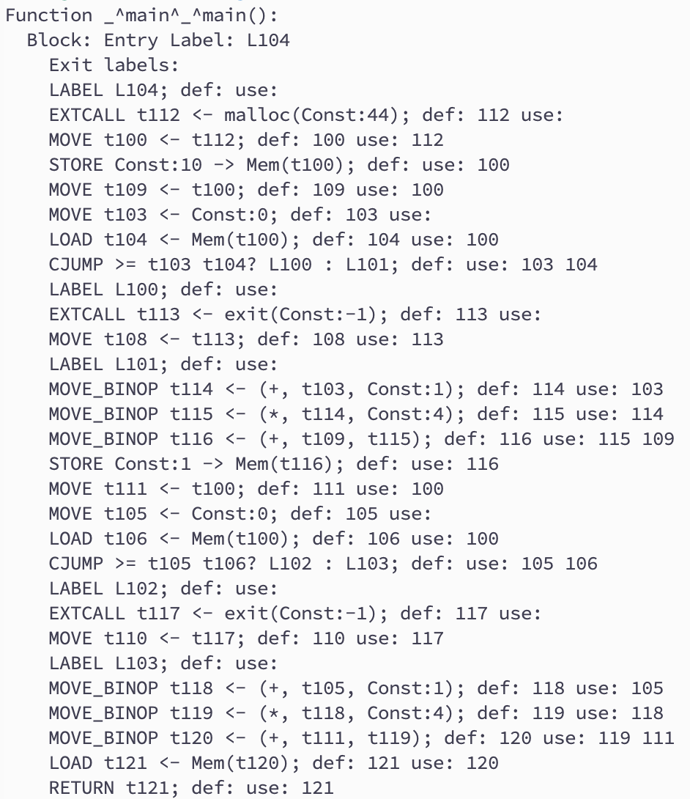
Example

Slide 26
Next Week… liveness analysis
Note:
HW4 is due this Thursday (April 10)
HW5 is due next Thursday (April 17)
Quiz 2 will be on April 17
On AST to IR conversion (HW4-5)
Don’t be late

