Slide 1
编译（H） COMP130014h.01 Week 9
复旦大学计算机科学技术学院
2024-2025第二学期（2025年春季）
主讲：王晓阳（江湾叉二A3021）
xywangcs@fudan.edu.cn
https://daslab.fudan.edu.cn
助教：林琰钧、王雨晨
课堂：周一6-8节（下午13:30开始，HGX303 教室）
实验：周四1-2节（上午8:00开始，H逸夫楼305）

Slide 2
本周内容: Review & SSA
Review: Canonicalization, Quadruple representation， Instruction Selection (for Quad)
Static Single-Assignment
注意：
HW5 周四（4月17日）晚due
Quiz 2: 周四（4月17日）上午8点！
HW6 周四（4月24日）晚due

Slide 3
Overview
Source Code
High-level concepts:
objects, arrays… if-then-else, loops….
Easier for human users
Computer Representation of source code
With high-level concepts
Easier for computer analysis
AST
Data flow and Control flow analysis.
Static Single-Assignment form.
Code optimization
Intermediate Representation:
Only low-level machine-level instructions, but with nested expressions
IR
Quad
Quadruple Representation:
Simple machine-level instructions
Target code
Machine executable

Slide 4
Overview
Intermediate Representation:
Only low-level machine-level instructions, but with nested expressions
IR
Canonicalization
Instruction Selection
Quad
Quadruple Representation:
Simple machine-level instructions
Block formation
SSA form
Optimization

Slide 5
Canonicalization Process (1) Get rid of ESeq nodes
Linearize: get rid of ESeq nodes, convert to list of statements
Goal: each statement does one simple operation (assignment/arithmetic/function call/etc.)
For example:
In C: y = (x = x + 1)
In IR: Move(y, Eseq(x=x+1, x))
Linearize: x=x+1, move(y, x)

Slide 6
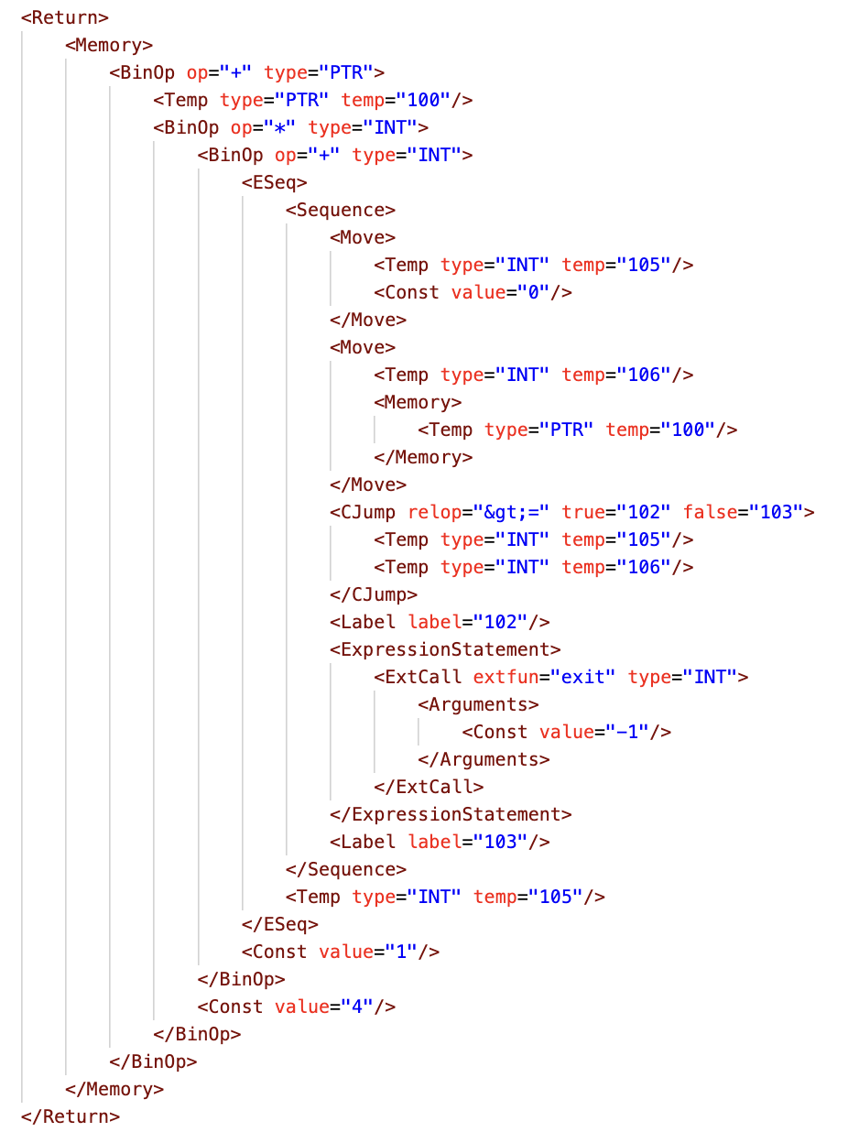
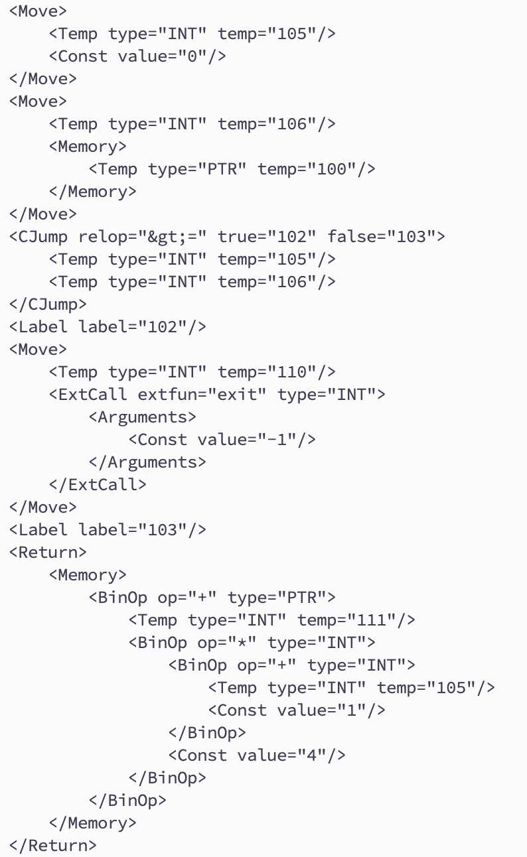
Example Segment

Slide 7
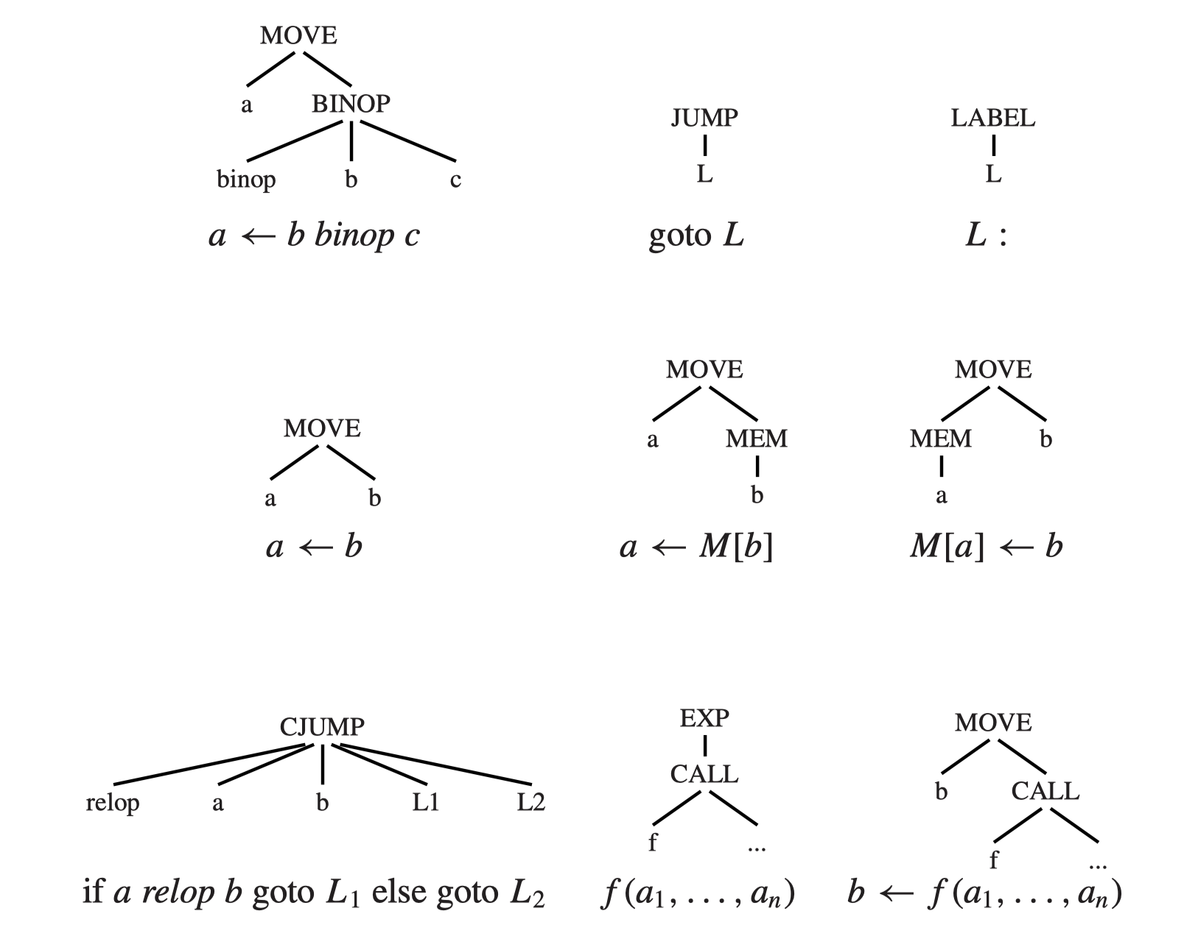
Quadruple Representation (Another IR)

Slide 8
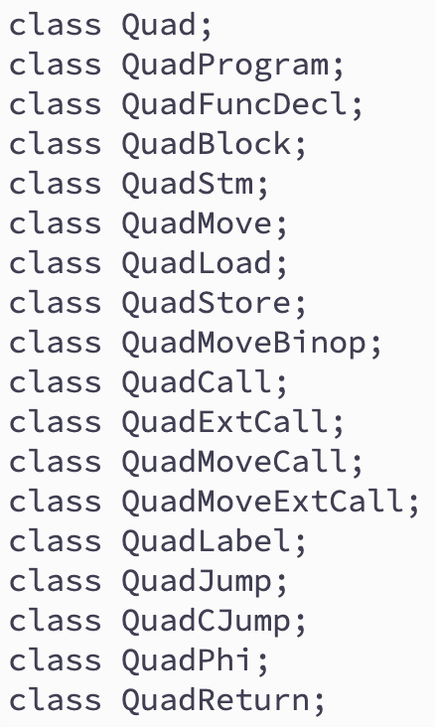









Quadruple Classes
1. a, b, c are temp, const, or name
2. L is a label
3. f is a method_name [ temp ] , or external method name

Slide 9
Instruction Selection (for Quad)
To select instructions for an IR tree
We do it on the Tree+ IR after Canon
How to do it:
Each instruction corresponds to a set of tree patterns (each is called a tile)
We want to cover an IR-tree with a set of tiles
Different machine instruction sets will have different “tiles”
The output will be a QuadProgram
Very close to an assembly language
But remember which temps are defined and used, and where the next instruction may be (for Control Flow Graph, and Liveness Analysis)

Slide 10
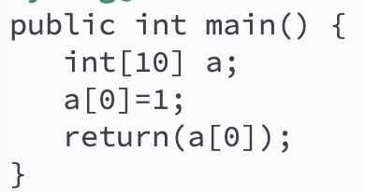
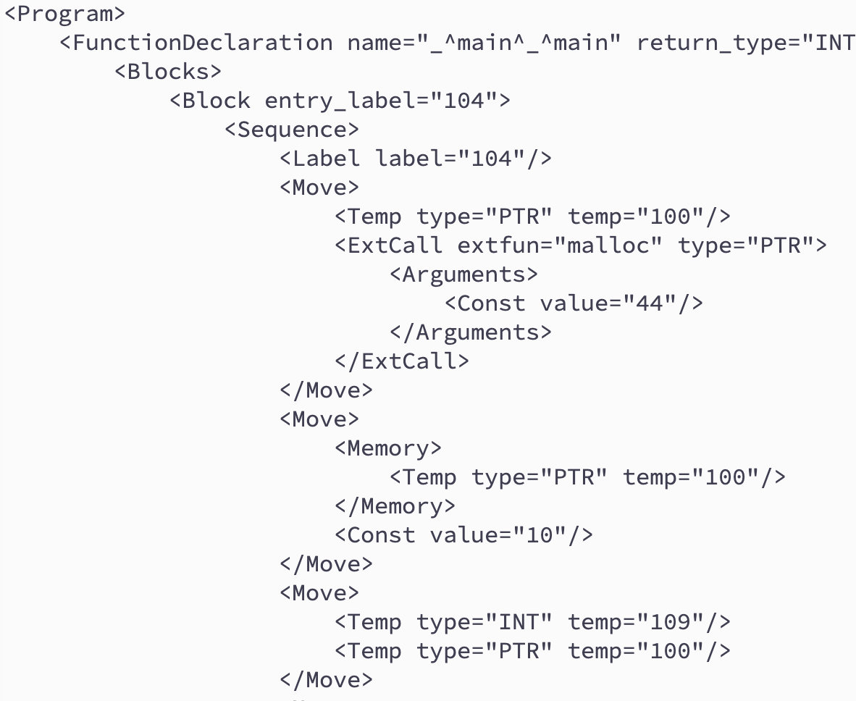
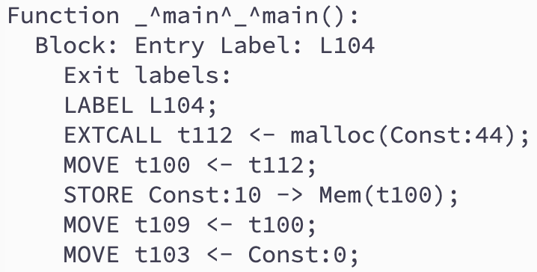
Quad Program Example

Slide 11
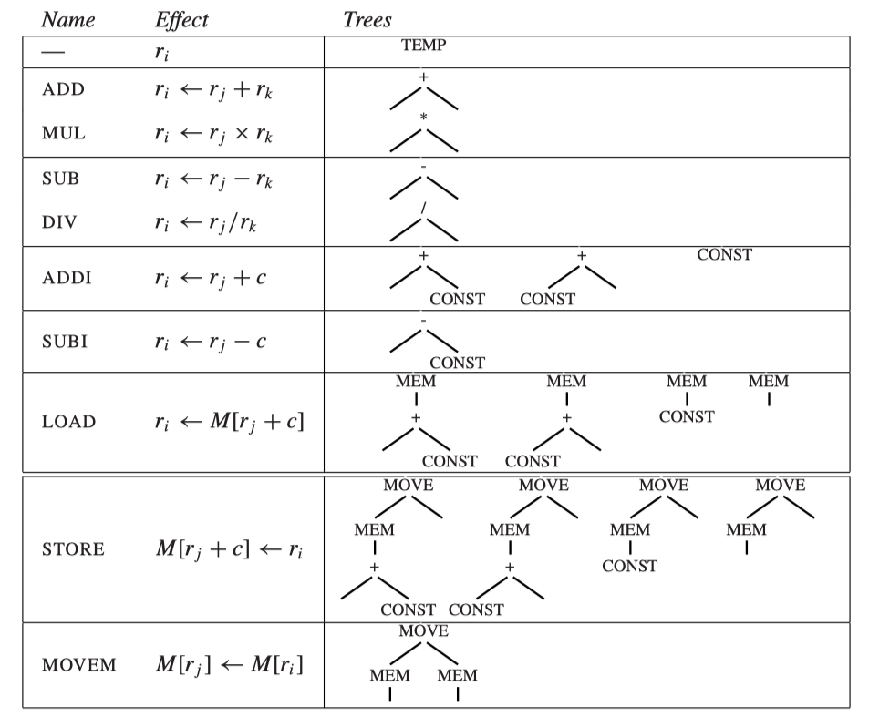
Tile Examples (Example machine, close to Quad) (r0=0 in this machine)

Slide 12
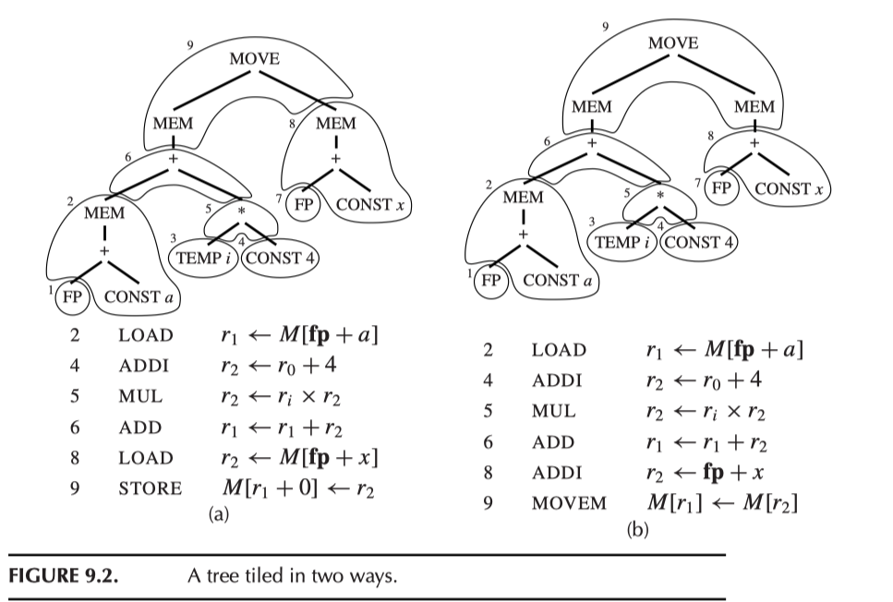
Tiling Example
Assume a and x are local vars stored in the Stack Frame (temporaries not in registers)

Slide 13
Use, Def, and Jump to
Each instruction in the Quad program has:
List of temp defined (i.e., the left side of move)
List of temp used (i.e., the value of which used in the instruction)
List of labels that Jump and Cjump jump to.
Used for code analysis

Slide 14
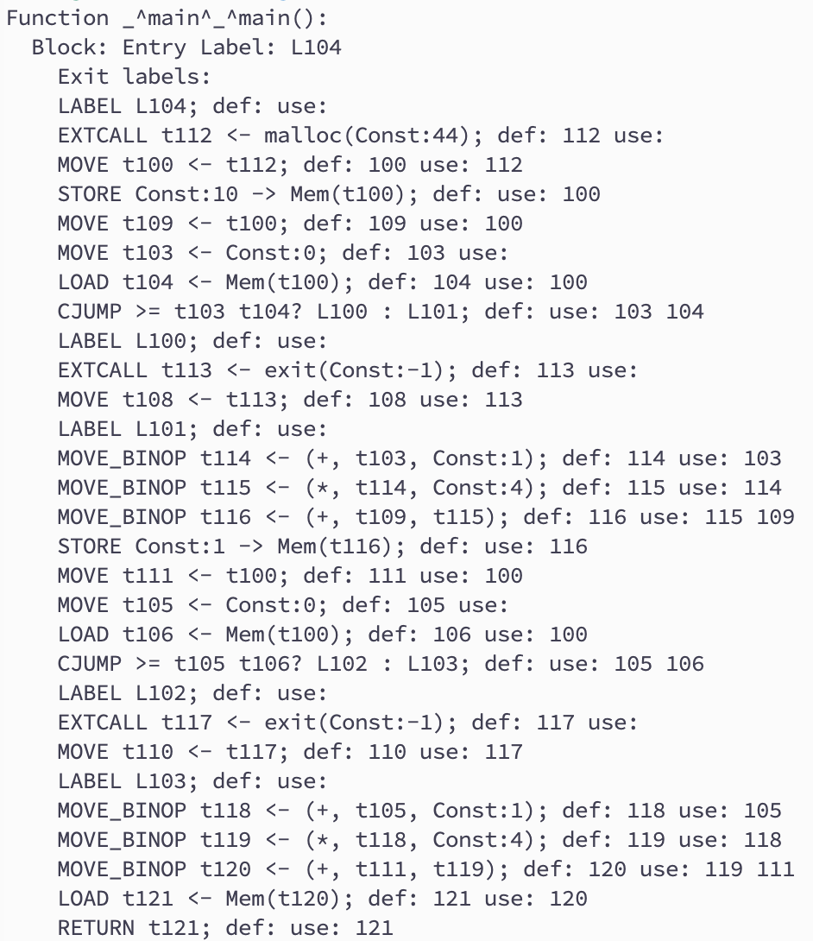
Example

Slide 15
Block Formation
A block is a straight-line program (no jumps)
The first instruction must be a label
The last instruction must be:
Jump/CJump
Return
Simplified depiction

Slide 16
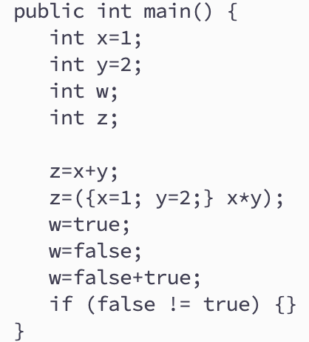
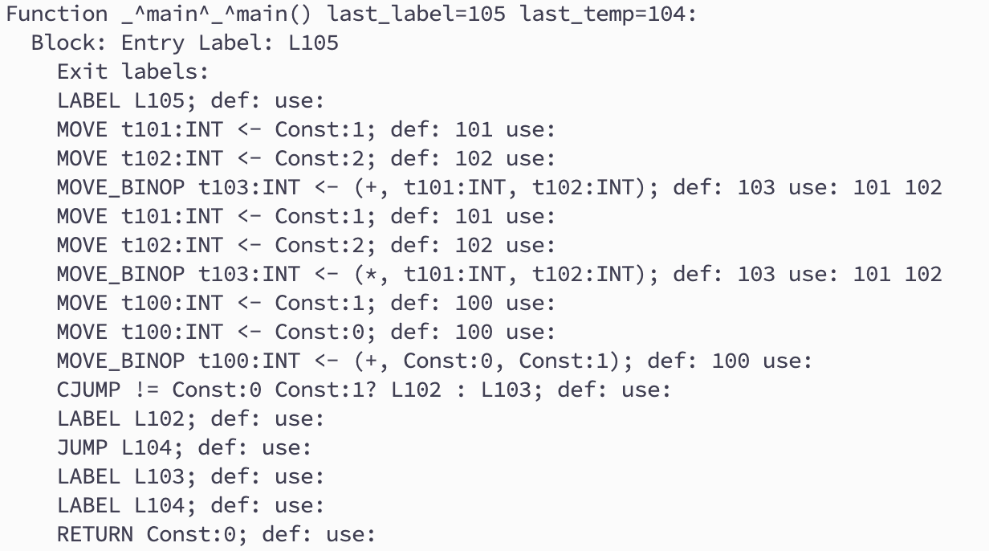
Example
1
2
3
4
1
2
3
Add an instruction “jump 104”
4

Slide 17
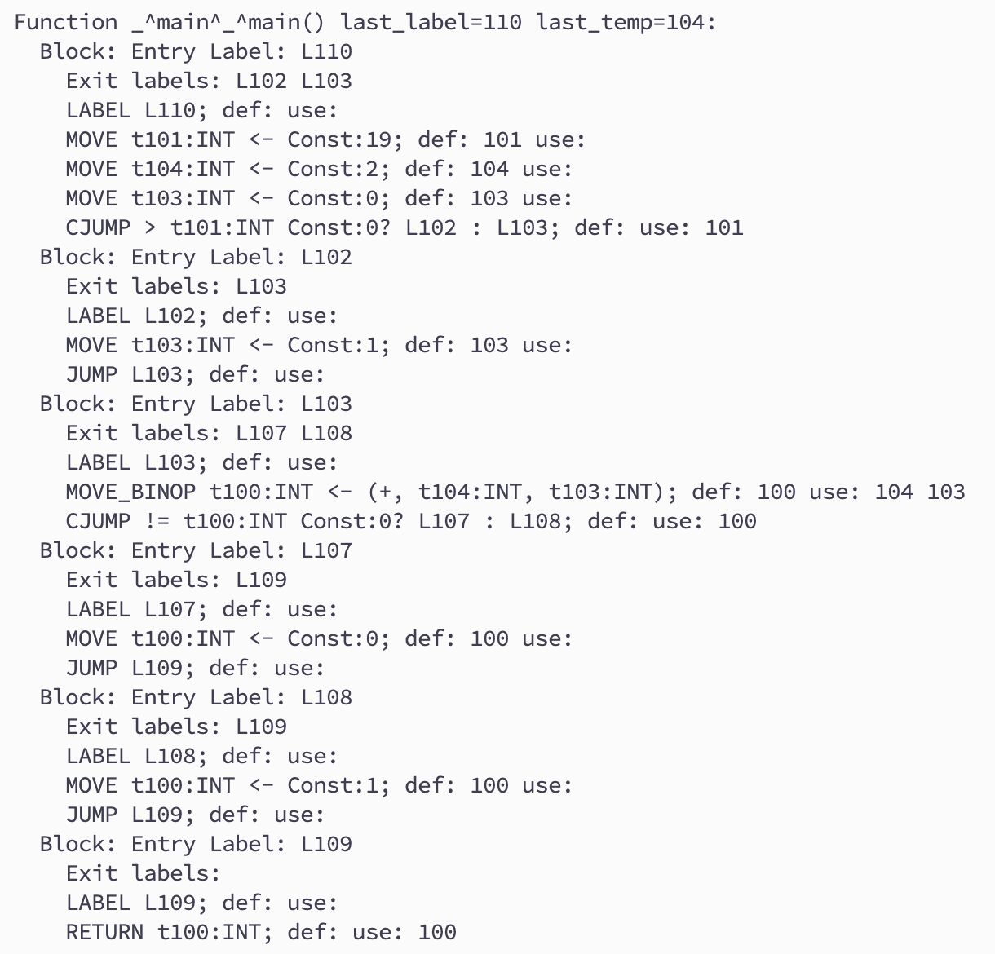
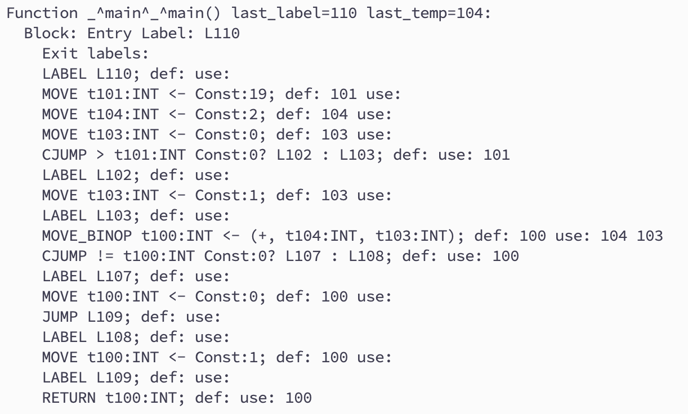
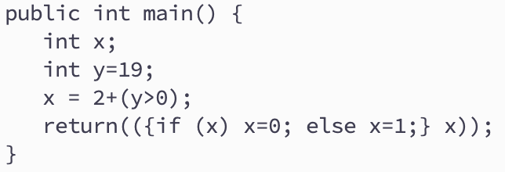
Example 2
1
2
3
4
5
1
6
2
3
4
5
6

Slide 18
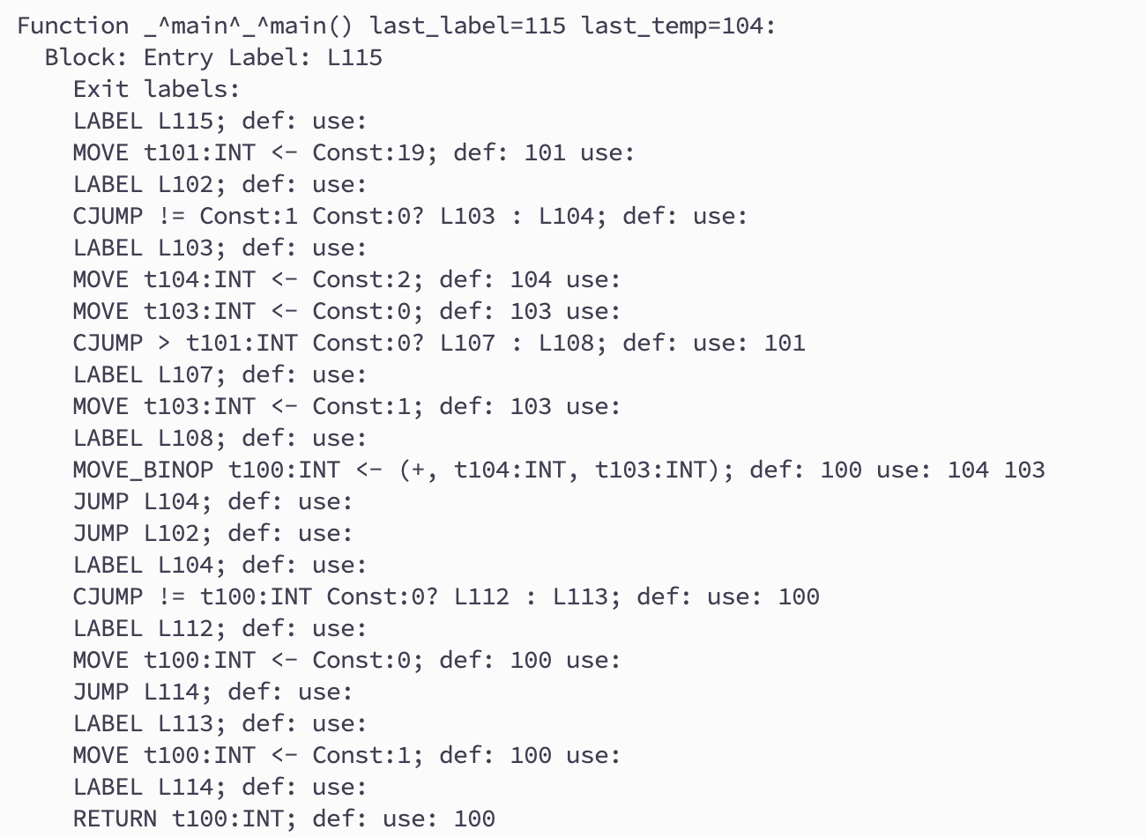
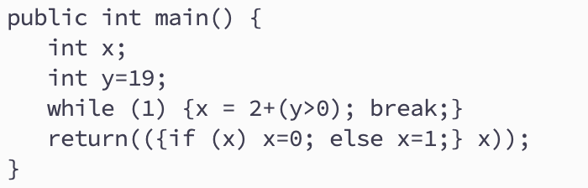
Example 3
1
2
1
3
2
4
5
3
6
4
7
5
8
6
7
9
10
8
9
10

Slide 19
Control Flow vs Data Flow
Control Flow
What’s the next instruction
Useful in analyzing data flow
Data Flow (or data dependency)
Where was the value defined when a value is used?
Useful in analyzing/optimizing the code
For example: Constant propagation

Slide 20
Static Single Assignment
Each variable has only one deﬁnition in the program text (can use many times)
Useful for several reasons:
Dataﬂow analysis and optimization algorithms can be made simpler
Smaller space to store def-use relationships
Simplify many problems, e.g., interference graphs
Unrelated uses of the same variable in the source program become different variables in SSA form, eliminating needless relationships

Slide 21
Easy for Straight Line Programs

Slide 22
Other Cases: An example

Slide 23
The phi-function
phi-function: a₃ takes the a₂ value if the control flow is from block 3, otherwise takes the a₁ value.
The phi-“function” that
“knows” which control path was taken.

Slide 24
Another Example
Dead code
Edge splitting
We assume all variables are defined in the start node (and every program starts with a start node).
b0 and c0 could be undefined (but could also be from input parameters)

Slide 25
The phi-function
How can we implement a phi-function that “knows” which control path was taken?
Answer 1: we don’t!! The function is used only to connect use to definitions during optimization, but is never implemented.
Answer 2: If we must execute the phi-function, we can implement it by inserting MOVE instructions in all control paths.

Slide 26
Criteria for Inserting phi-Functions
We could insert one phi-function for each variable at every join point (a point in the CFG with more than one predecessor). But that would be wasteful.
To insert a phi-function for a variable a at node z of the CFG:
Intuitively, we should add a phi-function if there are two definitions of a that can reach the point z through distinct paths.

Slide 27
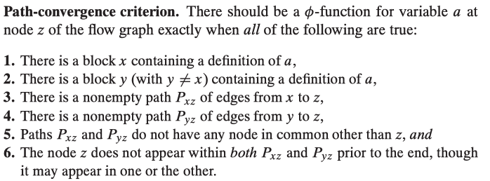
Path Convergence Criterion

Slide 28
Naïve Algorithm
The phi-function itself is a definition of a. Therefore, the path-convergence criterion should be repeatedly tested:
This algorithm is extremely costly, because it requires the examination of every triple of nodes x, y, z and every path from x to z and from y to z.

Slide 29
The SSA Conversion Problem
For each variable x defined in a CFG G=(V, E), find the minimal set J(x) of nodes that requires a phi-function for x.

Slide 30
Dominance Relation
Dominance relation: A node d dominates a node n if every path from the start node to n goes through d.
Example:
Node 1 dominates all nodes.
Node 2 dominates nodes 2, 3 and 4
Node 3 doesn’t dominate any other nodes
Node 4 either
Note: a node dominates itself

Slide 31
Dominance property of SSA form

Slide 32
The Dominance Frontier

Slide 33
Dominance frontier criterion

Slide 34
Another Example

Slide 36
Final Remarks
周四上午 Quiz 2（8am，不要迟到）
HW5 周四晚 due
HW6 下周四 due

