Slide 1
BARN OWL
Find rat risk where 311 is quiet
A 311 complaint is a report.
It is not a rat count.
NYC inspections give us another signal: active rat signs found on swept blocks.
Notes:
New York records rat complaints, but a call depends on someone choosing to report. Barn Owl asks where active rat signs might be found even when 311 is quiet. We use the city's inspections of swept blocks as an independent outcome for training and backtesting. That inspection sample still has limits, which I will show on the evidence slide.
Source: model/README.md, model/05_backtest.py; plan/master-plan.md §10

Slide 2
Two signals, one map
A
Complaint model
Silence Score
Ranks expected 311 reports
risk percentile − report percentile
B
Active-sign model
East Harlem North +80
Uses physical and environmental features; no complaint counts
0 complaints · 8.2% modeled risk
West Village -15
31 complaints · 4.3% modeled risk
Prior 12 months · September 2026 export
02
Notes:
Barn Owl scores each H3 cell and month two ways. Model A estimates complaints. Model B estimates the share of swept lots where an inspector would find active signs. Model B uses building and environmental features and omits complaint counts. A positive Silence Score means modeled risk ranks above reporting. In the September 2026 export, East Harlem North has zero complaints in the prior 12 months, 8.2% modeled risk, and a +80 gap, rank 10 of 5170. The West Village cell has 31 complaints, 4.3% modeled risk, and a -15 gap. These are two examples of model output, not measured prevalence or a causal income result. On the live map, switch from complaints to risk, then silence.
Source: model/out/cells.json; model/README.md §Key decisions; web/src

Slide 3
The ranking finds more active signs
19.5%
vs 15.2%
Model B risk / prior 12-month 311 complaints
Mean monthly share of swept lots with active signs. Top 50 swept cells each month, 119 months (2016–2026).
03
Notes:
This is the exported rolling backtest, not a simulation. Each month the model trains only on earlier months, then each method picks its top 50 among cells that inspectors actually swept that month. We count the share of swept lots in those picked cells with active rat signs and average the monthly shares. Model B risk averages 19.5%, compared with 15.2% for a ranking by prior 311 calls, a 4.3 point gap. The result is conditional on the swept sample; it does not tell us how many rats live citywide or prove a causal gain from deploying sensors. The quiet-block comparison is separate and is not the bar labeled Model B.
Source: model/out/backtest.json and model/05_backtest.py

Slide 4
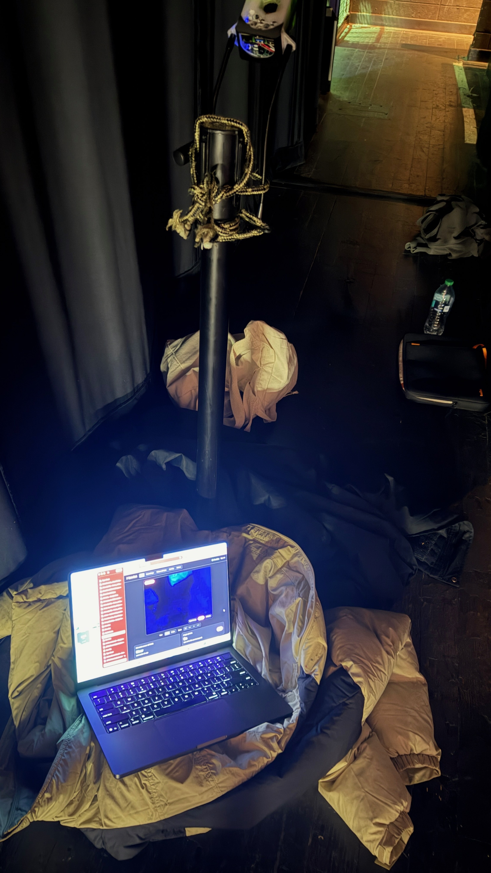
Recorded footage reaches the map
1
Pick a site
Rank risk and the data gap; select a tree pit
2
Capture
Physical owl rig: Pi 5 camera and PIR sensor
3
Detect
Room-lit plush model; live Pi test pending
4
Update the map
Accepted events update a chosen prior
Physical prototype at the hackathon
Verified replay
1 event · score 9.2% → 13.0% · rank 11 → 2
04
Notes:
The planner has 20 candidate tree sites in its current export. The table prop is room-lit. In a local Mac replay, original camera footage from zoom15_b at 59–63 seconds passed through the exported ONNX model, the Pi Detector class and its three-hit rules, crop generation, and the local API. Exactly one event at confidence 0.860 was accepted. The served cell score moved from 0.0923 to 0.1297; the plan candidate moved from rank 11 to 2. The frontend screenshot showed the crop, one sighting, and rank 2. This is a verified saved-video software loop, not a physical Pi inference test or the formal 20-push/three-minute-negative event gate. PIR only wakes capture; the detector decides. Team-reported IR capture does not validate the model under IR. An accepted event updates a chosen Beta prior and can rerank candidates; it does not retrain Model B. If demonstrating from recorded footage on stage, name it as recorded. A physical Pi trigger can be shown only if it works in a fresh test.
Source: vision/replay_video.py; vision/RUNBOOK.md; vision/TRAINING_RESULTS.md; model/out/plan.json; api/posterior.py; team local replay and frontend screenshot 2026-09-26; team physical-rig photo IMG_1788.jpeg 2026-09-26

Slide 5
What is real today
Real
Demo and open work
NYC data and sweep outcomes
Cell models and a 119-month backtest
Pi camera, PIR and IR capture
verified by onsite team
Rat AP50: .943 tuned; .870 independent
Independent result below .90 target
Recorded footage → local API → map verified
Formal push and live Pi tests pending
No field deployment or rat population count
Next test
A supervised 50-node pilot, checked against later sweeps.
05
Notes:
Here is the honest state. The data exports, model scores, and sweep backtest exist. Teammates report working Pi 5 camera, PIR, and infrared capture. The prop footage is room-lit. V3 matched PyTorch and ONNX rat AP50 of .943296 on two fixed validation clips reused for recipe and checkpoint selection. Its locked independent test across 186 reviewed frames measured rat AP50 .870308, below the .90 target; a fresh new-angle positive clip measured .844166. Person AP50 also fell on the fresh clip. Further training is under way. A separate Mac replay of saved camera footage carried one accepted event through the Pi detector rules and local API to the visible map. That is an integration check on recorded footage. The formal 20-push/3-minute-negative event gate and physical Pi inference have not been evaluated. The event posterior uses a chosen prior; an accepted event updates the served score and can change candidate order, but does not retrain the city model. There is no field deployment or rat population estimate. A supervised 50-node pilot would need later proactive sweeps and false-event checks.
Source: vision/HILL_CLIMB.md independent test; model/out/backtest.json; model/out/metrics.json; node/DEBRIEF-utsav.md; api/posterior.py; plan/master-plan.md §12

