Slide 1
BARN OWL
Find rat risk where 311 is quiet
A 311 complaint is a report.
It is not a rat count.
NYC inspections give us another signal: active rat signs found on swept blocks.
Notes:
New York records rat complaints, but a call depends on someone choosing to report. Barn Owl asks where active rat signs might be found even when 311 is quiet. We use the city's inspections of swept blocks as an independent outcome for training and backtesting. That inspection sample still has limits, which I will show on the evidence slide.
Source: model/README.md, model/05_backtest.py; plan/master-plan.md §10

Slide 2
Two signals, one map
A
Complaint model
Silence Score
Ranks expected 311 reports
risk percentile − report percentile
B
Active-sign model
East Harlem North +80
Uses physical and environmental features; no complaint counts
0 complaints · 8.2% modeled risk
West Village -15
31 complaints · 4.3% modeled risk
Prior 12 months · September 2026 export
02
Notes:
Barn Owl scores each H3 cell and month two ways. Model A estimates complaints. Model B estimates the share of swept lots where an inspector would find active signs. Model B uses building and environmental features and omits complaint counts. A positive Silence Score means modeled risk ranks above reporting. In the September 2026 export, East Harlem North has zero complaints in the prior 12 months, 8.2% modeled risk, and a +80 gap, rank 10 of 5170. The West Village cell has 31 complaints, 4.3% modeled risk, and a -15 gap. These are two examples of model output, not measured prevalence or a causal income result. On the live map, switch from complaints to risk, then silence.
Source: model/out/cells.json; model/README.md §Key decisions; web/src

Slide 3
The ranking finds more active signs
19.5%
vs 15.2%
Model B risk / prior 12-month 311 complaints
Mean monthly share of swept lots with active signs. Top 50 swept cells each month, 119 months (2016–2026).
03
Notes:
This is the exported rolling backtest, not a simulation. Each month the model trains only on earlier months, then each method picks its top 50 among cells that inspectors actually swept that month. We count the share of swept lots in those picked cells with active rat signs and average the monthly shares. Model B risk averages 19.5%, compared with 15.2% for a ranking by prior 311 calls, a 4.3 point gap. The result is conditional on the swept sample; it does not tell us how many rats live citywide or prove a causal gain from deploying sensors. The quiet-block comparison is separate and is not the bar labeled Model B.
Source: model/out/backtest.json and model/05_backtest.py

Slide 4
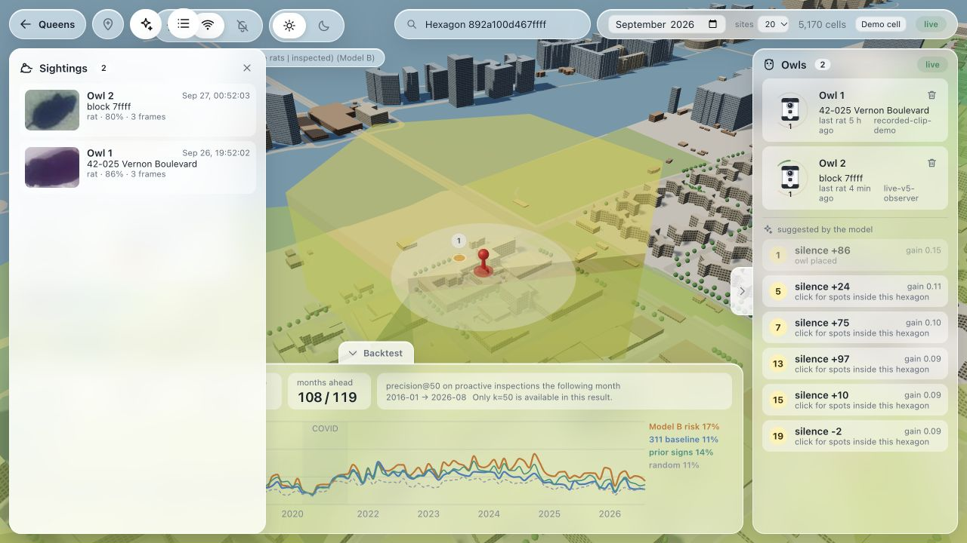
A live Pi event reaches the map
1
Pick a site
Rank risk and the data gap
2
Capture
Pi 5 camera watches the room-lit prop
3
Detect
V5 processed 1,346 live frames in 90 s
4
Update the map
One genuine event reached the local API
Live map · two sightings · site rank 1
Live loop
1 event · score 13.0% → 16.2% · rank 2 → 1
04
Notes:
The room-lit physical Pi 5 camera fed the locked V5 ONNX detector for 89.859 seconds. The observer inferred 1,346 frames at 14.98 processed frames per second, mean 59.15 milliseconds per frame. It saved six event crops; root and the API reviewer inspected all six and each showed the same visible plush. Exactly one genuine event from the live Pi observer was relayed to the local API on the Mac, which returned HTTP 200 and accepted it. The node was live-v5-observer in H3 cell 892a100d467ffff at 2026-09-27 04:52:03.340 UTC. The served score changed from .1297 to .1618, sightings from one to two, and candidate rank from two to one. The visible map screenshot shows the new sighting and rank-one site. The other five saved events were not posted. This verifies a supervised live Pi camera-to-detector-to-local-API-to-map loop on a room-lit plush prop. It does not establish field reliability, wild-rat or infrared performance, or the .90 detector target. PIR wakes capture; the detector decides. An accepted event updates a chosen Beta prior and reranks candidates; it does not retrain Model B.
Source: pitch/evidence/v5-live-run-stats.json; pitch/evidence/v5-live-integration-result.json; pitch/assets/live-pi-map-20260927.png; api/posterior.py; vision/V5_FORMAL_EVENT_RESULTS.md

Slide 5
What is real today
Real
Demo and open work
NYC data and sweep outcomes
Cell models and a 119-month backtest
Pi camera and PIR at the hackathon
Live plush event reached the map
Fresh V5 box target not established
Formal replay: 17 false alerts / 190 s
Cap and shoe caused those alerts
Room-lit prop; no field deployment
No IR or wild-rat validation
Next
Improve cap and shoe handling, then test on new footage.
05
Notes:
The city data, cell models and 119-month swept-cell backtest exist. The live room-lit plush Pi-to-local-API-to-map loop is verified on one accepted event; see slide four. Detector readiness is separate. V4 scored rat AP50 .925806 on 59 adjacent same-session frames, then .882675 on 439 reviewed new-room frames. V5 used those new-room clips for tuning and scored .960806 rat AP50 on its weakest development clip and .975279 combined over 146 development frames. Its frozen fresh box test measured .615779 rat AP50 as run on 369 frames, with exact PyTorch/ONNX AP parity. Completed source-only annotation QC found shifted and oversized reference boxes; 31 correction proposals remain unadopted and no corrected AP exists. The .90 box target is not established. In a separate fixed recorded-video formal event test, 18 of 19 source-reviewed plush appearances eventually had verified alerts, or 94.7 percent observed on that source; the brief first appearance was missed. All 43 emitted positive crops showed plush, but include repeat firings. The negative clip produced 17 false events over 190.409 seconds, or 5.357 per minute, above the required fewer than .5 per minute. Sixteen false alerts targeted one cap and one targeted a partial shoe. The formal event test failed, and 19 appearances also fall short of the specified 20-push coverage. These event and box measurements do not establish general field performance. There is no IR or wild-rat validation, field deployment, or rat population estimate. Improve cap and shoe handling, then evaluate on new independent footage before any pilot.
Source: vision/V5_FORMAL_EVENT_RESULTS.md; vision/V5_FRESH_RESULTS.md; pitch/evidence/v5-live-integration-result.json; pitch/evidence/v5-live-run-stats.json; vision/artifacts/rat-litroom-v5-development-candidate-20260927.zip; model/out/backtest.json; api/posterior.py

