Slide 1
BARN OWL
Find rat risk where 311 is quiet
A 311 complaint is a report.
It is not a rat count.
NYC inspections give us another signal: active rat signs found on swept blocks.
Notes:
New York records rat complaints, but a call depends on someone choosing to report. Barn Owl asks where active rat signs might be found even when 311 is quiet. We use the city's inspections of swept blocks as an independent outcome for training and backtesting. That inspection sample still has limits, which I will show on the evidence slide.
Source: model/README.md, model/05_backtest.py; plan/master-plan.md §10

Slide 2
Two signals, one map
A
Complaint model
Silence Score
Ranks expected 311 reports
risk percentile − report percentile
B
Active-sign model
East Harlem North +80
Uses physical and environmental features; no complaint counts
0 complaints · 8.2% modeled risk
West Village -15
31 complaints · 4.3% modeled risk
Prior 12 months · September 2026 export
02
Notes:
Barn Owl scores each H3 cell and month two ways. Model A estimates complaints. Model B estimates the share of swept lots where an inspector would find active signs. Model B uses building and environmental features and omits complaint counts. A positive Silence Score means modeled risk ranks above reporting. In the September 2026 export, East Harlem North has zero complaints in the prior 12 months, 8.2% modeled risk, and a +80 gap, rank 10 of 5170. The West Village cell has 31 complaints, 4.3% modeled risk, and a -15 gap. These are two examples of model output, not measured prevalence or a causal income result. On the live map, switch from complaints to risk, then silence.
Source: model/out/cells.json; model/README.md §Key decisions; web/src

Slide 3
The ranking finds more active signs
19.5%
vs 15.2%
Model B risk / prior 12-month 311 complaints
Mean monthly share of swept lots with active signs. Top 50 swept cells each month, 119 months (2016–2026).
03
Notes:
This is the exported rolling backtest, not a simulation. Each month the model trains only on earlier months, then each method picks its top 50 among cells that inspectors actually swept that month. We count the share of swept lots in those picked cells with active rat signs and average the monthly shares. Model B risk averages 19.5%, compared with 15.2% for a ranking by prior 311 calls, a 4.3 point gap. The result is conditional on the swept sample; it does not tell us how many rats live citywide or prove a causal gain from deploying sensors. The quiet-block comparison is separate and is not the bar labeled Model B.
Source: model/out/backtest.json and model/05_backtest.py

Slide 4
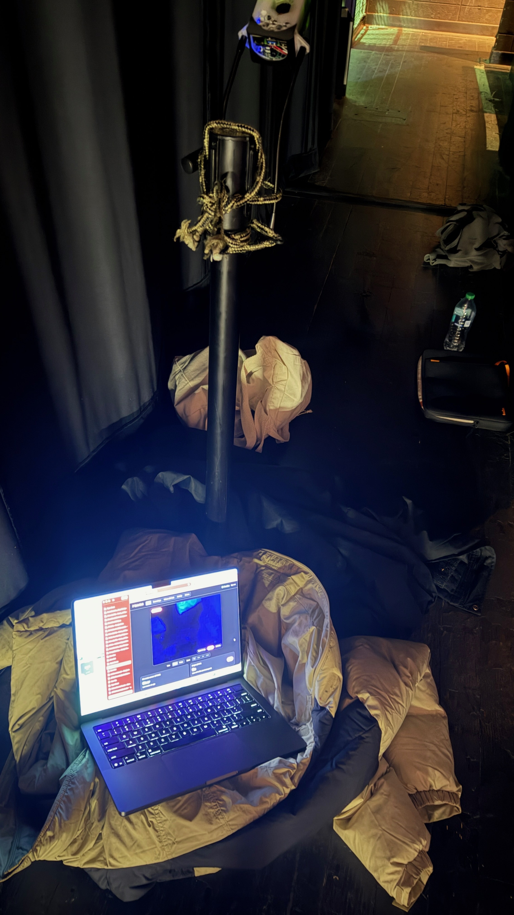
Recorded footage reaches the map
1
Pick a site
Rank risk and the data gap; select a tree pit
2
Capture
Physical owl rig: Pi 5 camera and PIR sensor
3
Detect
Room-lit plush model; live positive test pending
4
Update the map
Accepted events update a chosen prior
Physical prototype at the hackathon
Earlier replay
1 event · score 9.2% → 13.0% · rank 11 → 2
04
Notes:
The planner has 20 candidate tree sites in its current export. The table prop is room-lit. In an earlier local Mac replay using the V2 detector, original camera footage from zoom15_b at 59–63 seconds passed through the exported ONNX model, the Pi Detector class and its three-hit rules, crop generation, and the local API. Exactly one event at confidence 0.860 was accepted. The served cell score moved from 0.0923 to 0.1297; the plan candidate moved from rank 11 to 2. The frontend screenshot showed the crop, one sighting, and rank 2. V5 has separate detector development results but has not been verified through the same API path. The earlier software loop used saved video on a Mac. V5 also ran on a saved frame on the physical Pi; positive live-camera detection remains unverified. PIR only wakes capture; the detector decides. Team-reported IR capture does not validate the model under IR. An accepted event updates a chosen Beta prior and can rerank candidates; it does not retrain Model B. If demonstrating from recorded footage on stage, name it as recorded. A physical Pi trigger can be shown only if it works in a fresh test.
Source: vision/replay_video.py; vision/RUNBOOK.md; vision/TRAINING_RESULTS.md; model/out/plan.json; api/posterior.py; team local replay and frontend screenshot 2026-09-26; team physical-rig photo IMG_1788.jpeg 2026-09-26

Slide 5
What is real today
Real
Demo and open work
NYC data and sweep outcomes
Cell models and a 119-month backtest
Pi camera and PIR at the hackathon
Saved-frame ONNX inference on Pi
Fresh V5 test did not establish .90 AP50
Labels and edge misses need work
Tuned development: .961 weakest clip
Earlier footage → API → map verified
Room-lit prop demo; no field deployment
Next
Improve the detector and repeat a frozen test before a pilot.
05
Notes:
Here is the honest state. The data exports, model scores, and sweep backtest exist. Teammates report working Pi 5 camera, PIR, and infrared capture; the prop footage is room-lit. V4 scored rat AP50 .925806 on 59 adjacent frames from the same camera session, then .882675 on 439 reviewed new-room frames, below the .90 box target. Its recorded replay missed a parked plush and fired once on a dark case. V5 used those prior new-room clips as development data. The locked V5 checkpoint reached .960806 rat AP50 on its weakest selected development clip and .975279 combined over 146 development frames. A frozen fresh test of 369 reviewed frames measured .615779 rat AP50 and .492688 person AP50 as run, with .703102 rat AP50 on the positive clip; PyTorch and ONNX AP matched exactly. Completed source-only review of all 193 positive sampled frames found shifted and oversized rat reference boxes. Thirty-one source-estimated correction proposals are drafts and were not adopted or rescored; the frozen labels, model settings, and original report remain unchanged. The .615779 figure is the as-run score with known annotation defects, not a corrected performance estimate. The as-run test did not establish the .90 rat-box target. The fresh replay emitted 34 events in the positive clip; independent review of every saved event crop beside its source frame confirmed all 34 target the visible plush. The negative clip emitted zero events over 175.937 seconds. These are repeated firings across only two complete coarse positive presences, not 34 independent encounters or a 20-push recall test. The negative clip is shorter than three minutes, so the formal event gate is incomplete. The second presence first alerted 58.890 seconds after its start, largely while the plush was near the image edge. Source-only annotation QC is complete; the 31 proposed corrections remain unadopted. The V5 ONNX ran on a saved plush frame on the physical Pi at 60.23 milliseconds median, confidence .931. A separate earlier Mac replay using V2 footage carried one accepted event through detector rules and local API to the visible map. A later Pi live-camera trial had no plush target; positive live-camera integration is pending. AP50 is a box detection measure, not accuracy or rat population prevalence. No IR or wild-rat detector test and no field deployment have been done. An accepted event updates a chosen prior and can change candidate order; it does not retrain Model B. Improve the detector and repeat a frozen test before a field pilot.
Source: vision/V5_FRESH_RESULTS.md (completed crop and source-only annotation reviews; 31 correction proposals unadopted); pitch/evidence/v5-fresh-test-provisional.json (frozen as-run box scores); vision/artifacts/rat-litroom-v5-development-candidate-20260927.zip: reports/metrics.json, reports/candidate_lock.json, reports/dev_replay, reports/pi_saved_frame_smoke.json; vision/artifacts/rat-litroom-v4-new-room-evaluation-20260927.zip; model/out/backtest.json; api/posterior.py

