Slide 1
NIGHT OWL
Model active rat signs beyond 311 reports
A 311 complaint is a report.
It is not a rat count.
NYC inspections give us another signal: active rat signs found on swept blocks.
Notes:
New York records rat complaints, but someone must choose to report. Night Owl compares those reports with inspection findings on swept blocks. Those inspections provide the outcome for training and backtesting. They cover only the places that crews swept.
Source: model/README.md, model/05_backtest.py; plan/master-plan.md §10

Slide 2
Two signals, one map
A
Complaint model
Silence Score
Ranks expected 311 reports
risk percentile − report percentile
B
Active-sign model
East Harlem North +80
Uses physical and environmental features; no complaint counts
0 complaints · 8.2% modeled risk
West Village -15
31 complaints · 4.3% modeled risk
Prior 12 months · September 2026 export
02
Notes:
Night Owl scores each H3 cell and month two ways. Model A estimates complaints. Model B estimates the share of swept lots where an inspector would find active signs. Model B uses building and environmental features and omits complaint counts. A positive Silence Score means modeled risk ranks above reporting. In the September 2026 export, East Harlem North has zero complaints in the prior 12 months, 8.2% modeled risk, and a +80 gap, rank 10 of 5170. The West Village cell has 31 complaints, 4.3% modeled risk, and a -15 gap. These are two examples of model output, not measured prevalence or a causal income result. On the live map, switch from complaints to risk, then silence.
Source: model/out/cells.json; model/README.md §Key decisions; web/src

Slide 3
Higher active-sign share among swept cells
19.5%
vs 15.2%
Model B risk / prior 12-month 311 complaints
Mean monthly share of swept lots with active signs. Top 50 swept cells each month, 119 months (2016–2026).
03
Notes:
This is the exported rolling backtest, not a simulation. Each month the model trains only on earlier months, then each method picks its top 50 among cells that inspectors actually swept that month. We count the share of swept lots in those picked cells with active rat signs and average the monthly shares. Model B risk averages 19.5%, compared with 15.2% for a ranking by prior 311 calls, a 4.3 point gap. The result is conditional on the swept sample; it does not tell us how many rats live citywide or prove a causal gain from deploying sensors. The quiet-block comparison is separate and is not the bar labeled Model B.
Source: model/out/backtest.json and model/05_backtest.py

Slide 4
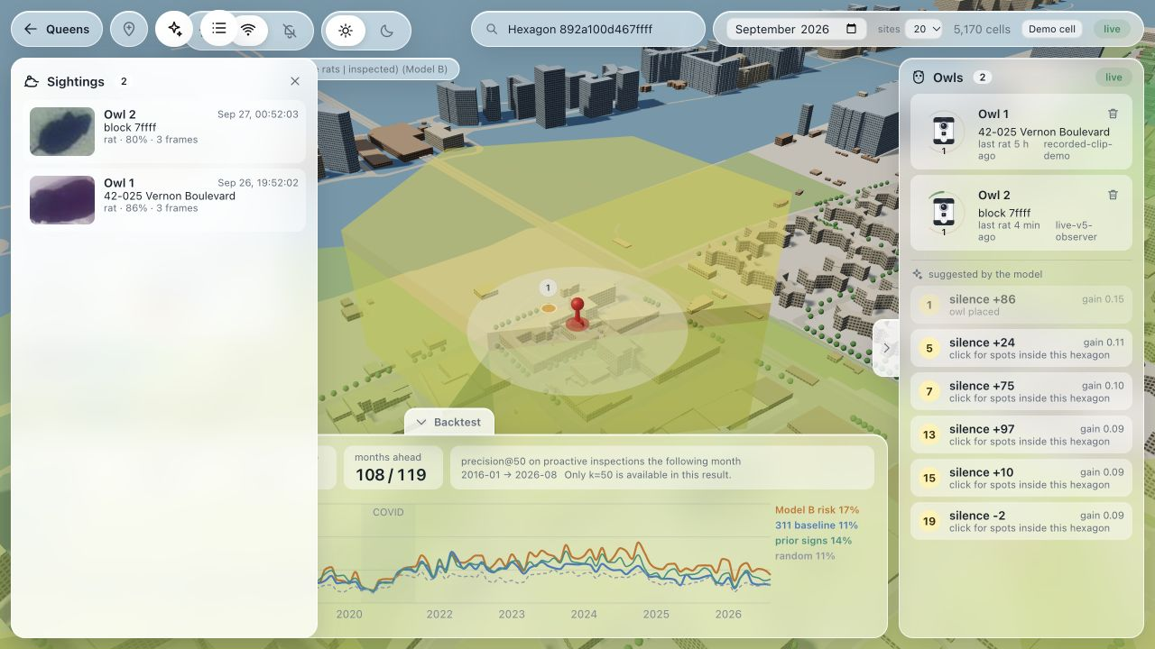
A live Pi event reaches the map
1
Pick a site
Rank risk and the data gap
2
Capture
Pi 5 camera watches the room-lit prop
3
Detect
V5 processed 1,346 live frames in 90 s
4
Update the map
One genuine event reached the local API
Live map · two sightings · site rank 1
Live loop
1 event · score 13.0% → 16.2% · rank 2 → 1
04
Notes:
The room-lit physical Pi 5 camera fed the locked V5 ONNX detector for 89.859 seconds. The observer inferred 1,346 frames at 14.98 processed frames per second, mean 59.15 milliseconds per frame. It saved six event crops; root and the API reviewer inspected all six and each showed the same visible plush. Exactly one genuine event from the live Pi observer was relayed to the local API on the Mac, which returned HTTP 200 and accepted it. The node was live-v5-observer in H3 cell 892a100d467ffff at 2026-09-27 04:52:03.340 UTC. The served score changed from .1297 to .1618, sightings from one to two, and candidate rank from two to one. The visible map screenshot shows the new sighting and rank-one site. The other five saved events were not posted. This verifies a supervised live Pi camera-to-detector-to-local-API-to-map loop on a room-lit plush prop. It does not establish field reliability, wild-rat or infrared performance, or the .90 detector target. PIR wakes capture; the detector decides. An accepted event updates a chosen Beta prior and reranks candidates; it does not retrain Model B.
Source: pitch/evidence/v5-live-run-stats.json; pitch/evidence/v5-live-integration-result.json; pitch/assets/live-pi-map-20260927.png; api/posterior.py; vision/V5_FORMAL_EVENT_RESULTS.md

Slide 5
What is real today
Real
Demo and open work
NYC data and sweep outcomes
Cell models and a 119-month backtest
Pi camera and PIR at the hackathon
Live plush event reached the map
Fresh V5 box target not established
Formal replay: 17 false alerts / 190 s
Cap and shoe caused those alerts
Room-lit prop; no field deployment
No IR or wild-rat validation
Next
Improve cap and shoe handling, then test on new footage.
05
Notes:
The city data, cell models, and 119-month swept-cell backtest exist. One room-lit plush event traveled from the live Pi camera through the local API to the map. That proves the path worked once. V5 is still the demo detector. V4 scored rat AP50 .925806 on 59 same-session frames and .882675 on 439 new-room frames. V5 used those new-room clips for tuning and scored .960806 on its weakest development clip. Its fresh box test scored .615779 rat AP50 as run on 369 frames; PyTorch and ONNX matched. Source review found shifted and oversized reference boxes. Thirty-one correction proposals remain unadopted, so there is no corrected score. The .90 box target was not established. A separate fixed recorded event test alerted on 18 of 19 reviewed plush appearances but produced 17 false alerts in 190.409 seconds without a plush, above the limit of fewer than .5 per minute. Sixteen false alerts targeted one cap and one targeted a partial shoe. All 43 positive event crops showed the plush, but include repeat firings. That event test failed, and 19 appearances also fall short of 20 requested pushes. V6 trained for 30 epochs on added hard negatives but failed its preset development floors: table_c rat AP50 .892 versus .936 required, table_c person .801 versus .820, and old-combined person .742 versus .808. The team did not replay V6 or put it on the Pi. Neither version has demonstrated general field, IR, or wild-rat performance. Improve cap and shoe handling, then test on new independent footage before a pilot.
Source: vision/V5_FORMAL_EVENT_RESULTS.md; vision/V5_FRESH_RESULTS.md; vision/V6_PLAN.md; pitch/evidence/v6-checkpoint-selection.json; pitch/evidence/v5-live-integration-result.json; pitch/evidence/v5-live-run-stats.json; model/out/backtest.json; api/posterior.py

