Slide 1
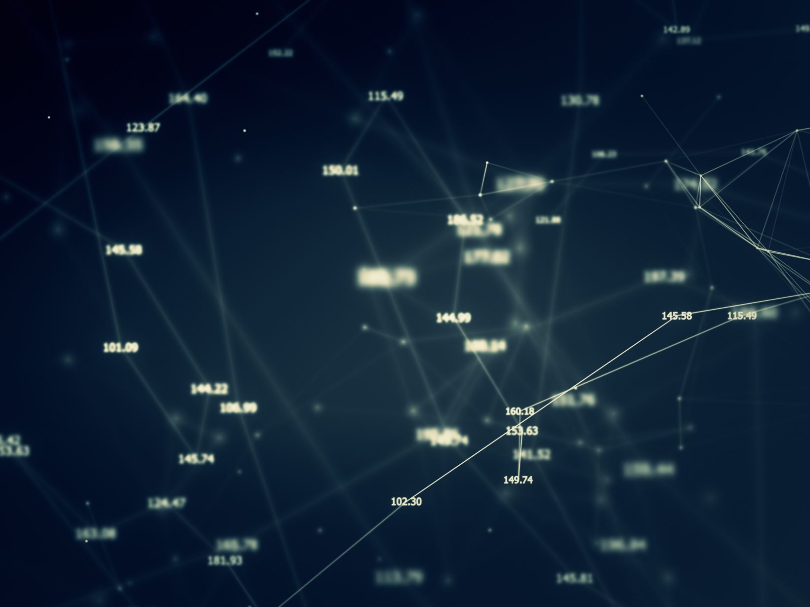
AI-Generated Text Detection using Transformer Models
Ethan Coomber
CS5100 (July 2025)
Notes:
Hello, my name is Ethan Coomber, and today I’ll present my final project for CS5100—AI-Generated Text Detection using Transformer Models.
This project compares a traditional text classification approach with a modern transformer-based model to determine whether text is AI-generated or written by a human.

Slide 2
Problem Statement
Generative AI (e.g., GPT models) produces text nearly indistinguishable from human writing.
Challenge: Detecting AI-generated content to prevent plagiarism, disinformation, and spam.
Notes:
Generative AI models like GPT-4 are producing human-like text, which makes detecting AI-generated content increasingly challenging.
This is important for preventing issues such as academic plagiarism, misinformation, and spam.
My project focuses on creating a system to classify text as either human-written or AI-generated.

Slide 3
Motivation & Goals
Develop a classifier to distinguish AI-generated vs. human text.
1
Compare a baseline (TF-IDF + Logistic Regression) with a transformer model (fine-tuned BERT).
2
Evaluate models using accuracy, F1-score, and ROC-AUC.
3
Notes:
The main goal was to build a robust and accurate classifier.
I started with a simple and interpretable baseline model, TF-IDF with logistic regression, and then implemented a fine-tuned DistilBERT model to test how much performance could improve with modern NLP techniques.
I also compared these approaches using accuracy, F1-score, and ROC-AUC.

Slide 4
Dataset & Preprocessing
Dataset: HC3 benchmark dataset with balanced AI and human text.
Preprocessing:
Text cleaning and tokenization.
Train-test split.
TF-IDF feature extraction for baseline model.
Notes:
I used the HC3 dataset, which is widely regarded as a benchmark for AI text detection.
Preprocessing involved cleaning the text, removing unwanted characters, tokenizing it, and splitting it into training and testing sets.
For the baseline model, I used TF-IDF to convert text into numerical feature vectors.

Slide 5
Models & Approach
Baseline: TF-IDF + Logistic Regression (simple and interpretable).
Advanced: Fine-tuned DistilBERT using Hugging Face Transformers.
Workflow: Data → Preprocessing → Model Training → Evaluation.
Notes:
The first model was a logistic regression classifier trained on TF-IDF features, chosen for its simplicity and interpretability.
The second model was DistilBERT, a smaller version of BERT, fine-tuned using the Hugging Face Transformers library.
The workflow included data exploration, preprocessing, training both models, and comparing their results.

Slide 6
Results
TF-IDF + Logistic Regression:
Accuracy: 96%
F1-score: 0.95
DistilBERT:
Accuracy: 99%
F1-score: 0.99
BERT outperforms baseline due to better semantic understanding.
Notes:
The baseline TF-IDF model achieved 96% accuracy and an F1-score of 0.95, which was surprisingly strong.
The fine-tuned DistilBERT model outperformed the baseline, reaching 99% accuracy and an F1-score of 0.99.
This shows that transformer models are better at capturing semantic and contextual differences between AI and human text.

Slide 7
Discussion & Limitations
BERT captures context beyond word frequency, leading to superior results.
Limitations:
Initial debugging with limited data reduced performance.
Transformer fine-tuning requires significant computational resources.
Future Work: Hyperparameter tuning, larger models, and ensemble methods.
Notes:
BERT's ability to capture deep context gives it a clear edge over simpler lexical models.
However, transformers require significantly more computational resources, and performance can suffer without proper fine-tuning.
In the future, I’d like to experiment with larger datasets, optimize hyperparameters further, and possibly explore ensemble approaches.

Slide 8
Conclusion
Developed a full NLP pipeline for AI-text detection.
Baseline achieved 96% accuracy; fine-tuned BERT reached 99% accuracy.
Lessons: Transformers need careful fine-tuning, while TF-IDF remains a strong baseline.
Thank you!
Notes:
To conclude, this project developed a full NLP pipeline for AI text detection.
While TF-IDF proved to be a strong baseline, BERT achieved near-perfect accuracy when fine-tuned properly.
This work shows the value of combining traditional and modern techniques for robust AI detection.
Thank you for your time, and I’m happy to take any questions.

