Slide 1
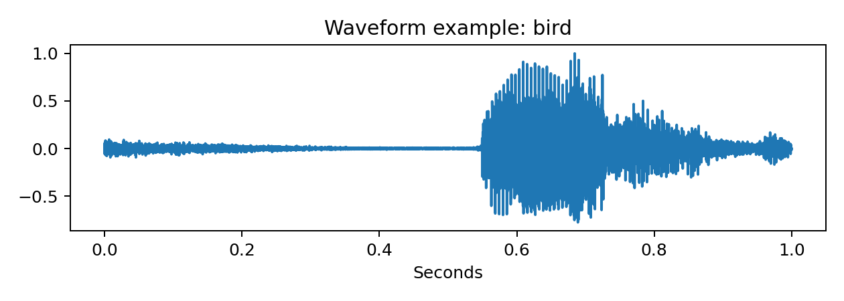
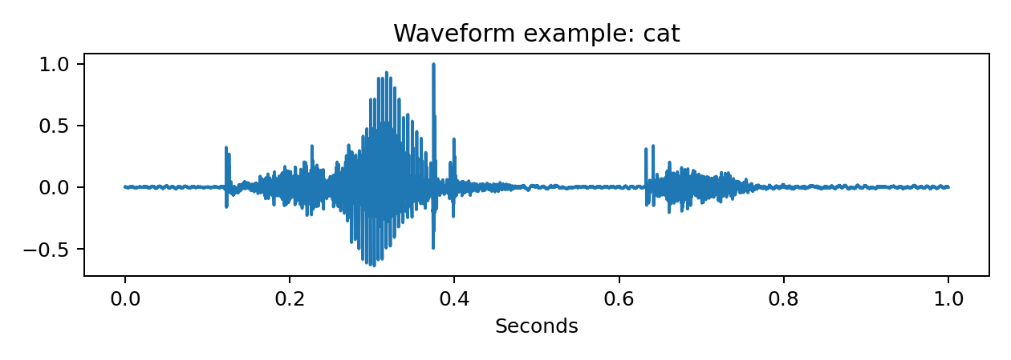
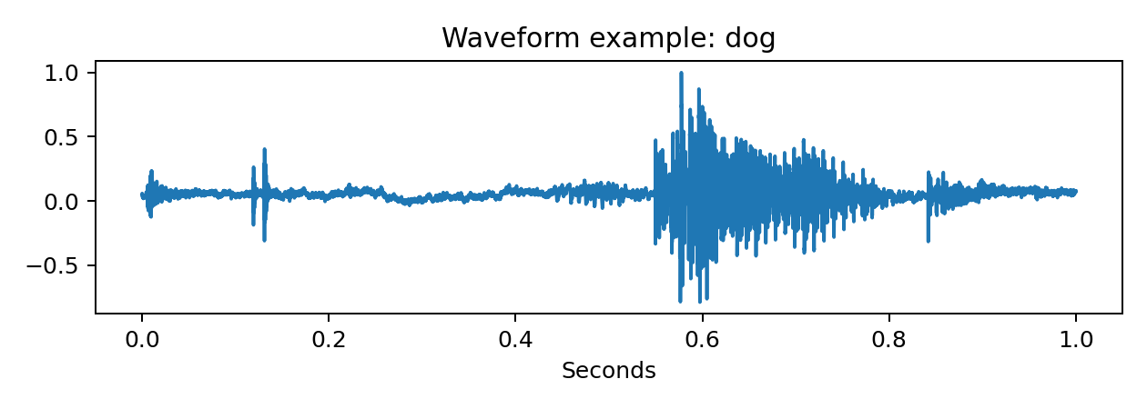
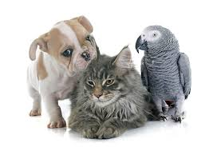
Audio Classification
Bird vs Cat vs Dog
Using acoustic features and five machine learning models to classify short spoken-word audio clips.
610
27
5
audio clips
numeric features
models tested
Presentation: May 6, 2026 • 2–4pm
Ethan DeLaRosa

Slide 2
Problem trying to solve
Can a program recognize an animal word from the sound alone?
Input
Features
Prediction
short .wav clip
loudness, pitch range, spectral shape
bird / cat / dog
The challenge: raw audio is not like a spreadsheet. The model needs numerical features that capture what makes each word sound different.
Audio Classification Project • 2

Slide 3
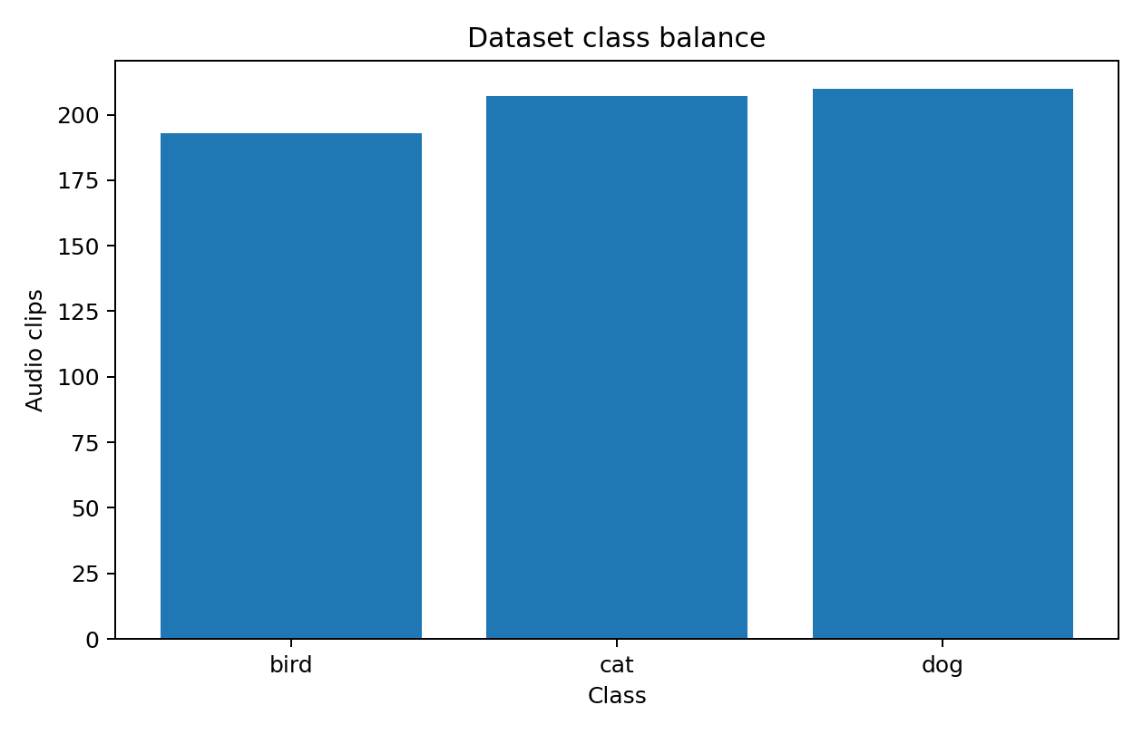
Dataset overview
Kaggle audio clips labeled as bird, cat, or dog
Class balance is almost even
Bird: 193 clips
Cat: 207 clips
Dog: 210 clips
Because no class dominates the data, accuracy is a fair first look, and a stratified train/test split keeps every class represented.
Split: 80% train / 20% test
Audio Classification Project • 3

Slide 4
Method used to solve it
Cleaning the data and converting audio into ML-ready features
PREPROCESSING DECISIONS
Missing values: checked feature table; none found, but median imputation is in every model pipeline.
Outliers: clipped numeric audio features at the 1st and 99th percentiles.
Categorical column: label encoded bird/cat/dog as numbers for modeling.
Imbalance: classes are close; used stratified split and balanced class weights where available.
FEATURES EXTRACTED
RMS energy • zero crossing rate • spectral centroid • bandwidth • rolloff • entropy • frequency-band energy • cepstral shape
Audio Classification Project • 4

Slide 5
Models trained
Five different approaches were tested on the same features
1
2
3
4
5
KNN
Logistic
Regression
Random
Forest
XGBoost
Neural
Network
nearby examples vote
linear decision boundary
many trees vote together
boosted trees correct errors
small MLP learns patterns
All models used the same holdout test set, so the comparison is apples-to-apples.
Audio Classification Project • 5

Slide 6
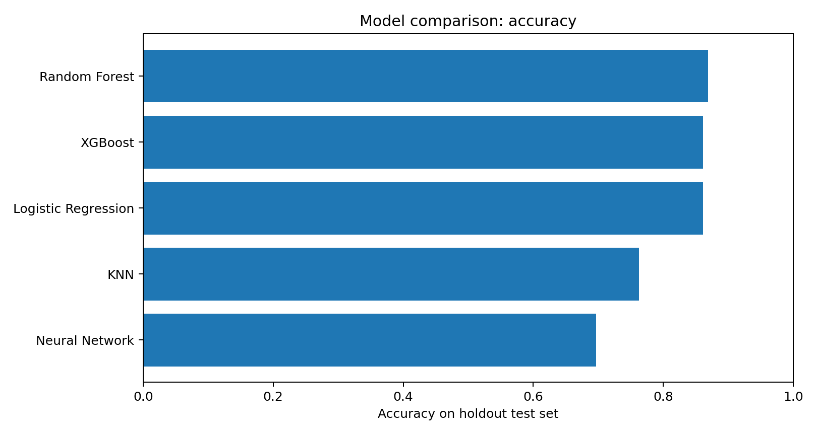
Results
Random Forest performed best overall on the holdout test set
Best model: Random Forest
86.9%
0.869
0.479
accuracy
macro F1
RMSE
Model
Acc.
RMSE
R²
Random Forest
86.9%
0.479
0.654
XGBoost
86.1%
0.536
0.568
Logistic Regression
86.1%
0.462
0.679
KNN
76.2%
0.695
0.271
Neural Network
69.7%
0.805
0.024
Note: RMSE and R² are calculated on encoded class labels because the assignment asked for them; accuracy/F1 are more natural for classification.
Audio Classification Project • 6

Slide 7
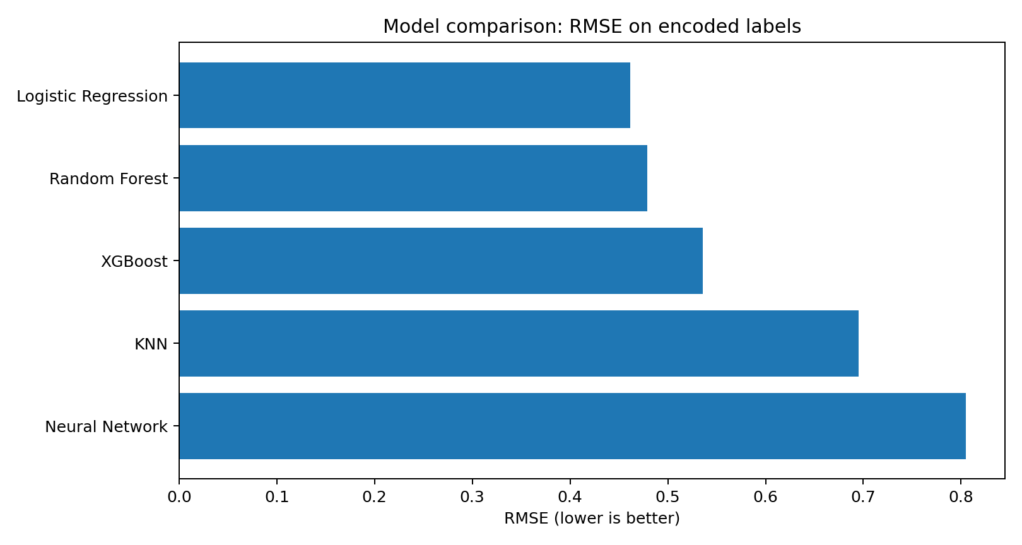
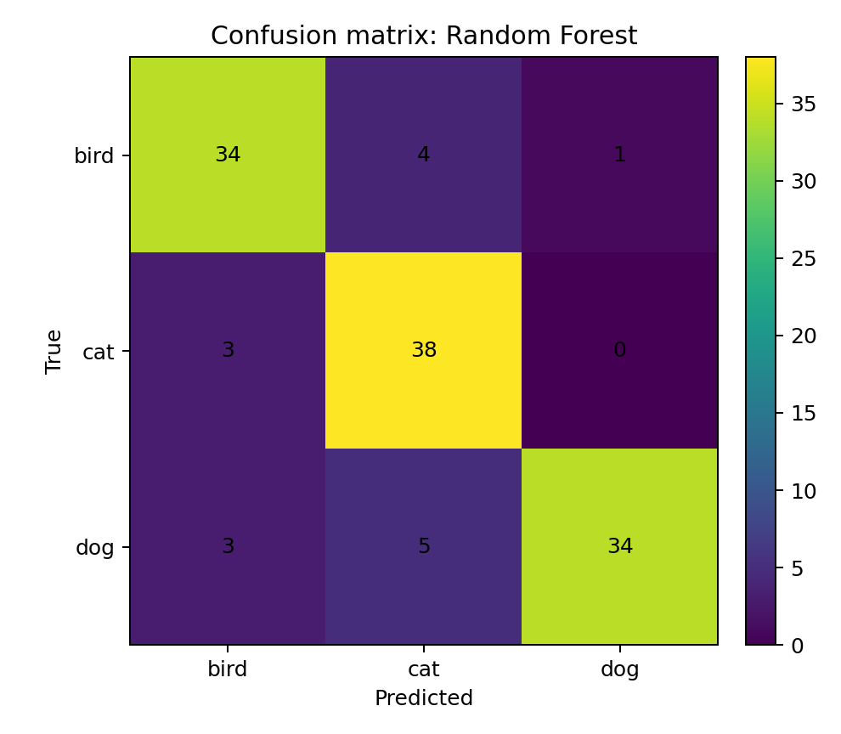
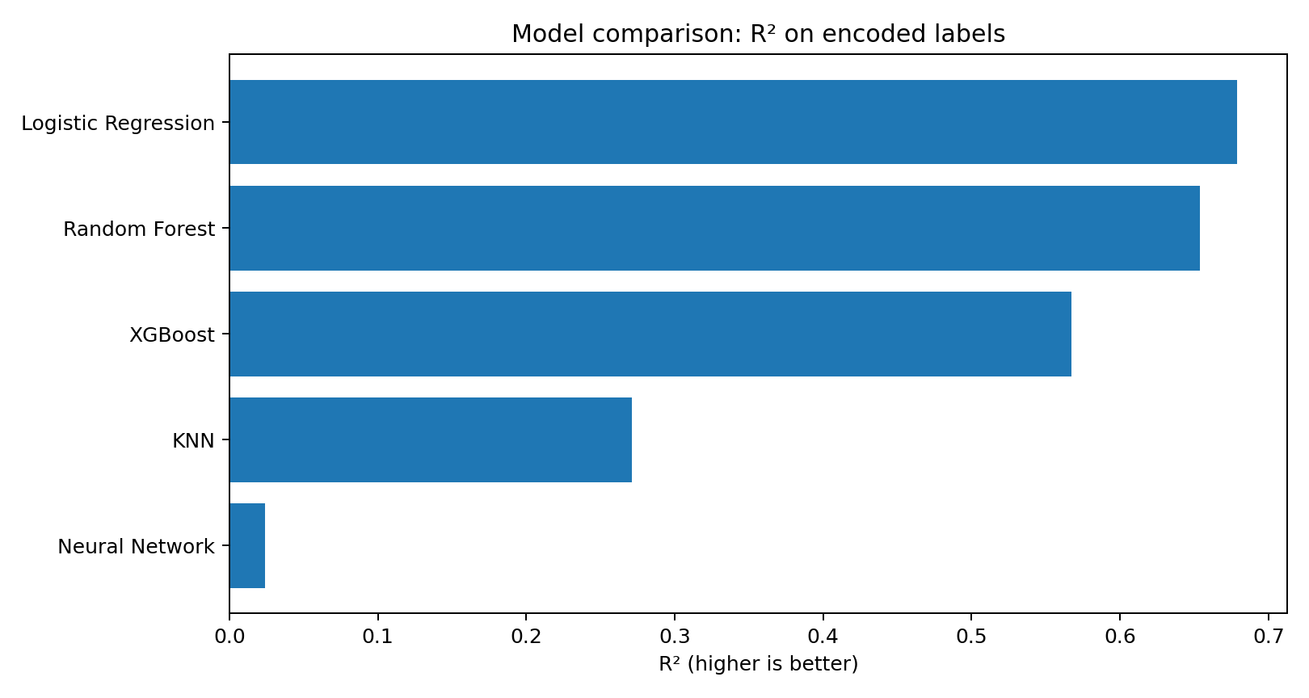
Where the model succeeds and misses
The main errors were between cat and dog clips
Random Forest got the strongest accuracy. Logistic Regression slightly led on RMSE/R² because encoded-label distance can reward some wrong classes more than others.
Audio Classification Project • 7

Slide 8
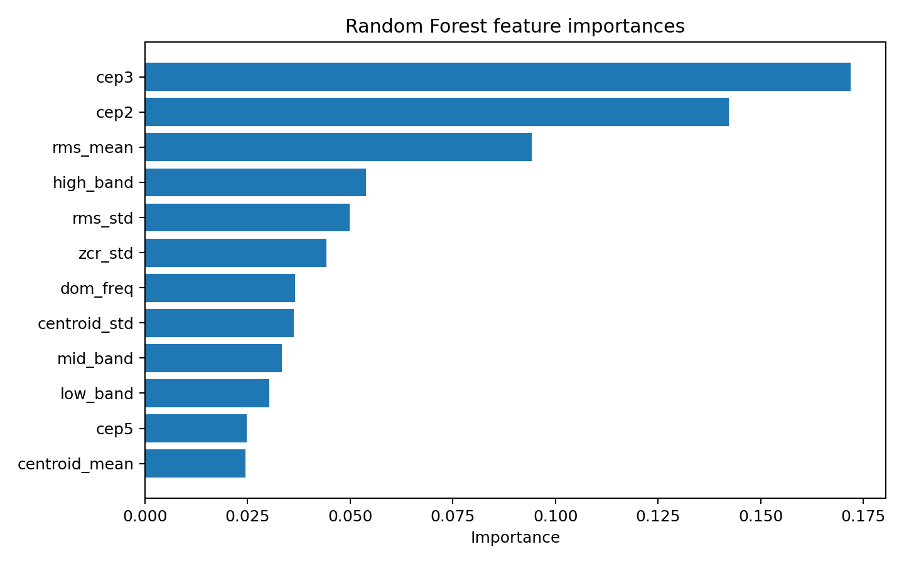
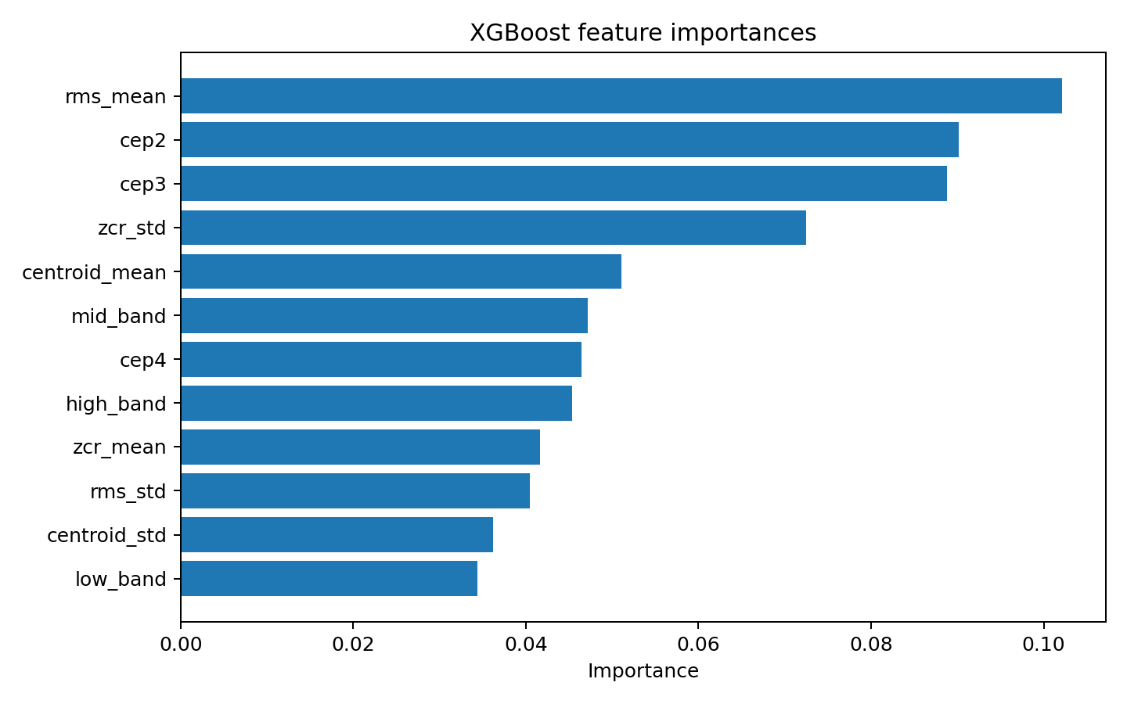
Feature importances
Tree models relied on frequency shape and spectral distribution
The most useful signals were not the file name or label text. They came from acoustic structure: energy, frequency balance, and cepstral/spectral shape.
Audio Classification Project • 8

Slide 9
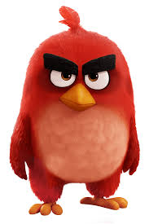
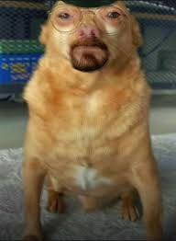
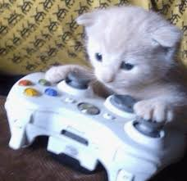
Main takeaway
Conclusion & Next Steps
Hand-built audio features were enough to classify bird, cat, and dog clips with about 87% accuracy using Random Forest.
Audio Classification Project • 9

