Slide 1
Billiards mod
By Ethan Fagan and Ashleigh Henry

Slide 2
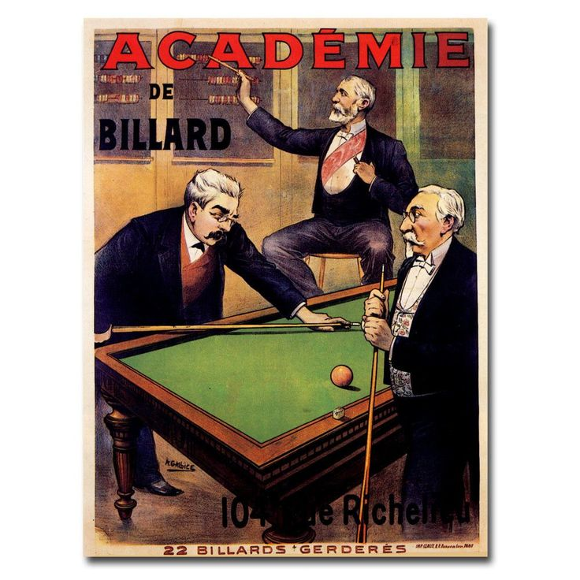
History of game
Originally formed from three different games.
The winning game, the losing game and carambole game
Has been played since the 15th century.
Popular throughout history
Common bar game
Fiercely competitive roots

Slide 3
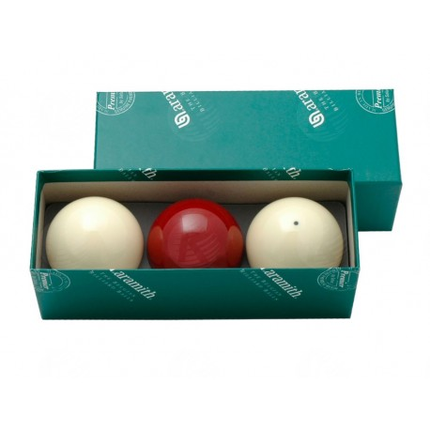
Rules & scoring
The game uses three balls, a red object ball and two player balls
Each players ball is considered an object ball for the other player
Score is awarded as follows
A cannon = 2pts
Potting the red = 3pts
In-offs = 2/3 pts depending on the circumstance

Slide 4
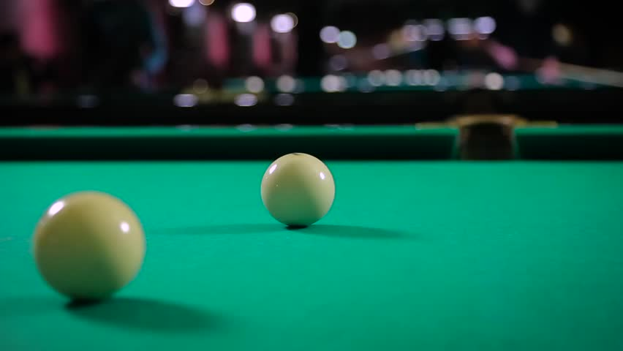
Play experience
The player first clicks a spot on the table, this then becomes a pivot spot
Shots are taken by clicking a point on screen and dragging the mouse backwards before releasing
A gauge in the bottom-left corner conveys the power of your shot

Slide 5
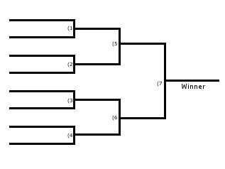
New mode rules
We will have a base version of billiards in our game.
Alternate modes:
First-to-foul-mode, time per shot shortens every turn
Cinematic story mode, featuring popular actors
Online 8 player tournament mode

