Slide 1
SDSERF: Sequential Dual-Stage Embedding Retrieval Framework for Obscure Query Matching
Code: https://github.com/EthanFusion03/SDSERF

Slide 2
Motivation
With the rapid increase in the number and variety of products, existing search methods struggle to match the most suitable products to users' needs amidst an overwhelming array of choices.
With large language models (LLMs) showing emerging abilities to capture rich seman-tics，there is a growing interest in leveraging LLMs to deal with more language-heavy recommendation tasks.

Slide 3
Related work
Contrastive Learning for Sequential Recommendation (Liu et al., 2021)
The paper introduces the CL4SRec model, which combines next-item prediction with contrastive learning to enhance user representation learning in recommendation systems.
Bridging Language and Items for Retrieval and Recommendation (Hou et al., 2024)
The paper introduces BLAIR, a series of pre-trained sentence embedding models specifically designed for retrieval and recommendation scenarios by bridging item metadata with potential natural language contexts. It evaluates BLAIR's generalization capabilities across various fields and tasks, including a new complex product search task, using a large-scale dataset.

Slide 4
Datasets
Amazon-C4 Dataset
- query
- item_id
- user_id
...
sampled_item_metadata_1M Dataset
- item_id
- category
- metadata

Slide 5
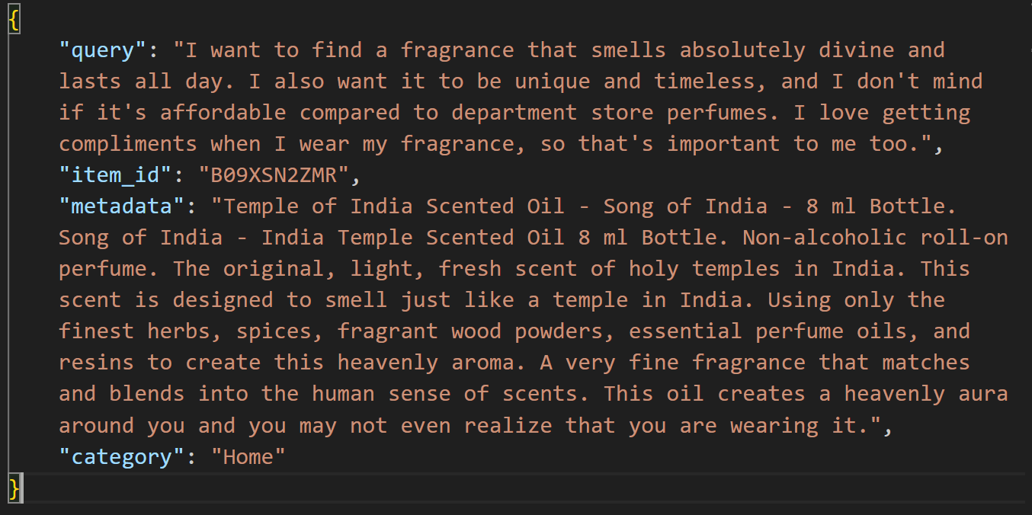
Combined Dataset

Slide 6
Problem Description
To retrieve the most relevant item metadata for obscure user queries by maximizing semantic relevance through a robust similarity-based retrieval framework.

Slide 7
Methodology
Stage 1: to shrink the dataset by first predicting the category of the expected item
Stage 2: to conduct similarity search between query and all the metadata of item in the top-2 category retrieved in stage 1

Slide 8
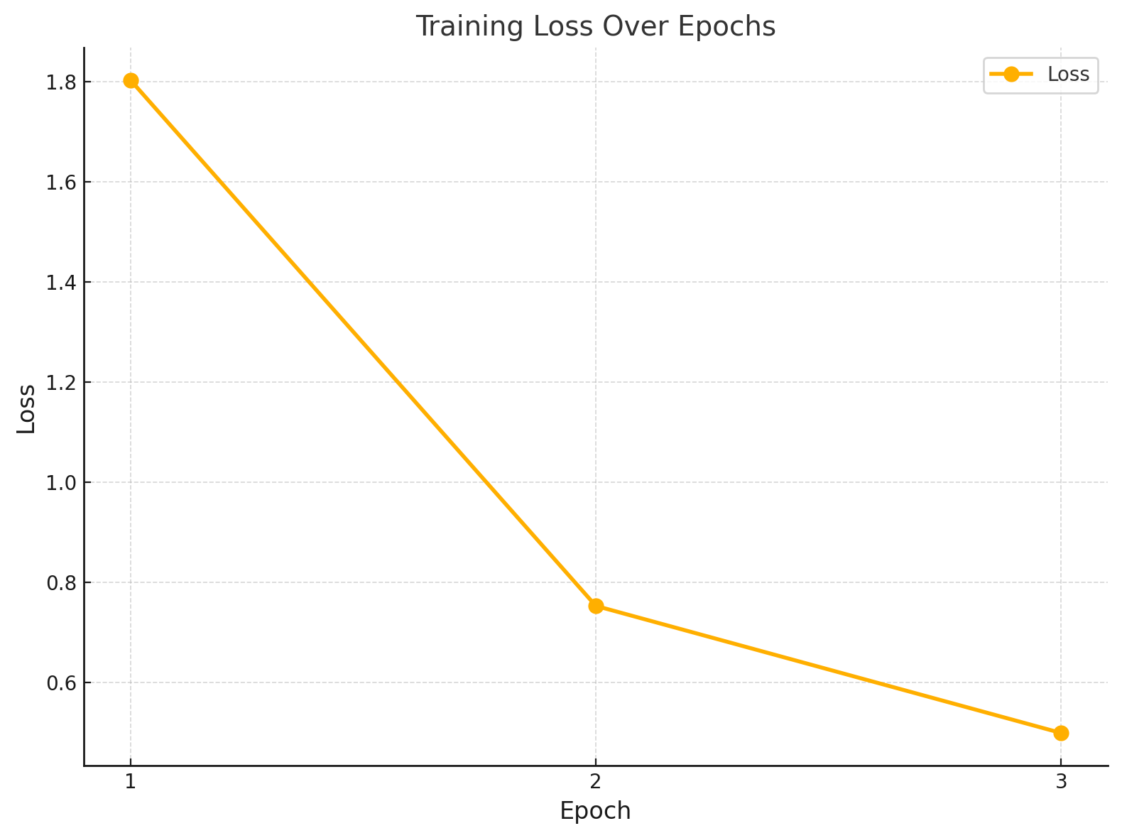
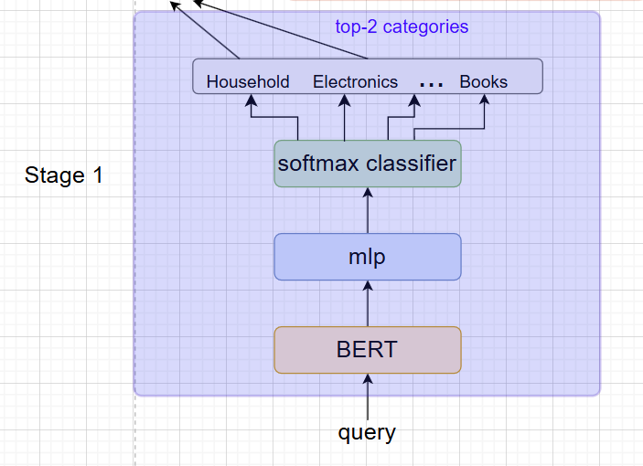
Methodology（stage 1)
Top-2 accuracy on test data:93.70%

Slide 9
Stage 2: model choose
Bi-encoder
ColBERT
E5(EmbEddings from bidirEctional Encoder rEpresentations)

Slide 10
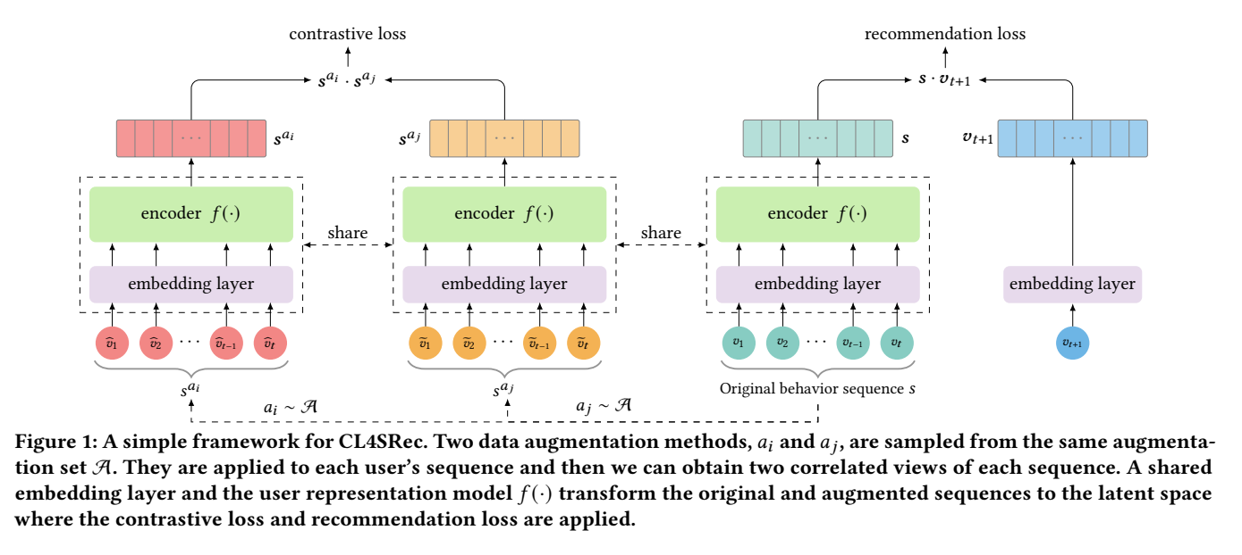
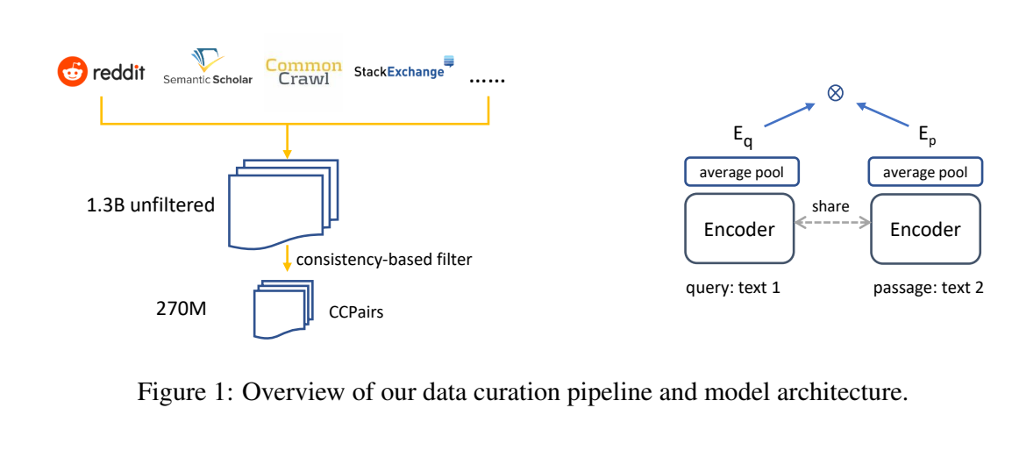
Stage 2: E5 (EmbEddings from bidirEctional Encoder rEpresentations)
https://doi.org/10.48550/arXiv.2212.03533
Text Embeddings by Weakly-Supervised Contrastive Pre-training

Slide 11
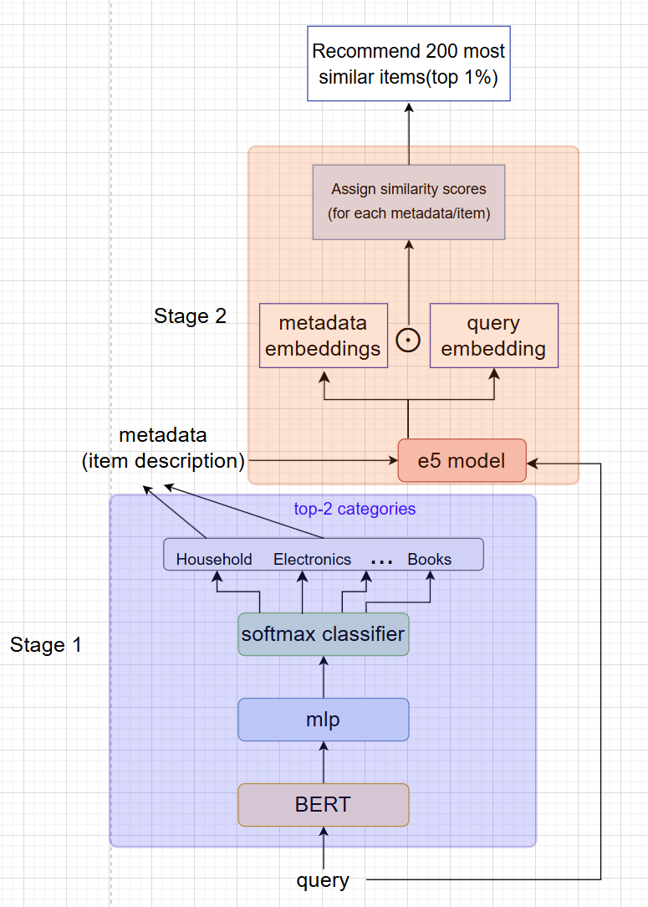
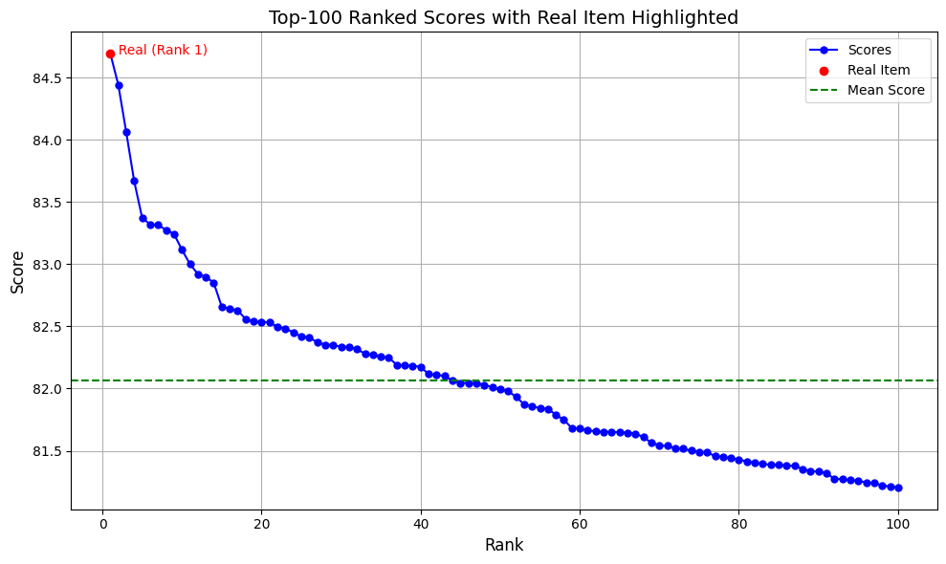
Methodology（stage 2) using E5

Slide 12
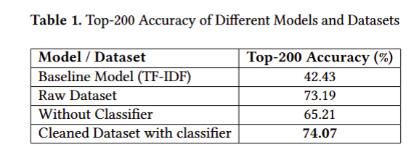
Evaluation

Slide 13
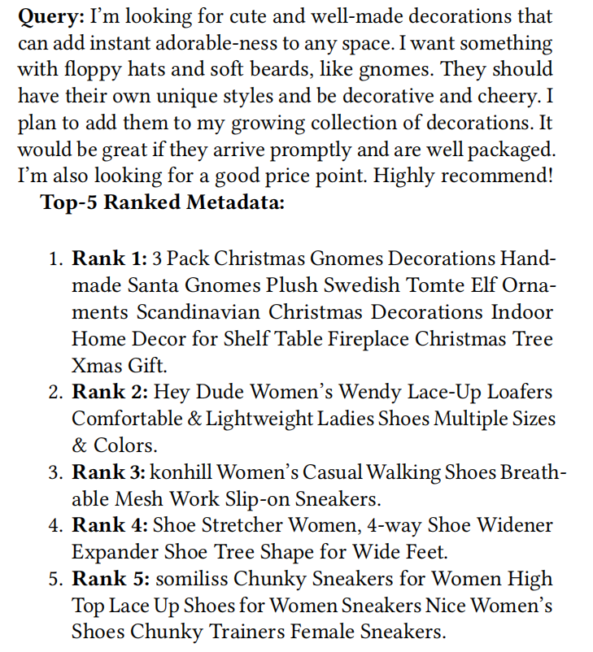

Evaluation

Slide 14
Future Work
building up a prediction task on the whole dataset (1M) with more computation power
Create an interface for the task and design a user-friendly front-end UI to facilitate user queries

Slide 15
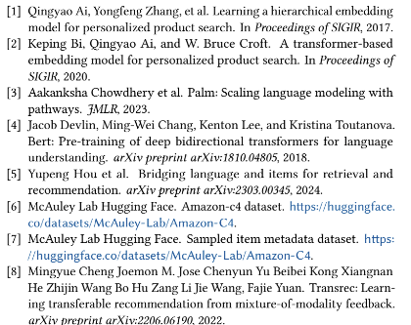
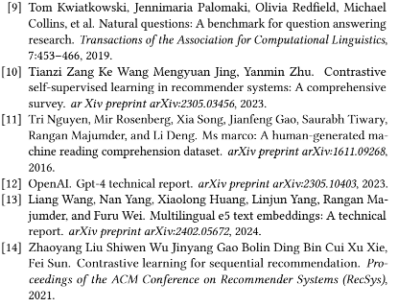
References

