Slide 1
How Does Economic Performance Affect the Housing Market?
A Regression Study on Real U.S. Home Prices · 1984 – 2025
Samuel Melghem · Omar Hernandez · Ryan Rhodes Ethan Hennenhoefer · Logan Crider
ISQS 3358 · Spring 2026 · Texas Tech University

Slide 2
Presentation Roadmap
1
Project Purpose
2
Industry Background
3
Datasets & Sources
4
Data Pipeline
Why housing? Why it matters
The housing market at a glance
7 FRED series, 1984 – 2025
Download → clean → merge → model
5
Exploratory Analysis
6
Regression Model
7
Key Findings
8
Limitations & Conclusion
Trends, relationships, affordability
Features, methodology, results
What drives home prices
What the model can and can't do
ISQS 3358 · Spring 2026 · Texas Tech University

Slide 3
Project Purpose
Housing is the single largest financial decision most Americans make — yet few understand what actually drives prices.
• Median home price rose from $79K in 1984 to $420K+ by 2025 — a 5× increase in nominal terms
• Inflation-adjusted, real prices roughly doubled — but income growth has lagged behind
• Mortgage rates swung from 14% (1984) to under 3% (2021), reshaping who can afford to buy
• The 2008 crisis showed that mispriced housing can take down the entire economy
Research Question
Do economic indicators predict inflation-adjusted home prices — and which factors have the strongest effect?
ISQS 3358 · Spring 2026 · Texas Tech University

Slide 4
Industry Background
THE U.S. HOUSING MARKET
OUR APPROACH
• $40+ trillion in U.S. residential real estate value
• Prices set by supply, demand, and financing costs
• Highly sensitive to Federal Reserve rate policy
• Only ~1.5 million new homes built per year — supply is slow
• Pull 7 economic series from FRED (Federal Reserve Economic Data)
• Standardize all frequencies to monthly, merge into one dataset
• Inflation-adjust home prices: RealPrice = HomePrice ÷ CPI × 100
• Fit a linear regression model to quantify each factor's effect
• Full dataset: January 1984 – December 2025
WHY IT'S HARD TO PREDICT
• Mortgage rates move weekly; income data updates annually
• Supply shocks (COVID, 2008) create structural breaks
• Regional markets often diverge sharply from national averages
ISQS 3358 · Spring 2026 · Texas Tech University

Slide 5
Datasets · All from FRED (Federal Reserve Economic Data)
Variable
FRED ID
Description
Frequency
Home Price
MSPUS
Median U.S. home sale price
Quarterly
CPI
CPIAUCSL
Consumer Price Index (inflation base)
Monthly
Mortgage Rate
MORTGAGE30US
30-year fixed mortgage rate
Weekly → Monthly
Unemployment
UNRATE
U.S. unemployment rate
Monthly
Med. Income
MEHOINUSA646N
Median household income
Annual → Monthly
Population
POPTHM
U.S. total population
Monthly
Housing Starts
HOUST
New housing construction starts
Monthly
Target: RealPrice = HomePrice ÷ CPI × 100 (inflation-adjusted price)
ISQS 3358 · Spring 2026 · Texas Tech University

Slide 6
Data Pipeline · One Command Runs Everything
1 Download
2 Resample
3 Merge
4 Adjust
5 Model
fetch_fred.py 7 FRED series → data/raw/
resampler.py Weekly → monthly mean Annual → forward-fill
merge_data.py Outer join on date Fill any gaps
calculate_real_price.py RealPrice = HomePrice ÷ CPI × 100
model.py Linear regression 1984 – 2025 full fit
KEY CLEANING DECISIONS
• Weekly mortgage rate → averaged to monthly mean
• Annual income → forward-filled (same value held month-to-month until next release)
• All 7 series merged on date with outer join; remaining gaps filled forward
• Result: 504 clean monthly observations, January 1984 – December 2025
ISQS 3358 · Spring 2026 · Texas Tech University

Slide 7
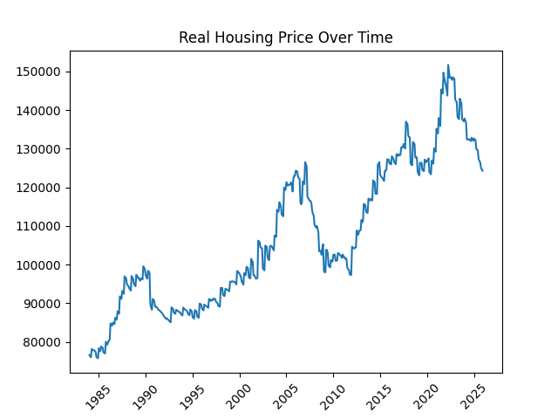
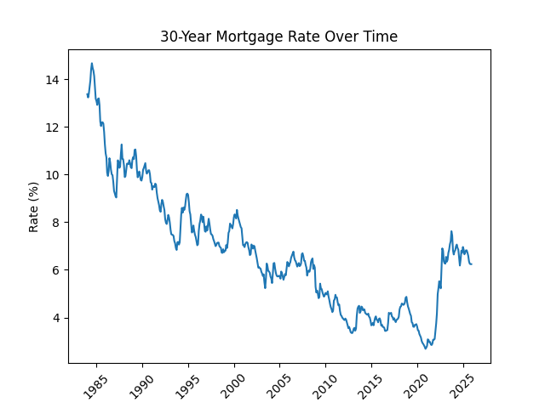
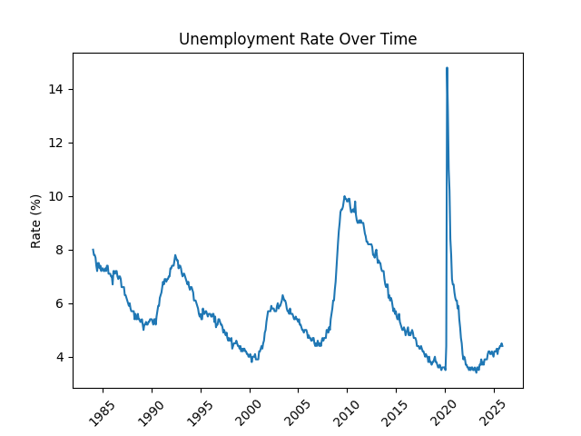
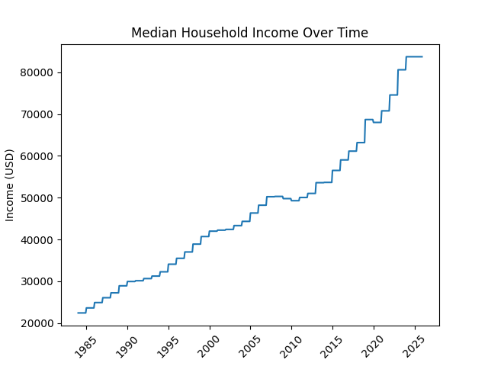
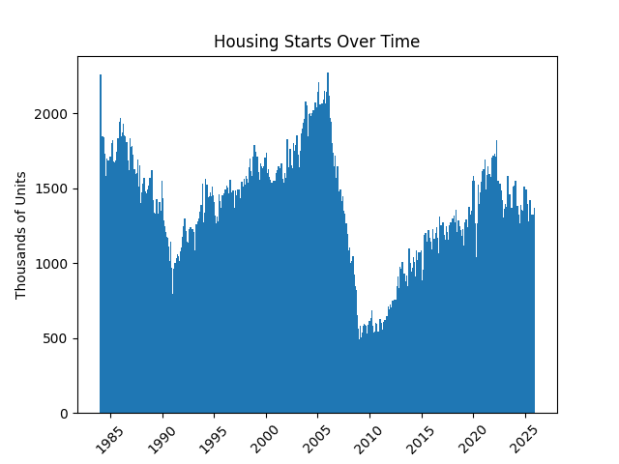
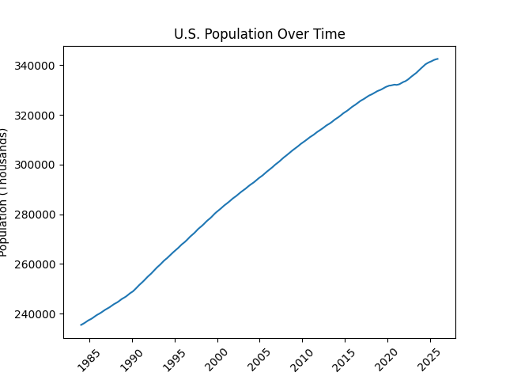
Exploratory Analysis · Individual Trends (1984 – 2025)
Real prices peaked in 2006, crashed in 2008, recovered and surged through 2025. Mortgage rates fell from 14% → 3% before rebounding in 2022.
ISQS 3358 · Spring 2026 · Texas Tech University

Slide 8
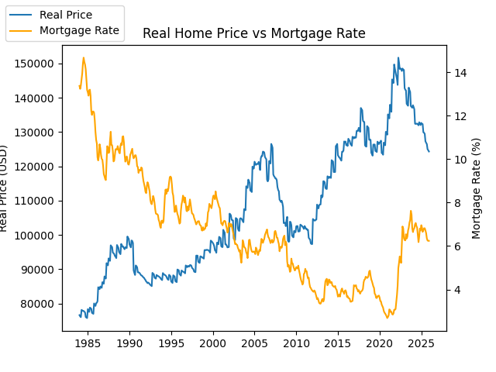
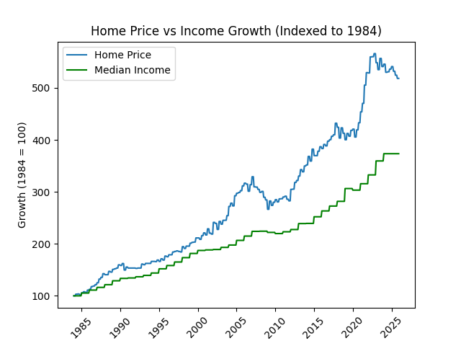
Exploratory Analysis · Key Relationships
WHAT WE SEE
• Mortgage rate (top): strong negative relationship — as rates fell from 14% → 3%, prices surged. Higher rates price buyers out of the market.
• Income vs Price (bottom, indexed to 100 in 1984): home prices grew nearly twice as fast as incomes — the gap widened dramatically after 2000 and again after 2020.
ISQS 3358 · Spring 2026 · Texas Tech University

Slide 9
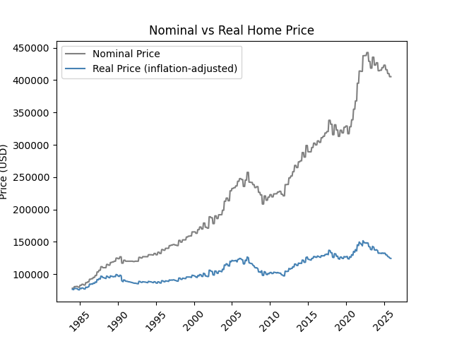
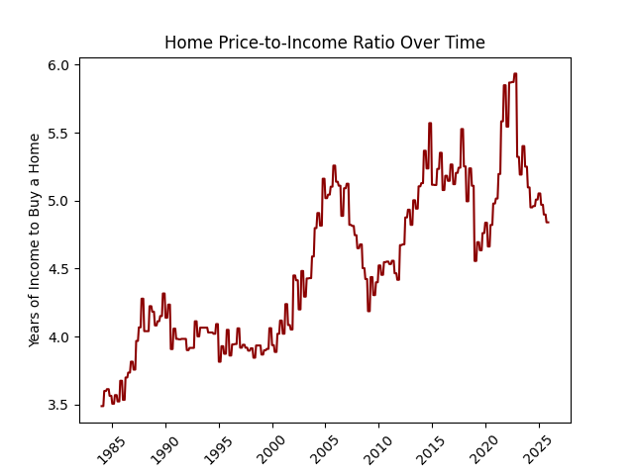
Affordability · Are Homes Getting Harder to Buy?
Nominal vs. Real Price
Price-to-Income Ratio
• Nominal price rose 5× from 1984 to 2025
• Inflation-adjusted real price rose only ~2×
• Inflation explains more than half the apparent increase
• 1984: a home cost ~3.5 years of median income
• 2025: that figure is now 7+ years — doubled
• Affordability has significantly deteriorated
ISQS 3358 · Spring 2026 · Texas Tech University

Slide 10
Regression Model · Setup & Methodology
MODEL TYPE
DATA COVERAGE
Ordinary Least Squares Linear Regression
January 1984 – December 2025
FEATURES (X — INDEPENDENT VARIABLES)
504 monthly observations All data used for model fitting (no train/test split — full dataset regression)
• Unemployment Rate
• Mortgage Rate (30-year fixed)
• Median Household Income
• U.S. Population
• Housing Starts
R² = 0.8775
TARGET (Y — DEPENDENT VARIABLE)
RealPrice — inflation-adjusted median home sale price
Model explains 88% of variation in real home prices
WHY LINEAR REGRESSION?
• Interpretable coefficients — we can say exactly how much each variable moves price
• Strong baseline for economic data with expected linear relationships
ISQS 3358 · Spring 2026 · Texas Tech University

Slide 11
Regression Results · Coefficients & Model Performance
R²
√MSE
Observations
Features
0.8775
≈ $6,546
504 months
5 variables
Explains 88% of variation in real home prices
Average prediction error in today's dollars
January 1984 through December 2025
All FRED series after inflation adjustment
Feature
Coefficient
Direction
Interpretation
Mortgage Rate
−847
↓ Negative
Higher rates → fewer buyers → lower prices
Unemployment Rate
−1,338
↓ Negative
Higher unemployment → less buying power → lower prices
Median Household Income
+0.55
↑ Positive
More income → more purchasing power → higher prices
Population
+0.20
↑ Positive
More people → more demand → higher prices
Housing Starts
+7.53
↑ Positive
More construction during growth periods
ISQS 3358 · Spring 2026 · Texas Tech University

Slide 12
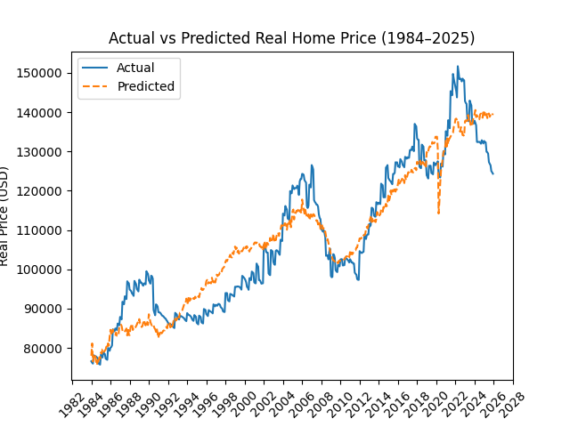
How Well Did the Model Predict? · Actual vs. Predicted
READING THE CHART
• Blue = actual inflation-adjusted price
• Dashed = model's fitted values
WHAT THIS TELLS US
• Model tracks the 40-year trend extremely well (R² = 0.88)
• Captures the 2008 crash and the long recovery
• The 2020–2025 COVID surge is visible — the model follows it but economic fundamentals were stress-tested
• Short-term shocks move prices above or below the economic baseline
ISQS 3358 · Spring 2026 · Texas Tech University

Slide 13
Key Findings
Income Drives Prices Up
Mortgage Rates Suppress Prices
Unemployment Drives Prices Down
Median household income had the strongest positive effect. As earnings rise, buyers qualify for larger mortgages — prices follow.
Every 1% rise in the 30-year rate corresponds to ~$847 lower real price. The 40-year rate decline quietly subsidized price growth.
Higher unemployment reduces buying power and forces distressed sellers — seen clearly in the 2008–2009 price crash.
Affordability Has Deteriorated
Inflation Masks Real Growth
Model Explains 88% of Variation
Price-to-income ratio doubled from 3.5× in 1984 to 7×+ in 2025. Even adjusting for inflation, homes are much harder to afford.
Nominal prices rose 5×, but inflation-adjusted prices only ~2×. Inflation explains most of the apparent price explosion.
Five economic variables — income, rates, unemployment, population, and housing starts — capture the vast majority of price movement.
ISQS 3358 · Spring 2026 · Texas Tech University

Slide 14
Limitations · What the Model Can't Fully Capture
National Averages Only
All FRED series are U.S.-wide. Texas, California, and rural Midwest behave very differently — a national model misses all regional variation.
Multicollinearity
Income, population, and time all trend together. This can inflate or deflate individual coefficients — interpret directions, not exact magnitudes.
Linear Assumption
The model assumes relationships are constant over 40 years. In reality, a 1% mortgage rate change at 14% differs from one at 3%.
Supply-Side Gaps
Zoning laws, construction costs, and land scarcity matter. Housing starts is a rough proxy, not a full picture of supply.
ISQS 3358 · Spring 2026 · Texas Tech University

Slide 15
Conclusion · What We Learned
Economic performance drives the housing market — but not always in the ways people assume.
What We Found
The Big Picture
• Income and mortgage rates are the two strongest forces on home prices
• Homes now cost 7× median annual income — up from 3.5× in 1984
• Inflation explains most of the 5× nominal price increase; real growth was ~2×
• Five economic variables explain 88% of 40 years of price variation
• Short-term shocks (2008 crisis, COVID) add noise above the economic baseline
• The 40-year decline in mortgage rates (14% → 3%) quietly subsidized price growth — cheap financing made expensive homes feel affordable
• When rates reversed sharply in 2022, affordability collapsed almost overnight
• Data-driven analysis of fundamentals is essential — nominal prices alone are misleading
github.com/EthanH2004/Housing_Analysis · Full code & data, one command reproduces the entire analysis
ISQS 3358 · Spring 2026 · Texas Tech University

Slide 16
Thank You
Questions?
Samuel Melghem · Omar Hernandez · Ryan Rhodes Ethan Hennenhoefer · Logan Crider
ISQS 3358 · Spring 2026 · Texas Tech University

