Slide 1
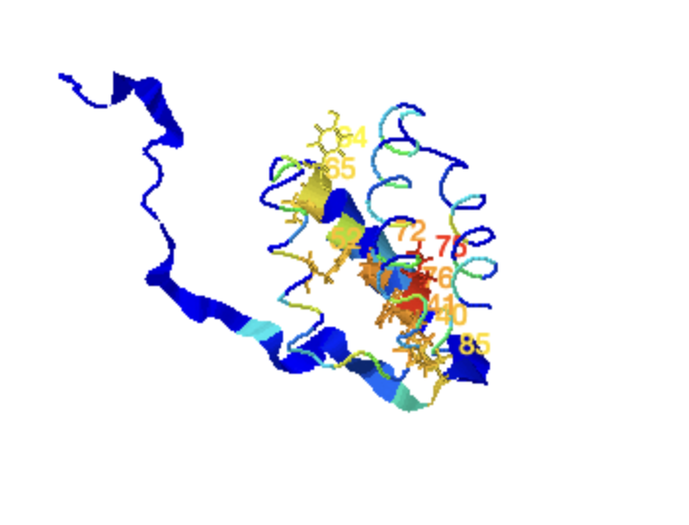
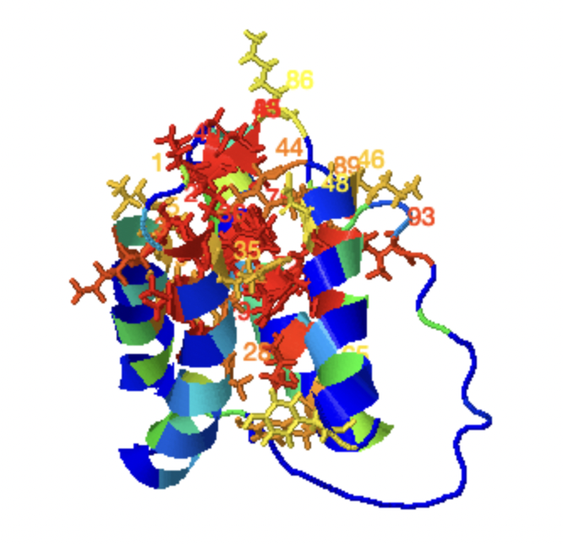
2KIW – GDT_TS: 0.81
Precision Analysis
NMR ensembles
AF2 ensembles
Protein | Meth- od | DP max | DP_{avg} | <DP>ª | <R>* | <P>* | <F>*
2KIW | NMR | 0.61 | 0.568 | 0.74 | 0.95 | 0.80 | 0.87
 | AF | 0.63 | 0.610 | 0.65 | 0.97 | 0.77 | 0.86

Slide 2
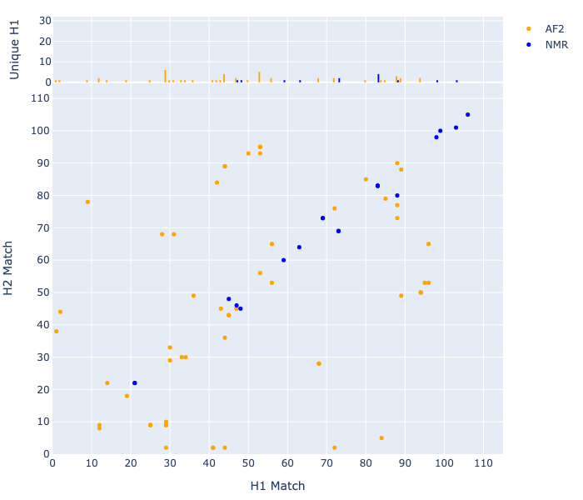
Double Recall Analysis

