Slide 1
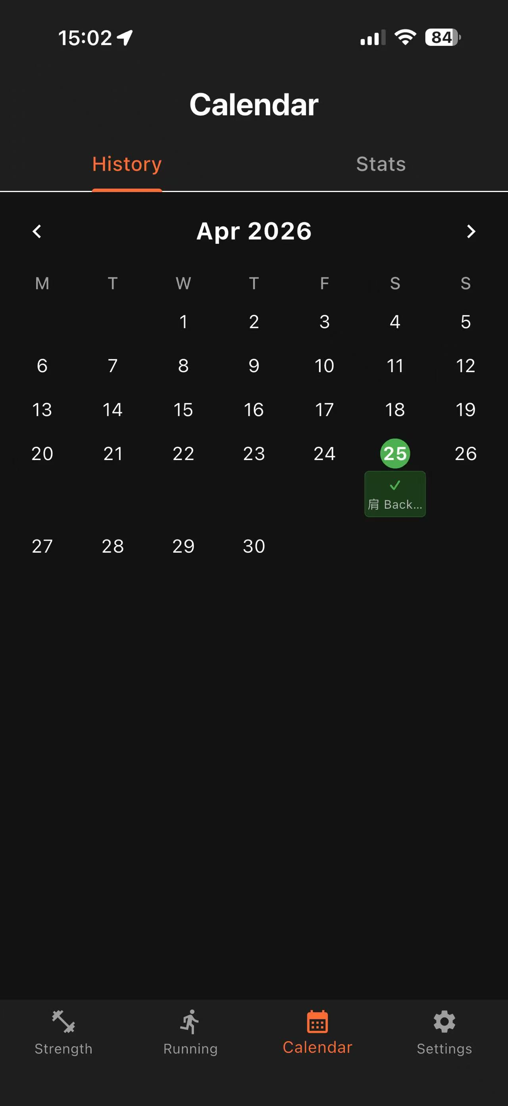
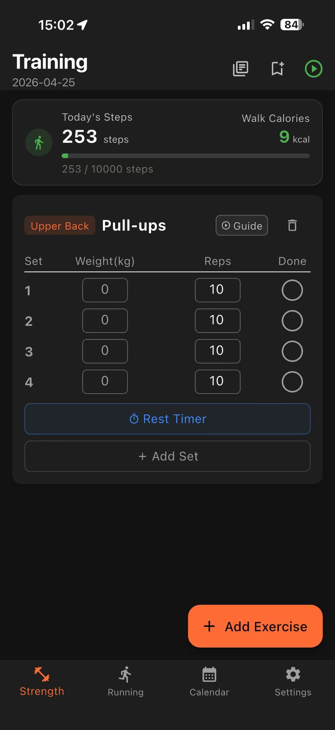
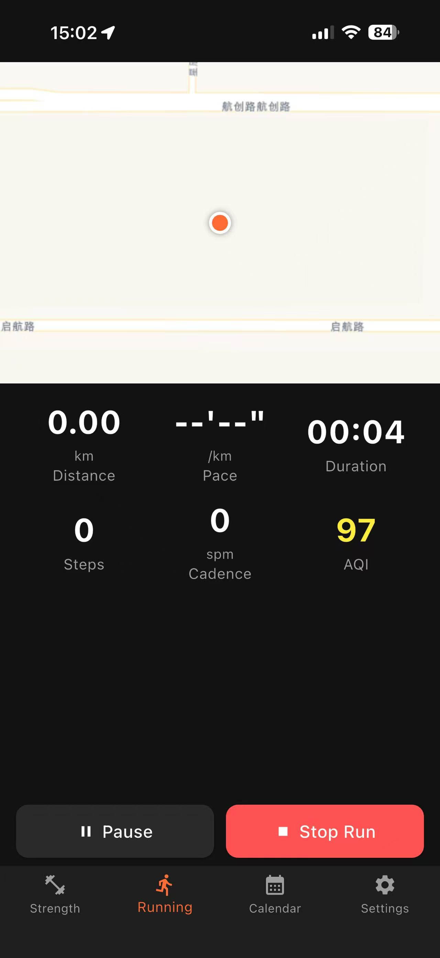

CASA0015 · UCL Connected Environments
Urban FitLog
A Connected Environments Fitness Tracker for Urban Runners
Ethan Han · MSc Connected Environments · UCL CASA

Slide 2
CONTENTS
01
Problem & Background
Connected Environments theme · App overview
02
Technical Implementation
Sensors · Cloud APIs · GPS running · Key decisions
03
Other Modules & Reflection
Strength training · Calendar · Challenges learned

Slide 3
Part 01
Problem & Background
Why urban runners need environmental context

Slide 4
01
Problem & Background
How does the urban environment affect outdoor exercise?
🌫️ Is the air quality safe to run in today?
Urban runners need real-time environmental context — not just pace & distance.
🌡️ Is the temperature and humidity comfortable?
📍 Where did I run — and how far exactly?
Urban FitLog answers this in one app.
👟 Am I running at an efficient cadence?

Slide 5
01
Problem & Background
Four Modules, One Connected Experience
🏋️ Strength Training
🏃 Aerobic Running
50+ exercises · sets/reps/weight Rest timer · templates · calorie tracking
Live GPS map · AQI & weather Accelerometer cadence · route history
📅 Activity Calendar
⚙️ Settings
Monthly grid with per-day badges Full session detail on tap
BMR body data · API key management Light/Dark theme · 中文 / EN toggle

Slide 6
Part 02
Technical Implementation
Sensors · Cloud APIs · GPS Map · Key Design Decisions

Slide 7
02
Technical Implementation
Three Onboard Sensors
📍
📳
👟
GPS
Accelerometer
Pedometer
geolocator 13.x
sensors_plus 6.x
pedometer 4.x
Real-time position stream Route tracking & distance Pace calculation (min/km)
Magnitude √(x²+y²+z²) Peak detection algorithm Cadence in steps/min (SPM)
Cumulative step count System-level sensor fusion Steps delta per run session

Slide 8
02
Technical Implementation
Real-Time Environmental Data from Three Cloud APIs
🌡️ OpenWeatherMap
🌫️ AQICN
🗺️ CARTO / OSM
Temperature · Humidity Wind speed · Description
Air Quality Index (0–500) Good / Moderate / Unhealthy / Very Unhealthy
OpenStreetMap map tiles Voyager style, 4 subdomains, HTTPS
Data flow: GPS location → HTTP request → JSON parse → UI render
Good 0–50
Moderate 51–100
Unhealthy 101–150
Very Unhealthy

Slide 9
02
Technical Implementation
Live GPS Running View
🗺️ OSM Map
CARTO Voyager tiles, loads in real time
🟠 GPS Position
Orange dot follows you, updates each fix
📏 Route Line
Polyline drawn via Haversine distance calc
📊 Stats Panel
Distance · Pace · Duration · Steps · SPM · AQI
⏸ Controls
Pause / Resume / Stop _runActive flag prevents iOS freeze

Slide 10
02
Technical Implementation
Four Key Design Decisions
_runActive Flag
IndexedStack for Map
Never cancel sensor streams in handlers. Callbacks no-op when flag is false. → Eliminates iOS freeze on Pause/Stop.
FlutterMap never disposed between states. Stack index toggles view; widget stays alive. → Prevents NSURLSession crash.
CARTO Tiles + ATS Exception
getCurrentPosition() + distanceFilter:0
OSM blocked on iOS by App Transport Security. Switched to CARTO Voyager (HTTPS). → Tiles load on device without Xcode.
Stream alone delays first fix 5–10 s. One-shot call fires immediately. → Map centres on user instantly.

Slide 11
Part 03
Other Modules & Reflection
Strength training · Calendar · Challenges · Demo

Slide 12
03
Other Modules
Strength Training & Activity Calendar
🏋️ Strength Training
📅 Activity Calendar
· 50+ exercise database (bilingual zh/en)
· Monthly grid with per-day badges
· Log sets, weight, reps per exercise
· Green badge = strength session
· Rest timer with animated clock face
· Orange badge = km run that day
· Workout templates for quick reuse
· Tap any day → full session detail
· Calorie: MET × weight × duration
· Monthly: sets, volume, distance
· YouTube tutorial link per exercise

Slide 13
03
Reflection
Challenges & What I Learned
iOS Thread Freeze
Map Tiles Not Loading
Cancelling native sensor streams in button handlers blocked the iOS main thread. Learned: _runActive flag; only dispose() cancels.
iOS ATS blocked HTTP tile requests on device. OSM tiles also unreliable. Learned: CARTO Voyager HTTPS + NSAllowsArbitraryLoads.
GPS Cold Start Delay
Single-File Architecture
Stream-only approach delayed first fix 5–10 s. Map stayed blank at run start. Learned: pair one-shot getCurrentPosition() with stream.
5 100+ lines in main.dart is manageable now. Hard to navigate as the app grows. Next: split into feature modules with clean interfaces.

Slide 14
DEMO
▶ Watch the Demo
youtube.com/shorts/LG8FoDgh3UU
Environment check · GPS run · Strength training · Calendar history

Slide 15
Thank You
Urban FitLog — bridging fitness tracking with real-world environmental data for smarter urban running.
GPS Route Tracking
Live AQI Monitoring
Real-Time Weather
Accelerometer Cadence
Strength Training
Activity Calendar
Ethan Han · CASA0015 · UCL Bartlett · github.com/EthanHXY/flutter_application_1

