Slide 1

A Scoring and Subclassification Framework
for Predicting Vessel Deficiency Severity：
Leveraging Historical Expertise
XIAOPANJI Hotpot
Jan. 17th 2025
©Copyright National University of Singapore. All Rights Reserved.

Slide 2
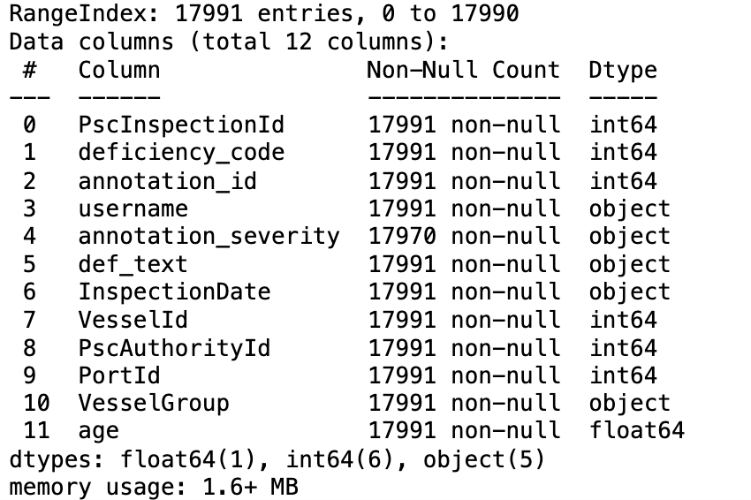
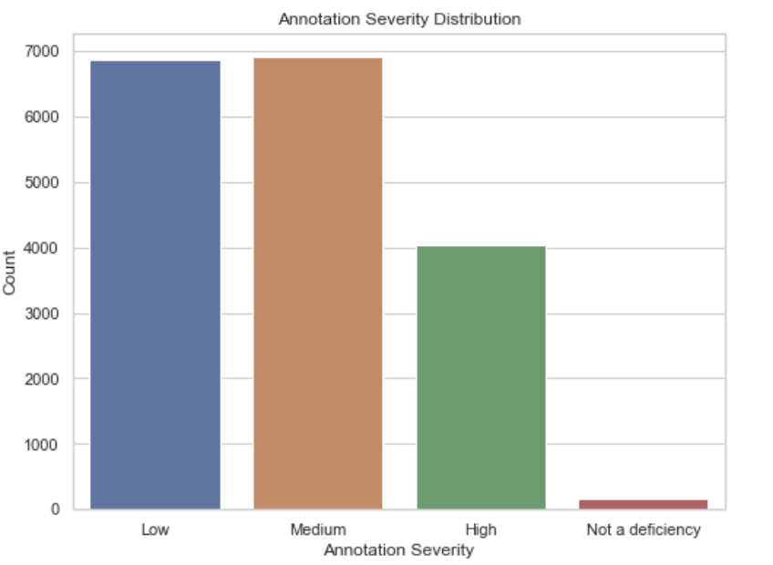
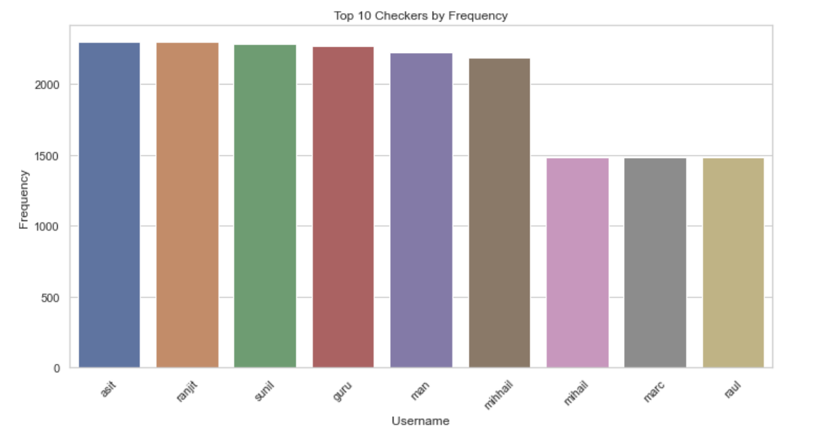
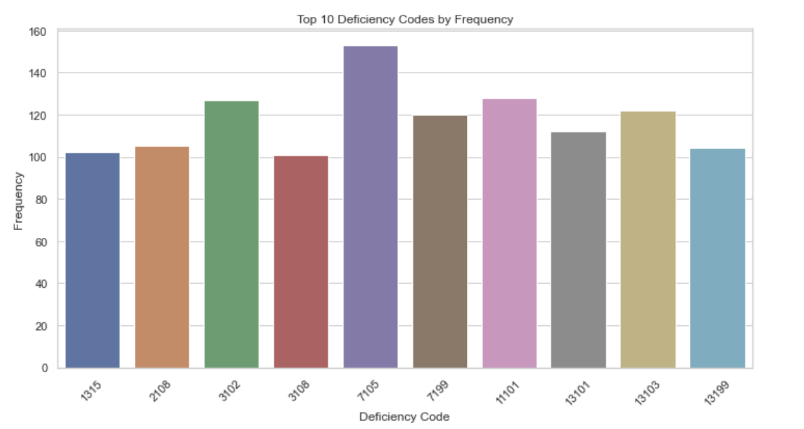
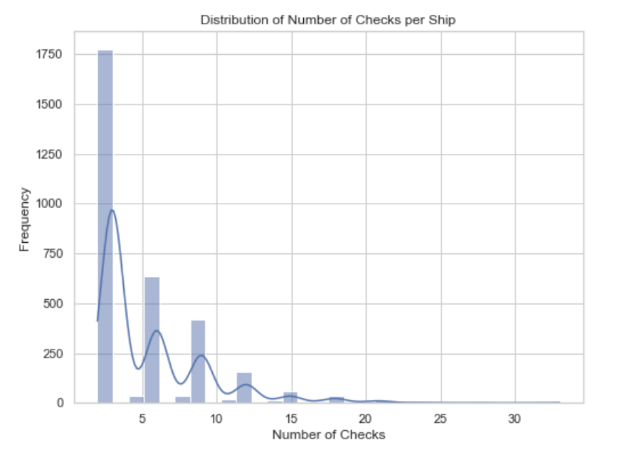
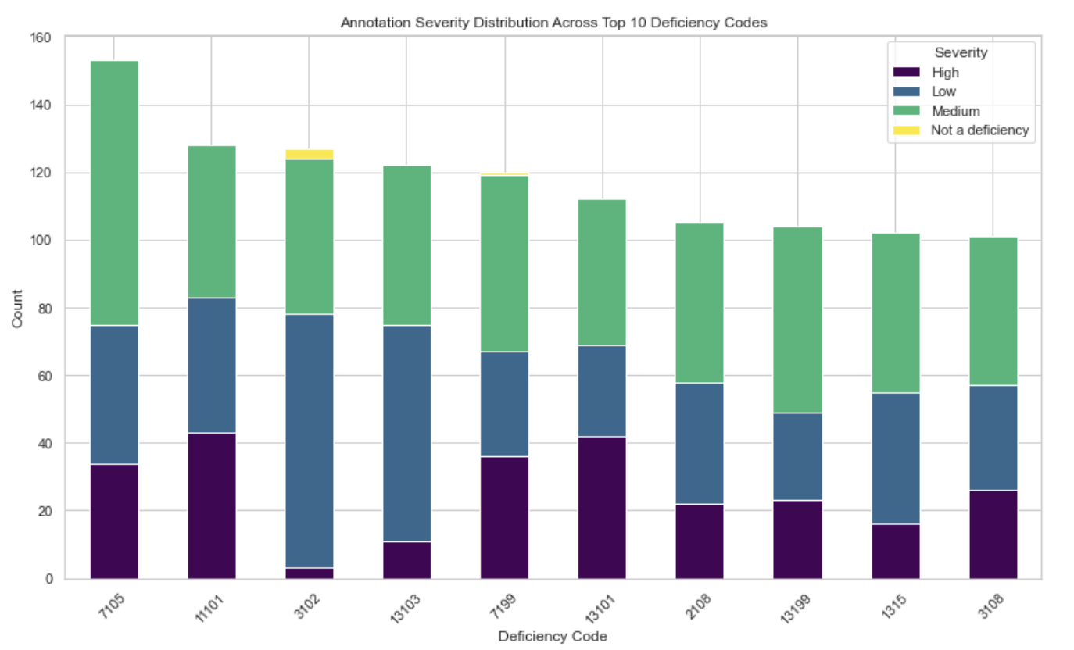
1.1 Dataset exploration
(a) The data are not all aligned, so preprocessing is needed.
(b) For ‘annotation_severity’, the numbers of ‘Low, Medium, High’ are basically the same order of magnitude, while ‘Not a deficiency’ can be basically ignored.
(c) In most cases, a ship has more than one annotation record, and the text content of deficiency of different annotators is the same. The same ship number also has the same PscAuthorityId, PortId, etc.
©Copyright National University of Singapore. All Rights Reserved.

Slide 3
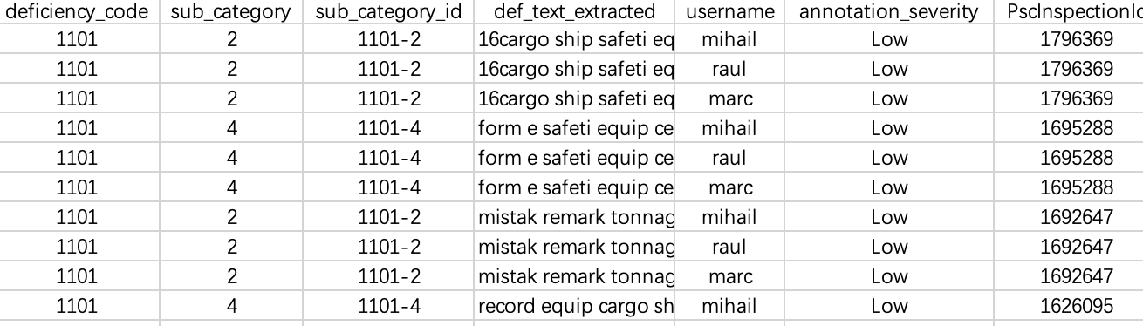
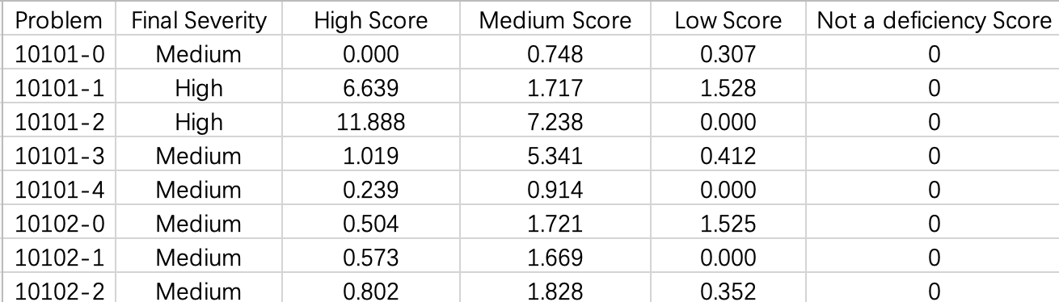
1.2 Methodology
1. Sub-category Framework:
Using BERT's [CLS] token embeddings, the preprocessed texts are transformed into semantic vector representations.
K-Means clustering group similar deficiencies(within the same deficiency_code) into subcategories, with unique IDs generated for traceability.
2. Historical Expertise
Evaluates each engineer's experience by analyzing the number of judgments they have made for a specific problem.
Calculates weighted severity scores by combining these judgment counts with the normalized probabilities of the engineer's historical annotation patterns (Low, Medium, High, Not a Deficiency).
©Copyright National University of Singapore. All Rights Reserved.

Slide 4
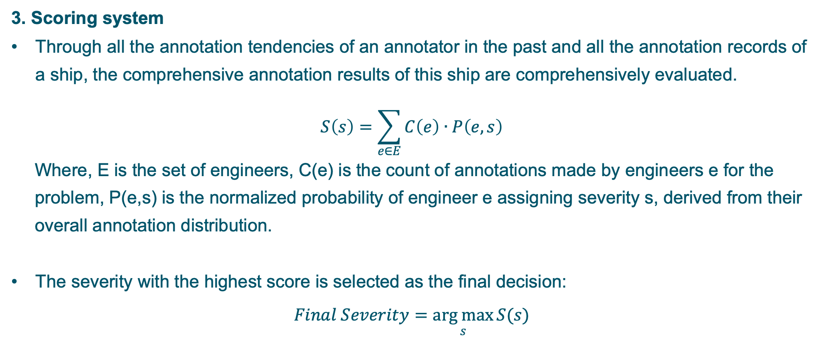
1.2 Methodology
3. Scoring system
Through all the annotation tendencies of an annotator in the past and all the annotation records of a ship, the comprehensive annotation results of this ship are comprehensively evaluated.
$$S\left(s\right)=\sum_{e∈E}{C\left(e\right)∙P\left(e,s\right)}$$
Where, E is the set of engineers, C(e) is the count of annotations made by engineers e for the problem, P(e,s) is the normalized probability of engineer e assigning severity s, derived from their overall annotation distribution.
The severity with the highest score is selected as the final decision:
$$Final Severity=\underset{s}{arg max}{S(s)}$$
©Copyright National University of Singapore. All Rights Reserved.

Slide 5
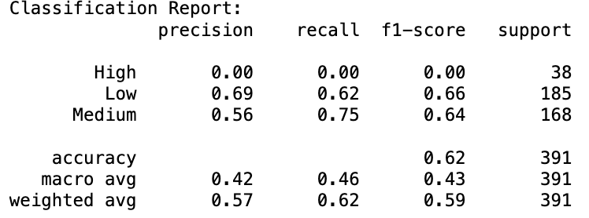
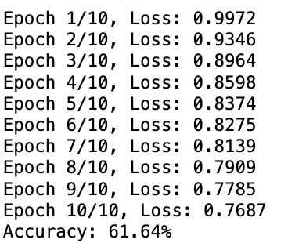
1.3 Project flow and Experimental results
Raw data
Predict result
1. Data exploration
Raw data
MLP
Test set
2. Data preprocess
Extract key information
7. Network training
3. BERT embedding
Embedding Texts
Embedding Texts
6. BERT embedding
4. Dynamic K-means
Final severity
Sub-category
The accuracy of our model on validation part of training set is 61.64%.
5. Historical expertise
©Copyright National University of Singapore. All Rights Reserved.

