Slide 1

Project 2 – Drone Simulation with Extended Kalman Filter
EE4308: Autonomous Robot Systems
Team #3
©Copyright National University of Singapore. All Rights Reserved.

Slide 2

CONTENTS
1
Introduction & Objectives
2
Node Design
3
System Implementation
4
Simulation Video
©Copyright National University of Singapore. All Rights Reserved.

Slide 3
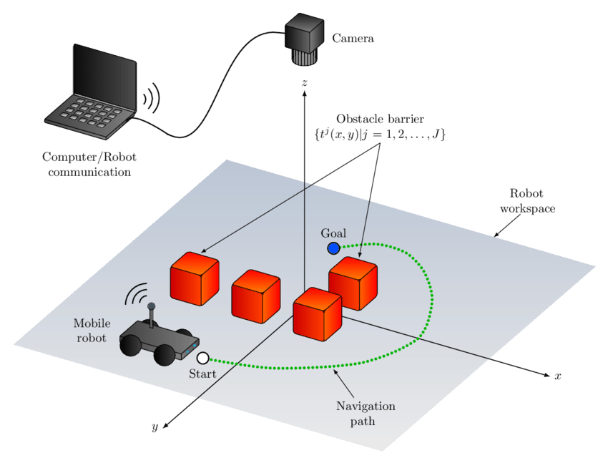
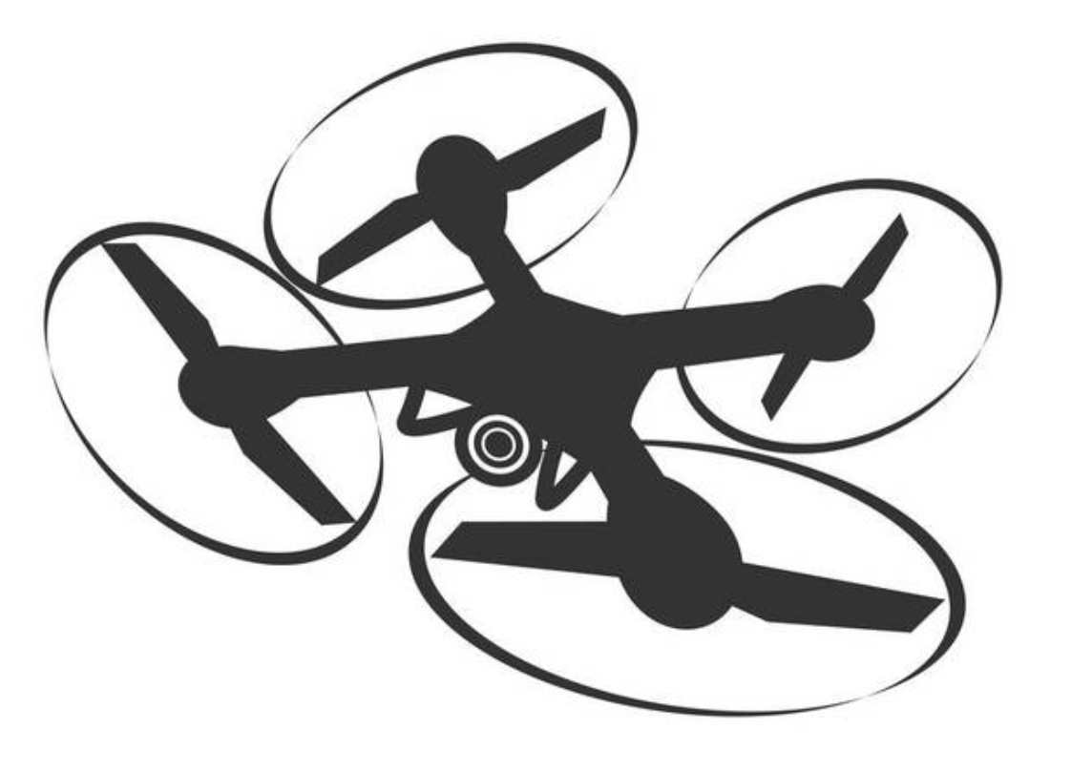
1 Introduction & Objectives
Project Goals:
Design an automatic UAV simulation system, which combine with a simplified Kalman filter for autonomous takeoff, tracking turtlebot and returning to land.
Core Function module:
Behavior Node: responsible for task state control.
Controller Node: path control
Estimator Node: simplifying state estimation
Use real sensor data (IMU, GPS, Sonar, etc.) for fusion.
Follow
©Copyright National University of Singapore. All Rights Reserved.

Slide 4
2 Node Design - Behavior Node
The behavior of the drone is governed by a finite state machine (FSM) with the following states:
BEGIN
TAKEOFF
INITIAL
TURTLE_POSITION
TURTLE_WAYPOINT
LANDING
END
When the state transition is triggered, the transitions function are executed, where the different message are received.
1st point of the path
BEGIN
TAKE OFF
INITIAL
TURTLE
POSITION
LANDING
END
Last point of the path
TURTLE
WAYPOINT
Drone position
©Copyright National University of Singapore. All Rights Reserved.

Slide 5
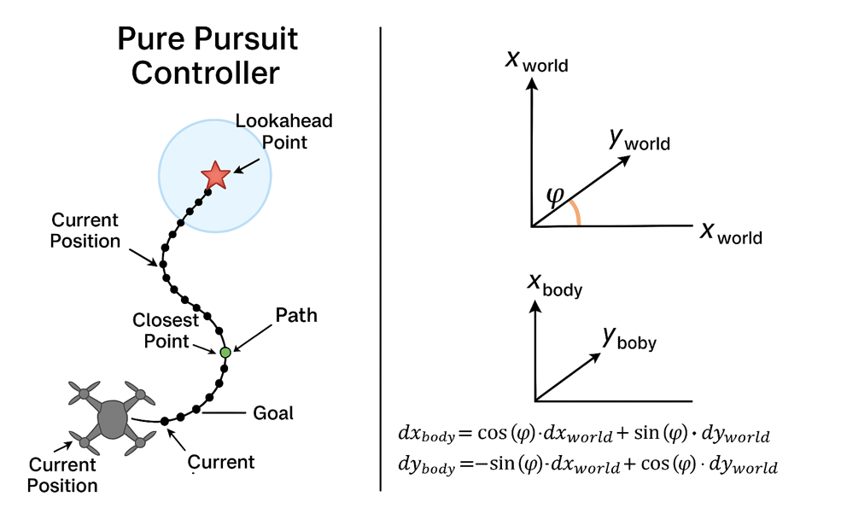
2 Node Design - Controller Node
Lookahead Point Chosen logic:
Find the closest point in the path to the current position of the drone.
From this closest point, traverse the path toward the desired waypoint and find the first point whose distance from the drone exceeds the predefined lookahead distance. This point becomes the lookahead point.
If no such point is found, it implies that the drone is near the desired waypoint. In this case, the lookahead point is set to the waypoint itself.
Since the drone is holonomic and can move in any direction, the curvature from project 1 should not be calculated. Thus, the desired velocities are first determined by a proportional(𝑃) controller, which considers the distance to the lookahead point.
©Copyright National University of Singapore. All Rights Reserved.

Slide 6
2 Node Design - Estimator Node
Main Goals:
implement an Extended Kalman Filter (EKF) to estimate the drone’s 3D position, velocity, and yaw angle based on sensor data from IMU and GPS, Sonar and Magnetic Compass.
Estimated state:
position：x, y, z
velocity：v_{x}, v_{y}, v_{z}
Yaw：𝜃
Sensor input:
IMU: linear acceleration and angular velocity (body coordinate system)
GPS: global positioning information (LLA)
Sonar: Drone’s height from the ground
Magnetic Compass: strength and direction of magnetic fields
IMU
Estimator Node
EKF
ROS2
GPS
Estimated
State
Sonar
Magnetic
©Copyright National University of Singapore. All Rights Reserved.

Slide 7
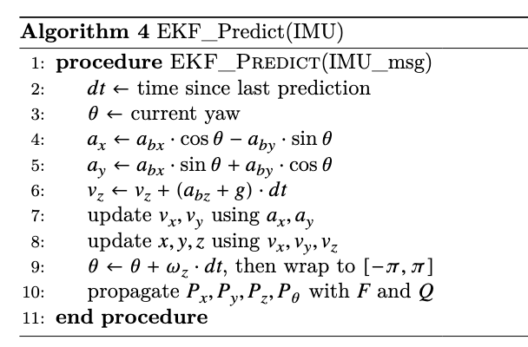
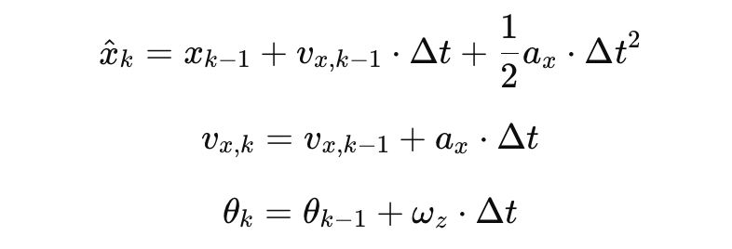

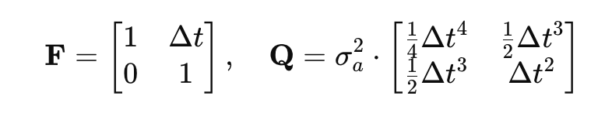
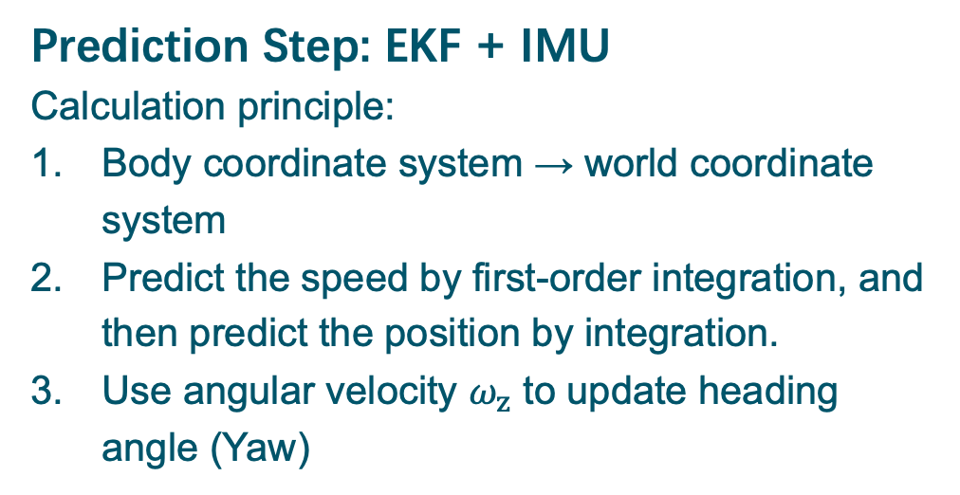
2 Node Design - Estimator Node
Prediction Step: EKF + IMU
Calculation principle:
Body coordinate system → world coordinate system
Predict the speed by first-order integration, and then predict the position by integration.
Use angular velocity $ω_{z}$ to update heading angle (Yaw)
State update equation:
Covariance propagation:
where
©Copyright National University of Singapore. All Rights Reserved.

Slide 8
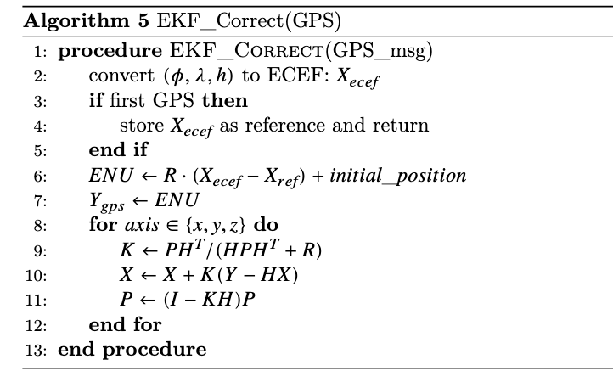



2 Node Design - Estimator Node
Correction Step: GPS + ECEF to ENU
GPS raw data：𝜙, 𝜆, ℎ
LLA → Earth-Centered Earth-Fixed (ECEF)：
ECEF → East-North-Up (ENU)：
ENU → World (Used for simulate alignment) ：
​Kalman Filter Correction equation（x-axis）：
©Copyright National University of Singapore. All Rights Reserved.

Slide 9
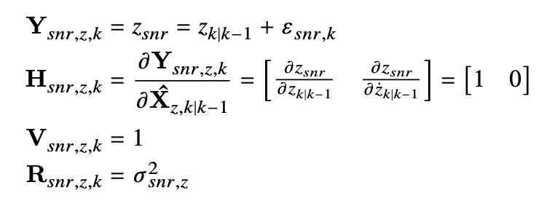
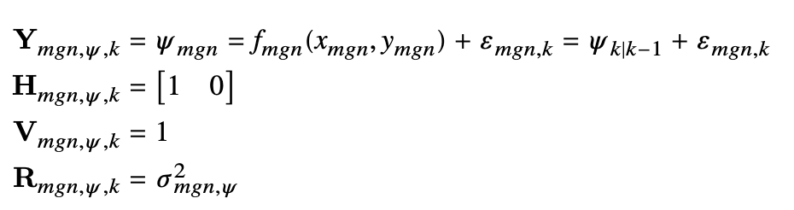
2 Node Design - Estimator Node
Height Correction Using Sonar
By emitting sound waves and receiving the echoes from the ground, the sensor calculates the distance to the surface, providing accurate altitude measurements.
Heading Correction Using Magnetic Compass
The sensor measures the magnetic flux and calculates the azimuth (or yaw) angle, which indicates the direction of travel or the drone’s orientation relative to the Earth’s magnetic poles.
H = [1,0] indicates that we only care about the position, not velocity.
Sonar sensor model
Magnetic Compass sensor model
©Copyright National University of Singapore. All Rights Reserved.

Slide 10
3 System Implementation
System Architecture & Workflow:
The Turtlebot publishes its pose to the drone’s Behavior Node, which generates waypoints using FSM.
The Estimator Node applies a Kalman filter to process sensor data.
The Controller Node sends control commands for the drone to autonomously follow the Turtlebot.
Turtlebot
- Publish odometry/pose
Drone Behavior Node
- Subscribes to Turtlebot pose
- FSM task logic
Drone Controller Node
- Subscribes to:
Estimated pose
Target waypoint
- Publishes velocity commands to drone
Gazebo Simulation
- Executes cmd_vel
- Feeds back new sensor data
Drone Estimator Node
- Sensor fusion (KF)
- Outputs: Estimated drone pose
Sensor Inputs
- IMU, GPS, Sonar, Magnetic Compass
©Copyright National University of Singapore. All Rights Reserved.

Slide 11
Thank you for listening！
©Copyright National University of Singapore. All Rights Reserved.

