Slide 1

Autonomous Robot Navigation with RPP and A*
EE4308: Autonomous Robot Systems
Group 3
©Copyright National University of Singapore. All Rights Reserved.

Slide 2

CONTENTS
1
Introduction & Objectives
2
Algorithm Overview
3
System Implementation
4
Conclusion & Future Work
©Copyright National University of Singapore. All Rights Reserved.

Slide 3
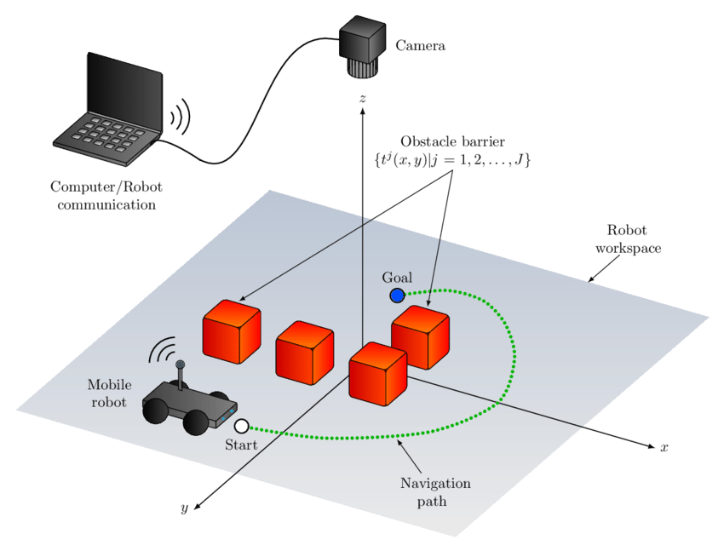
1 Introduction & Objectives
Challenges in Autonomous Navigation:
Precise path tracking
Smooth trajectory execution
Efficient obstacle avoidance
Project Goals:
Improve path-tracking accuracy
Optimize path smoothness
Enhance obstacle avoidance capabilities
©Copyright National University of Singapore. All Rights Reserved.

Slide 4

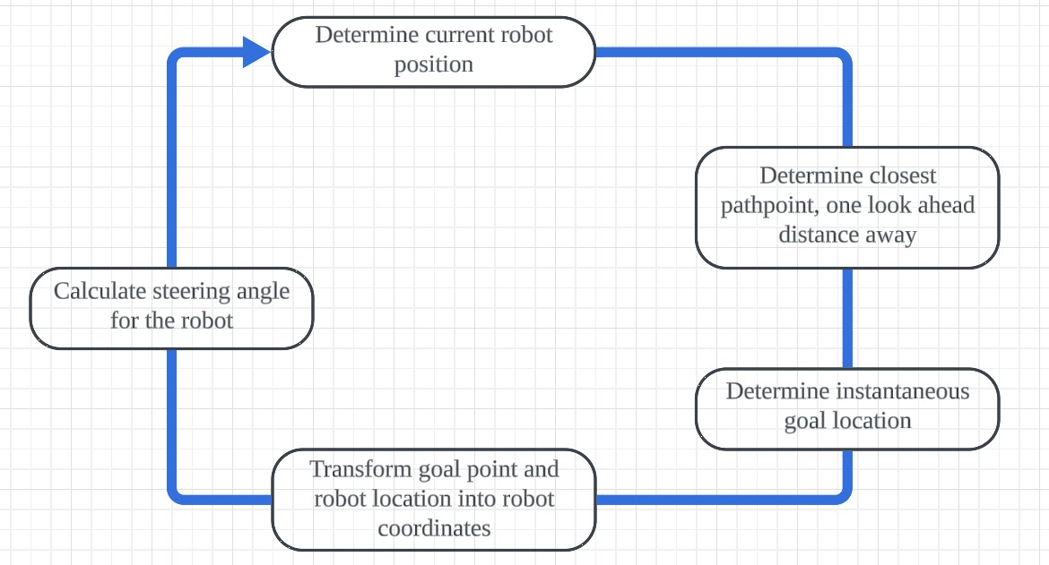
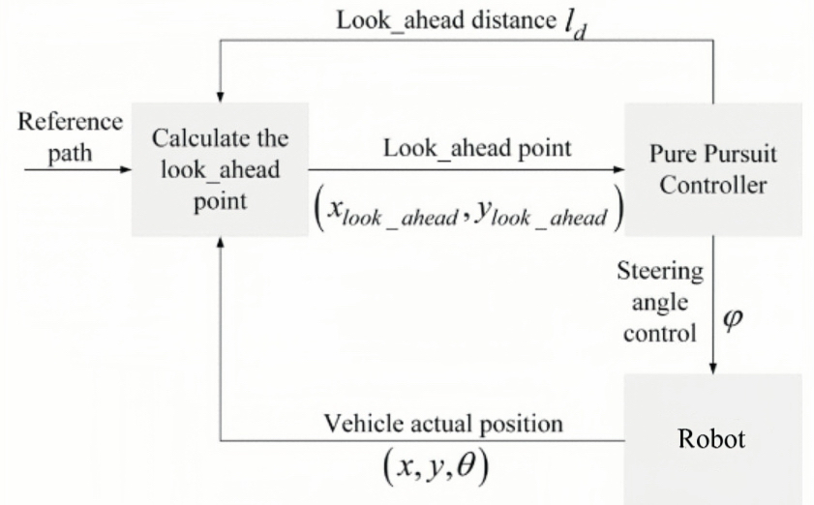
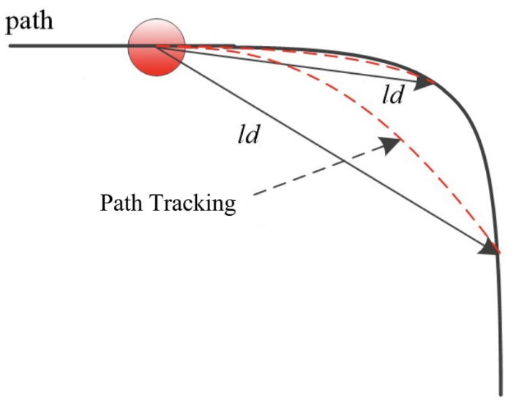
2 Algorithm Overview
Traditional Pure Pursuit & Its Limitations
Pure Pursuit Algorithm:
A geometric path tracking method.
Adjusts robot's heading to align with a dynamically selected lookahead point.
Ensures efficient and stable motion control.
Limitations:
Excessive deviation on high-curvature paths.
Lack of speed control for dynamic environments.
Potential oscillations during sharp turns.
©Copyright National University of Singapore. All Rights Reserved.

Slide 5
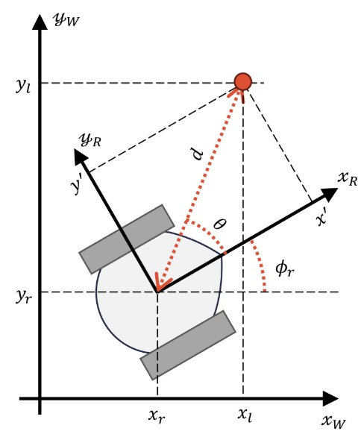
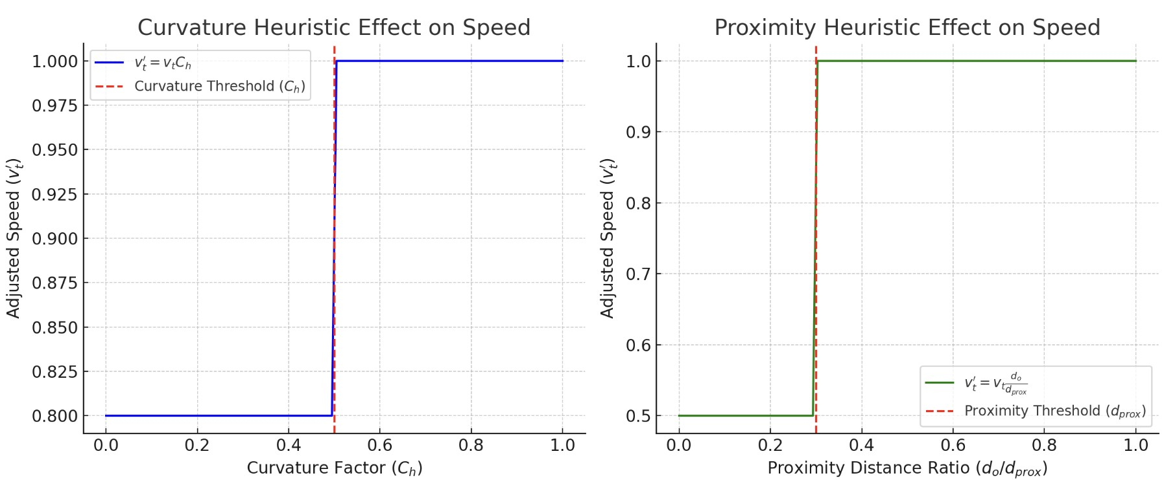
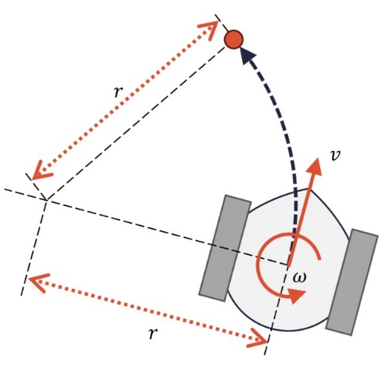
2 Regulated Pure Pursuit (RPP)
An advanced algorithm that enhances the traditional Pure Pursuit by dynamically adjusting speed and lookahead distance. Specifically designed for service and industrial mobile robots operating in constrained environments.
Key Features of RPP:
Dynamic Lookahead Distance: Adjusts based on the robot's speed and path curvature.
Curvature Heuristic: Slows the robot in sharp turns to improve safety.
Proximity Heuristic: Adjusts speed based on distance to obstacles for enhanced obstacle avoidance.
©Copyright National University of Singapore. All Rights Reserved.

Slide 6
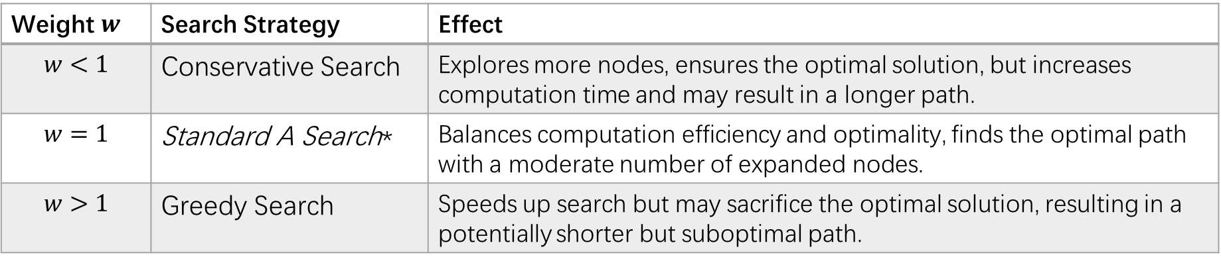
2 A* Path Planning
Combines mathematical and heuristic methods for optimal path planning.
Evaluates paths using f(n)=g(n)+h(n), where g(n) is the cost from start to current node, and h(n) is the heuristic estimate to the goal.
Heuristic Functions:
Euclidean Distance:
Manhattan Distance:
Diagonal Distance:
Weight $w$ | Search Strategy | Effect
$$w<1$$ | Conservative Search | Explores more nodes, ensures the optimal solution, but increases computation time and may result in a longer path.
$$w=1$$ | Standard A Search* | Balances computation efficiency and optimality, finds the optimal path with a moderate number of expanded nodes.
$$w>1$$ | Greedy Search | Speeds up search but may sacrifice the optimal solution, resulting in a potentially shorter but suboptimal path.
©Copyright National University of Singapore. All Rights Reserved.

Slide 7
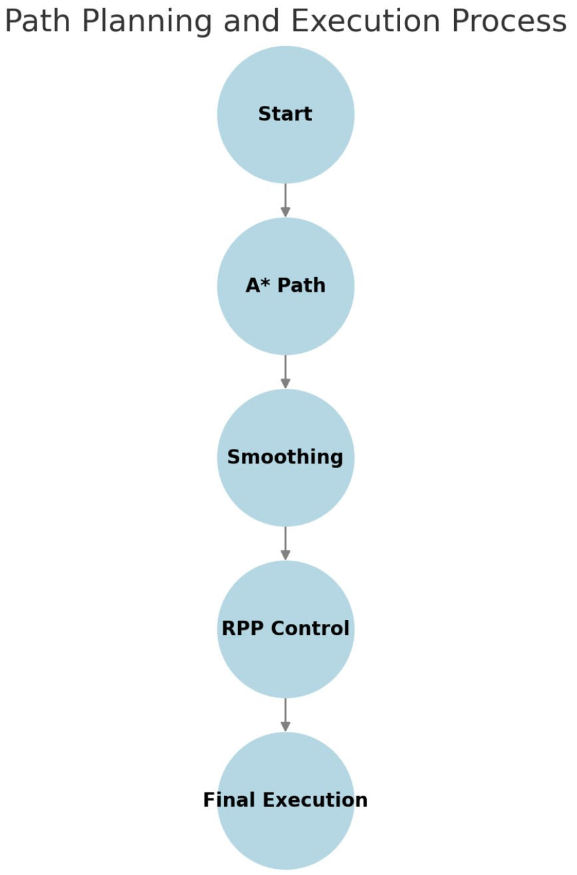
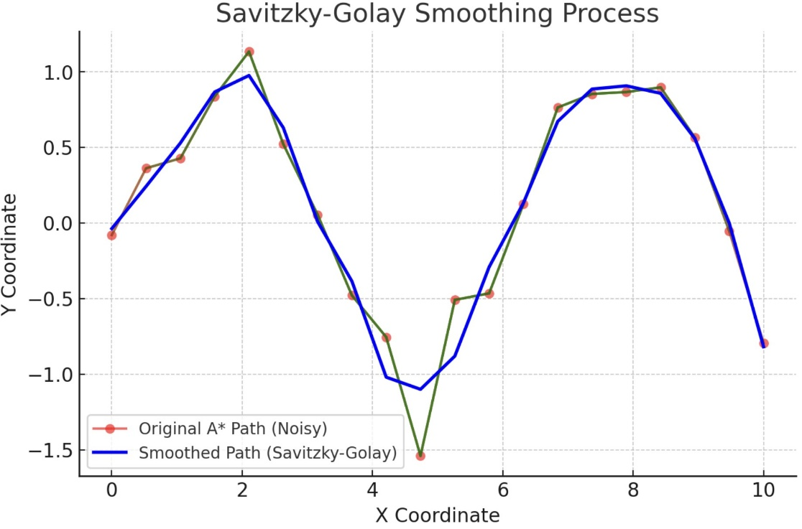
2 Savitzky-Golay Smoothing
A polynomial smoothing algorithm that reduces noise in data while preserving its structure.
Essential for converting discrete, optimal paths into continuous, kinematically feasible trajectories.
Application in Path Planning :
Used to refine paths generated by the A* algorithm.
Smooths out abrupt changes and enhances trajectory tracking for improved navigation.
©Copyright National University of Singapore. All Rights Reserved.
Notes:
The graph compares the original A* path (labeled as "Noisy") with the path after applying the Savitzky-Golay smoothing technique.
The X-axis represents the coordinate along the path, and the Y-axis represents the corresponding values.
The red dots and line represent the original path, which may contain sharp turns and noise.
The blue line represents the smoothed path, which is more continuous and suitable for robot navigation.

Slide 8
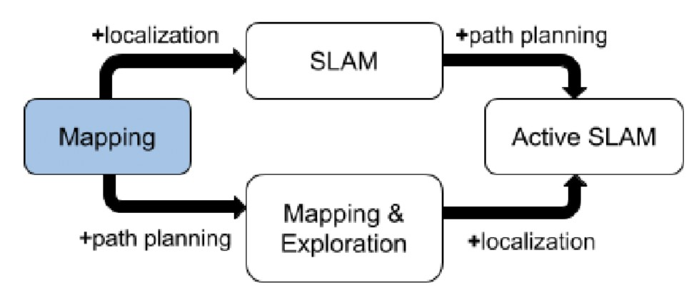
3 System Implementation
System Implementation & Code Structure:
Our system consists of three major components: the A* path planner, the Savitzky-Golay smoothing module, and the Regulated Pure Pursuit controller.
Integration and Workflow:
The Mapping module initializes the environment map and integrates localization data.
SLAM updates the map in real-time and feeds into Active SLAM for path planning.
The A* path planner generates a path, which is then smoothed by the Savitzky-Golay module.
The RPP controller executes the smoothed path, ensuring precise and safe navigation.
©Copyright National University of Singapore. All Rights Reserved.

Slide 9
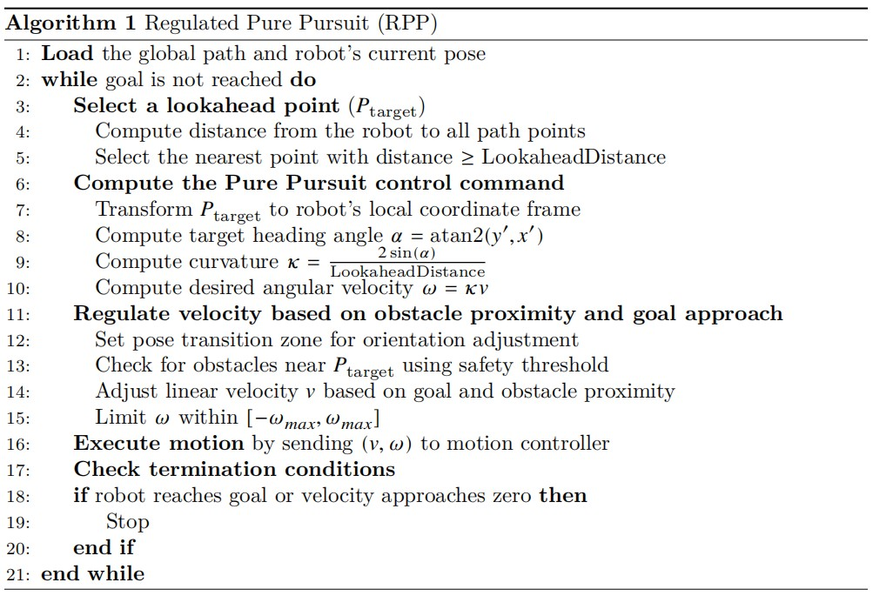
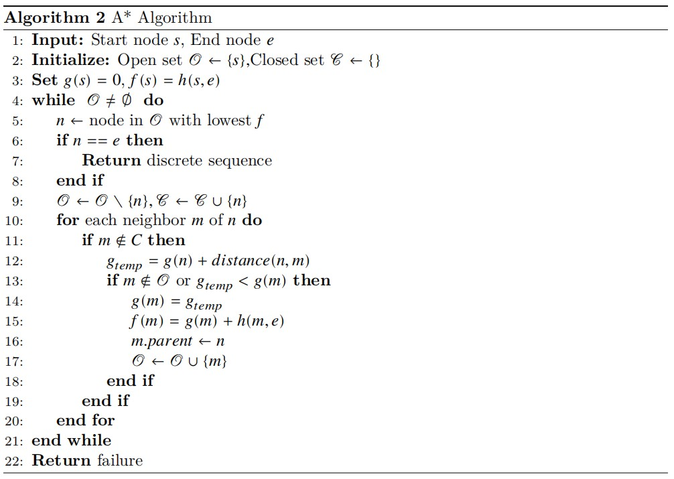
3 System Implementation
Regulated Pure Pursuit (RPP)
A Path Planning Algorithm
The pseudocode provided outlines the core algorithms driving our autonomous navigation system, showcasing the integration of path planning and real-time control.
©Copyright National University of Singapore. All Rights Reserved.

Slide 10
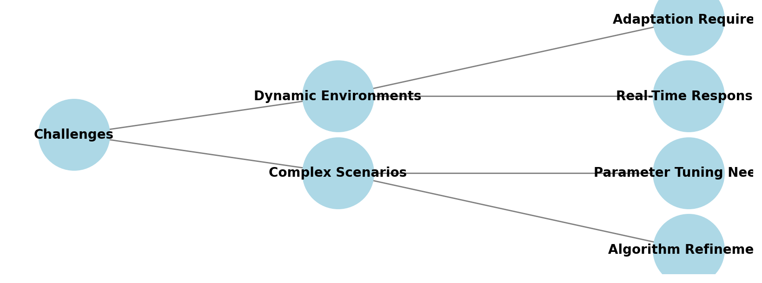
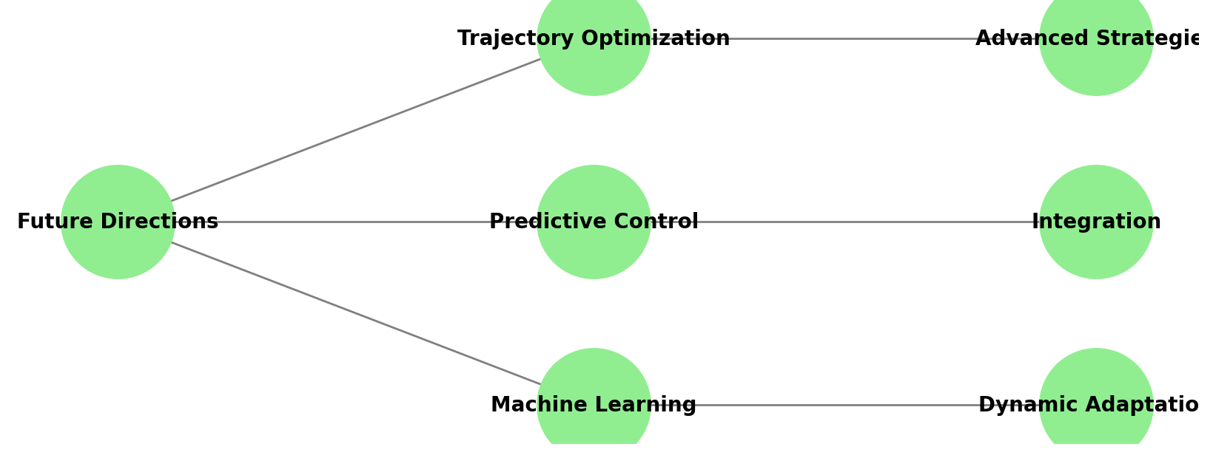
4 Conclusion & Future Work
Key Achievements:
Successfully integrated Regulated Pure Pursuit (RPP), A* path planning, and Savitzky-Golay smoothing for enhanced navigation.
Improved trajectory tracking and stability, especially in high-curvature scenarios.
Strengths:
Adaptive lookahead mechanism in RPP for better path tracking.
Heuristic-based speed regulation for obstacle avoidance.
Smooth and feasible paths through A* and smoothing techniques.
©Copyright National University of Singapore. All Rights Reserved.

Slide 11
Thank you for listening！
©Copyright National University of Singapore. All Rights Reserved.

