Slide 1
[placeholder] x PartySlate
[month] 2026

Slide 2
Quick Snapshot
Here are advantages of a partnership with PartySlate
Higher-value event demand from consumers actively planning weddings, corporate, and large-scale social
Sales acceleration with Photo Hub tools that help prospects visualize and decide faster
Measurable performance tracking across views, inquiries, and conversion (with Tripleseat integration)

Slide 3
Goals of the Partnership
This partnership is designed to:
Increase high-value event inquiries aligned with your ideal event mix
Improve conversion by supporting tours, follow-ups, and proposals with the right visuals
Reduce sales effort per booking by speeding up responses and client decision-making
Expand brand reach through trusted partner and planner networks

Slide 4
Why PartySlate
PartySlate supports revenue across the full client journey:
Profile & Directory exposure: High-intent search visibility that drives demand and higher-value inquiries
Photo Hub sales enablement: Store, find, and share event visuals to shorten the sales cycle and increase conversion

Slide 5
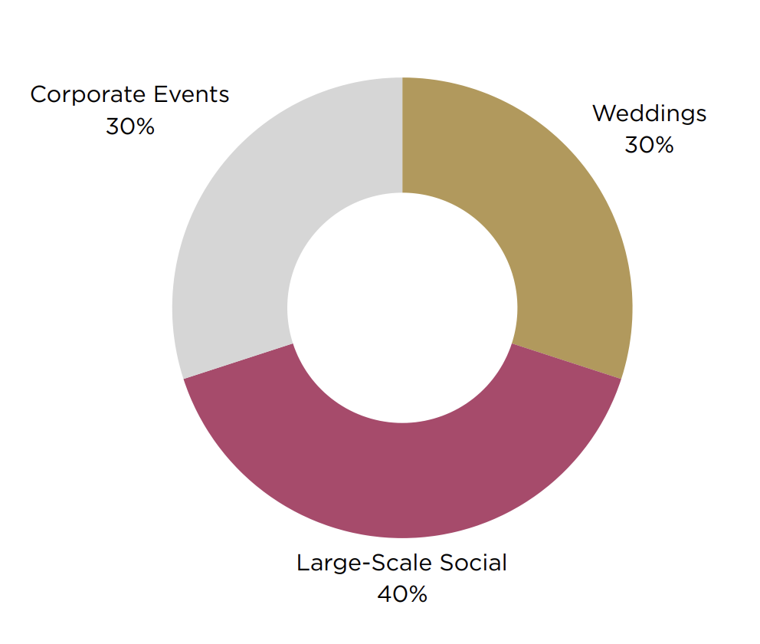
PartySlate attracts hosts planning all types of events
Inquiry breakout
last 12 months
PartySlate.com
4.9 million
Visitors last 12 months
70%
Of our traffic is sourced from a high-intent Google searches
Social Media
400,000 Instagram followers
8.2 M Monthly Instagram impressions
Email
150,000+ Email subscribers
Events
10
Large scale, high profile PartySlate Summits/ year
10+ Partnership events/ year

Slide 6
PARTYSLATE

Slide 7
PartySlate Customer Success and Support
We provide hands-on support to help you drive visibility, inquiries, and revenue.
Onboarding
Our Operations team partners with your sales and marketing teams to optimize your profile for high-value inquiries.
Account Reviews
A dedicated Customer Success Manager meets with you 3× annually to review performance, inquiry quality, and optimization opportunities.
Analytics
A centralized dashboard tracks profile views, inquiries, calls, and clicks so you can measure impact and make informed decisions.

Slide 8
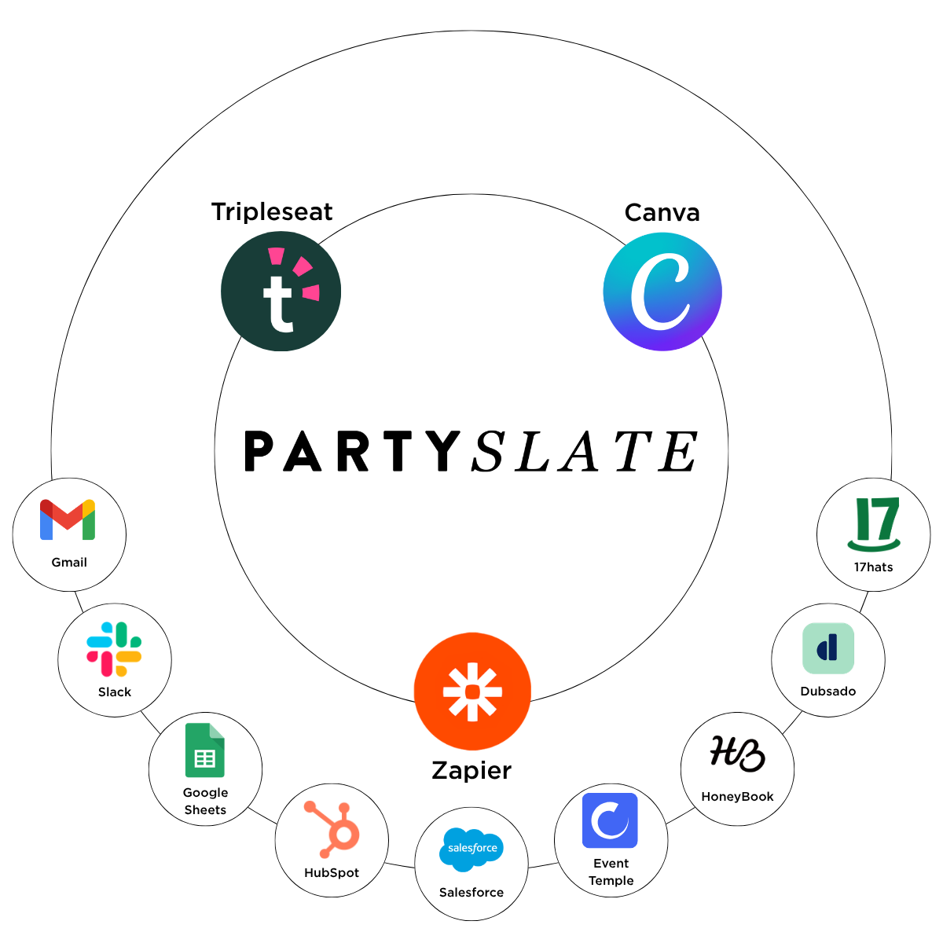
Seamless Integrations with Your Existing Tools
PartySlate integrates with your existing tools to streamline lead management, improve follow-ups, and accelerate the sales cycle.
CRM reporting provides visibility into inquiry details and close rates.
With Canva you can create and publish proposals and marketing visuals faster using approved event imagery without hunting for files

Slide 9
Extra Value for Members Industry networking events
Exclusive events designed to connect you with high-intent planners and partners.
12 member events annually in key markets
Direct access to planners and partners who influence bookings
Brand-building visibility in premium industry settings

Slide 10



Standard Metros
Portfolio
Close deals faster
Sales-ready photos tools to move inquiries forward.
$795
per month
✓ Unlimited photo storage with AI-powered photo search
✓ Canva Integration
✓ Public Profile with all features unlocked
✓ Tier 3 directory boost
✓ Complete onboarding
✓ Support Access
POPULAR
Premier
Book more events
Added exposure and integrations to convert more inquiries.
$995
per month
✓ Unlimited photo storage with AI-powered photo search
✓ Canva Integration
✓ Public Profile with all features unlocked
✓ Tier 2 directory boost
✓ Photo posting service (8 event albums)
✓ Tripleseat integration
✓ Complete onboarding
✓ Support Access
Platinum
Drive revenue
Leverage every tool to drive revenue, with full-service support
$1,395
per month
✓ Unlimited photo storage with AI-powered photo search
✓ Canva Integration
✓ Complimentary Photo Hub setup
✓ Public Profile with all features unlocked
✓ Top tier directory boost
✓ Photo posting service (unlimited albums)
✓ Tripleseat integration
✓ Custom concierge onboarding
✓ Dedicated Customer Success Manager
✓ Advanced analytics & performance reviews
Notes:
This is what you should always be tying back to

Slide 11
Major Metros
Portfolio
Close deals faster
Sales-ready photos tools to move inquiries forward.
$895
per month
✓ Unlimited photo storage with AI-powered photo search
✓ Canva Integration
✓ Public Profile with all features unlocked
✓ Tier 3 directory boost
✓ Complete onboarding
✓ Support Access
POPULAR
Premier
Book more events
Added exposure and integrations to convert more inquiries.
$1,195
per month
✓ Unlimited photo storage with AI-powered photo search
✓ Canva Integration
✓ Public Profile with all features unlocked
✓ Tier 2 directory boost
✓ Photo posting service (8 event albums)
✓ Tripleseat integration
✓ Complete onboarding
✓ Support Access
Platinum
Drive revenue
Leverage every tool to drive revenue, with full-service support
$1,695
per month
✓ Unlimited photo storage with AI-powered photo search
✓ Canva Integration
✓ Complimentary Photo Hub setup
✓ Public Profile with all features unlocked
✓ Top tier directory boost
✓ Photo posting service (unlimited albums)
✓ Tripleseat integration
✓ Custom concierge onboarding
✓ Dedicated Customer Success Manager
✓ Advanced analytics & performance reviews
Notes:
This is what you should always be tying back to

Slide 12
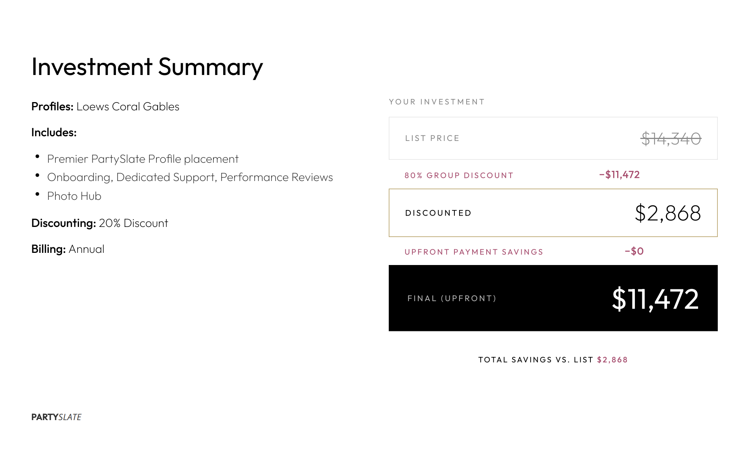
Package Recommendation: Premier

Slide 13









Trusted by leading hospitality brands to drive demand and support conversion

