Slide 1
[Company Name] x PartySlate
[month] 2026

Slide 2
Quick Snapshot
Here are advantages of a partnership with PartySlate
Higher-value event demand from consumers actively planning weddings, corporate, and large-scale social
Sales acceleration with Photo Hub tools that help prospects visualize and decide faster
Measurable performance tracking across views, inquiries, and conversion (with Tripleseat integration)

Slide 3
Goals of the Partnership
This partnership is designed to:
Increase high-value event inquiries aligned with your ideal event mix
Improve conversion by supporting tours, follow-ups, and proposals with the right visuals
Reduce sales effort per booking by speeding up responses and client decision-making
Expand brand reach through trusted partner and planner networks

Slide 4
Why PartySlate
PartySlate supports revenue across the full client journey:
Profile & Directory exposure: High-intent search visibility that drives demand and higher-value inquiries
Photo Hub sales enablement: Store, find, and share event visuals to shorten the sales cycle and increase conversion

Slide 5
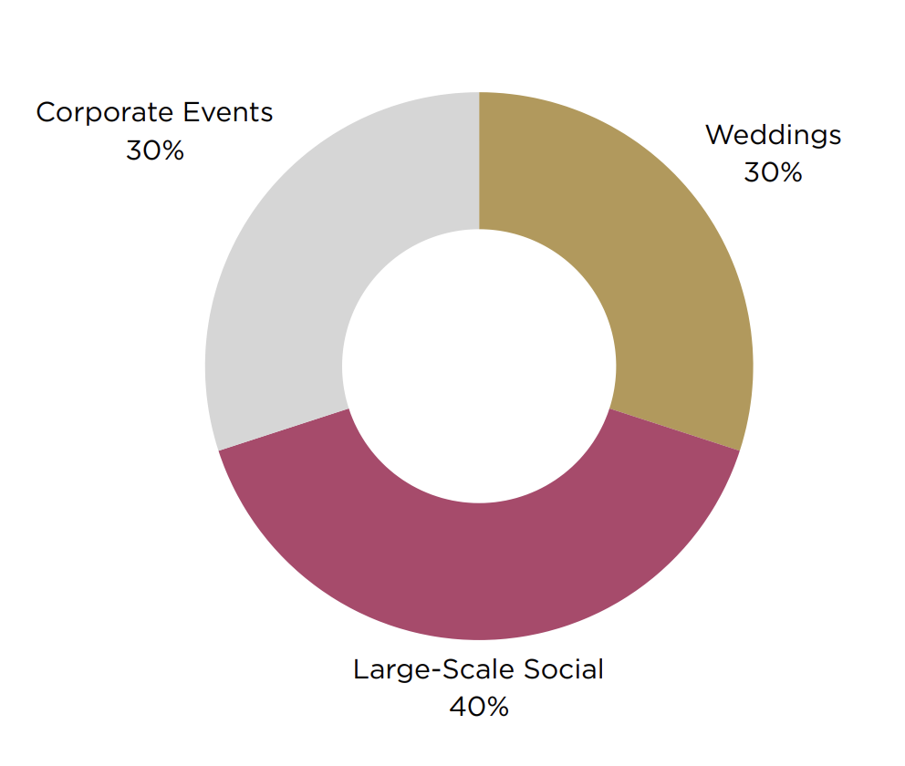
PartySlate attracts hosts planning all types of events
Inquiry breakout
last 12 months
PartySlate.com
5.5 million
Visitors last 12 months
70%
Of our traffic is sourced from a high-intent Google searches
Social Media
400,000 Instagram followers
8.2 M Monthly Instagram impressions
Email
150,000+ Email subscribers
Events
10
Large scale, high profile PartySlate Summits/ year
10+ Partnership events/ year

Slide 8
PartySlate Customer Success and Support
We provide hands-on support to help you drive visibility, inquiries, and revenue.
Onboarding
Our Operations team partners with your sales and marketing teams to optimize your profile for high-value inquiries.
Account Reviews
A dedicated Customer Success Manager meets with you 3× annually to review performance, inquiry quality, and optimization opportunities.
Analytics
A centralized dashboard tracks profile views, inquiries, calls, and clicks so you can measure impact and make informed decisions.

Slide 9
Marketing Activities
PartySlate delivers additional opportunities to increase exposure to event professionals.
PartySlate Summit - 12 annual industry events to meet and interact with pros.
Media Sponsorship - You host an event, we invite impactful guest that can drive event revenue.
Instagram - PartySlate will post a venue spotlight to drive increased exposure.

Slide 10
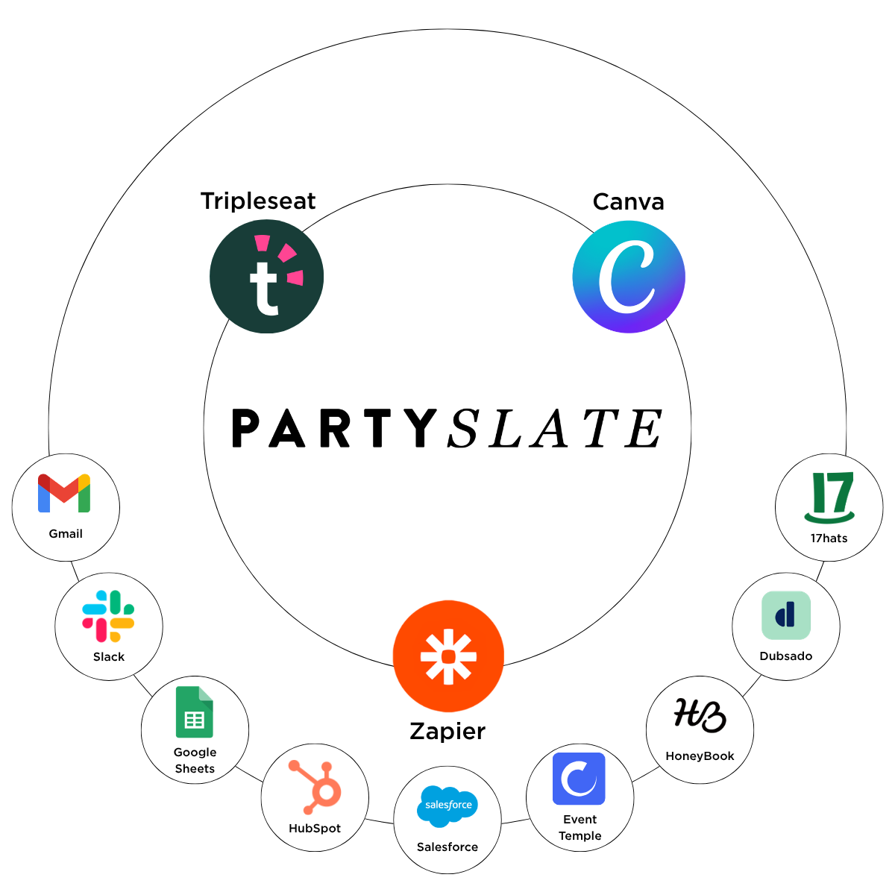
Seamless Integrations with Your Existing Tools
PartySlate integrates with your existing tools to streamline lead management, improve follow-ups, and accelerate the sales cycle.
CRM reporting provides visibility into inquiry details and close rates.
With Canva you can create and publish proposals and marketing visuals faster using approved event imagery without hunting for files

Slide 11
Investment Summary
Profiles: X,Y, Z
Includes:
Premium PartySlate Profile placement
Photo Hub sales enablement tools
Integrations
Additional Marketing Activities
Onboarding, support, and performance reviews
Discounting: 30% multi-location group discount applied
Billing: Annual or quarterly options available

Slide 12









Trusted by leading hospitality brands to drive demand and support conversion

