Slide 1
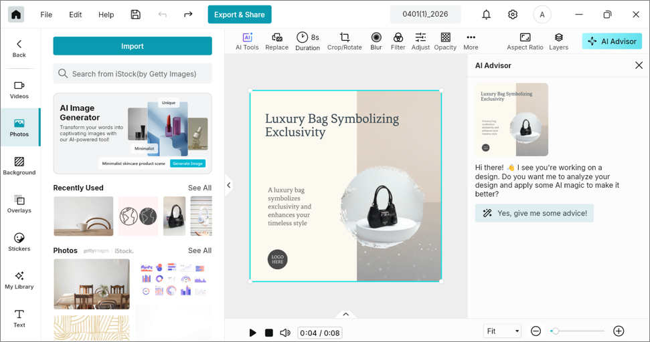
AI Advisor: Give advice button not hidden after canvas edit triggers Re-analyze *上移15px, 24號字
PX, fix in X/X
Current: Give advice button for old canvas can still be clicked even after editing canvas and “Re-analyze” option appears *上移20px
7. Edit on canvas to make it dirty

