Slide 1
Q1-2026 Desktop Customer Survey Results
Ethan Katz (CMEE)
Q2 2026

Slide 2
Legal Disclaimer
Your costs and results may vary.
No product or component can be absolutely secure.
All product plans and roadmaps are subject to change without notice.
Intel technologies may require enabled hardware, software or service activation.
Intel does not control or audit third-party data. You should consult other sources to evaluate accuracy.
No license (express or implied, by estoppel or otherwise) to any intellectual property rights is granted by this document.
Customer is responsible for safety of the overall system, including compliance with applicable safety-related requirements or standards.
Code names are used by Intel to identify products, technologies, or services that are in development and not publicly available. These are not "commercial" names and not intended to function as trademarks.
Intel disclaims all express and implied warranties, including without limitation, the implied warranties of merchantability, fitness for a particular purpose, and non-infringement, as well as any warranty arising from course of performance, course of dealing, or usage in trade.
© Intel Corporation. Intel, the Intel logo, and other Intel marks are trademarks of Intel Corporation or its subsidiaries.
*Other names and brands may be claimed as the property of others.

Slide 3
Agenda
Background
Customer Survey Results
  Heatsink Mounting & Design
  Height & Physical Constraints
  TIM
  ILM Requirements
  Open Feedback
Summary

Slide 4
Background
CCG made a request to CMEE to obtain Desktop Customer feedback regarding HS mounting/design, physical constraints, TIM (thermal interface material), and ILM (independent loading mechanism) Requirements.
Survey purpose:
  As we (CCG) are preparing to architect future platforms, our mechanical architecture team would like to understand how Intel customers are using our enabling solutions. The purpose of this survey is to grow better understanding on this topic so we can consider customer feedback during the design process
4 of the largest Desktop customers (OEMs) were surveyed: Asus, Dell, HP, and Lenovo.
All OEMs, except HP, have provided responses
Dell provided survey responses from both their Thermal Engineering and Services Engineering teams

Slide 5
Customer Survey Results – Heatsink Mounting & Design
Asus | Dell (Thermal Eng.) | Dell (Services Eng.) | HP | Lenovo
Q1: Do you find value in removing heatsink holes on PCB and directly attaching the heatsink to the loading mechanism? (e.g. to the loading mechanism fasteners) How important is this (rate from 1(not important) to 5(Very important) ?
no (This will limit design space for top fan), 4 | yes, 5 I would like to reserve the flexibility to keep the current mounting patten for tower cooler (heat pipes routing) | yes very important - makes it more serviceable | No response | Yes, 3. (Maybe strain gauge impact due to heavy heatsink）
Q2: Do you find value in a backplate that extends to heatsink holes, to enable one combined backplate that is shared for both the socket loading mechanism and the heatsink anchors? How important is this (rate from 1(not important) to 5(Very important) ?
yes (cost benefit), 4 | No | yes very important - makes it more serviceable | No response | Yes, 4.
Q3: If known, can you share load provided by heatsinks on the systems you design? (Min & max)
min:19kg, max:24kg | 20-40 lbf | No response | No response | 45±5 lbf

Slide 6
Customer Survey Results – Heatsink Mounting & Design
Asus | Dell (Thermal Eng.) | Dell (Services Eng.) | HP | Lenovo
Q4: Do you have experience with Heatsinks that include a pedestal in the cold plate that sits on top of IHS?
Yes | Yes | No | No response | No
Q5: If yes to the above question, what challenges have you encountered or foresee with pedestal designs?
Heat sink static loading force, strain gauge test, CPU contact for hotspot | tolerance of Z-height stack up | N/A | No response | N/A
Q6: Could you share the mechanical validation processes of heatsinks installed in your platform?
thermal, shock, vibration, drop test , strain gauge test | Thermal performance Interference check Tolerance analysis shock & vibration | No response | No response | thermal analysis, structural analysis, durability, shoke, vibration

Slide 7
Customer Survey Results – Height & Physical Constraints
Asus | Dell (Thermal Eng.) | Dell (Services Eng.) | HP | Lenovo
Q7: Could your systems accommodate a thicker back-plate (>2.2mm) to improve socket loading the deflection?
Yes | depends on platforms | Don’t know | No response | No
Q8: If yes to the above question, can you provide value of available clearance on the bottom of the PCB (Available space to grow back-plate thickness)?
2.54mm | depends on platforms | N/A | No response | N/A
Q9: Can you share the PCB thickness used along with LGA products on your systems?
1.55mm | ~1.6mm in most platforms | No response | No response | 1.6mm / 1.2mm
Q10: If possible, share any issues you can identify regarding the interaction between loading mechanism and other board components
N/A | heat sink hits the VR component, like cap, chock | No response | No response | No response

Slide 8
Customer Survey Results – TIM
Asus | Dell (Thermal Eng.) | Dell (Services Eng.) | HP | Lenovo
Q11: What are the current TIM pastes you use?
7762、TC-5026 | Dow and Shinetsu series | Don’t know | No response | TC 5622 or equivalent
Q12: Do you use Liquid Metal TIM on any of your designs?
No | Yes, but not in Intel platform | I think so - portable Alienware. | No response | No
Q13: If yes to the above question, what specific Liquid Metal TIM do you use?
N/A | trade secret | Don’t know | No response | N/A
Q14: Would you find use in a Loading Mechanism solution to enable de-lidded packages?
No | Yes | Yes | No response | No

Slide 9
Customer Survey Results – ILM Requirements
Asus | Dell (Thermal Eng.) | Dell (Services Eng.) | HP | Lenovo
Q15: Is Lever actuated ILM (tool-less) necessary for your high-performance applications and designs?
Yes | Yes | sometimes - depends on system | No response | Yes
Q16: Is an ILM solution requiring a tool for package installation be acceptable?
Yes | No | No | No response | No
Q17: Is your organization currently modifying/customizing the ILM certified by Intel in any way to address system needs?
No | No | No | No response | Yes
Q18: If yes to the above question, please share how you're modifying/ customizing Intel's certified ILM design.
N/A | N/A | N/A | No response | No response

Slide 10
Customer Survey Results – Open Feedback
Asus | Dell (Thermal Eng.) | Dell (Services Eng.) | HP | Lenovo
Q19: Please provide general feedback on the design of the Intel ILM
Please provide strain gauge and PCB deformation specification. | Need to address the deformation after stress applied Since ADL (or LGA1700), the IHS deformation is obviously after the ILM applies force on it. We measured the flatness and it becomes 0.15~0.3mm. It makes me no choice to increase the TIM thickness and scarify the performance to cover the tolerances. | design is adequate | No response | Better tolerance control to avoid interference between Part A/B/C/D (We found that the tolerance definitions for A/B/C/D in the illustration were incomplete on other platforms, which led to interference and breakage issues. We hope to define appropriate tolerances to avoid interference.)
Q20: Please provide general feedback on HVM (High Volume Manufacturing) assembly of the Intel ILM
N/A | No | servicing current solution is established and has no issues | No response | Need to qualify Socket vendor A w/ backplane & ILM B for mass production.(The socket and the ILM/backplane are used at different stations. We hope that the socket from vendor A can be compatible with the ILM/backplane from vendor B.)

Slide 11
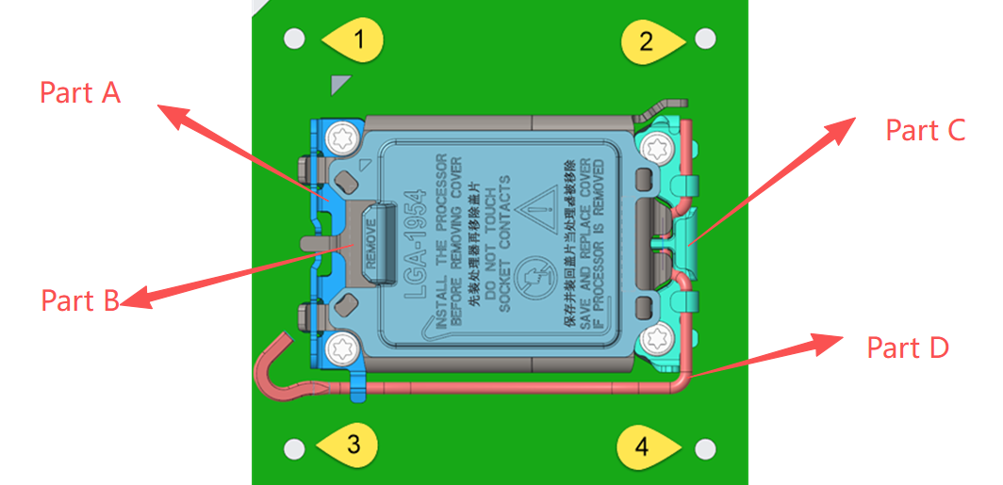
Customer Survey Results – Open Feedback
Lenovo
Better tolerance control to avoid interference between Part A/B/C/D (We found that the tolerance definitions for A/B/C/D in the illustration were incomplete on other platforms, which led to interference and breakage issues. We hope to define appropriate tolerances to avoid interference.)

Slide 12
Summary
The summarized results below include Asus, Dell (Thermal Eng.), Dell (Services Eng.), and Lenovo
Heatsink Mounting & Design:
  3/4 OEMs find value in removing PCB heatsink holes and directly attaching heatsink to ILM
  3/4 OEMs find value in extending backplate for connecting both socket LM and heatsink anchors
  OEMs HS min/max load range: ~20lbf to ~53lbf
  2/4 OEMs have experience with HS w/ pedestal in the cold plate. Some challenges from pedestal design are HS static loading, strain gage testing, CPU contact for hotspot, and Z-height stack up tolerance
  Common HS mechanical validation processes: Drop, Durability, Interference, Shock, Strain, Structural Analysis, Thermal, Tolerance, Vibration
Height and Physical Constraints:
  1/4 OEMs can accommodate a backplate thicker than 2.2mm. The available clearance from this customer is 2.54mm
  3/4 OEMs PCB thickness for LGA product systems is ~1.55-1.6mm (1 of the 3 also mentioned 1.2mm)
  1/4 OEMs provided potential issues between LM and other board components (e.g. HS hits VR component, like a cap or choke)
ILM Requirements:
  3/4 OEMs say that a lever actuated ILM (tool-less) is necessary for their high-performance applications & designs (1/4 says it depends on the system)
  3/4 OEMs say that an ILM solution involving a tool is not acceptable
  1/4 OEMs say they modify/customize the Intel certified ILM to address their system needs, but did not provide any further details
Open Feedback:
  Asus requested strain gage and PCB deformation spec
  Dell (Thermal Eng.) OEMs requested the IHS deformation post ILM closure to be addressed
  Dell (Services Eng.) stated that the design is adequate for servicing and has no issues
  Lenovo requested:
    Better tolerance control, as they found the tolerance illustrations incomplete (leading to interference and breakage issues)
    Qualification of Socket Vendor and ILM vendor mixing (e.g. Socket Vendor A to work with ILM Vendor B for mass production)

