Slide 1
NLP FINAL PROJECT · 2026
Banking Intent
Classification
Teaching Machines to Understand Customer Needs
5 MODELS · BANKING77 · 13,083 SAMPLES · 77 INTENT CLASSES

Slide 2
THE CHALLENGE
Why Banking Intent Classification Matters?
Banks receive millions of customer queries daily. Manual routing is slow and error-prone — NLP can automate intent detection at scale.
77
13K+
5
Intent Classes
Training Samples
Models Tested
Instant, accurate query routing to the right channel
Reduced operational costs at scale
About BANKING77
24/7 consistent customer experience
A fine-grained banking customer service benchmark by PolyAI. Contains real-world categories reflecting the semantic complexity of banking queries across 77 distinct intents.
Handle millions of interactions without human error
Source: PolyAI — task-specific-datasets (GitHub)

Slide 3
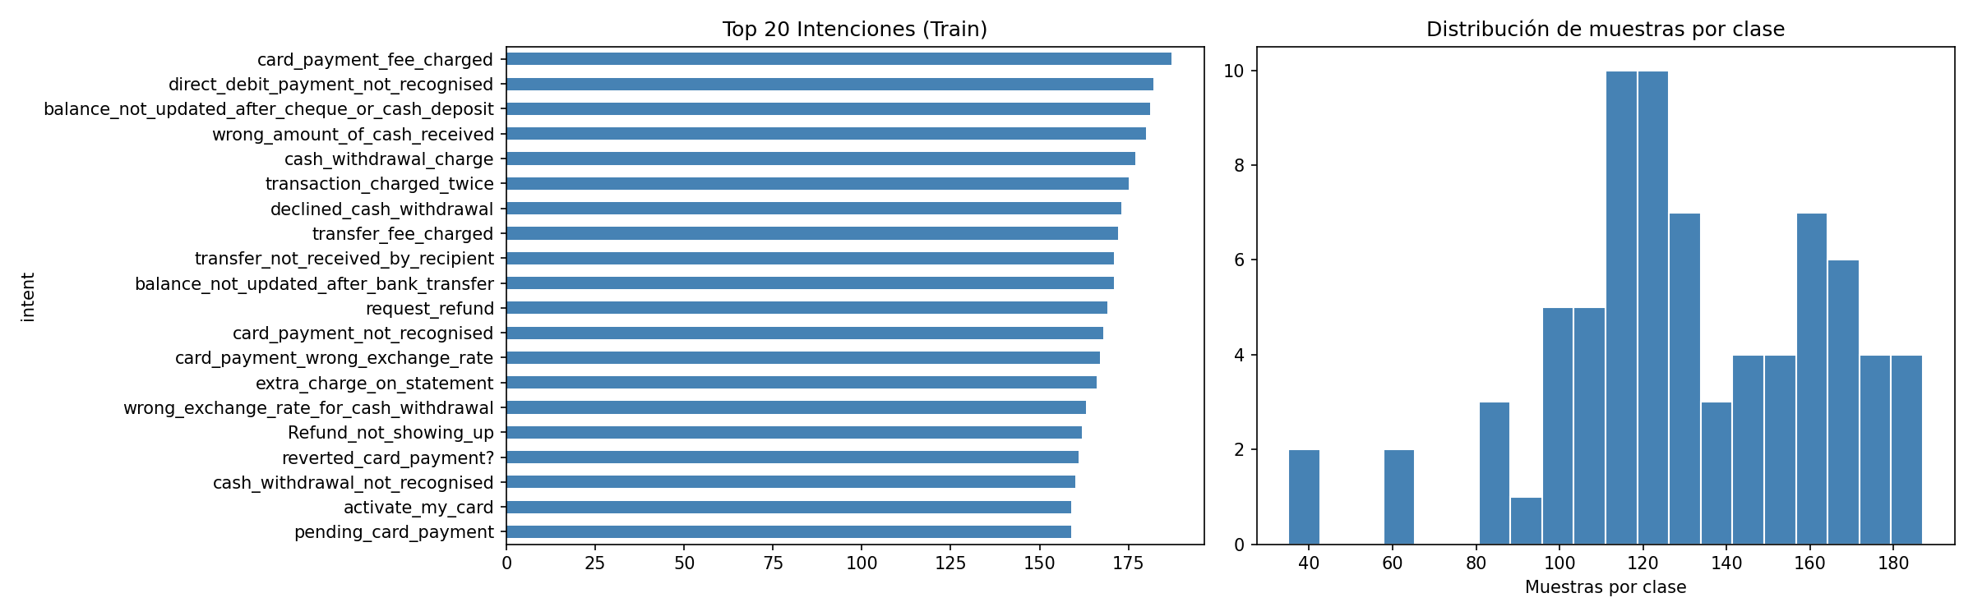
DATASET
BANKING77 — Fine-Grained Intent Detection Benchmark
10,003
3,080
77
~11
Training samples
Test samples
Intent classes
Avg. words/query
76.5% of total
23.5% of total
Fine-grained categories
Short utterances

Slide 4
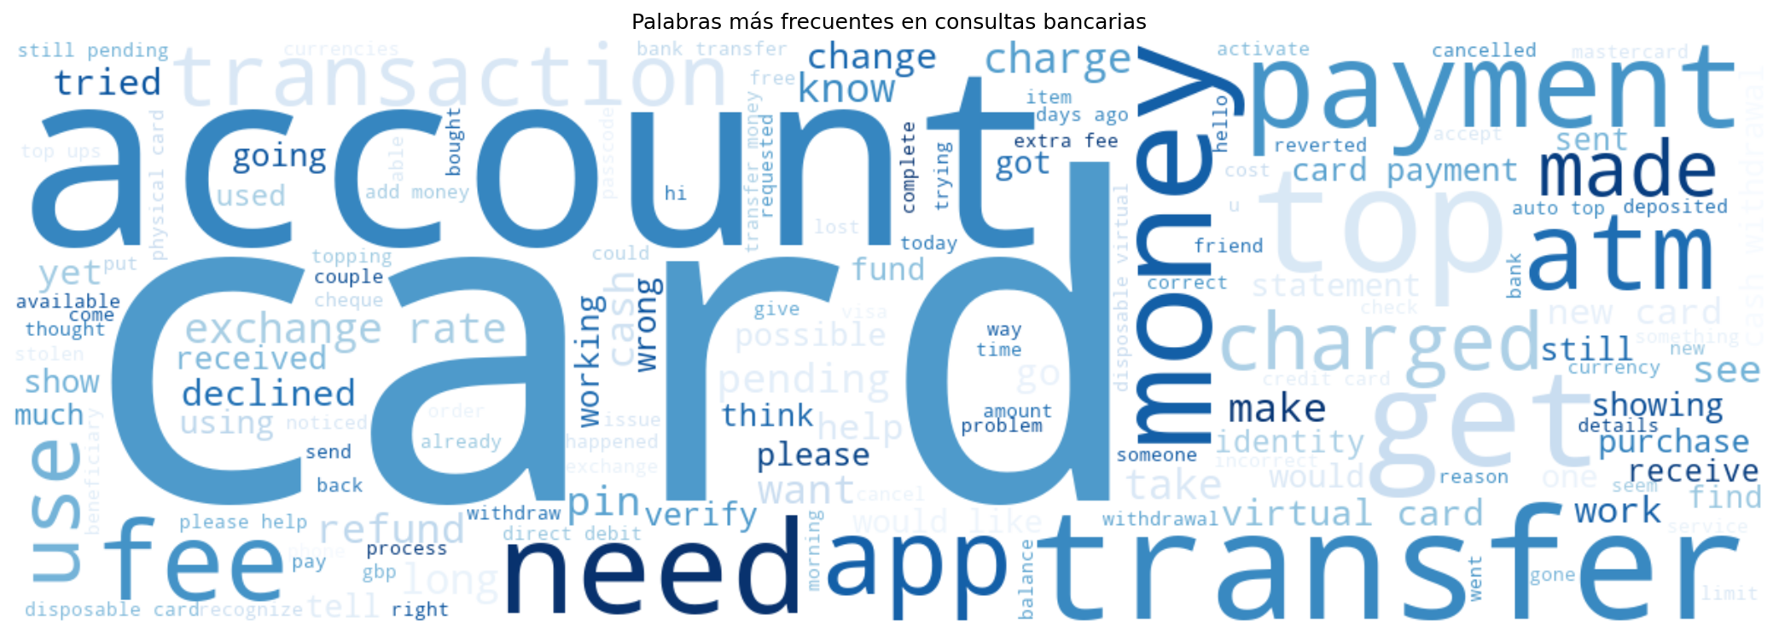
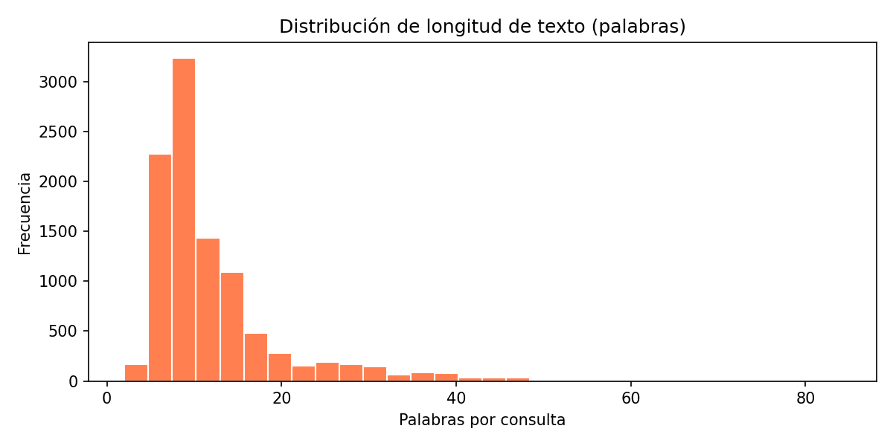
EXPLORATORY ANALYSIS
What Does Banking Language Look Like?
Most Frequent Words in Queries
Query Length Distribution (words)
Key Insight:
Queries are short (~11 words) and dominated by banking keywords (card, payment, transfer, account). The challenge is NOT vocabulary — it is distinguishing 77 semantically similar intents from each other.

Slide 5
OUR APPROACH
5 Models. One Goal: Maximum Accuracy.
TRADITIONAL ML — TF-IDF Features
DEEP LEARNING — Neural Embeddings
1
2
3
4
5
Logistic
Regression
SVM
(LinearSVC)
Random
Forest
Bidirectional
LSTM
DistilBERT
(Fine-tuned)
85.6%
89.4%
86.6%
89.9%
93.2%
★ BEST MODEL
All models trained and evaluated on the identical BANKING77 train/test split — fully comparable results.

Slide 6
TRADITIONAL ML — MODELS 1–3
Logistic Regression, SVM & Random Forest with TF-IDF
Baseline
Best Traditional
Ensemble
Logistic Regression
SVM (LinearSVC)
Random Forest
Accuracy
F1 Macro
Accuracy
F1 Macro
Accuracy
F1 Macro
85.55%
85.40%
89.35%
89.37%
86.56%
86.52%
Fast linear classifier using TF-IDF bag-of-words (unigrams + bigrams, up to 100K features). Strong L2 regularization. Provides solid interpretable baseline.
Maximum margin classifier with linear kernel on TF-IDF. Excels in high-dimensional sparse spaces. Outperforms LR by +3.8% — best traditional model.
100 decision trees over TF-IDF features. Bagging provides robustness to noise. Slightly outperforms LR but lags SVM — trees struggle with sparse vectors.
✓ Fast, interpretable, low memory ✗ Assumes linear separability
✓ Handles sparse text features well ✗ No probability calibration
✓ Robust, handles noise ✗ Slow on sparse TF-IDF vectors

Slide 7
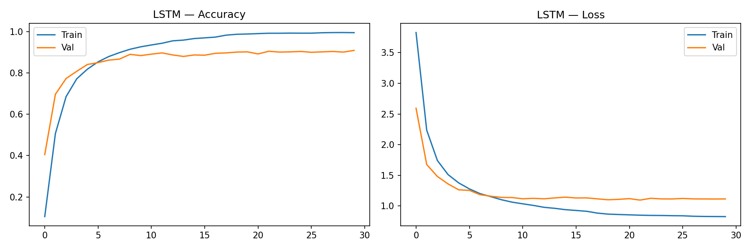
DEEP LEARNING — MODEL 4
Bidirectional LSTM with GloVe Embeddings
Architecture
Training Curves — Accuracy & Loss
Embeddings:
GloVe 6B 100d (frozen)
Architecture:
BiLSTM → Dropout → Dense → Softmax
Hidden units:
128 per direction → 256 total
Dropout:
0.4 for regularization
Optimizer:
Adam lr=1e-3
Epochs:
30 (early stopping patience=5)
Result
89.94% Accuracy | 89.94% F1 Macro

Slide 8
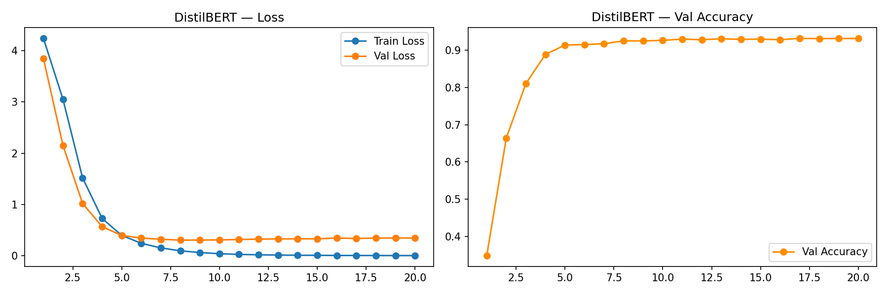
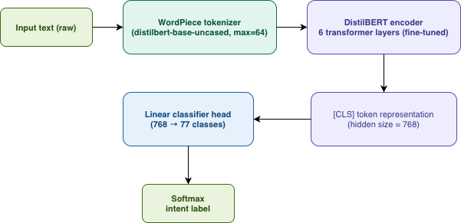
DEEP LEARNING — MODEL 5 ★ BEST MODEL
DistilBERT — Fine-Tuned Transformer for Intent Classification
Architecture
Training History — Loss & Val Accuracy
Base model:
distilbert-base-uncased
Tokenizer:
WordPiece (max_len = 64)
Encoder:
6 Transformer layers, 768 hidden
Classifier:
Linear head: 768 → 77 classes
Optimizer:
AdamW lr = 2e-5
Epochs:
20 (early stopping patience=3)
93.18% Accuracy | 93.18% F1 Macro
+3.24% over BiLSTM | +4.32% over SVM (best traditional)

Slide 9
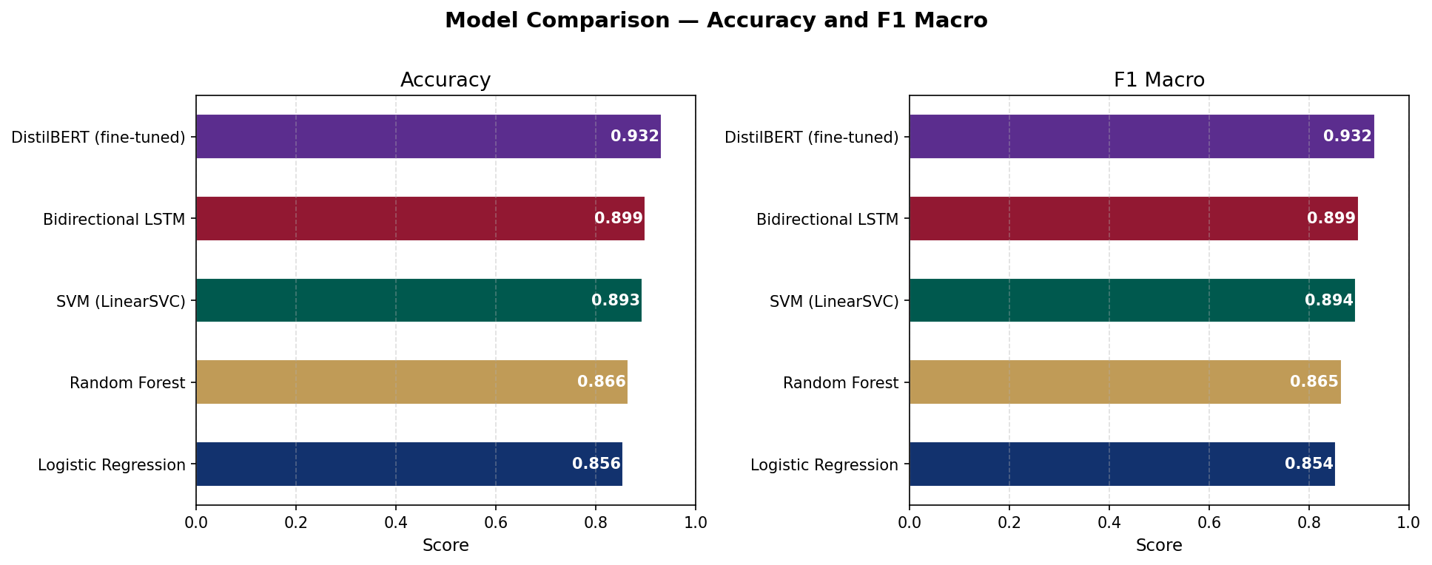
RESULTS
The Performance Showdown — All 5 Models Head-to-Head
93.18%
DistilBERT Accuracy — Best Model
★ Clear Winner
+9.11%
gain over LR baseline (F1 Macro)
85.55% → 93.18%
journey from LR to DistilBERT

Slide 10
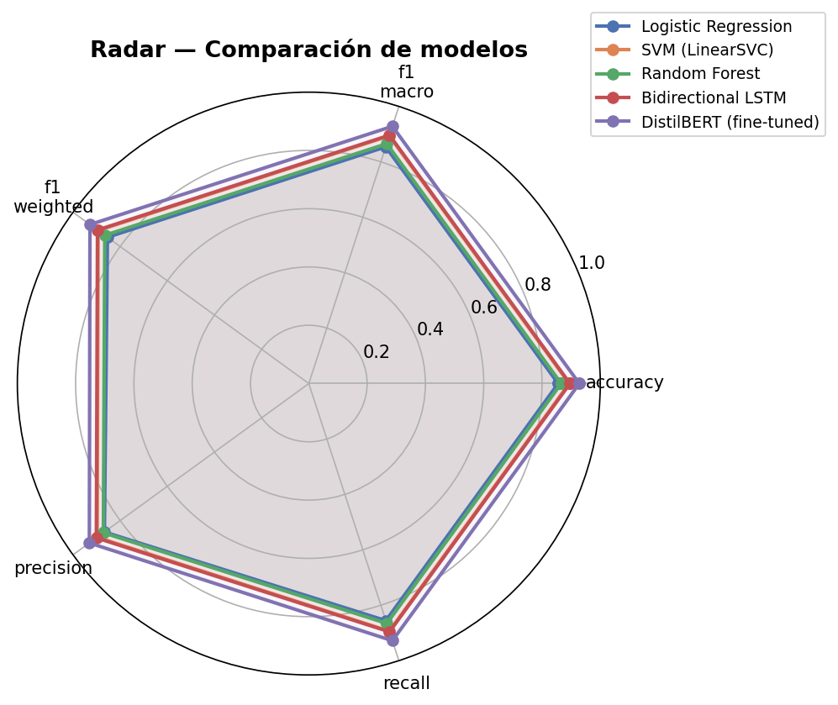
METRICS
Complete Evaluation — Accuracy, Precision, Recall & F1
Model | Accuracy | Precision | Recall | F1 Macro
Logistic Regression | 85.55% | 86.67% | 85.55% | 85.40%
Random Forest | 86.56% | 87.12% | 86.56% | 86.52%
SVM (LinearSVC) | 89.35% | 89.76% | 89.35% | 89.37%
Bidirectional LSTM | 89.94% | 90.34% | 89.94% | 89.94%
★ DistilBERT | 93.18% | 93.41% | 93.18% | 93.18%
Radar chart — DistilBERT consistently dominates every axis across all 5 metrics.

Slide 11
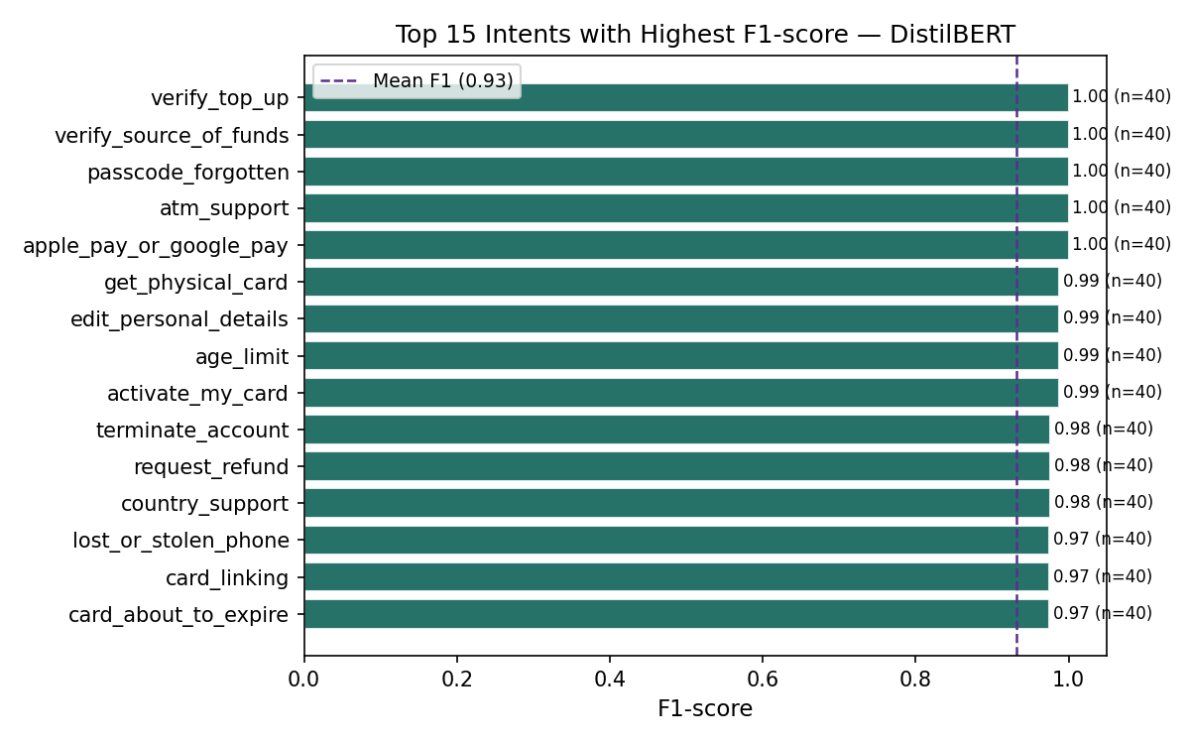
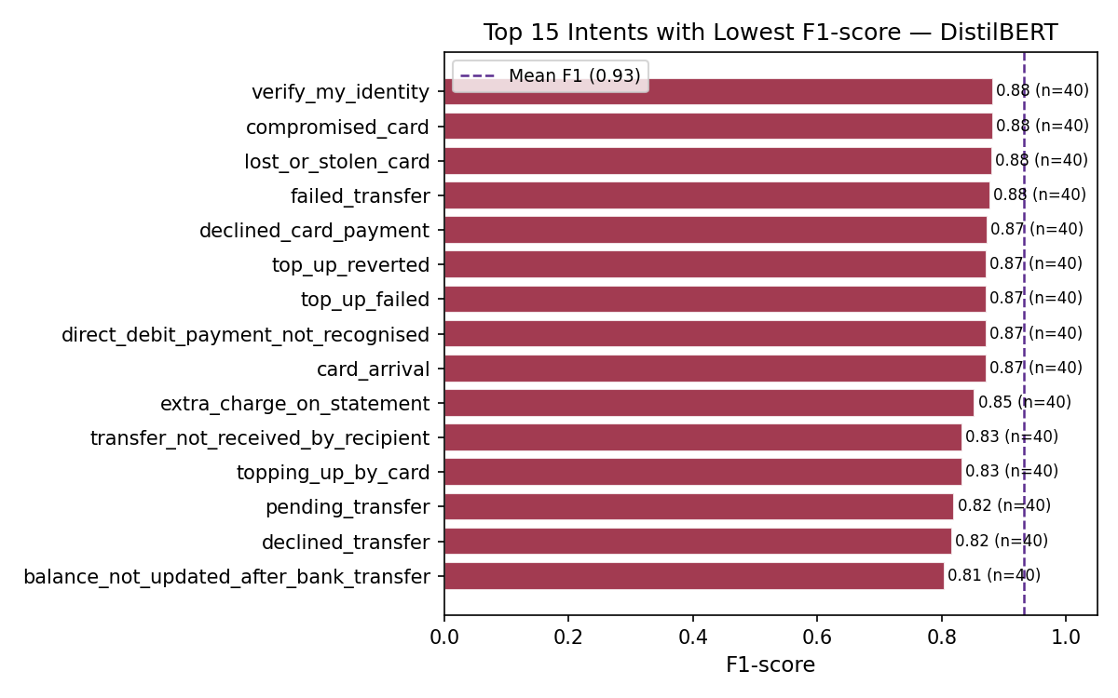
FINDINGS
Where Does BERT Excel — and Where Does It Struggle?
Top Performers — F1 = 1.00
Hardest Intents — F1 ≈ 0.81–0.88
Insight: Hardest intents share semantic overlap (failed_transfer vs pending_transfer) — they require deep contextual understanding beyond lexical features.

Slide 12
CHALLENGES
Key Challenges & Differences Across the 5 Models
Fine-Grained Intent Overlap
Short, Sparse Utterances
77 classes share near-identical vocabulary (top_up_failed vs top_up_reverted). Traditional ML fails here — only context-aware models can distinguish them.
Queries average ~11 words. TF-IDF vectors are extremely sparse, limiting tree-based models like Random Forest from finding discriminative patterns.
Compute Cost vs Accuracy
Static vs Contextual Embeddings
DistilBERT requires ~20× more compute than LR. Training takes minutes vs. seconds — but the +7.6% accuracy gain justifies the investment in production.
GloVe (BiLSTM) is static: 'card blocked' and 'card declined' look similar. BERT's contextual embeddings encode different meanings in different contexts.
Relative F1 gain over LR baseline: DistilBERT +9.11% | BiLSTM +5.32% | SVM +4.65% | Random Forest +1.31%

Slide 13
THE VERDICT
Why DistilBERT is the Clear Winner
01
Contextual Understanding
04
Dominates Even the Hardest Intents
BERT reads bidirectionally — 'card not working' vs 'card blocked' carry different context. Word-level models cannot make this distinction.
Even BERT's weakest intents (F1=0.81) beat SVM's class average. No intent falls below 0.80 — the floor is dramatically raised.
02
Pre-trained on 3.3 Billion Words
05
Stable Convergence, No Overfitting
Transfer learning: 66M parameters already understand English grammar, semantics, and financial vocabulary before seeing a single training sample.
Validation accuracy plateaus at 93.18% in ~7 epochs. Training and validation loss track closely — a robust, generalizable model.
03
+3.24% Over the Second-Best Model
The gap over BiLSTM is consistent across all 3,080 test samples and all 5 evaluation metrics — not a statistical fluke.

Slide 14
CONCLUSIONS
Key Takeaways
1
Fine-Tuned Transformers Win on Fine-Grained Tasks
DistilBERT (93.18%) significantly outperforms all baselines. Pre-trained language models are the right tool for short, ambiguous banking queries where context is everything.
2
Traditional ML Has a Hard Ceiling
SVM achieves a strong 89.35% and is 20× faster — ideal for resource-constrained environments. But semantic overlap between intents creates a ceiling that BERT shatters.
3
Context is King in NLP
77 BANKING77 intents are not lexically distinct — they demand contextual understanding. Models that capture context (BiLSTM, BERT) consistently beat bag-of-words approaches.
Thank you — Questions?
Banking Intent Classification · BANKING77 · NLP Final Project 2026

