Slide 1

Spring 2023
permutation test
Programming and Data Analysis for Modern Neuroscience
NEU 365P/385L
Marcel Goldschen-ohm
Assistant Professor in the Department of Neuroscience, The University of Texas at Austin

Slide 2

Learning goals – Permutation test
You will be able to test the hypothesis that two samples come from the same distribution using resampling.

Slide 3












Permutation test
Sample data set A
Sample data set B
x
x
x
x
x
x
x
$$x_{0}$$
x
x
x
$$x_{1}$$
$$x_{2}$$
$$x_{N−1}$$
$$x_{0}$$
$$x_{1}$$
x
x
x
$$⋯$$
$$stat$$
x
$$x_{2}$$
$$⋯$$
$$x_{M−1}$$
x
x
x
x
x
x
$$stat$$
x
x
x
x
x
x
x
x
x
x
x
x
x
x
x
x
x
x
x
x
x
x
x
x
size N
size M
Permutation test addresses only one question:
Do samples A and B come from the same distribution?

Slide 4
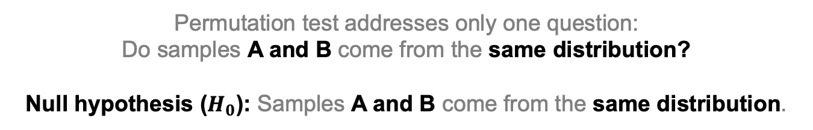
Permutation test
Sample data set A
Sample data set B
x
x
x
x
x
x
x
$$x_{0}$$
x
x
x
$$x_{1}$$
$$x_{2}$$
$$x_{N−1}$$
$$x_{0}$$
$$x_{1}$$
x
x
x
$$⋯$$
$$stat$$
x
$$x_{2}$$
$$⋯$$
$$x_{M−1}$$
x
x
x
x
x
x
$$stat$$
x
x
x
x
x
x
x
x
x
x
x
x
x
x
x
x
x
x
x
x
x
x
x
x
size N
size M
Permutation test addresses only one question:
Do samples A and B come from the same distribution?
Null hypothesis ($H_{0}$): Samples A and B come from the same distribution.

Slide 5
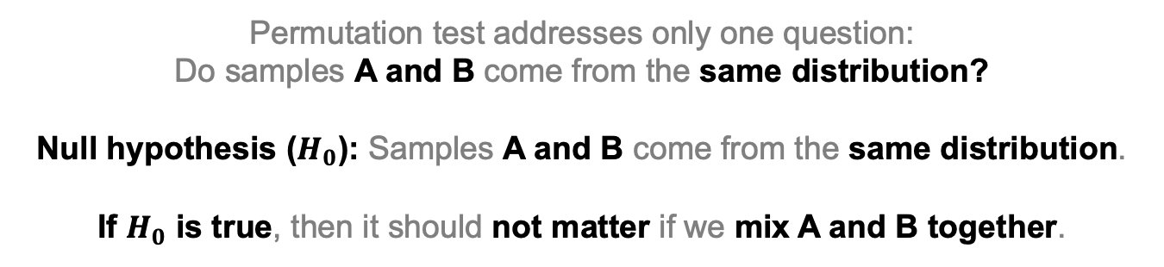
Permutation test
Sample data set A
Sample data set B
x
x
x
x
x
x
x
$$x_{0}$$
x
x
x
$$x_{1}$$
$$x_{2}$$
$$x_{N−1}$$
$$x_{0}$$
$$x_{1}$$
x
x
x
$$⋯$$
$$stat$$
x
$$x_{2}$$
$$⋯$$
$$x_{M−1}$$
x
x
x
x
x
x
$$stat$$
x
x
x
x
x
x
x
x
x
x
x
x
x
x
x
x
x
x
x
x
x
x
x
x
size N
size M
Permutation test addresses only one question:
Do samples A and B come from the same distribution?
Null hypothesis ($H_{0}$): Samples A and B come from the same distribution.
If $H_{0}$ is true, then it should not matter if we mix A and B together.

Slide 6












Mix and shuffle data sets A and B
Sample data set A
Sample data set B
x
x
x
x
x
x
x
$$x_{0}$$
x
x
x
$$x_{1}$$
$$x_{2}$$
$$x_{N−1}$$
$$x_{0}$$
$$x_{1}$$
x
x
x
$$⋯$$
$$stat$$
x
$$x_{2}$$
$$⋯$$
$$x_{M−1}$$
x
x
x
x
x
x
$$stat$$
x
x
x
x
x
x
x
x
x
x
x
x
x
x
x
x
x
x
x
x
x
x
x
x
size N
size M
Permutations:
x
x
x
x
x
x
x
$$x_{9}$$
x
x
x
$$x_{3}$$
$$x_{8}$$
$$x_{7}$$
$$x_{2}$$
$$x_{5}$$
x
x
x
$$⋯$$
$$stat∗$$
x
$$x_{4}$$
$$⋯$$
$$x_{0}$$
x
x
x
x
x
x
$$stat∗$$
x
x
x
x
x
x
x
x
x
x
x
x
x
x
x
x
x
x
x
x
x
x
x
x
size N
size M

Slide 7






















Mix and shuffle data sets A and B
Sample data set A
Sample data set B
x
x
x
x
x
x
x
$$x_{0}$$
x
x
x
$$x_{1}$$
$$x_{2}$$
$$x_{N−1}$$
$$x_{0}$$
$$x_{1}$$
x
x
x
$$⋯$$
$$stat$$
x
$$x_{2}$$
$$⋯$$
$$x_{M−1}$$
x
x
x
x
x
x
$$stat$$
x
x
x
x
x
x
x
x
x
x
x
x
x
x
x
x
x
x
x
x
x
x
x
x
size N
size M
Permutations:
x
x
x
x
x
x
x
$$x_{9}$$
x
x
x
$$x_{3}$$
$$x_{8}$$
$$x_{7}$$
$$x_{2}$$
$$x_{5}$$
x
x
x
$$⋯$$
$$stat∗$$
x
$$x_{4}$$
$$⋯$$
$$x_{0}$$
x
x
x
x
x
x
$$stat∗$$
x
x
x
x
x
x
x
x
x
x
x
x
x
x
x
x
x
x
x
x
x
x
x
x
x
x
x
x
x
x
x
x
x
x
x
$$x_{5}$$
$$x_{2}$$
$$x_{6}$$
$$x_{8}$$
$$x_{6}$$
$$x_{3}$$
x
x
x
$$⋯$$
$$stat∗$$
x
x
x
$$x_{9}$$
$$⋯$$
$$x_{3}$$
$$stat∗$$
x
x
x
x
x
x
x
x
x
x
x
x
x
x
x
x
x
x
x
x
x
x
x
x
x
x
x
x
x
x
x
x
x
x
x
x
x
x
$$x_{7}$$
$$x_{9}$$
$$x_{3}$$
$$x_{1}$$
$$x_{7}$$
$$x_{4}$$
x
x
x
$$⋯$$
$$stat∗$$
x
x
x
$$x_{5}$$
$$⋯$$
$$x_{5}$$
$$stat∗$$
x
x
x
x
x
x
x
x
x
x
x
x
x
x
x
x
x
x
x
x
x
x
x
x
x
x
x
size N
size M

Slide 8
Mix and shuffle data sets A and B
Sample data set A
Sample data set B
x
x
x
x
x
x
x
$$x_{0}$$
x
x
x
$$x_{1}$$
$$x_{2}$$
$$x_{N−1}$$
$$x_{0}$$
$$x_{1}$$
x
x
x
$$⋯$$
$$stat$$
x
$$x_{2}$$
$$⋯$$
$$x_{M−1}$$
x
x
x
x
x
x
$$stat$$
x
x
x
x
x
x
x
x
x
x
x
x
x
x
x
x
x
x
x
x
x
x
x
x
size N
size M
Permutations:
In principle, you should do this for all possible permutations.
In practice, doing this for a large number of random permutations works well (Monte Carlo).

Slide 9























Compare measured and permuted statistics
Sample data set A
Sample data set B
x
x
x
x
x
x
x
$$x_{0}$$
x
x
x
$$x_{1}$$
$$x_{2}$$
$$x_{N−1}$$
$$x_{0}$$
$$x_{1}$$
x
x
x
$$⋯$$
x
$$x_{2}$$
$$⋯$$
$$x_{M−1}$$
x
x
x
x
x
x
$$stat−stat$$
x
x
x
x
x
x
x
x
x
x
x
x
x
x
x
x
x
x
x
x
x
x
x
x
size N
size M
compare
Permutations:
x
x
x
x
x
x
x
$$x_{9}$$
x
x
x
$$x_{3}$$
$$x_{8}$$
$$x_{7}$$
$$x_{2}$$
$$x_{5}$$
x
x
x
$$⋯$$
x
$$x_{4}$$
$$⋯$$
$$x_{0}$$
$$stat∗−stat∗$$
x
x
x
x
x
x
x
x
x
x
x
x
x
x
x
x
x
x
x
x
x
x
x
x
x
x
x
x
x
x
x
x
x
x
x
x
x
x
x
x
x
$$x_{5}$$
$$x_{2}$$
$$x_{6}$$
$$x_{8}$$
$$x_{6}$$
$$x_{3}$$
x
x
x
$$⋯$$
x
x
x
$$x_{9}$$
$$⋯$$
$$x_{3}$$
$$stat∗−stat∗$$
x
x
x
x
x
x
x
x
x
x
x
x
x
x
x
x
x
x
x
x
x
x
x
x
x
x
x
x
x
x
x
x
x
x
x
x
x
x
$$x_{7}$$
$$stat∗−stat∗$$
$$x_{9}$$
$$x_{3}$$
$$x_{1}$$
$$x_{7}$$
$$x_{4}$$
x
x
x
$$⋯$$
x
x
x
$$x_{5}$$
$$⋯$$
$$x_{5}$$
x
x
x
x
x
x
x
x
x
x
x
x
x
x
x
x
x
x
x
x
x
x
x
x
x
x
x
size N
size M

Slide 10

Distribution of permuted statistic differences
Should be roughly centered around zero because we’ve mixed the samples together.
counts
$$stat∗− stat∗$$
from permutations
0

Slide 11
Confidence interval
2.5% of permutations
95% of permutations
2.5% of permutations
counts
$$stat∗− stat∗$$
from permutations
0
confidence interval

Slide 12


Confidence interval
import numpy as np
lb, ub = np.quantile(permutations, [0.025, 0.975])
$$lb$$
$$ub$$
counts
$$stat∗− stat∗$$
from permutations
0
confidence interval

Slide 13
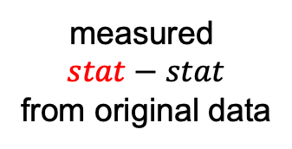
Compare measured and permuted statistics
reject H₀
do NOT reject H₀
reject H₀
counts
$$stat∗− stat∗$$
from permutations
measured
$$stat−stat$$
from original data
0
confidence interval

Slide 14
Learning goals – Permutation test
You will be able to test the hypothesis that two samples come from the same distribution using resampling.

