Slide 1
Deep Space
Group 28
Eldin Vujic, Ethan Luong, Victor Fong, Saude Chaudry

Slide 2
Credit to. . .
Group of February 2018
Nicole Mihaylova, Eson Musabelliu, Alejandro Serrano, Timothy Werkheiser.

Slide 3
Introduction
Deep Space is an adventure-dungeon-puzzle game that allows players to explore a spaceship while simultaneously battling alien-like creatures who have boarded the ship and figuring out ways to get to the next room in the spaceship. The player has spent decades in cryogenic sleep only for them to wake up now, surrounded by unfamiliarities. The players goal is simple and that is to get off the spaceship. The player will overcome obstacles, gather resources, and battle among the spaceship in hopes of finding a escape pod.

Slide 4
Our Goal for this Project
Our goal for this project was to make a adventure-dungeon like game that focuses on the player going through obstacles and when they complete these obstacles, they get rewarded. Another goal we had was to make this game vastly updatable, so this includes having the player create their own players, add more enemies, add more items, and even add more weapons/armor. Overall we wanted to make this game as expanadable as we can and have the player control the course of the game.

Slide 5
How we started building this project. . .

Slide 6
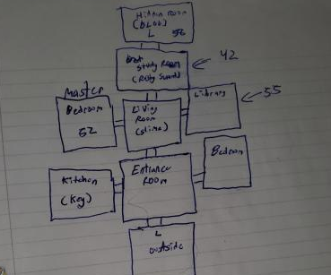
Rooms
Rooms are a big feature for our project they allow the player to. . .
Find Items.
Fight Enemies.
Move through the Rooms.
Find the escape

Slide 7
Player
The player objectives are simple:
Traverse through rooms
Battle enemies that have invaded the ship if they stand in your path
Collect items / keys / armor / weapons
Unlock doors that may be unlocked
Unlock panels that may be locked
Find hidden rooms
Find hidden treasures
Escape
Movement
The player is able to traverse through rooms using the inputs of Up, Down, Right, and Left by either typing or using the game controller.

Slide 8

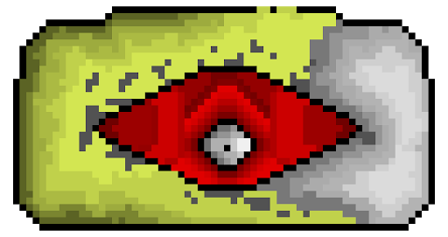
Enemies
The enemies that have invaded the ship have a simple objective. . .
Attack the player depending if the enemy is aggressive or not
Damage the player
Stand in way of the player

Slide 9
Combat
The combat. . .
The combat is pretty simple, it autoruns the combat between the player and the enemy. So player attacks first then enemy attacks second and this repeats until either side is dead.
Player starts off with 20/20HP (Hit-Points) and 5AD (Attack Damage).
Enemies start off from any amount of Hit-points and Attack Damage.
Player loses health at the end of the battle depending on how much enemy Attack Damage they took.

Slide 10
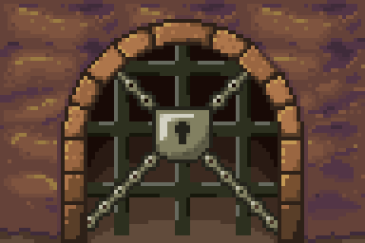
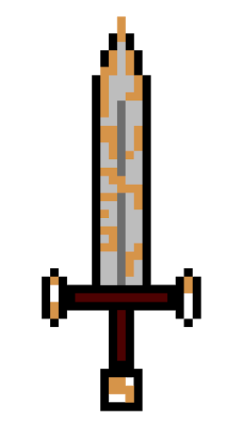

Items
Items are essential for this game, they give the player an option of surviving further combat, increasing the players stats, unlocking hidden rooms / doors.

Slide 11
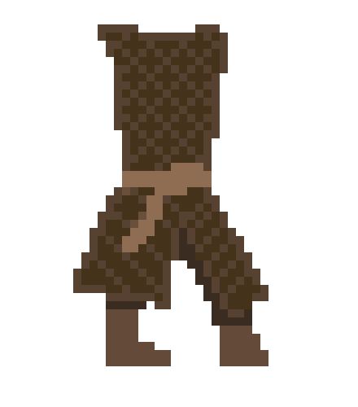
Armor Items
There are 3 equippable armor items, Helmet, Chest Piece, and Leggings.
All of these armor pieces give stat increases.
Increasing HP (Hit/Health Points).
Increasing AD (Attack Damage).
+5 AD
+ 10 HP

Slide 12

Weapon Items
There are many different weapon options in the game, swords, guns, energy guns, energy swords, plasma rifles, etc.
These weapons work like armor, but unlike armor usually weapons increase Attack Damage and very rarely increase Hit/Health Points.
+30 AD

Slide 13
Power-ups/Heal Items
Power-ups and Heal items are very different from armor and weapons.
*These items have temporary stat bonuses unlike the previous items, so if you use them then the item disappears.
Power-ups
May Increase Attack Damage / Health Damage for a certain time (1 Battle or 2 Battles, etc).
Heal
May Increase players HP if the player is currently low on HP (15/20 -> 20/20).
All Heal items have a different unit on how much they increase your HP.

Slide 14
Other Items
There are several other items like keys, junk, and misc. These items often have no value and can be only used for specific things.
Keys
They open doors / hidden rooms / Control Panels.
Junk/Misc
Some random items you may find on the ship.

Slide 15
What we could of done to make this game better. . .
Added better combat.
Added level up and experience.
Added more enemy types.
Added more stat bonuses for combat, not just increasing health and attack damage.
Added more explorable rooms.
Added more unique items.

Slide 16
Thank you.

