Slide 1
Modeling Carbon Uptake by the Harvard Forest
Ethan Manninen
4/l0/19

Slide 2
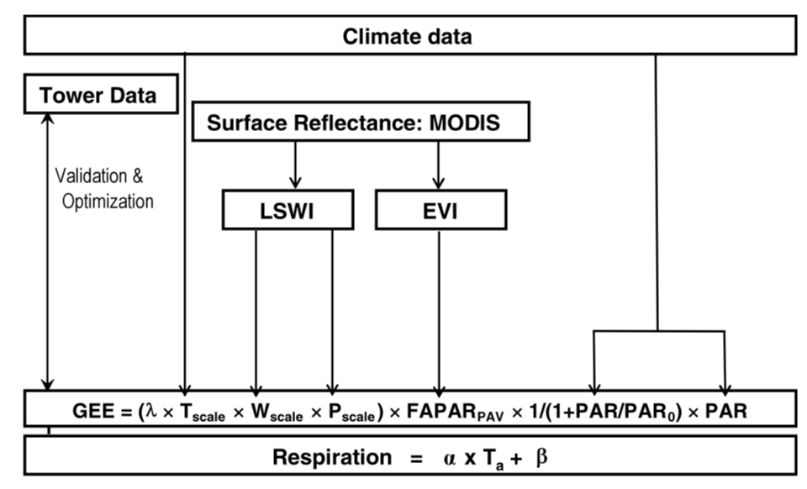
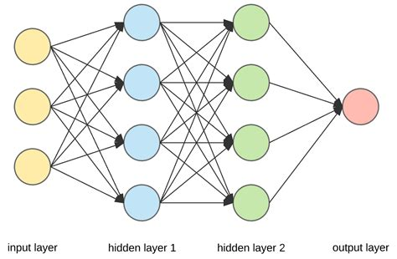
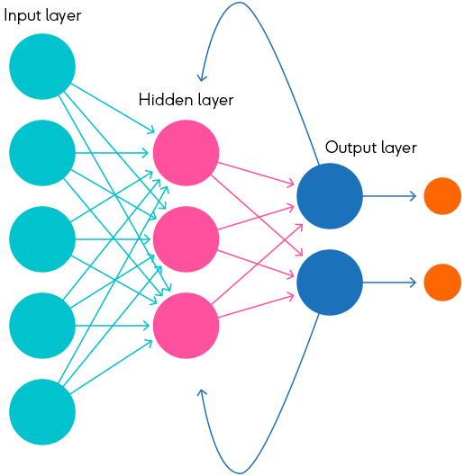
Background: Three Models

Slide 3
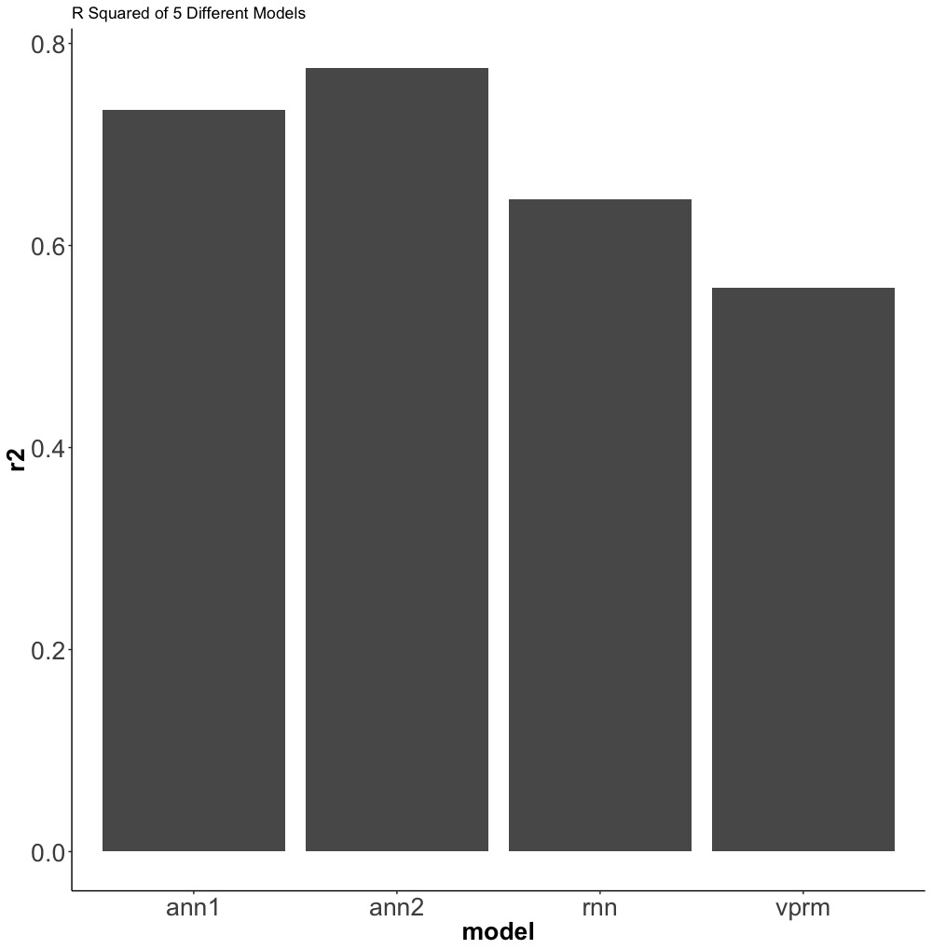
R² To Differentiate Models of NEE
RNN discarded:
“Base model” does not offer an advantage over ANN in return for increase in required resources
RNN would need to train on minimum of a full year of data, out of ~15

Slide 4
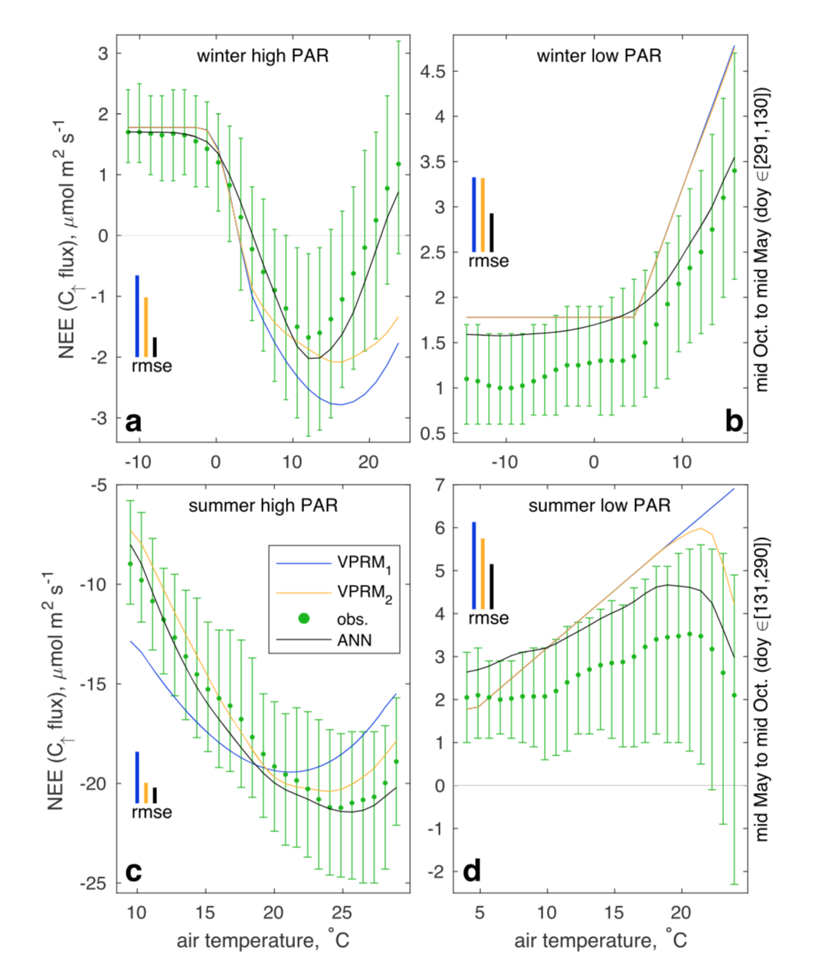
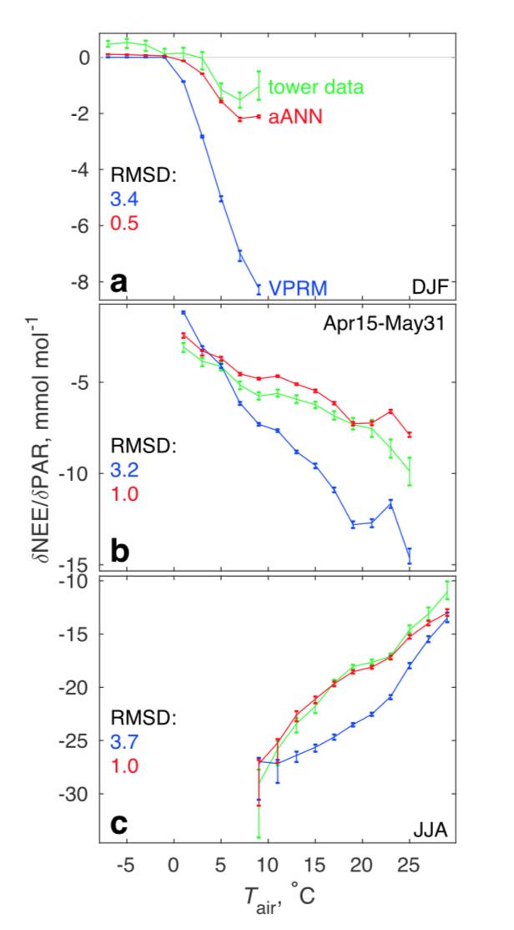
Neural Networks Can Attribute VPRM Error to Cov(T, PAR)
Eshel et al 2019
Notes:
Cov par and t
In the heart of summer (June-July-August, Figure 6c), with ample PAR availability and temperatures that are at least high enough for full pace photosynthesis but often too high, the situation reverses

Slide 5
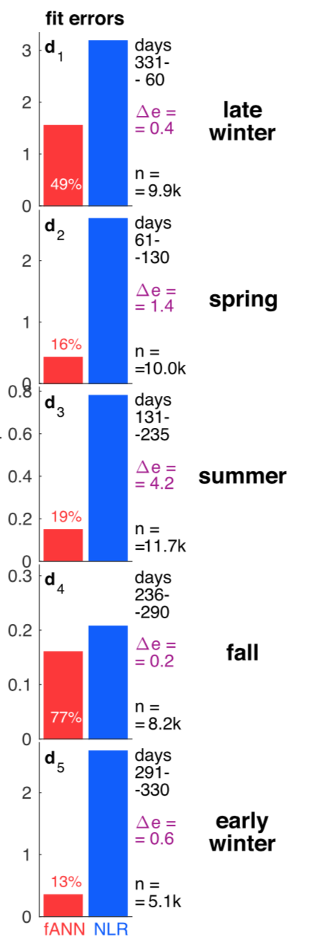
Error in ANN Partly Driven by n?

Slide 6
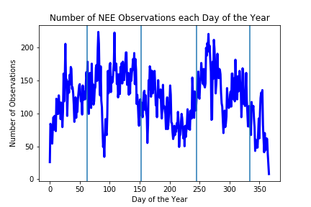
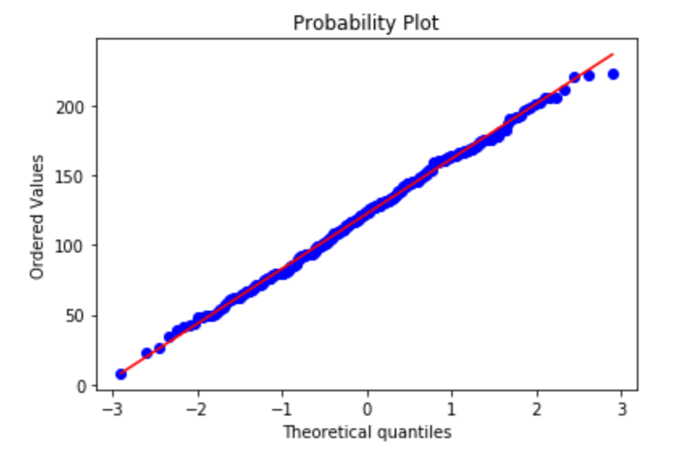
Seasonality of NEE Observation Availability

Slide 7
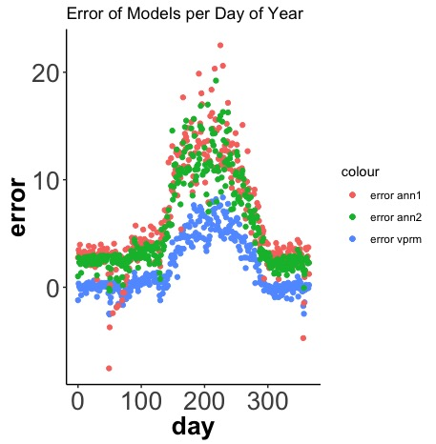
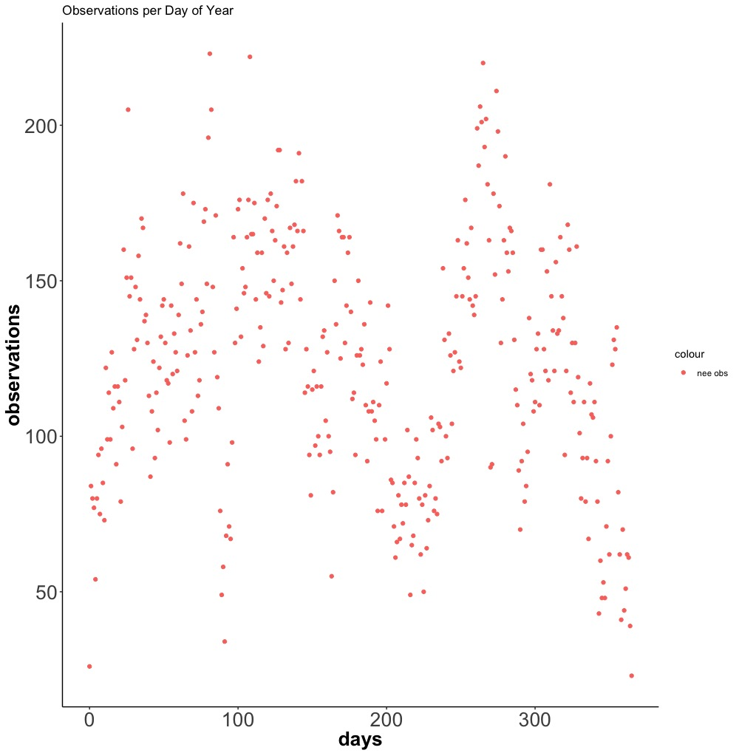
Models’ Error Peaks Align with Summer Observation Dropoff, but not Winter
Why does the VPRM display less error, but lower R²?

Slide 8
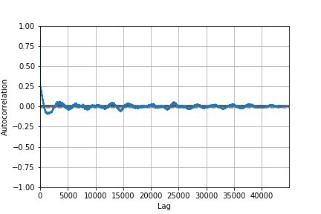
Autocorrelation to Determine ARIMA Parameters
Average Number Lags per year: ~2,600

Slide 9
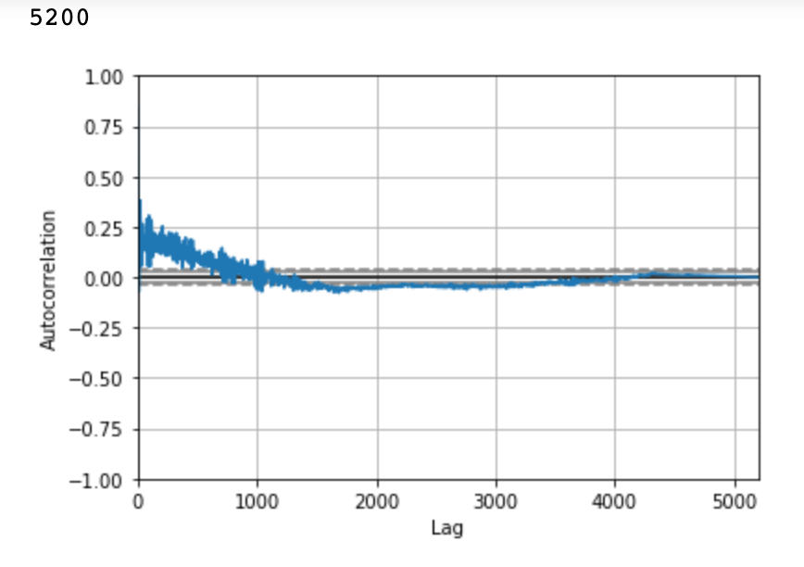
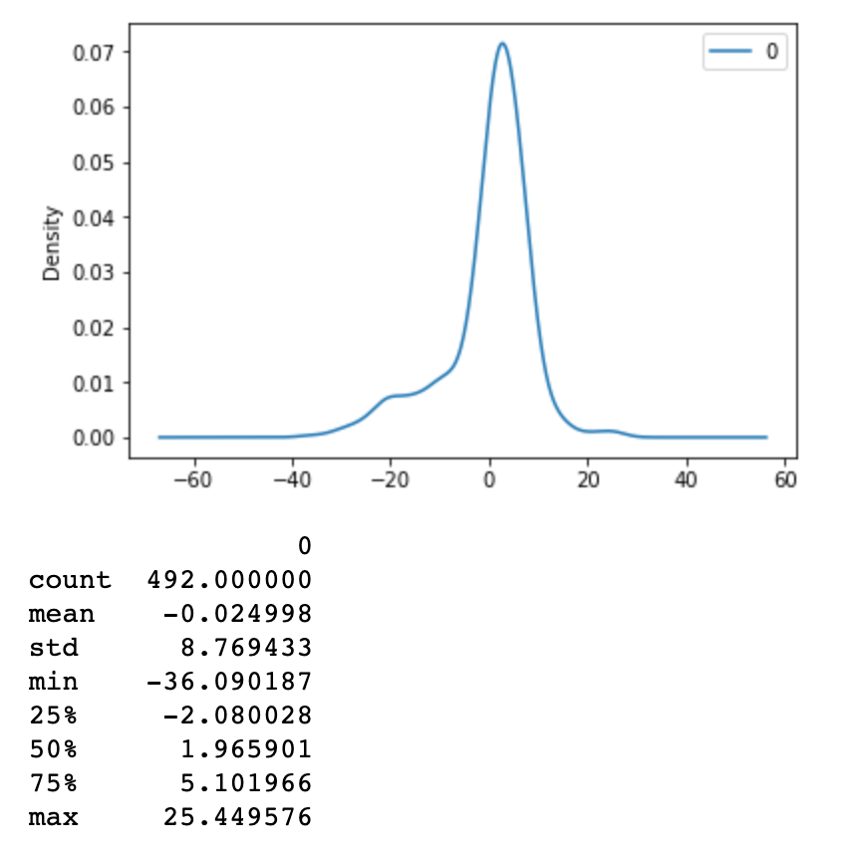
Resource Constrained ARIMA
100

Slide 10
Conclusions, Future Directions, Limitations
RNN likely does not offer significant advantage over recent ANN in predicting NEE in HF
Potential link between seasonality of error and number of observations, needs rigorous treatment
No Bootstraps
ARIMA with sufficient resources to investigate Observation Seasonality and Model Error
Acknowledgements: Tianning Zhao, Prof. Wofsy, Prof. Tziperman

