Slide 1


Tech talk: CMake Introduction
Github.com\EthanNote

Slide 2
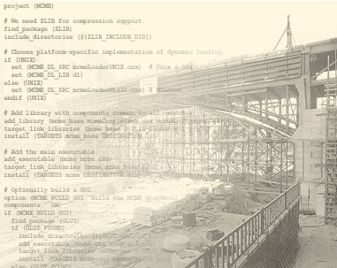
What is CMake
Open source build management tool
Project build file generator
  Makefile, *.sln(.vcproj), *.cbp
Programming language
  CMakeList.txt(command list), *.cmake(command extension)

Slide 3
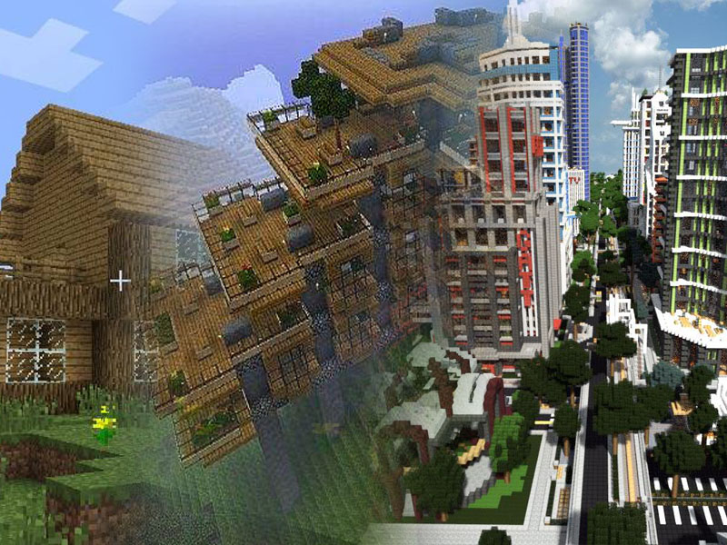
The build tools
GCC
  Compile Single object
Make
  Module compiling setup
CMake
  Build entire project

Slide 4
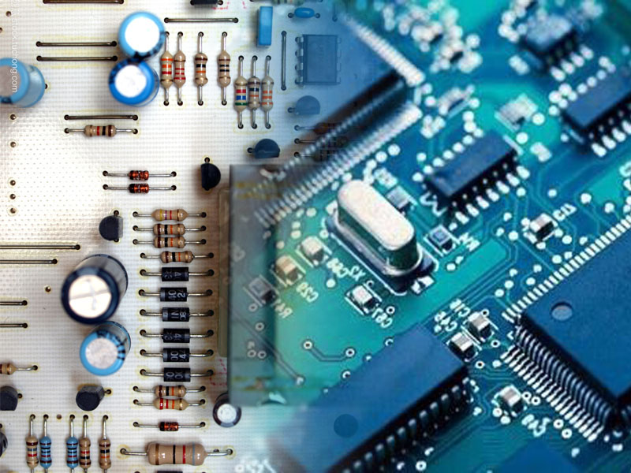
Compare with GNU make
Readable syntax
Multiple build system generation (Xcode, Eclipse, Visual Studio, and GNU make)
Cross platform
Process library dependency
Better GUI support (cmake-gui vs make menuconfig)

Slide 5

Basic Tutorial
Example 1: Single c++ source file
cmake_minimum_required (VERSION 2.6)
project (Tutorial)
add_executable(Tutorial tutorial.cxx)

Slide 6
Basic Tutorial
Example 2: Macro configuration
#cmakedefine FOO_ENABLE
#cmakedefine FOO_STRING "@FOO_STRING@"
foo.h.in
+
option(FOO_ENABLE "Enable Foo" ON)
if(FOO_ENABLE)
set(FOO_STRING "foo")
endif()
configure_file(foo.h.in foo.h @ONLY)
CMakeList.txt
=
foo.h
#define FOO_ENABLE
#define FOO_STRING "foo"
else:
/* #undef FOO_ENABLE */
/* #undef FOO_STRING */

Slide 7
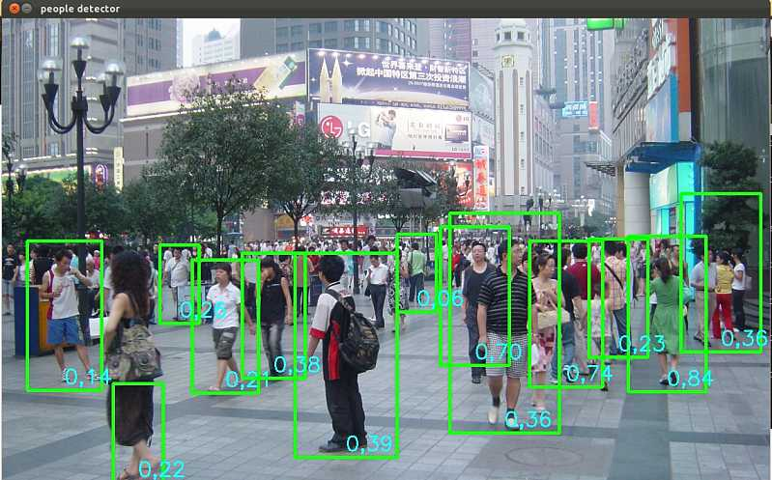
Development case:
Modify OpenCV CMake settings
CMake downloads libraries while building OpenCV
Some libraries may not officially accessible
Modify CMakeList.txt to use a library downloaded from elsewhere

Slide 8
Development case:
Modify OpenCV CMake settings
OpenCV IPPICV library download code
from https://github.com/opencv/opencv/blob/master/3rdparty/ippicv/ippicv.cmake
set(THE_ROOT "${OpenCV_BINARY_DIR}/3rdparty/ippicv")
ocv_download(FILENAME ${OPENCV_ICV_NAME}
HASH ${OPENCV_ICV_HASH}
URL
"${OPENCV_IPPICV_URL}"
"$ENV{OPENCV_IPPICV_URL}"
"https://raw.githubusercontent.com/opencv/opencv_3rdparty/${IPPICV_COMMIT}/ippicv/"
DESTINATION_DIR "${THE_ROOT}"
ID IPPICV
STATUS res
UNPACK RELATIVE_URL)
if(res)
set(${root_var} "${THE_ROOT}/${OPENCV_ICV_PACKAGE_SUBDIR}" PARENT_SCOPE)
endif()
set(OPENCV_ICV_UNPACK_PATH "${CMAKE_CURRENT_LIST_DIR}/unpack")
set(OPENCV_ICV_PATH "${OPENCV_ICV_UNPACK_PATH}${OPENCV_ICV_PACKAGE_SUBDIR}")
message(STATUS "ICV: Package successfully downloaded")
set(OPENCV_ICV_PATH "${OPENCV_ICV_PATH}" PARENT_SCOPE)

Slide 9

Learning Resources
CMake online documents
Book：Mastering CMake (PDF available)

Slide 10
Thanks !

