Slide 1
XML and Web Services
Introduction
LIU Yan
Givemeareason@gmail.com

Slide 2
Index
Course Overview
Course Assessment
Main Contents of the course
XML Overview
Web Services and SOA
Definitions
Evolvement of Remote Invocation
Examples
The Web Services Model
SOA Reference Architecture
Related Tools
Course materials and references

Slide 3
Prerequisites
Preferably programming skills in Java
Developed distributed applications by using Java, or C++.
Knowledge on JavaEE architecture and programming experience (Servlet, JSP, EJB) will be helpful but not necessary.

Slide 4
Course Overview
Service-oriented architecture (SOA) represents a new and evolving model for building distributed applications.
Services are distributed components that provide well-defined interfaces that process and deliver XML messages.
Web Service (WS) standard provides a platform-independent method for messaging-based interaction of applications.
In this course we will learn XML techniques, then study the basic concepts, technologies that support SOA, and the design and implementation of a SOA using web services.

Slide 5
Reference Books
There is no textbook for this course.
You can find some reference books in the directory of %courseware%/0.books
Primary References are:
SOA Using Java Web Services, Mark D. Hansen, Prentice Hall, 2007.
Java SOA Cook Book, Eben Hewitt, 2009.
Introduction to XML and Related Technologies，IBM.
Web Service Development for IBM WebSphere Application Server V7, IBM.
XML in a Nutshell, 3rd Edition, Elliotte Rusty Harold, W. Scott Means, O’Reilly, 2004.

Slide 6
Assessment
XML Assignment, 30%
Individual report on given topics.
Team Project (3~5 members), 70%
Project requirements will be released in the second week.

Slide 7
Main Contents
XML and related technologies:
XML syntax, Validating XML (DTD/Schema), XSLT, XPath, DOM/SAX, Querying XML
Web Services Fundamentals:
Service definition, Web services definition language (WSDL), Service publication and discovery, Service encapsulation and consumption of a web service by an application.
Web Services Development:
Developing Web Services, Creating Web Services Clients, Web Services Interoperability, Introduction to ESB.
Basic SOA concepts will also be covered: loose coupling of systems, communication through messaging, enterprise service bus, composition of complex services, BPEL for Business Process.

Slide 8
Share your experiences
Think about the following questions, talk with students sitting near you and share your experiences with us
Have you ever use XML before?
Why do we use web services?
Do you know when and where to use web services?

Slide 9
XML Overview
XML stands for EXtensible Markup Language. It is a markup language much like HTML and it was designed to describe data. XML tags are not predefined. You must define your own tags. It is a prefect choice for enabling cross-platform data communication in Web Services.
Well-formed XML documents
Schema languages
DTDs: http://www.w3schools.com/dtd/default.asp
XML Schemas: http://www.w3.org/XML/Schema
Query Languages
XPath: http://www.w3.org/TR/xpath
XQuery: http://www.w3.org/TR/xquery/
XSLT
XSLT: http://www.w3.org/TR/xslt
Programming APIs
DOM (Document Object Model): http://www.w3.org/DOM/
SAX (Simple API for XML): http://www.saxproject.org/
Examples

Slide 10
Web Service definition
A simple definition:
“a Web Service is an application component accessible over open protocols”.
Examples:
*Amazon web services:
http://aws.amazon.com/
*Google Developers
http://developers.google.com
SOAP-based web service example: https://developers.google.com/doubleclick-publishers/

Slide 11
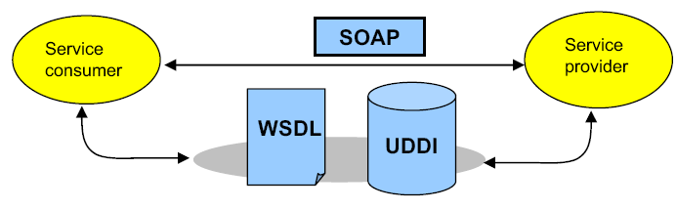
XML and Web Services
XML is part of the definition of Web services according to the W3C Web Services Architecture Working Group.
“… defined, described, and discovered by XML artifacts…”
“… interacts with other software systems using XML messages”
XML is the basis for many of the Web services standards.
XML characteristics map well to business integration needs.
Interoperability
Vendor, platform, language neutral
http://www.w3.org/TR/2004/NOTE-ws-arch-20040211/#whatis

Slide 12
Web Services and SOA
Web Services is a technology that allows for applications to communicate with each other in a standard format.
A Web Service exposes an interface that can be accessed through XML messaging.
A Web service uses XML based protocol to describe an operation or the data exchange with another web service. Ex: SOAP
A group of web services collaborating accomplish the tasks of an application. The architecture of such an application is called Service-Oriented Architecture (SOA).

Slide 13
History
Web services evolved from previous technologies that served the same purpose such as RPC, ORPC (DCOM, CORBA and JAVA RMI/EJB).

Slide 14
Issues in distributed systems
Heterogeneity in various aspects of a distributed systems
Communication modes
Synchronous: RPC
Asynchronous: P2P, Publish and subscribe
Variations in products
Many vendors: IBM, Progress, TIBCO, Apache, Adobe
Additional runtime features:
fault tolerance, load balancing, transaction handling, usage metering, auditing, ..

Slide 15
Communication Network
Application
Application
Network Protocol Stack
Network Protocol Stack
A communication middleware framework isolates the application developers from the details of the network protocol.
Notes:
A communication middleware framework isolates the application developers from the details of the network protocol.

Slide 16
Communication Middleware
Application
Application
Middleware
Middleware
Network Protocol Stack
Network Protocol Stack

Slide 17
Remote procedure call (RPC)
Client
Application
Server
Application
Procedure
call
Execute
call
RPC Stub code
RPC stub code
RPC library/runtime
RPC library/runtime
Network Protocol Stack
Network Protocol Stack
RPC stubs and runtime enable location transparency, encapsulate RPC communication
infrastructure and provide a procedure call interface.
Notes:
RPC stubs and runtime enable location transparency, encapsulate RPC comm infrastructure and provide a proceudre call interface.

Slide 18
Distributed Objects
Client
Application
Server
Application
invoke
method
Execute
method
Client proxies
Server skeletons
ORB
ORB
Network Protocol Stack
Network Protocol Stack
ORBs enable client applications to remotely instantiate, locate, invoke methods and
Delete server objects; Java RMI, Microsoft’s DCOM; CORBA is meant to be platform independent.
Notes:
RPC stubs and runtime enable location transparency, encapsulate RPC comm infrastructure and provide a proceudre call interface.

Slide 19
Disadvantages of Earlier Component Technologies
Inability/Difficult to interoperate with each other
Tightly coupled & highly dependent on each other
Proprietary protocols
Firewall penetration
Lack of standards
Complexity – involves whole learning curve
New technology & languages
Web Services were intended to solve three main problems:
Interoperability
Firewall traversal
Complexity

Slide 20
Interoperability
Earlier distributed systems suffered from interoperability issues because each vendor implemented its own on-wire format for distributed object messaging.
Development of DCOM apps strictly bound to Windows Operating system.
Development of RMI bound to Java programming language. (RMI-IIOP later)

Slide 21
Firewall traversal
Collaboration across corporations was an issue because distributed systems such as CORBA and DCOM used non-standard ports.
Web Services use HTTP as a transport protocol and most of the firewalls allow access though port 80 (HTTP), leading to easier and dynamic collaboration.

Slide 22
Complexity
Web Services is a developer-friendly service system.
Most of the above-mentioned technologies such as RMI, COM, and CORBA involve a whole learning curve.
New technologies and languages have to be learnt to implement these services.

Slide 23
Web Service definition revisited
A more precise definition for ‘big’ Web Services:
an application component that:
Communicates via open protocols (HTTP, SMTP, etc.)
Processes XML messages framed using SOAP
Describes its messages using XML Schema
Provides an endpoint description using WSDL
Can be discovered using UDDI

Slide 24
Usage Scenario: A simple Web Service
A buyer (which might be a simple client) is ordering goods from a seller service.
The buyer finds the seller service by searching the UDDI directory.
The seller service is a Web Service whose interface is defined using Web Services Description Language (WSDL).
The buyer is invoking the order method on the seller service using Simple Object Access Protocol (SOAP) and the WSDL definition for the seller service.
The buyer knows what to expect in the SOAP reply message because this is defined in the WSDL definition for the seller service.

Slide 25
Sample application (service consumer)
iMediaMan
http://www.imediaman.com/
Repricing Tools
https://www.appeagle.com/

Slide 26
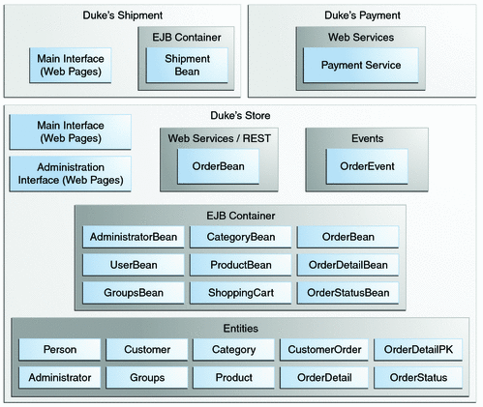
Example: Using Web Services in Enterprise Applications
Duke’s Forest Case Study
http://docs.oracle.com/javaee/6/tutorial/doc/glnpw.html

Slide 27
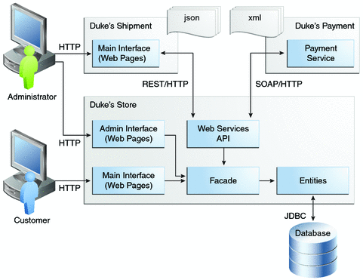
Interactions between Duke’s Forest Components

Slide 28
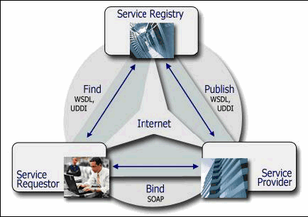
The Web Service Model
The Web Services architecture is based upon the interactions between three roles:
Service provider
Service registry
Service requestor/consumer
The interactions involve the:
Publish operations
Find operation
Bind operations.

Slide 29
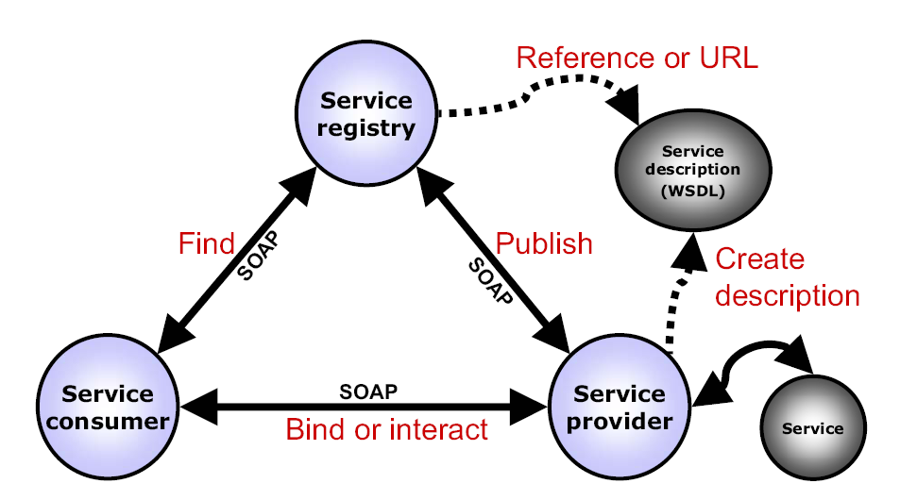
Relationship between the core standards

Slide 30
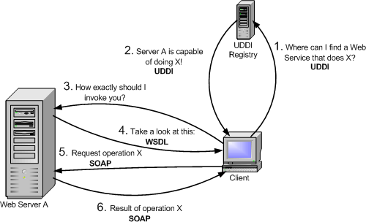
The Web Service Model (cont)
1
3
2
4
5
6
From http://www.globus.org

Slide 31
Examples of Web Services Based Solution
Transportation
– Need to quote realistic prices made difficult when shipments travel over multiple carriers
Banking
– Need to provide banking services to multiple requesters
– Need to integrate large numbers of internal
applications
Government
– Need to share and access data across agencies

Slide 32
Common Uses of Web Services
Interoperability between heterogeneous systems
B2B interactions
– Lower cost than EDI and proprietary alternatives
Multiple requesters
– Particularly for heterogeneous platforms, protocols, and channels
Encapsulation of legacy systems
Isolation from changing systems
Enterprise standardization of services
Integration of third-party packages
Process choreography
Portal development/ Mashup

Slide 33
Find More Web Services
http://www.xmethods.com/
http://programmableweb.com
https://evelopers.google.com
http://www.webservicex.net/WS/default.aspx

Slide 34
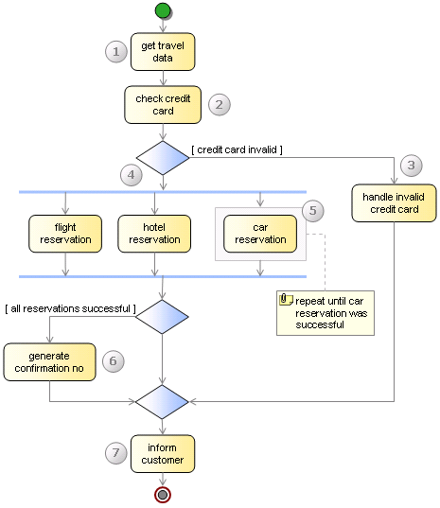
Business Integration Example: Travel Booking Application
The travel booking component references on four Web services:
Hotel Reservation Service,
Credit Card Checking Service,
Flight Reservation Services,
and Car Reservation Service.

Slide 35
SOA
SOA is the architectural style of building applications based on services, and deals with the arrangement of services in application systems.
SOA can be implemented using Web services technologies

Slide 36
SOA-RA

Slide 37


Example: Process-enabled SOA
Enterprise Layer
Airline
Web site
Business Layer
Mobile Process
Booking
Process
B2B Process
Intermediary layer
BookAndBill
Basic layer
Flight
Booking
Billing
Customer

Slide 38
Related Tools
IDE:
RAD, Eclipse, Netbeans, Visual Studio…
XML Editors:
Stylus studio, XMLSPY…
SOAP Engine, Web Services Stack/Framework:
Apache Axis
Xfire
CXF
Java Metro
WSE, WCF in .Net Framework

Slide 39
Resources
http://www.xmethods.com/
http://programmableweb.com
http://www.webservicex.net/WS/default.aspx
http://www.w3.org
http://www.w3schools.com/
http://axis.apache.org/axis/
http://www.oracle.com/technetwork/java/index-jsp-137004.html
http://msdn2.microsoft.com/en-us/webservices/default.aspx
http://msdn.microsoft.com/zh-cn/netframework/aa663324.aspx
Many more on the web…

Slide 40
Reading Task …
Preview XML fundamentals
Read Chapter 1~3 in book 5.

