Slide 1
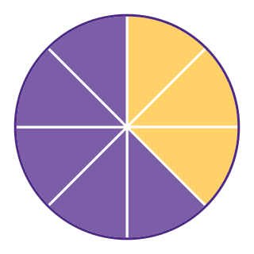
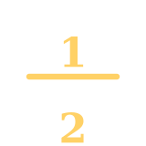
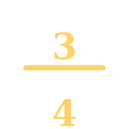
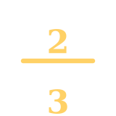
Basic Fractions
A Fun Introduction for 4th Graders
Math • Grade 4

Slide 2
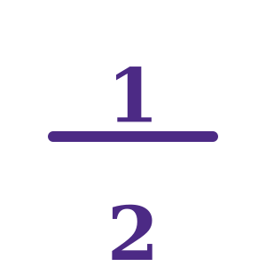


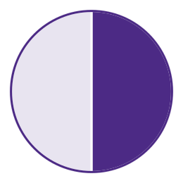
Slide 2
What Is a Fraction?
A fraction shows EQUAL parts
of a whole object or a set.
Think of sharing an apple
= one out of two equal parts
Cut it into equal pieces — each piece is a fraction!
Key Word: FRACTION — a number that names part of a whole or part of a group.

Slide 3

Slide 3
Parts of a Fraction
NUMERATOR
Top number — how many parts we HAVE
FRACTION BAR — means "out of" or "divided by"
DENOMINATOR
Bottom number — total equal parts
3/4 means: "3 out of 4 equal parts"

Slide 4
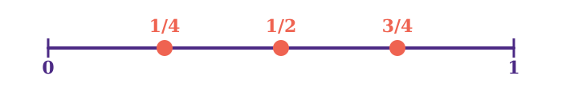
Slide 4
Fractions on a Number Line
①
②
③
Draw a number line from 0 to 1.
Divide it into equal parts (like 4 equal parts for fourths).
Count the parts from 0 — each jump is one fraction!
Example: 1/4, 2/4, and 3/4 are all between 0 and 1 on the number line.

Slide 5
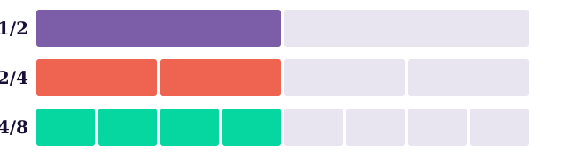
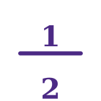
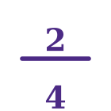
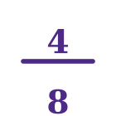
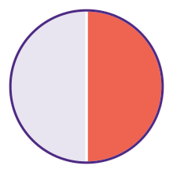
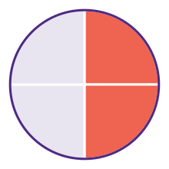
Slide 5
Equivalent Fractions
Equivalent fractions are DIFFERENT fractions that name the SAME amount.
= =
=
Both pizzas have the same amount eaten!
1/2
2/4

Slide 6

Slide 6
Let's Practice!
Q1 — Identify the fraction
Q2 — Label the parts
Q3 — Find the equivalent
A pizza is cut into 6 equal slices. You eat 2 slices.
What fraction did you eat?
In the fraction 5/8, which number is the numerator?
Which is the denominator?
Is 1/2 equivalent to 3/6?
Use a bar model or number line to explain.
Remember: Fractions name equal parts of a whole. Numerator on top, denominator on bottom. Some fractions look different but are equal!

