Slide 1

Introduction to Fractions
Exploring Parts of a Whole | Grade 4 Mathematics

Slide 2


What is a Fraction?
The Numerator
The Denominator
The top number of our fraction.
The bottom number of our fraction.
It tells us how many equal parts we are focusing on or have.
It tells us the total number of equal parts that make the whole.

Slide 3

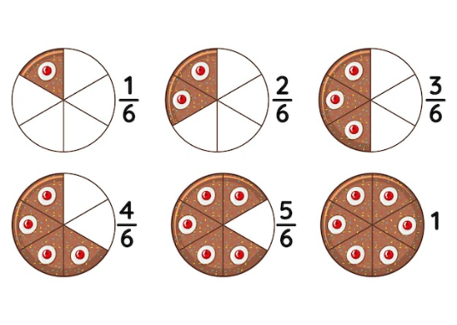
Visualizing Fractions
✦
The Area Model: We can partition shapes (circles, squares) into equal portions.
✦
Real-Life Context: Think of a round pizza cut into 8 slices. Shading 3 of them represents of the total pizza.
✦
Standard Rule: For a representation to count as a fraction, every partition must be of the exact same size!

Slide 4


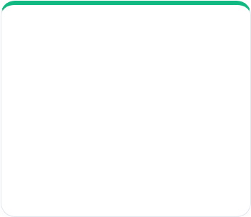


Equivalent Fractions
Same Amount
The Half Rule
Math Secret
Equivalent fractions are fractions that look different but show the exact same size or quantity.
Imagine 1/2 of a cake. If we cut it into smaller pieces, we get 2/4 or 4/8. It's the same amount of cake!
Multiply or divide both the top and bottom numbers by the same number to find an equivalent fraction!

Slide 5
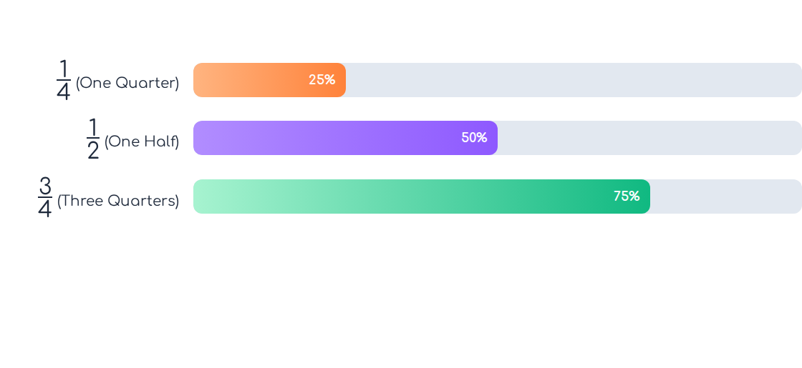
Comparing Fraction Sizes
Pedagogy Tip: When denominators are identical, simply compare the numerators. Since 3 pieces is more than 1, is larger than !

Slide 6
Let's Practice!
1. If a pizza is cut into 8 equal slices and you eat 3, what fraction did you eat? Answer:
2. Can you find an equivalent fraction for ? Answer: or
Great job today, fraction champions! 🌟

Slide 7

Image Sources
✦
https://img.magnific.com/free-vector/understanding-fractions-with-pizza-slices_1308-177278.jpg
Source: www.magnific.com

